Slide 1
VBC-321 Animal Biotechnology
Polymerase Chain Reaction

Slide 2
PCR
PCR was invented by Kary B. Mullis in 1985
The PCR is an in-vitro,enzymatic amplification of a desired sequence of DNA using a pair of oligonucleotide primers
These primers are complementary to one end of the DNA target sequence
These are extended towards each other by a thermostable DNA polymerase in a reaction cycle of three steps; denaturation, primer annealing and polymerization

Slide 3
COMPONENTS OF PCR
Template
Primers
dNTPs
Buffer
Enzymes

Slide 4
Template
PCR can amplify as little as one molecule of starting template
herefore, any source of DNA that provides one or more target molecules can in principle be used as a template for PCR
This includes DNA prepared from blood, sperm or any other tissue, from older forensic specimens, from ancient biological samples or in the laboratory from bacterial colonies or plaques as well as purified DNA

Slide 5
Primers
Oligonucleotides used for priming, preferably 16-30 nts in length
They should have similar G+C contents so that they anneal to their complementary sequences at similar temperatures
The PCR primers should not have self complementary regions as this leads to hairpin formation
The PCR primers should not complementary to each other this leads to primer dimmer formation
If the DNA sequence being amplified is known, then primer design is relatively easy

Slide 6
dNTPs
The 4 dNTPs, dATP, dGTP, dCTP and dTTP, used at saturating concentration (200 m M each)
Buffer
The standard buffer for PCR contains 50 mM KCl, 10 mM Tris.Cl and 1.5 mM MgCl2
pH is approximately 7.2
The presence of divalent cations is critical (Mg2+)

Slide 7
Enzymes
Thermostable DNA polymerases from a number of thermophilic bacteria are used for PCR
The most common is Taq polymerase from Thermus aquaticus
It survives the denaturation step of 95ºC for 1-2 min, having a half-life of more than 2hr at this temperature
It carries a 5’-3’ polymerization dependant exonuclease activity, but lack in 3’-5’ exonuclease activity (proof reading)
Hence, it is more prone for introducing errors
There are high-fiedality thermostable enzymes with 3’-5’ exonuclease activity. e.g., Vent polymerase, pfu polymerase

Slide 8
PCR CYCLES
PCR involves a repetitive series of temperature cycles. Each reaction cycle comprises of three stages
Initial Denaturation : 94ºC for 5 min
for denaturation of whole DNA
Denaturation : 94ºC for 1 to 2 min
Primer annealing : 40ºC to 60ºC for 1 min
Extension : 72ºC for 1to 2 min
Final Extension: 72ºC for 5- 15 min
35 cylcles

Slide 9
In the first cycle, the target DNA is separated into two strands by heating to 95ºC- denaturation
The temperature is reduced to around 55ºC to allow the primers to anneal. The actual temperature depends on the primer lengths and sequences- primer annealing
After annealing, the temperature is increased to 72ºC for optimal polymerization which uses up dNTPs in the reaction mix and requires Mg2+
If PCR was 100% efficient, one target molecule would become 2n after ‘n’ cycles. In practice, 20- 40 cycles are commonly used

Slide 10
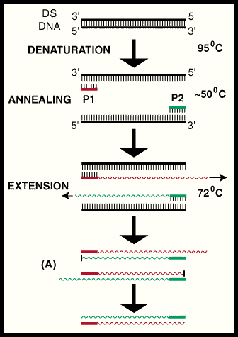

Slide 11
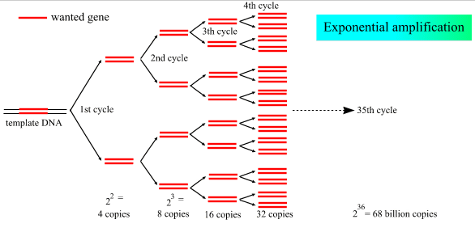

Slide 12
APPLICATIONS OF PCR
Genomic cloning
Generating template for sequencing
In-vitro mutagenesis
Analysis of biological materials for forensic applications
To study the evolutionary history in the field of molecular palaeontology
Medical applications such as pre-natal diagnosis of diseases and sexing of embryos
Detection of infectious diseases

