Slide 1
VBC-321 Animal Biotechnology
Gene Cloning

Slide 2
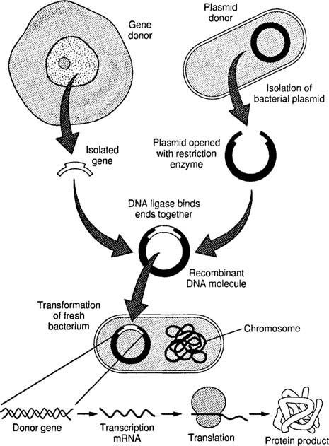
Gene Cloning

Slide 3
Requirement for Gene Cloning
Enzymes
Insert DNA
Vector
Host cell

Slide 4
Enzymes used in gene cloning
Restriction endonuclease- cut the DNA at Specific site, these of often known as molecular scissor
DNA ligase- joining of two DNA molecule, often known as molecular glue
Reverse transcriptase- use to produce cDNA from mRNA
Alkaline phosphatase- for removing 5’ phosphorus from DNA ends.
T4 Polynucleotide kinase- for addition of phosphate group to an end having a free 5’- OH

Slide 5
S1 nuclease- for removal of single stranded protrusions from ends, both 3’ and 5’ protrusion are removed
Klenow fragment of E. coli DNA polymerase I- to make the protruding ends double stranded by extending the shorter strands
Lambda Exonuclease- for removal of nucleotide from 5’ ends
Exonuclease III- for removal of nucleotides from 3’ end
Terminal deoxynucleotidyl transferase- for addition of single stranded sequence to 3’ end of blunt ended fragment

Slide 6
Bacterial transformation
Transformation is processes by which exogenous genetic material may be introduced into a bacterial cell
Methods
Chemical method
Electroporation

Slide 7
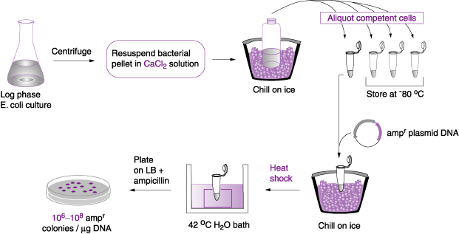
CHEMICAL TRANSFORMATION WITH CALCIUM CHLORIDE

Slide 8
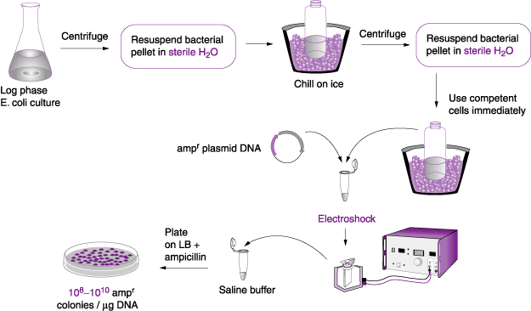
TRANSFORMATION BY ELECTROPORATION

Slide 9
TRANSFECTION
Transfection is the process of introducing nucleic acids into eukaryotic cells by using carrier molecules
Animal cells are transfected by opening transient pores or holes in the cell membrane to allow the uptake of material
Genetic material such as plasmid DNA or siRNA constructs or proteins such as antibodies may be transfected into cells
Transfection may cause changes in morphology of target cells

Slide 10
METHODS
Calcium Phophate method :
One of the cheapest methods of transfection is by calcium phosphate.
HEPES-buffered saline solution containing phosphate ions is combined with a calcium chloride solution containing the DNA to be transfected
Mixing of these two results in precipitate due to binding of positively charged calcium and the negatively charged phosphate
This suspension of precipitate is then added to the cells to be transfected, usually a cell culture grown in a monolayer
The cells take up some of the precipitate and the DNA

Slide 11
Liposome method :
It is a very efficient method of transfection. Liposomes, a small, membrane-bounded body that are in similar to the structure of a cell and can actually fuse with the cell membrane
The DNA to be transfected is trapped into the liposomes
This DNA loaded liposome is added to the cells to be transfected and release the DNA into the cell

Slide 12
PLASMID CLONING STRATEGY
Involves five steps: Enzyme restriction digest of DNA sample. Enzyme restriction digest of DNA plasmid vector. Ligation of DNA sample products and plasmid vector. Transformation with the ligation products. Growth on agar plates with selection for antibiotic resistance.

Slide 13
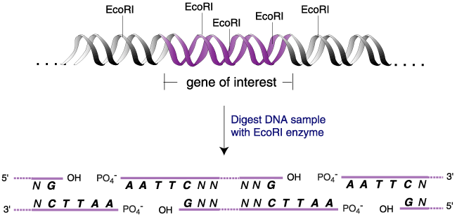
STEP 1. RE DIGESTION OF DNA SAMPLE

Slide 14
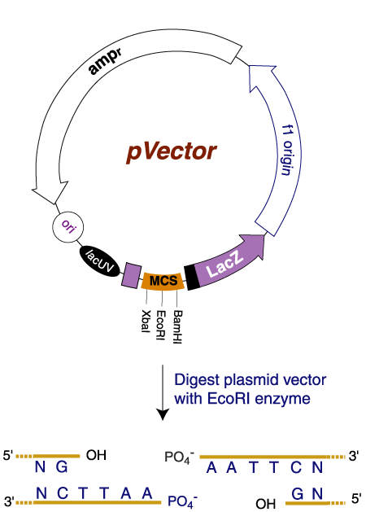
STEP 2. RE DIGESTION OF PLASMID DNA

Slide 15
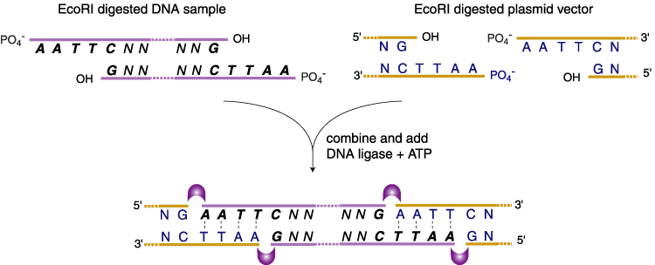
STEP 3. LIGATION OF DNA SAMPLE AND PLASMID DNA

Slide 16
STEP 4. TRANSFORMATION OF LIGATION PRODUCTS
The process of transferring exogenous DNA into cells is call “transformation”
There are basically two general methods for transforming bacteria. The first is a chemical method utilizing CaCl2 and heat shock to promote DNA entry into cells.
A second method is called electroporation based on a short pulse of electric charge to facilitate DNA uptake.

Slide 17
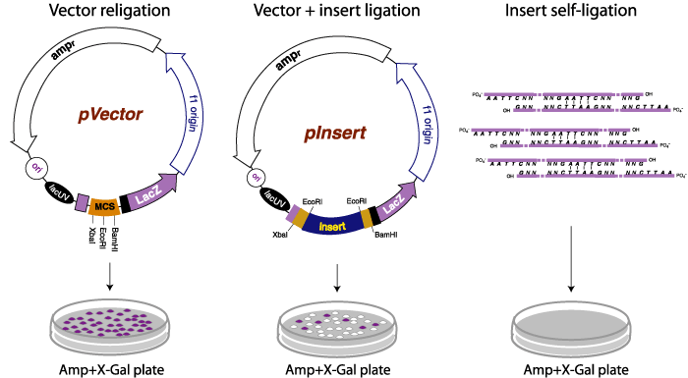
STEP 5. GROWTH ON AGAR PLATES

Slide 18
STEP 5
Blue colonies represent Ampicillin-resistant bacteria that contain pVector and express a functional alpha fragment from an intact LacZ alpha coding sequence. White colonies represent Ampicillin-resistant bacteria that contain pInsert and do not produce LacZ alpha fragment

Slide 19
BLUE/WHITE SCREENING
Colony Selection: finding the rare bacterium with recombinant DNA
Only E. coli cells with resistant plasmids grow on antibiotic medium
Only plasmids with functional lacZ gene can grow on Xgal lacZ(+) => blue colonies lacZ functional => polylinker intact => nothing inserted, no clone lacZ(-) => white colonies polylinker disrupted => successful insertion & recombination!

Slide 20
α -complementation
The portion of the lacZ gene encoding the first 146 amino acids (the α -fragment) are on the plasmid
The remainder of the lacZ gene is found on the chromosome of the host.
If the α -fragment of the lacZ gene on the plasmid is intact (that is, you have a non-recombinant plasmid), these two fragments of the lacZ gene (one on the plasmid and the other on the chromosome) complement each other and will produce a functional β -galactosidase enzyme.

Slide 21
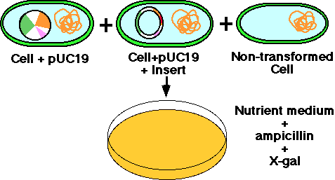
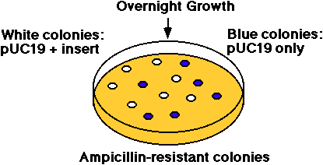
SCREENING RECOMBINANTS
In the example shown above, the b-galactosidase gene is inactivated. The substrate "X-gal" turns blue if the gene is intact, ie. makes active enzyme. White colonies in X-gal imply the presence of recombinant DNA in the plasmid.

Slide 22
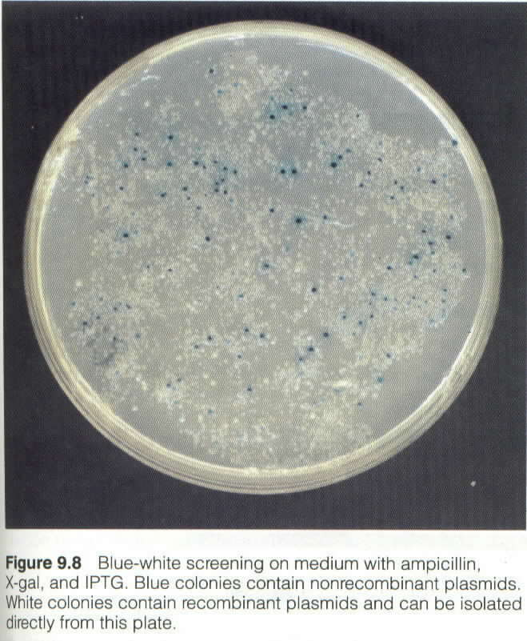

Slide 23
