Slide 1
DNA PROBES AND DNA FINGERPRINTING
VBC-321 Animal Biotechnology

Slide 2
A probe is a nucleic acid which has been labeled i.e., chemically modified in some way which allows it and hence anything it hybridizes to, to be detected.
There are three major types of probe:
Oligonucleotide probes,
DNA probes and
cRNA probes (riboprobes)
Oligonucleotide probes are synthesized chemically and end labeled
DNA probes which are cloned DNAs or PCR products and may either be end-labeled or internally labeled during in vitro replication

Slide 3
cRNA probes (complementary RNA probes) or riboprobes which are internally labeled during in vitro transcription of cloned DNA.
Riboprobes and oligonucleotide probes are generally labeled as single-stranded molecules. DNA may be labeled as a double-stranded or single-stranded molecule, but it is only useful as a probe when single stranded and must be denatured before use.

Slide 4
PROBE LABELING
Probes of the highest specific activity are generated by internal labeling, where many labeled nucleotides are incorporated during DNA or RNA synthesis.
End labeling involves either adding labeled nucleotides to the 3’ end of a DNA strand or exchanging the 5’ phosphate group for a labeled moiety.

Slide 5
DIFFERENT WAYS OF GENERATING PROBES
Labeling method | Probe
5’ end labeling | Oligo / DNA | Replacement of 5’ phosphate group with labeled (gamma) g -phosphate group of free nucleotide catalyzed by T4 polynucleotide kinase
3’ end labeling | Oligo / DNA | Tailing with labeled nucleotides using terminal transferase
Nick translation | DNA | Nicks introduced into dsDNA by Dnase I and free 3’ ends extended by DNA polymerase I using labeled nucleotides
Random priming | DNA | Short random primers annealed to denatured DNA and extended by DNA polymerase using labeled nucleotides. Higher specific activity probes than nick translation
Primer extension | DNA | As above but using a specific primer. Used to label PCR products during thermal cycling
In vitro transcription | RNA | Single strand RNA produced by in vitro transcription using labeled nucleotide

Slide 6
ADVANTAGES AND DISADVANTAGES OF HOT AND COLD PROBES
Hot probes
Advantages
More sensitive in the shortest time.
More specific in nature.
Disadvantages
Short half-life.
Expensive.
Inconvenience of disposal.
Hazards of working with the isotopes are more.
Carcinogenic.
Requires sophisticated laboratory facilities.

Slide 7
Cold probes
Though they are not so sensitive as hot probes, the disadvantages of the hot probes can be avoided.
Generally probes range in length from 100 to more than 1000bp, although both larger and smaller probes can be used.
Depending on the conditions of the hybridization reaction, stable binding requires a greater than 80% match within a segment of 50 bases.

Slide 8
APPLICATION OF DNA PROBES
For genetic engineering research.
For identification of specific plasmids and antibiotic resistant genes from clinical isolates.
For diagnosis of infectious diseases.
For identification of food contaminants.
For forensic investigations.
For epidemiological studies.
For distinguishing organisms at species and strain level.
Ante-natal diagnosis of inherited diseases.

Slide 9
DNA FINGERPRINTING

Slide 10
DNA finger printing (DNA profiling, DNA testing) is a process which uses fragments of DNA to identify the unique genetic makeup of an individual
Before the invention of PCR, the only method of establishing and authenticating personal identification was by the DNA fingerprint process
Since no two individuals have been found to have identical pattern of ridges on their fingers, this method has been universally accepted as a means of personal identification
In 1984, Sir Alec Jeffreys at the University of Leicester in England was able to distinguish differences among individuals based solely on their DNA composition

Slide 11
METHODS OF DNA FINGER PRINTING
The main types of DNA fingerprinting methods in use are:
Restriction fragment length polymorphism (RFLP)
Polymerase chain reaction (PCR)
Amplified fragment length polymorphism (AFLP)
Short tandem repeats (STR)

Slide 12
RESTRICTION FRAGMENT LENGTH POLYMORPHISM (RFLP)
Restriction fragment length polymorphism (RFLP) analyzes the length of the strands of the DNA molecules with repeating base pair patterns
While about 5% of DNA contains the genes, the other 95% is considered as non-coding genes (junk DNA) but contains identifiable repetitive sequences of base pairs, which are called Variable Number Tandem Repeats (VNTR)
To extract a DNA fingerprint, a Southern blot is performed and the DNA is analyzed via a radioactive probe
The restriction fragment length polymorphism analysis is used to detect the repeated sequences by determining a specific pattern to the VNTR, which becomes the person's DNA fingerprint
The drawback with this system is that it requires a considerable amount of DNA in order to be used

Slide 13
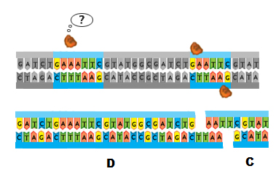
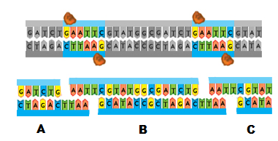
Restriction Fragment Length Polymorphism (RFLP)
Nucleotide sequence variations in a region of DNA that generates fragment length differences according to the presence or absence of restriction enzyme recognition sites.
Notes:
Restriction Fragment Length Polymorphisms, or RFLPs for short, are generated due to mutations in recognition sites. Remember what a recognition site is? Correct! It’s the specific nucleotide sequence recognized by restriction enzymes. The restriction enzymes bind to the DNA and cut within the recognition site. If the nucleotide sequence has been mutated, then the restriction enzyme will not bind and therefore will not cut at that site. As this example shows, the change in the recognition site will produce different length fragments in a restriction digest. Individual one has two recognition sites for the EcoRI enzyme. That means EcoRI will cut this DNA fragment twice. What happens when you cut a piece of string twice? You get three pieces. The same is true when you cut linear DNA with molecular scissors like restriction enzymes. Two cuts generates three fragments labeled here as A, B, and C. In individual 2 the first recognition site is not present. Instead of GAATTC the sequence is now GAAATTC. EcoRI will not bind and cut at this location. That means in the same restriction digest, the restriction enzyme will only cut once and generate two fragments, D and C.

Slide 14
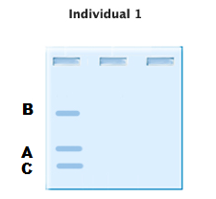
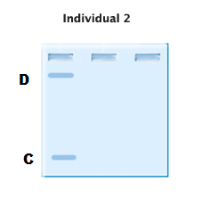
RFLP
The RFLP fragments can be separated by gel electrophoresis.
Notes:
The fragments from the restriction digests can be separated by gel electrophoresis. Because the fragments are different lengths, they will run to different locations on a gel. This creates the unique RFLP pattern, or DNA fingerprint, for each individual.

Slide 15
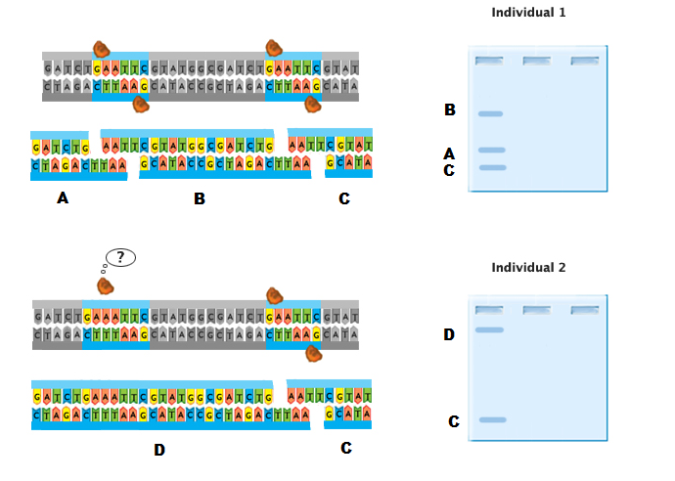
RFLP
RFLP animation
Notes:
Click on the RFLP animation to visualize the creation of a unique DNA fingerprint.

Slide 16
VNTR
Variable Number Tandem Repeat (VNTR)
sequences that are repeated multiple times and the number of repeats varies from person to person.
Notes:
Another reason why every individual has a unique DNA fingerprint is because of regions called variable number tandem repeats, or VNTR’s. A VNTR is a sequence that is repeated multiple times. The number of repeats varies from person to person. This example shows the sequence GATC repeated 5 times in one individual and only 2 times in a second individual.

Slide 17
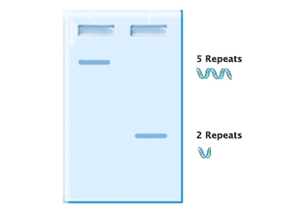
VNTR
VNTRs usually occur in introns
VNTRs can be amplified by PCR and run on agarose gels to produce unique DNA fingerprints
Notes:
These VNTR regions usually occur in introns. Do you remember what those are? Yes, the are noncoding regions of DNA that are cut out before the mature mRNA leaves the nucleus to make protein. That means the number of repeats in the VNTR region will have no effect on protein expression and therefore no effect on phenotypic traits. Because of this, VNTR loci are not under the same evolutionary selective pressure and are therefore highly variable.

Slide 18
PCR
The PCR analysis amplifies the DNA molecules using a smaller sample
On the forensic front, the PCR found to be useful in identifying DNA fingerprints in criminal matters and in paternity tests because it requires less amounts of DNA as it makes identical copies of the DNA sample
The PCR analysis amplified isolated regions on the strands of the DNA under examination.
The drawback is that it can not as discriminating as the RFLP

Slide 19
AMPLIFIED FRAGMENT LENGTH POLYMORPHISM
Amplified fragment length polymorphism (AmpFLP) is a popular DNA finger printing technique
It remains attractive because of its relatively less complicated operation and the cost-effectiveness of the procedure
By using the PCR analysis to amplify the minisatellite loci of the human cell, this method proved quicker in recovery than the RFLP
However, due to the use of gel in its analysis phase, there are issues of bunching of the VTRN's, causing misidentifications in the process

Slide 20
SHORT TANDEM REPEATS
The short tandem repeat (STR) methodology for extracting DNA is the system most widely used form of DNA fingerprinting
This system is based on the features of PCR, as it utilizes specific areas that have short sequential repeat DNA
The STR analyzes how many times base pairs repeat themselves on a particular location on a strand of DNA
The big advantage in this method is that the DNA comparisons can match the possibilities into an almost endless range
DNA fingerprinting has been extremely successful for use in the personal identification of criminal suspects, paternity issues, as well as in identification of the deceased
DNA, however, still poses issues because the VNTRs are not evenly distributed in all people because they are inherited
However, as forensic science continues its work in DNA testing, there appears to be no limit to the value it can render to society

Slide 21
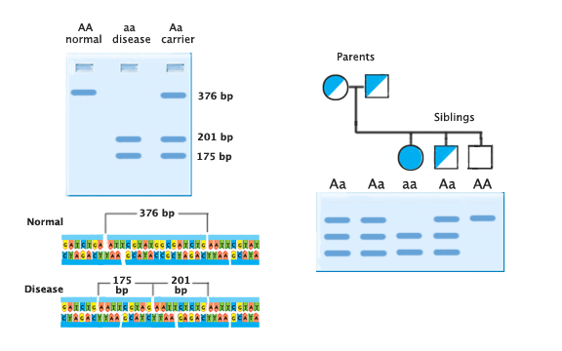
Applications
Diagnosing Disease
Notes:
Let’s talk about some applications of RFLP and VNTR analysis. One application for the medical field is diagnosing disease. Sickle cell anemia is a disease that is characterized by red blood cells that assume an abnormal, rigid, sickle shape. These abnormally shaped red blood cells cannot properly bind and transport oxygen in the blood. As you may recall from module one, this disease is the result of a single point mutation that causes the amino acid valine to replace glutamic acid in the amino acid chain. This mutation also creates an additional recognition site for the restriction enzyme DdeI. RFLP analysis will reflect this difference, as you can see in the picture of the gel, and can be used to diagnose sickle cell patients or alert potential parents that they are carriers of the disease.

Slide 22
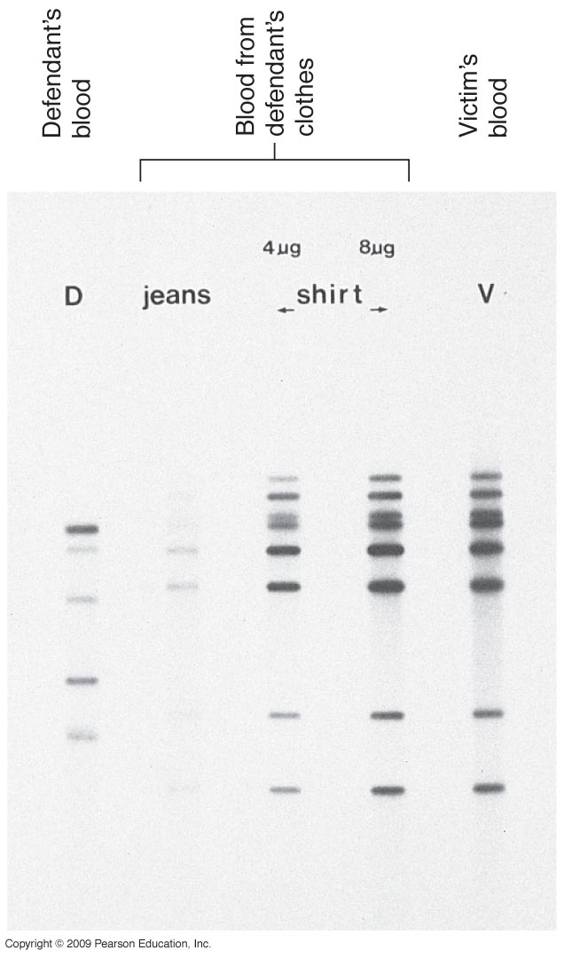
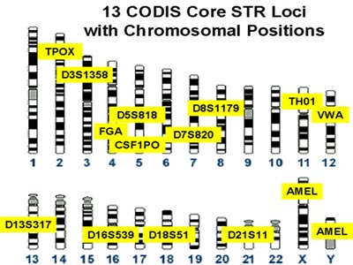
Applications
Forensics
Notes:
And of course RFLP and VNTR analysis can be used as forensic evidence. A crime scene is full of sources of DNA evidence including dirty laundry, a licked envelope, or a cigarette butt. Tiny blood stains, a smear of dried semen, or a trace of saliva is often all it takes to crack a case. In this example, a woman was found murdered in her apartment. The crime scene investigator collected samples of the woman’s blood, samples from the knife found under the body, and samples of blood from underneath the woman’s fingernails. The police suspected her ex-boyfriend was the perpetrator of the crime. A search of his apartment turned up a bloody shirt that he claimed was the result of falling into a rose bush while gardening. The evidence was very incriminating, so the investigator took him in for further questioning took a blood sample from him. This gel is a copy of the data obtained by PCR of VNTR loci in the labeled samples. You can see by matching the bands that the blood on the knife belonged to the woman and the blood under the woman’s fingernails belonged to her and another suspect that does not match the ex-boyfriend. Furthermore, the analysis of the blood stains on the ex-boyfriend’s shirt seem to confirm his alibi because his is the only blood on the shirt. Without DNA analysis, this man could have been convicted for this crime. Instead, he was exonerated and the real perpetrator was brought to justice. CODIS is a DNA database funded by the FBI that stores DNA profiles of convicted felons created by federal, state, and local crime labs. The standard in DNA profiles created for forensic evidence are to use 13 markers plus one to determine sex. If any two samples have matching genotypes at all 13 CODIS loci, it is a virtual certainty that the two DNA samples came from the same individual (or an identical twin). The applications for RFLP and VNTR loci extend beyond the scope of this module, but as you can see from these few examples this technology is powerful and necessary.

