Slide 1
Introduction to Biotechnology
VBC-321 Animal Biotechnology

Slide 2
Biotechnology consist of “ the controlled use of biological agents, such as, micro-organisms or cellular components, for benefit of the animal kind.”

Slide 3
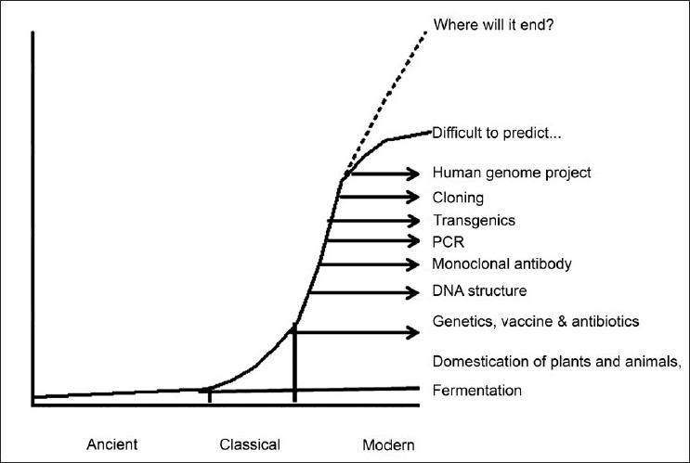
History

Slide 4
Biotechnology in India
National Biotechnology Board (NBTB)- 1982
Department of Biotechnology (DBT)-1986
National Dairy Research Institute (NDRI) - karnal
Indian Veterinary Research Institute (IVRI)- Izatnagar, Bareilly
International Centre for Genetic Engineering and Biotechnology (ICGEB)- Triesta, Italy
one centre at new delhi.

Slide 5
Recombinant DNA Technology
Recombinant DNA molecule is produced by joining together two or more DNA segments usually originated from different organisms
Objectives
To obtain a large number of specific DNA Molecule
eg. Gene cloning
To recover large quantities of protein produce by concerned gene- eg. Recombinant vaccine
To integrate the gene in to the chromosome of target organism where it express its self – eg. Gene therapy

Slide 6
Gene- A segment of DNA, which govern some trait usually by Producing a polypeptide or only RNA (tRNA, rRNA)
Vector – A vector is DNA molecule that has ability to replicate autonomously in a appropriate host cell and in to which DNA fragment to be cloned
Insert DNA- Vector containing DNA segment to be cloned, called DNA Insert
Chimaeric gene- A gene constructed by combining coding sequence from one gene with regulatory sequence of another gene

