Slide 1
Venturimeter and Pitot Tube
Dr. J. Badshah
University Professor – cum - Chief Scientist
Dairy Engineering Department
Sanjay Gandhi Institute of Dairy Science & Technology, Jagdeopath, Patna
(Bihar Animal Sciences University, Patna)

Slide 2
Flow Measurement
Introduction
A flowmeter to measure linear, nonlinear, mass or volumetric flow rate of a liquid or a gas in liters per second or kilograms per second
Positive-displacement flow meters
Ventury meter
Orifice Flow meter
Rotameter
Pitot Tube

Slide 3
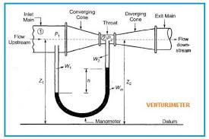
Venturimeter with U tube manometer

Slide 4
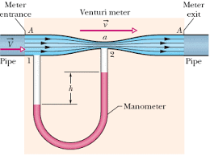
Venturimeter working

Slide 5
Venturimeter
Venturimeter is used to the measurement of flow rate. It is generally used for large diameter pipes. The venturi tube has a entrance zone, converging conical inlet, a cylindrical throat, and a diverging recovery cone.
Entrance Section is a straight cylinder having length equal to 5 to 8 times the diameter of the pipe.
The diameter of the tube of convergence section gradually decreases. The angle of cone = 21 ± 2°. When liquid flows inside the venturimeter, the velocity of fluid increases and correspondingly the pressure falls.
At throat, the diameter of the venturemeter cylindrical tube is minimum. Velocity is maximum and pressure is minimum. Throat diameter = 1/3 to 1/4th inlet diameter.
The diameter of the tube at diverging section gradually increases. Here due to gradual divergence, the pressure is build up to the original inlet pressure. The cone angle is 5-7°. Small size venturimeter are made of brass or, bronze and large venturimeters are made of cast iron or stainless steel.
The pressure difference between the upstream side of the cone and the throat is measured and provides a signal for the rate of flow.

Slide 6
Measurement of Flow rate in venturimeter
Flow rate can be given as:
Q = C_{d} a₁ a₂ √{ (a₁)² - (a₂)² }√ {2g (p₁ –p₂ )/w
Where, Q = flow rate, C_{d} = Coefficient of discharge. a₁ = area at the entrance of venturi a₂ = area at the venturi throat p₁ = Pressure at entrance of venture p₂ = Pressure at venture throat w = ρg
The venturi tube is suitable for clean, dirty and viscous liquid and some slurry services.
Loss of head due to installation in the pipeline is small.
Original pressure of the liquid can be recovered completely.
Accuracy is 1% of full range 5. Not much wear and tear.
Characteristics are well established and it is in use since years.
Can be used for large flow rates and large diameter pipes.
Space requirements are more and it is Expensive in installation.

Slide 7
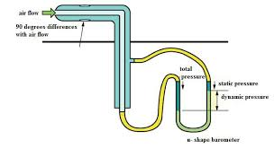
Pitot Tube for velocity and flow Measurement

Slide 8
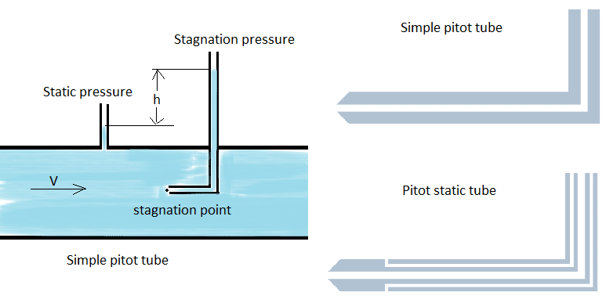
Difference between Pitot tube and static Tube

Slide 9
Pitot Tube
Pitot tube is used to measure flow velocity.
Outer body of pilot tube consist of ports at point A, for sensing the static pressure of fluid. At point B fluid velocity become zero and inner tube is for sensing the stagnation pressure.
The outlet C & D is connected to U-tube manometer for measuring the pressure difference between the points A and B.
Pitot tube The flow velocity is given by the following equation:
V = √ (2 g h)

Slide 10
THANK YOU

