Slide 1
Cholesterol metabolism
Anil Gattani

Slide 2
Functions of Cholesterol
a precursor of steroid hormones (progesterone, testosterone, estradiol, cortisol, etc.)
a precursor of bile acids
a precursor of vitamin D
important component of many mammalian membranes (modulates the fluidity)
all cells express the enzymes of cholesterol biosynthesis
synthesis and utilization is tightly regulated in order to prevent over-accumulation and abnormal deposition

Slide 3
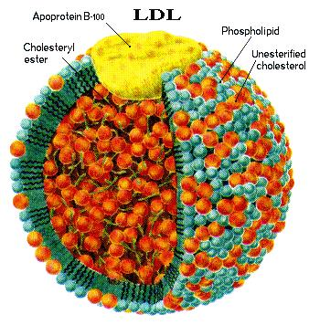
Sources of Cholesterol
from the diet
can be synthesized de novo (about 800 mg of cholesterol per day) - in the liver (major site)
- in the intestine
Liver-derived and dietary cholesterol are both delivered to body cells by lipoproteins

Slide 4
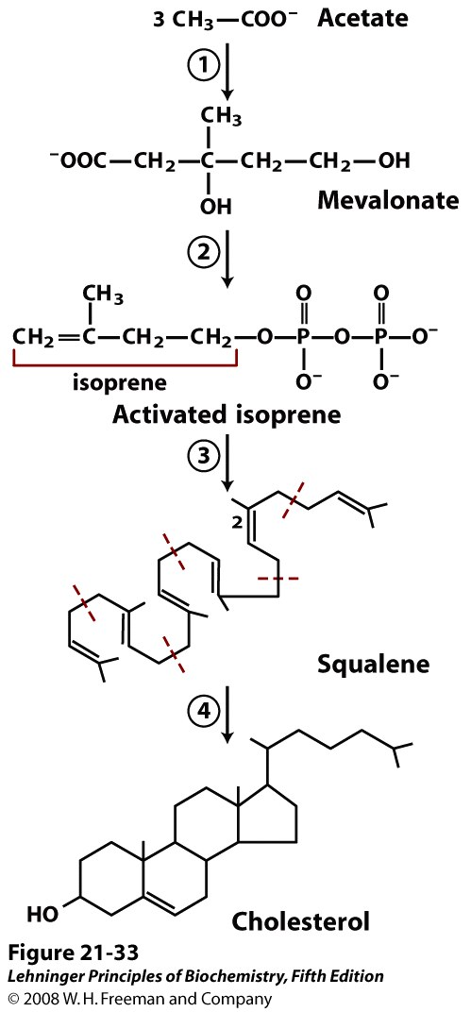
Biosynthesis of Cholesterol
Summary
1. Acetyl CoA => Mevalonate
2. Mevalonate => Isoprenes
3. 6 isoprenes => squalene
4. Squalene to lanosterol
5. Lanosterol to Cholesterol
Notes:
FIGURE 21-33 Summary of cholesterol biosynthesis. The four stages are discussed in the text. Isoprene units in squalene are set off by red dashed lines.

Slide 5
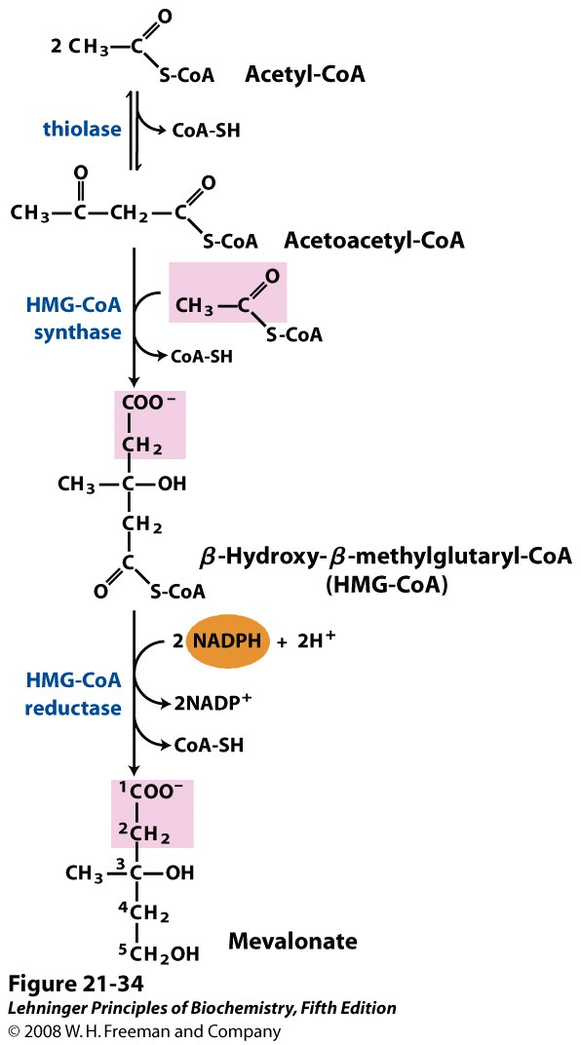
1. Formation of Mevalonate
*
*
HMG-CoA reductase is a target for some cardiovascular drugs
ER
* Different enzyme from ketone body synthesis in mitochondria

Slide 6
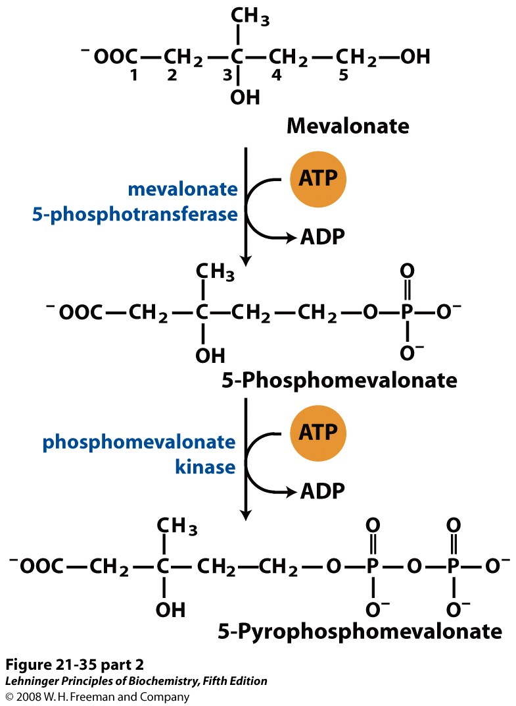
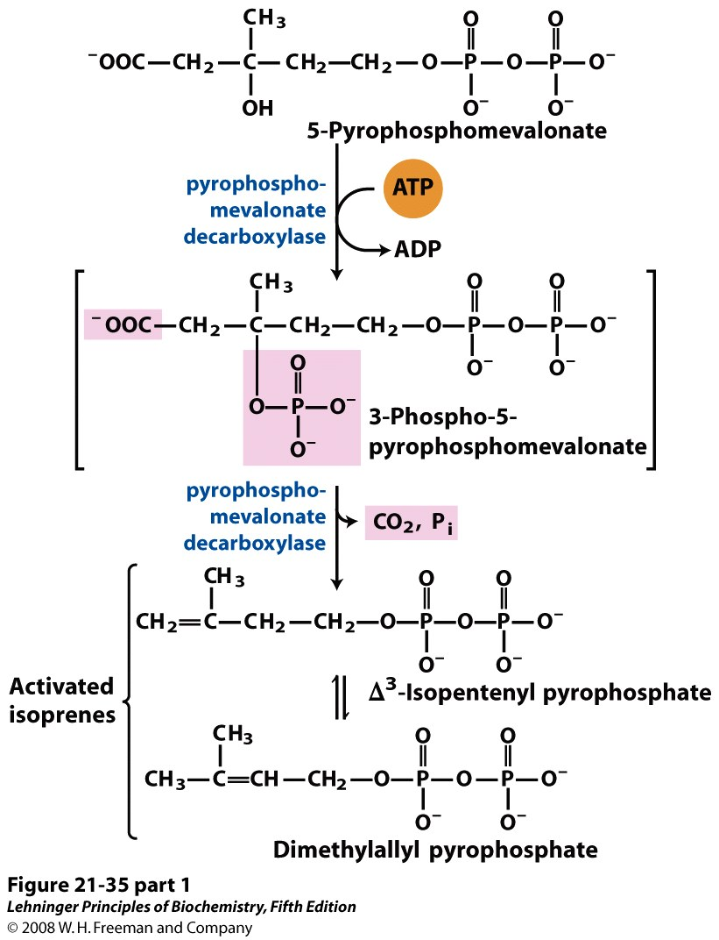
Formation of Activated Isoprene
Pyrophosphate is a good leaving group in these nucleophilic substitution reactions

Slide 7
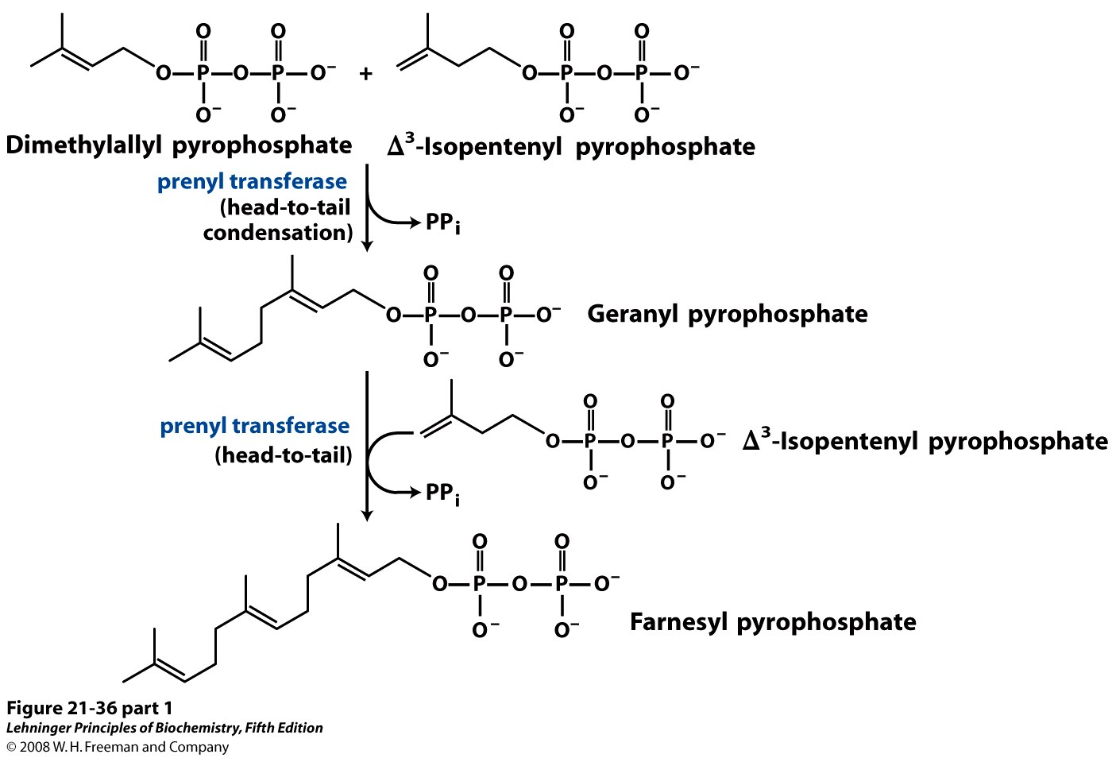
Formation of Squalene (1)

Slide 8
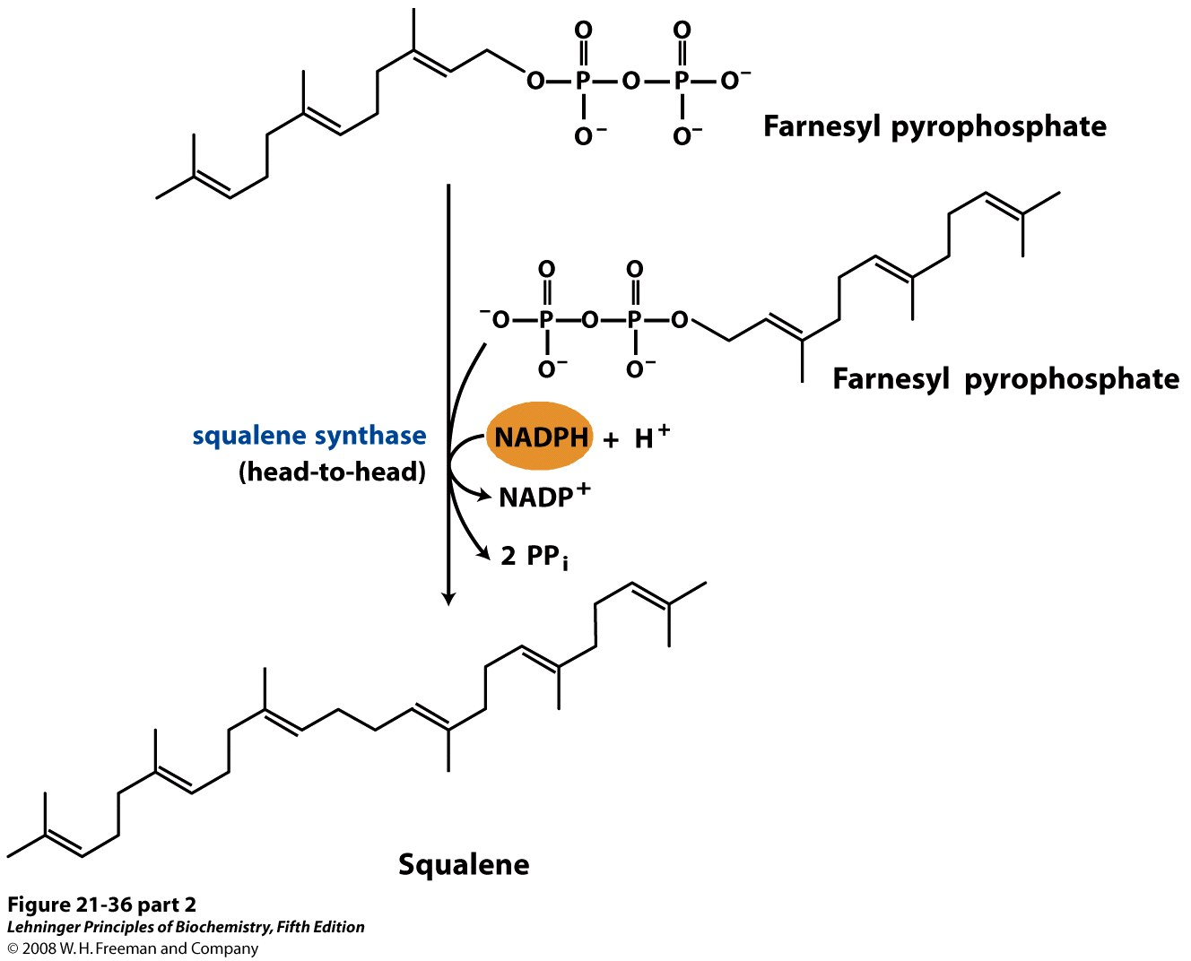
Formation of Squalene (2)

Slide 9
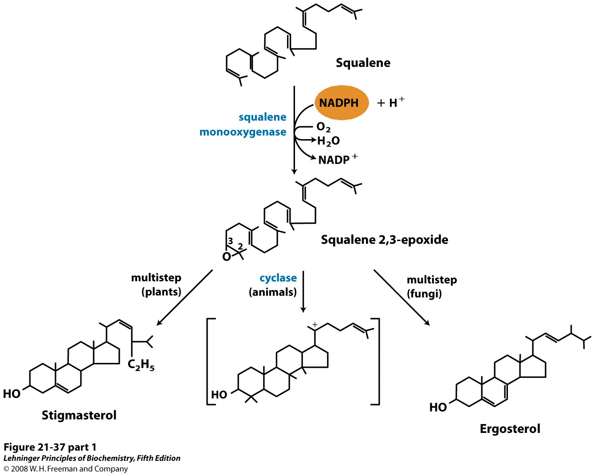
Ring closure converts squalene to the steroid nucleus
lanosterol
Notes:
FIGURE 21-37 (part 1) Ring closure converts linear squalene to the condensed steroid nucleus. The first step in this sequence is catalyzed by a mixed-function oxidase (a monooxygenase), for which the cosubstrate is NADPH. The product is an epoxide, which in the next step is cyclized to the steroid nucleus. The final product of these reactions in animal cells is cholesterol; in other organisms, slightly different sterols are produced, as shown.

Slide 10
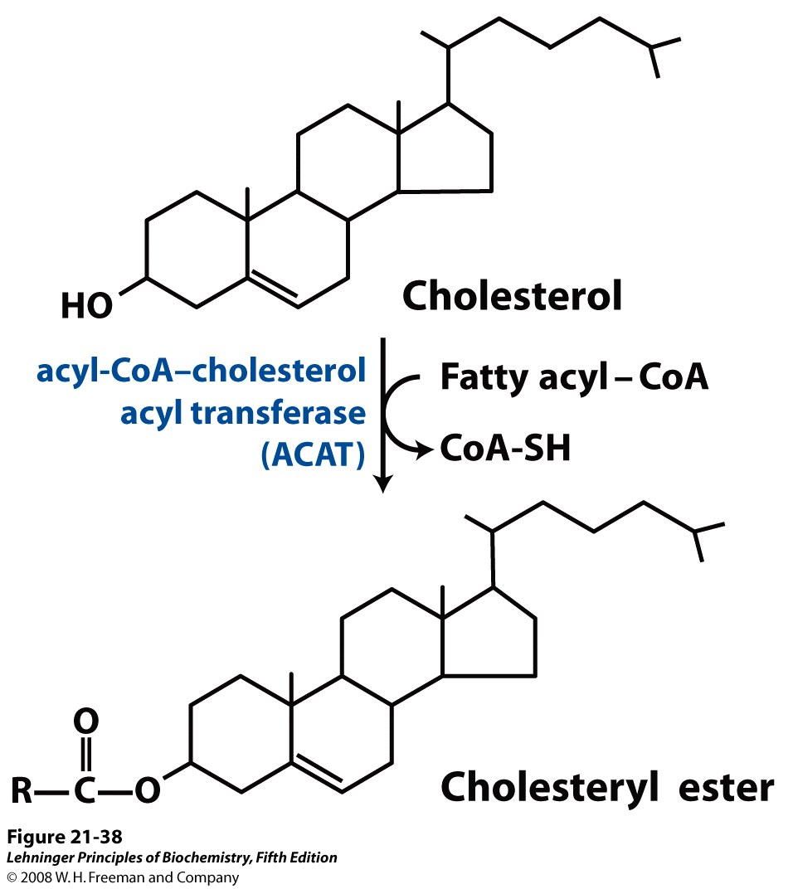
Cholesteryl esters.
Esters more hydrophobic
for storage and transport
Notes:
FIGURE 21-38 Synthesis of cholesteryl esters. Esterification converts cholesterol to an even more hydrophobic form for storage and transport.

Slide 12
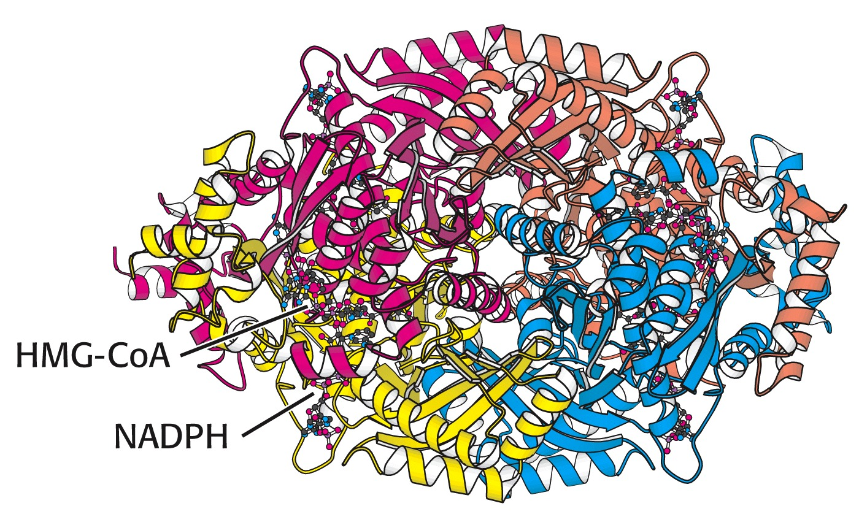
THE REGULATION OF CHOLESTEROL BIOSYNTHESIS
Regulatory enzyme - 3-hydroxy-3-methylglutaryl CoA reductase.
Tetrameric enzyme.
NADPH - coenzyme

Slide 13
HMG CoA reductase is controlled in multiple ways:
The rate of synthesis of reductase mRNA is controlled by the sterol regulatory element binding protein (SREBP).
When cholesterol levels fall this protein migrates to the nucleus and enhance transcription.
The rate of translation of reductase mRNA is inhibited by cholesterol
The degradation of the reductase is controlled.
The increase of cholesterol concentration makes the enzyme more susceptible to proteolysis.
4. Phosphorylation decreases the activity of the reductase.
Enzyme is switched off by an AMP-activated protein kinase. Thus, cholesterol synthesis ceases when the ATP level is low.

Slide 14
Products of Cholesterol Metabolism

Slide 15
Cytochrome P450 Enzymes in Cholesterol Metabolism
P450 enzymes is CYP
Among 57 CYP enzymes – eight involved in cholesterol biosynthesis and metabolism, includeing conversion of cholesterol to bile acids

Slide 16
Dolichol Phosphate Synthesis
polyisoprenoid compound
serve as the foundation for the lipid-linked oligosaccharide, LLO
required for the attachment of carbohydrate to asparagine residues in N-linked glycoproteins
phosphate donor for dolichol kinase is CTP and not ATP
Coenzyme Q (Ubiquinone) Synthesis
composed of a benzoquinone ring conjugated to a polyisoprenoid tail

Slide 17
Treatment of Hypercholesterolemia
Alirocumab, Evolcumab- injectible antibodies that block the function of proprotein convertase subtilisin/kexin type 9, PCSK9
Atorvastatin, Simvastatin, Lovastatin - These drugs are HMGR inhibitors and are members of the family of drugs referred to as the statins
Gemfibrozil, Fenofibrate - via the activation of peroxisome proliferation
Cholestyramine or colestipol (resins): nonabsorbable resins that bind bile acids and leads to its excretion rather absorption. The decrease of bile acids releases a feedback inhibitory mechanism and inhibiting bile acid synthesis

Slide 18
The pleiotropic effects of statins are mediated by inhibition of protein isoprenylation, altering several signal transduction molecules
statins also prevent the synthesis of other important isoprenoid intermediates
These isoprenoid intermediates serve as important lipid attachments for a variety of proteins
Rho proteins --proinflammatory cytokines
Ras proteins --in cell proliferation, apoptosis, and cell adhesion
statins renders them inactive

Slide 19
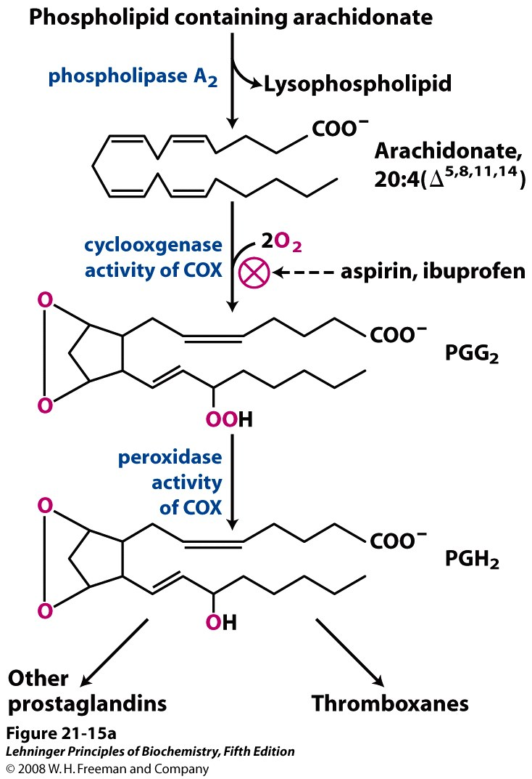
Synthesis of Eicosanoids
Cyclooxygenase is a target for many anti-inflammatory drugs
Notes:
FIGURE 21-15a The "cyclic" pathway from arachidonate to prostaglandins and thromboxanes. (a) After arachidonate is released from phospholipids by the action of phospholipase A₂, the cyclooxygenase and peroxidase activities of COX (also called prostaglandin H₂ synthase) catalyze the production of PGH₂, the precursor of other prostaglandins and thromboxanes.

Slide 20
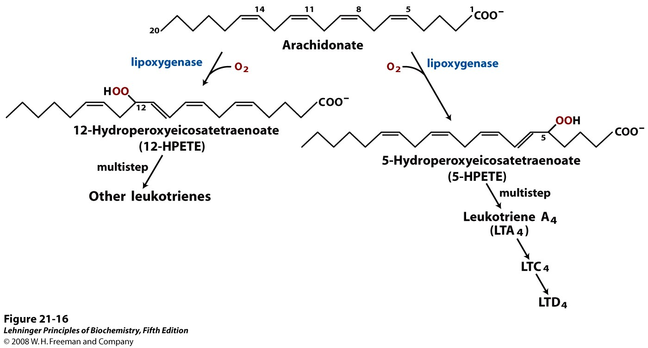
The "linear" pathway from arachidonate to leukotrienes.
Notes:
FIGURE 21-16 The "linear" pathway from arachidonate to leukotrienes.

Slide 21
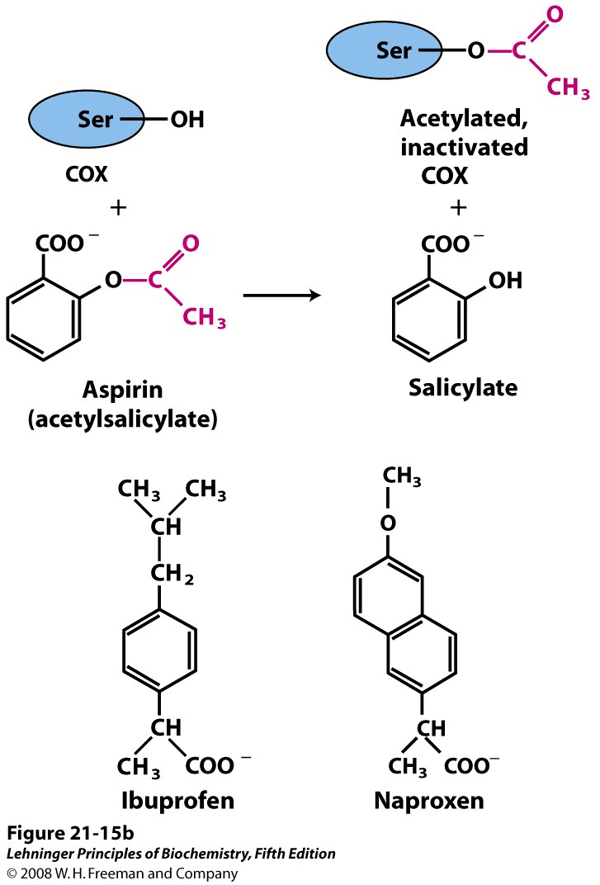
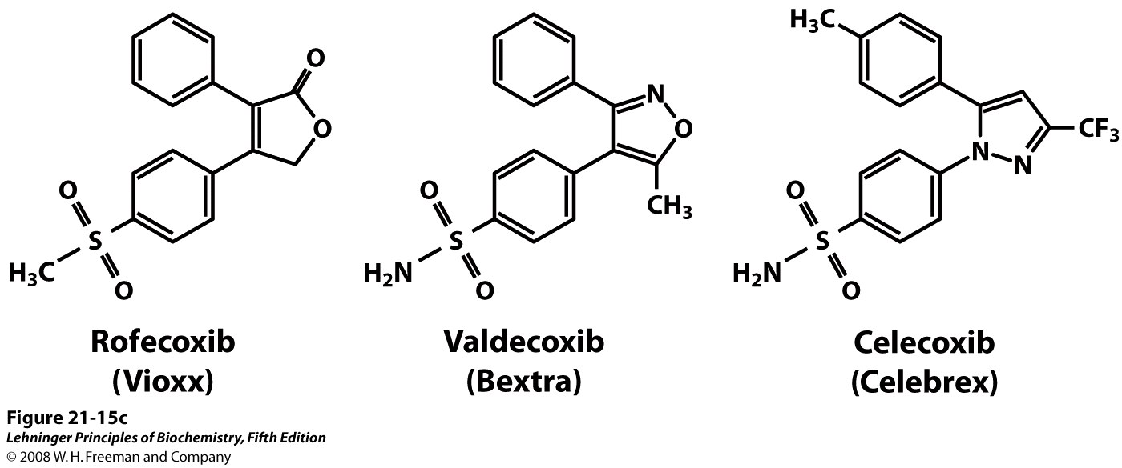
COX-2–specific cyclooxygenase inhibitors
Notes:
FIGURE 21-15b The "cyclic" pathway from arachidonate to prostaglandins and thromboxanes. (b) Aspirin inhibits the first reaction by acetylating an essential Ser residue on the enzyme. Ibuprofen and naproxen inhibit the same step, probably by mimicking the structure of the substrate or an intermediate in the reaction.

