Slide 1
COFFEE
B.K.Singh,Dairy Technology

Slide 2
Coffee is the common man’s gold, and like gold,
It bring to every man the feeling of luxury and nobility.

Slide 3
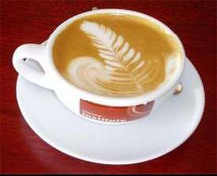

HISTORY
800 AD:
Ethiopia, Kaldi the goatherd
1000 AD:
Arab traders brought coffee back to their homeland and
cultivated the plant for the first time on plantations. They also began to boil the “beans” creating a drink they called “qahwa”.
1457:
Kiva Han, the world’s first coffee shop
opened in
coffee to
Constantinople . The Ottoman Turks introduced
Constantinople.
1600: Coffee was introduced to the west by Italian traders. In Italy, Pope Clement VIII baptized the “devil’s brew” making it an acceptable Christian beverage.
1607 :
Capt. John Smith brought coffee to North America.
1901:
The first soluble instant coffee was invented by Japanese-
American chemist Satori Kato of Chicago.

Slide 4
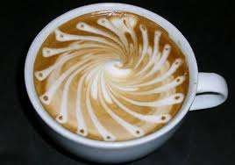

HISTORY CONTINUED:
1938:
Nestle’ developed Nescafe’ and introduced it to Switzerland.
1940:
The US imported 70% of the world’s coffee.
1946: Achilles Gaggia perfected his espresso machine in Italy. The term cappuccino started.
1971 : Starbucks opened its first store in Seattle’s Pike Place public market , creating a frenzy over fresh-roasted whole bean coffee.

Slide 5
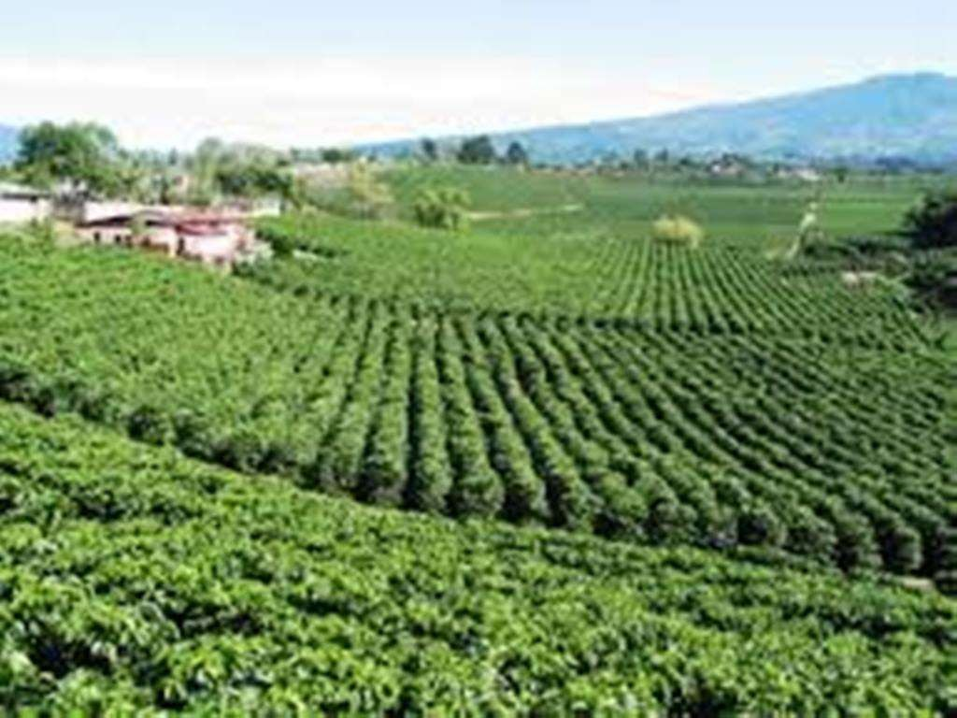

Slide 6
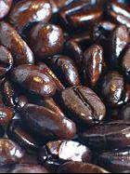


COFFEE
 Scientific Name: Coffea Rubiaceae
It is a widely consumed non-alcoholic beverage prepared from the roasted seeds commonly called the beans of a coffee plant.
 Four classifications (species) are ARABICA, ROBUSTA, LIBERICA and EXCELSA.
Scientific Name: Coffea Rubiaceae
It is a widely consumed non-alcoholic beverage prepared from the roasted seeds commonly called the beans of a coffee plant.
 Four classifications (species) are ARABICA, ROBUSTA, LIBERICA and EXCELSA.

Slide 7
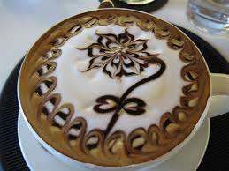



ARABICA VS. ROBUSTA:
Arabica:
 Superior grade of coffee/gourmet coffee
 Contains half of the caffeine of Robusta.
 Oval in shape
 Has more desirable flavors and aromatic properties.
 Cherries ripen after 6-8 months
Robusta:
 Also known as Canephora or Canillon
 Lower grade of coffee, typically grown
 Round in shape (beans). Cherries ripen after 9-11 months
 Trees are easier to grow and maintain, disease-resistant and produce a higher yield
 More astringent in flavor and contains higher amount of caffeine.

Slide 8
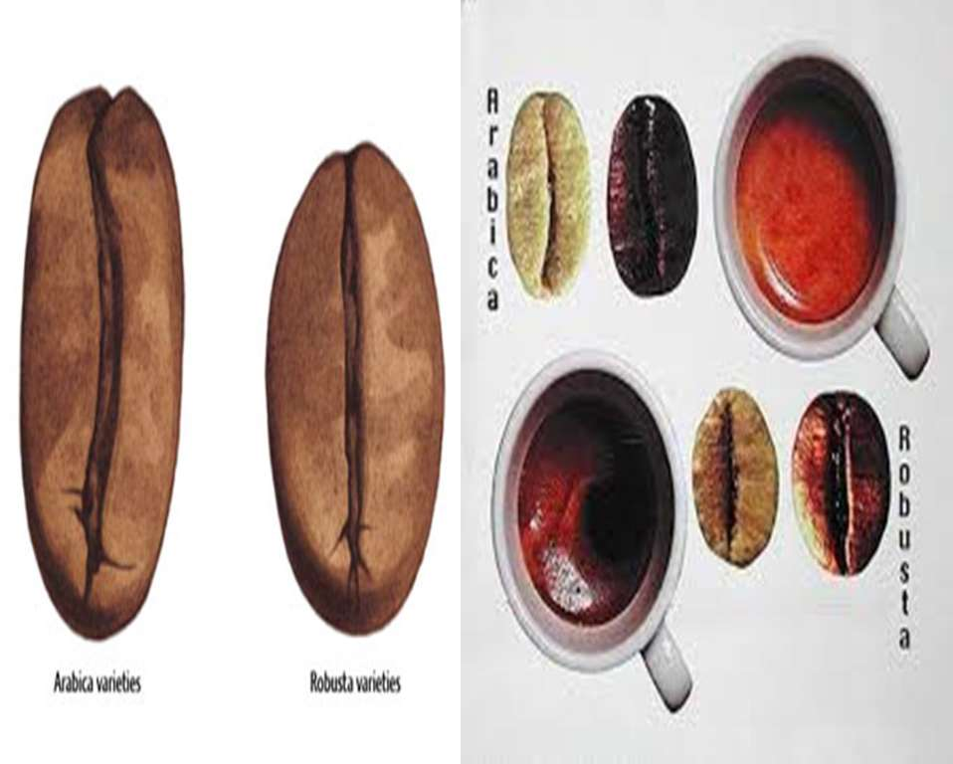

Slide 9
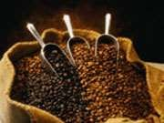
TOP 10 BIGGEST COFFEE-PRODUCING COUNTRIES IN THE WORLD:
Brazil
Colombia
Vietnam
Indonesia
India
Ethiopia
Mexico
Guatemala
Honduras
Uganda
Source: International Coffee Association

Slide 10
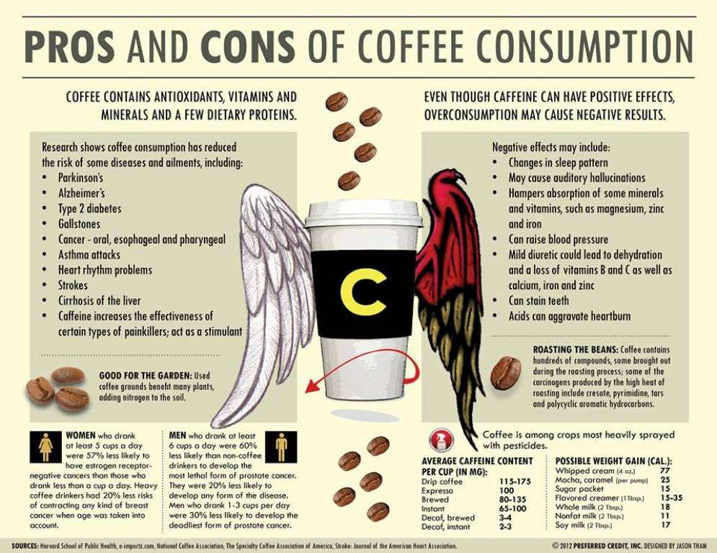

Slide 11
COFFEE PRODUCTION

Slide 12
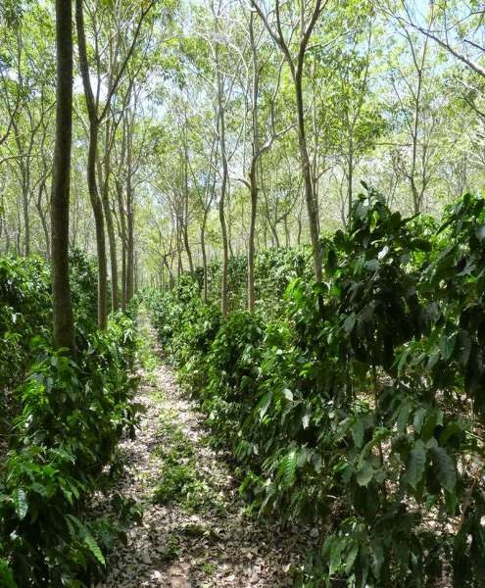
1.PLANTING
After sprouting, the seedlings are removed from the seed bed to be planted in individual pots. Planting often takes place during the wet season, so that the soil around the young trees remains moist while the roots become firmly established.

Slide 13
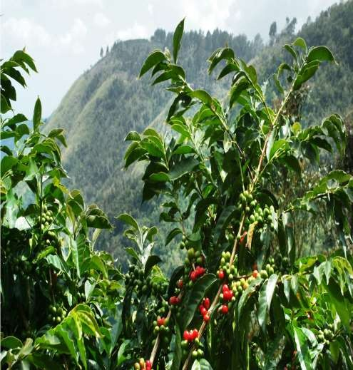
2.HARVESTING
Depending on the variety, it will take approximately 3 or 4 years for the newly
planted coffee trees to begin to bear fruit. The fruit, called the coffee cherry, turns a bright, deep red when it is ripe and ready to be harvested. All coffee is harvested in one of two ways:
Strip picked
Selectively picked

Slide 14
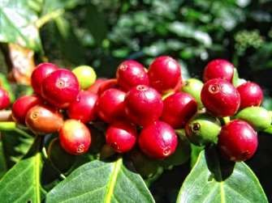
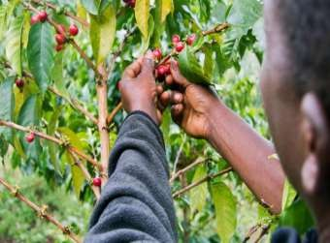
HARVESTING
Strip picked
the entire crop is harvested at one time. This can either be done by machine or by hand. In either case, all of the cherries are stripped off of the branch at one time.
Selectively picked
Only the ripe cherries are harvested and they are picked individually by hand. Pickers rotate among the trees every 8 - 10 days,
choosing only the cherries which are at the peak of ripeness. Because this kind of harvest is labor intensive, and thus more costly, it is used primarily to harvest the finer
Arabica beans.

Slide 15

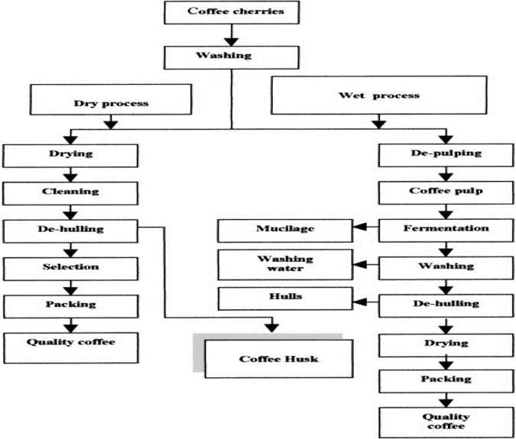
HARVESTING THE CHERRIES AND PROCESSING THE BEANS

Slide 16
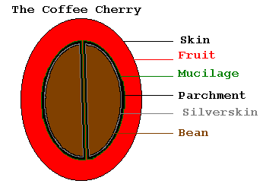
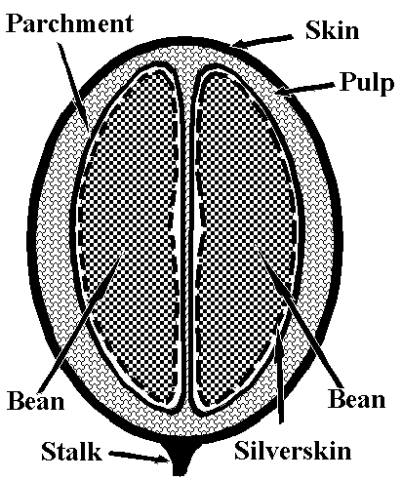
COFFEE CHERRY

Slide 17
3.PROCESSING
Coffee is processed in two
ways
The Dry method
The Wet method

Slide 18
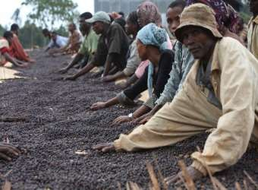
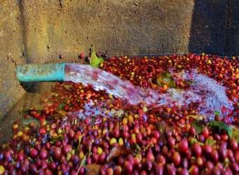
PROCESSING
The Dry Method
The freshly picked cherries are simply spread out on huge surfaces to dry in the sun. In order to prevent the cherries from spoiling, they are raked and turned throughout the day. When the moisture content of the cherries drops to 11 percent, the dried cherries are moved
to warehouses where they are stored.
The Wet Method
the freshly harvested cherries are passed through a pulping machine where the skin and pulp is separated from the bean. The pulp is washed away with water, usually to be dried. The beans are separated by weight as
they are conveyed through water channels, the lighter beans floating to the top, while the heavier, ripe beans sink to the bottom.

Slide 19
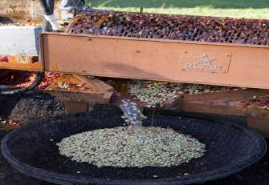
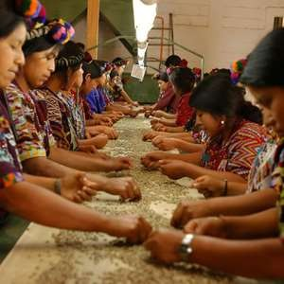
4.MILLING
HULLING
Machines are used to remove the parchment layer (endocarp) from wet processed coffee.
GRADING & SORTING
Before being exported, the coffee beans will be even more precisely sorted by size and weight. They will also be closely evaluated for colour flaws or other imperfections.

Slide 20
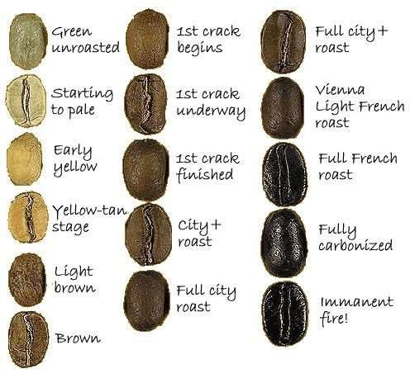
5. ROASTING
Roasting transforms green coffee into the aromatic brown beans that we purchase, either whole or already ground, in our favorite stores. Most roasting machines maintain a temperature of about 550 degrees Fahrenheit. The beans are kept moving throughout the entire process to keep them from burning and when they reach an internal temperature of about 400 degrees, they begin to turn brown and the caffeol, or oil, locked inside the beans begins to emerge.

Slide 21

ROASTING
 The heat causes a series of chemical reaction to take place. Starches are converted into sugars, which caramelize. Some types of acids are created, and others are broken down.
 CAFFEOL-Coffee essence or coffee oil.

Art and Science of roasting the green beans at approximately 400 degrees. The process creates flavor and aroma.
 Oxygen-The great enemy of roasted coffee beans
 464 degrees F.(240 degrees Celsius)-necessary temperature, for the correct amount of time oils will start to come out.
 Burnt coffee results from roasting beans at too high temperature
and the beans will taste thin and burnt. Burnt coffee is unpleasant.
 Most coffee machines are gas-fired. They work at temperatures of around 550 degrees F (90 degrees C). 2 common types: Drum type and hot air roasters.

Slide 22
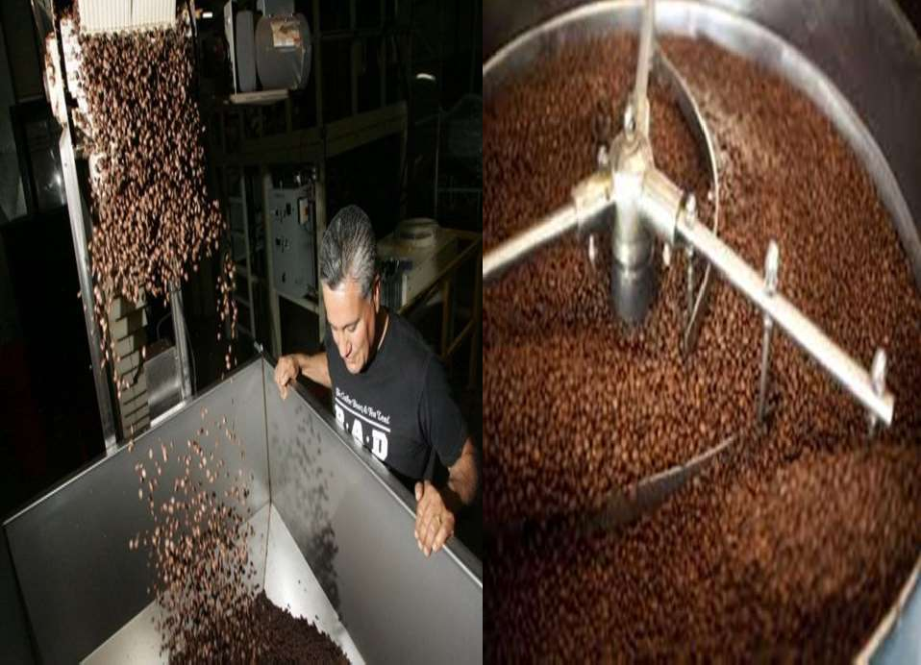

Slide 23
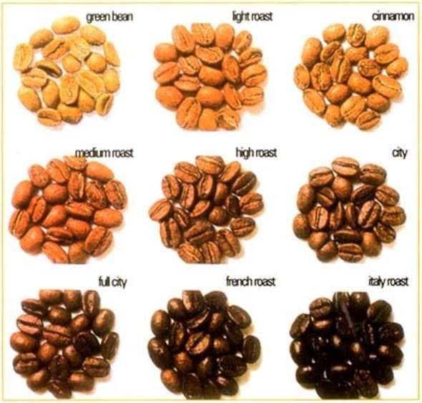
SAMPLES OF COFFEE ROASTS

Slide 24
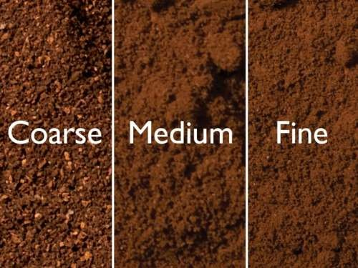
6. GRINDING
The objective of a proper grind is to get the most flavor in a cup of coffee. How coarse or fine the coffee is ground depends on the method by which the coffee is to be brewed. Generally, the finer the grind the more quickly the coffee should be prepared.
That is why coffee ground for use in an espresso machine is much finer than coffee which will be brewed in a drip system.

Slide 25

GRINDING COFFEE
TYPES OF GRIND:
 VERY FINE-espresso machine
 FINE- Filter
 MEDIUM/ MEDIUM COARSE-French Press/ Cafetiere
COARSE GRIND- Percolator or Jug Method
 PULVERIZED- Turkish

Slide 26
TYPES OF COFFEE

Slide 27
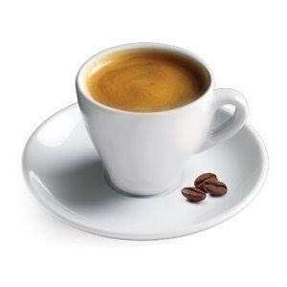
Espresso Made by forcing very hot water
under high pressure through finely ground, compacted coffee. This process produces an almost syrupy beverage by extracting both solid and dissolved components.

Slide 28
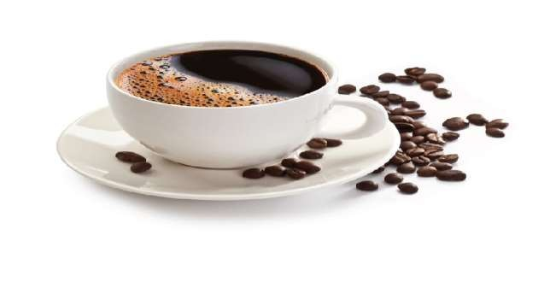
Cafe Americano
Coffee prepared by adding hot water to espresso, giving a similar strength to but different flavour from regular drip coffee. The strength of an Americano varies with the number of shots of espresso added

Slide 29

Café latte
Italian name for coffee ("cafe") with milk ("latte"). It is a coffee beverage consisting of strong or bold coffee (sometimes espresso) mixed with scalded milk in approximately a 1:1 ratio

Slide 30
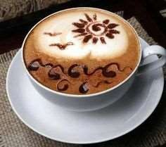
Cafe mocha
A café mocha is a variant of a cafe latte. Like a latte, but a portion of chocolate is added, typically in the form of a chocolate syrup, although other vending systems use instant chocolate powder. Mochas can contain dark or milk chocolate.

Slide 31
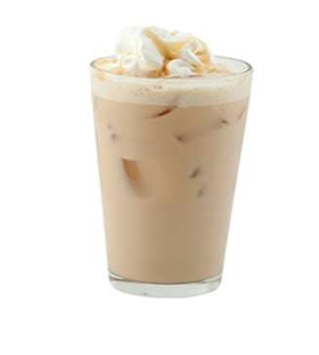
Frappe
A big favourite in parts of Europe and Latin America, especially during the summer months. Originally a cold espresso, it has more recently been prepared putting 1-2 teaspoons of instant coffee with sugar, water and ice

Slide 32
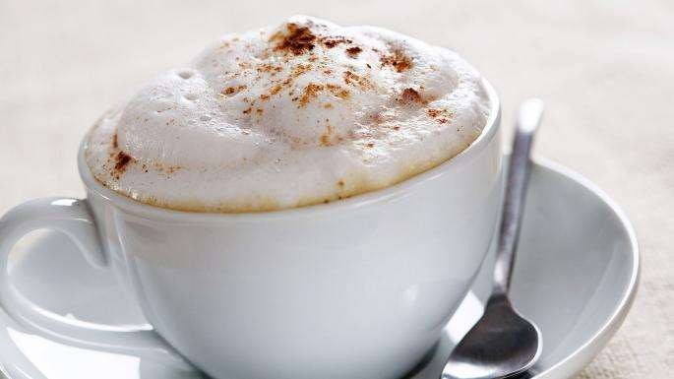
Cappuccino
Cappuccino is a coffee-based drink prepared with espresso, hot milk, and steamed milk foam.

Slide 33
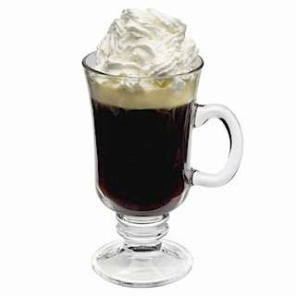
Irish coffee
Cocktail consisting of hot coffee, Irish whiskey, and brown sugar, stirred, and topped with thick cream. The coffee is drunk through the cream. The original recipe explicitly uses cream that has not been whipped, although whipped cream is often used.

Slide 34
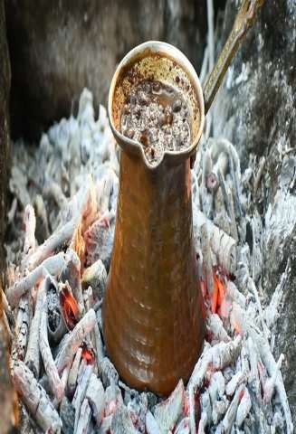
Turkish coffee
Turkish coffee is a method of preparing coffee where finely powdered roast coffee beans are boiled in a pot (cezve), with added sugar (depending on taste), before being served into a cup where the grounds settle. This method of serving coffee is common throughout the Middle East & North Africa.

Slide 35
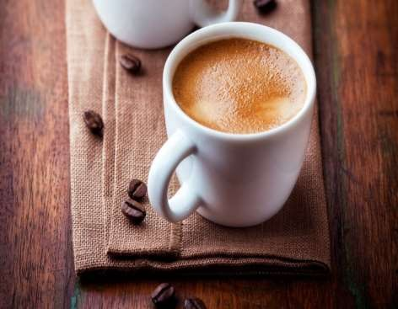
Macchiato
Macchiato, means 'stained', is an Espresso with a dash of foamed milk. At first sight it resembles a small Cappuccino.

Slide 36
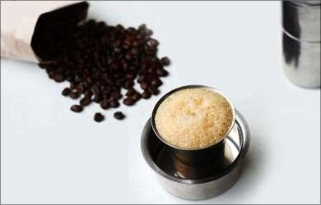
Madras filter coffee Filter Coffee is a sweet milky coffee
made from dark roasted coffee beans and chicory It is served with coffee to milk ratio of usually 3:1.

Slide 37

Cafe Latte Freddo
It is a type of cold coffee. Cafe Latte Freddo is an espresso mixed with cold milk in similar
proportions as a Cafe Latte that is usually shaken
well with ice in a cocktail shaker

Slide 38
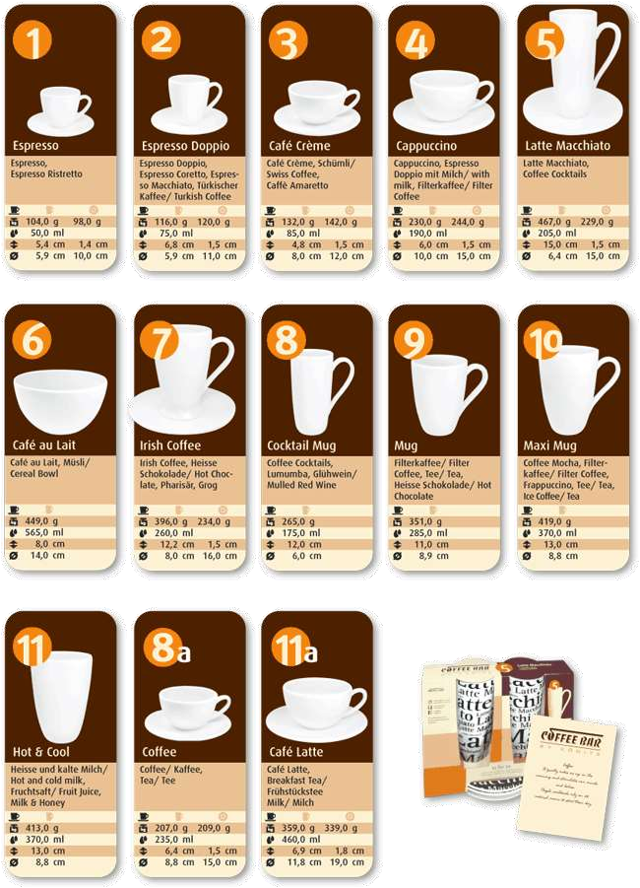
TYPES OF COFFEE CUPS

Slide 39
Proper Storage of Coffee:
Well ventilated storeroom.
Airtight container for ground coffee to ensure that the oils do not evaporate, causing loss of flavor and strength.
Away from excess moisture.
Must not be stored in any strong smelling food, as coffee will absorb their odors.

Slide 40
MAKING COFFEE BEVERAGE
A PERFECT CUP OF COFFEE
 Use freshly roasted and ground coffee.
 Buy/use the correct grind for type of machine you may have in use.
 Make sure all your equipment are clean before using
them
 Add boiling water to the coffee and allow to infuse.
 Strain and serve.
 Add milk or cream separately.
 Drink the freshly brewed coffee as soon as possible.
 Remember to warm your coffee cup before you pour in the coffee.

Slide 41

COFFEE BEVERAGES:
 ESPRESSO- means “express”. Italian Roast coffee
Variations:
Ristretto- “ristricted”. This is a short shot that is stopped at ¾ an ounce.
Single- Shot extracted to 1 ounce.
Lungo- “Long”. Extracted to 1. 5 ounce.
Double-2 ounce shot using twice as much coffee in the portafilter.
 Americano- espresso shot/s with hot water (about 6-8 oz)
 Macchiato-”Marked”. Espresso with a small amount of steamed milk and foam dabbed with a poon and served in a demitasse.
 Espresso Con Panna- “with cream”. Same as Macchiato but uses whipped
cream instead of foamed milk.
 Cappuccino- shot of espresso with steamed milk in without holding back the foam.
 Café Latte- espresso shot/s 6-8 oz steamed milk and a dollop of foam.
 Flavored Coffee Beverages- brew/espresso-based coffees, milk, flavored
syrups and or powders such as chocolate, vanilla, hazelnut, cinnamon, Irish cream caramel etc.

Slide 42
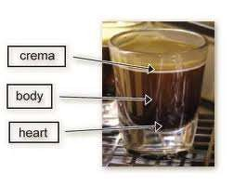
PARTS OF AN ESPRESSO SHOT

Slide 43
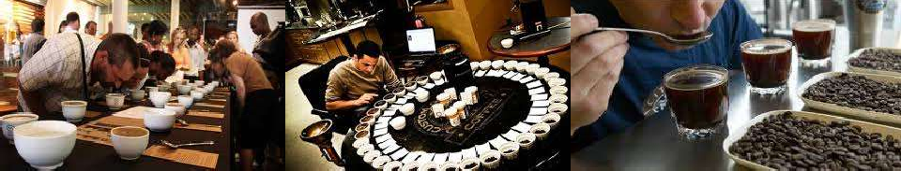
CUPPING AND EVALUATING COFFEE

Slide 44
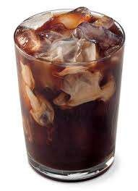
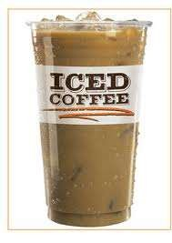

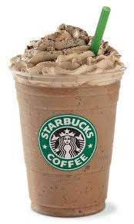
COLD COFFEE BEVERAGES:

Slide 45



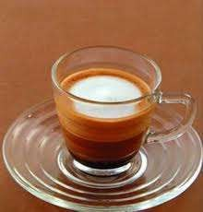

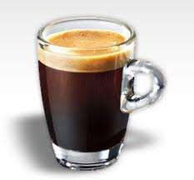
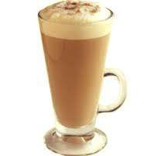
HOT COFFEE BEVERAGES:

Slide 46
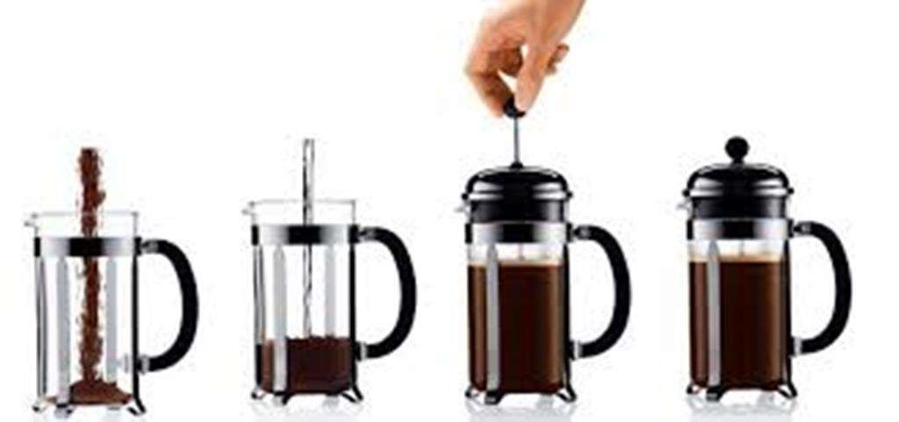
COFFEE MACHINES/METHODS
FRENCH PRESS

Slide 47

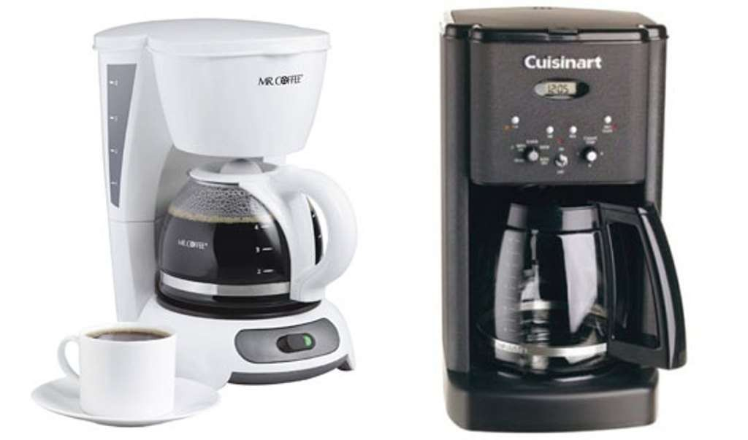
DRIP BREW

Slide 48
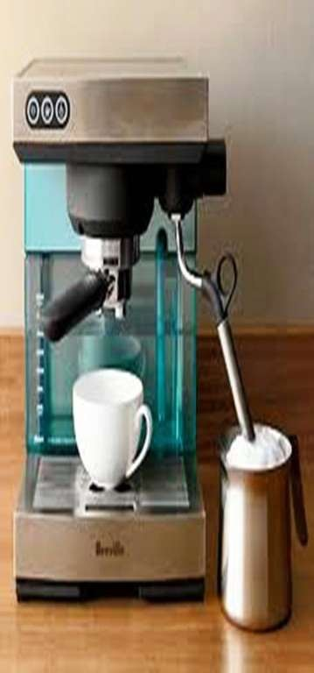
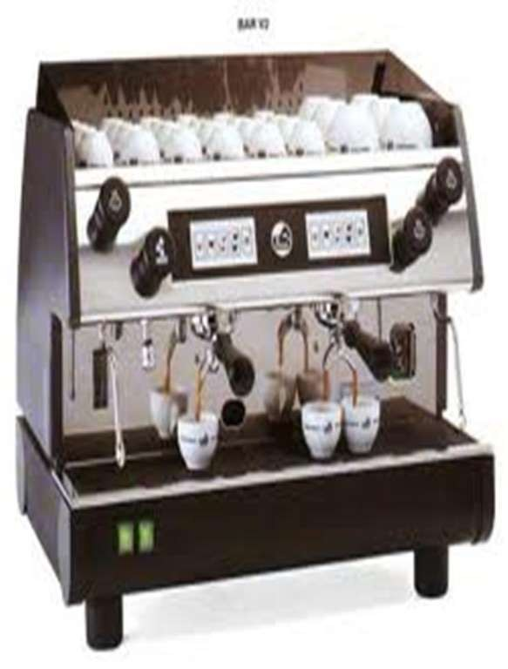
ESPRESSO MACHINES

Slide 49

DECAFFEINATION
 Caffeine- is odorless and tasteless stimulant found in coffee, tea, sodas and energy drinks and other caffeinated beverages.
 Beans are decaffeinated (decaffeination plants) first prior to roasting.
 Solvent Method
 SWD (Swiss Water Decaffeination)-patented by Coffex SA in 1979 uses only carbon filters and water.

Slide 50



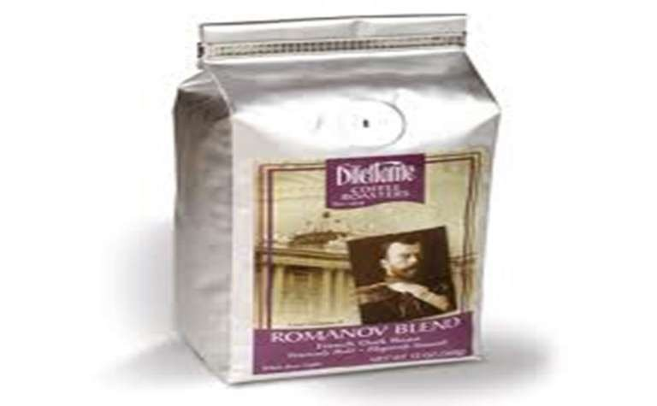
VACUUM-PACKED COFFEE

Slide 51
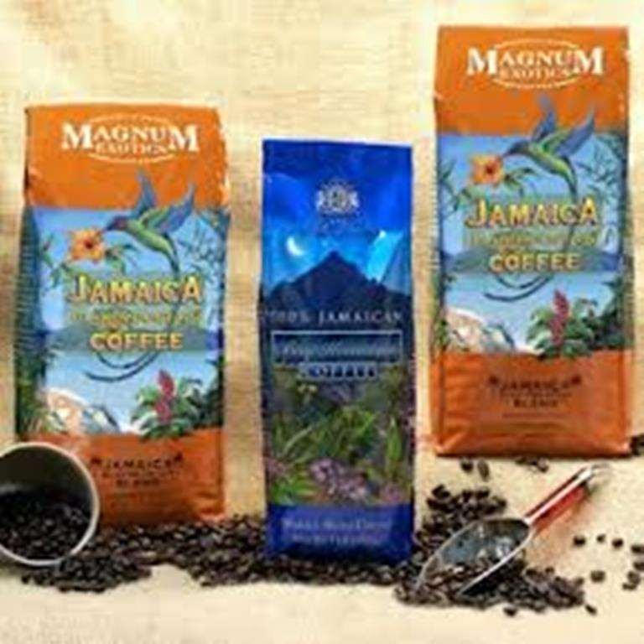
JAMAICA BLUE MOUNTAIN

Slide 52






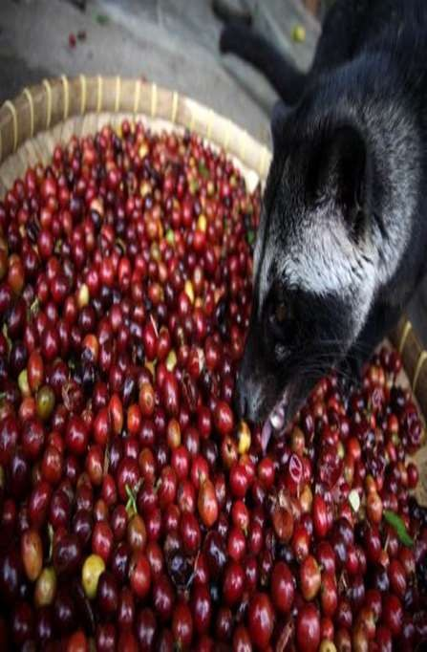
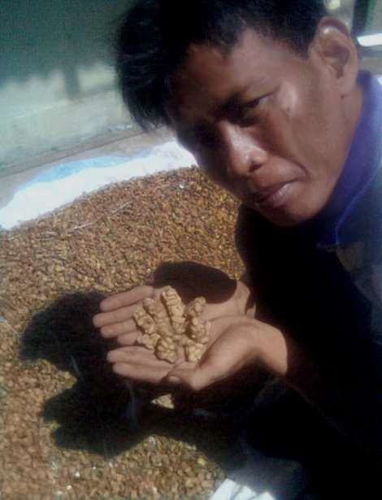
KOPI LUWAK/KAPENG ALAMID/PALM CIVET COFFEE

Slide 53
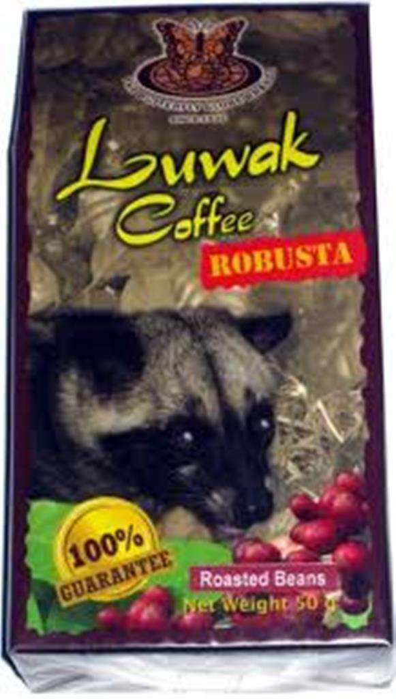


Slide 54


INSTANT COFFEES

Slide 55

DEFINITION OF TERMS:
 Acidity-refers to the sensation of dryness in the back and under the edges
of the tongue.
 Aroma- odor derived from coffee.
 Barista- Italian word for Bartender
 Body- refers to the way the coffee feels in the tongue, its viscosity or heaviness.
 Brewing- refers to the process of adding water with coffee.
 Cinnamon Roast- the lightest roast of coffee beans, the color is light brown.
 Coffee Blending-refers to the mixing of multiple varieties of coffee to come up with a balance aroma and flavor of coffee.
 Cupping- method used to evaluate the coffee’s characteristics.
 Dark Roast- French Roast or Italian Roast (Espresso Roast)
 Flavor- over-all perception of the acidity, aroma and body f the coffee.
 Gahwa- a term literally means to prevent sleep.
 Peaberry- Coffee cherry containing one bean.
 Roasting- Process of caramelizing the sugars and carbohydrates of the
coffee seeds.

Slide 56

A lot can happen over a cup of coffee.
THANK YOU ☺

