Slide 1
AFFECTIONS OF TEETH AND THEIR TREATMENT
Regional Veterinary Surgery
VSR-421(2+1)
Dr. Archana kumari
Asstt.Prof.
Deptt. of Veterinary Surgery
And Radiology

Slide 2
Affection of the Teeth and Their Treatment
The tooth is hard, white or yellowish white structures located in the alveoli of bones of the jaw. In animals, tooth is the masticatory organ .
tooth
temporary or deciduous permanent

Slide 3
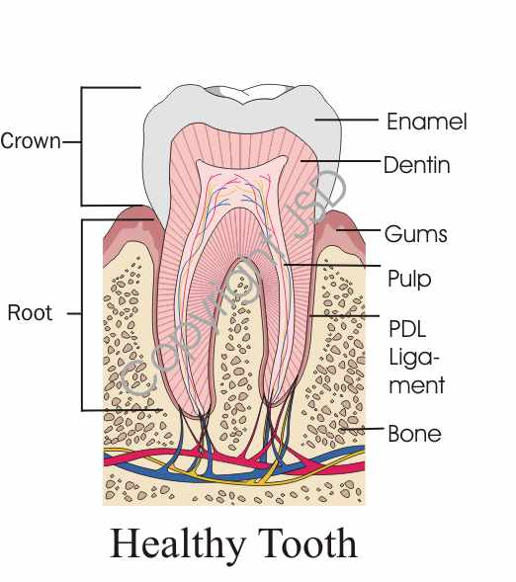
.

Slide 4
CONGENITAL AND DEVELOPMENTAL ANOMALIES
Over bite (parrot mouth or brachygnathism) Occurs when the lower jaw is shorter than the upper. There may a gap between the upper and lower incisors when the mouth is closed. This type of malocclusion is never considered normal in any breed and is a genetic fault. Generally elongated muzzles types of breed are mostly affected.
Under bite (Prognathism or Hog mouth) occurs when the lower teeth protrude in front of the upper jaw teeth. The most commonly affected breeds are those with short muzzles although, in medium muzzled breeds it is abnormal.

Slide 5
.

Slide 6
.
Even or level bite occurs when the upper and lower incisor teeth meet each other edge to edge. This condition is considered normal in some breeds, although it is actually an expression of under bite.
Anterior cross bite is one of the common malocclusions observed in veterinary dentistry which is not considered a genetic or inherited defect. This condition occurs when canine and premolar teeth on both sides of the mouth occlude normally but one or more of the lower incisors are positioned in front of the upper incisors. It can be caused by tug-of-war games, retained primary teeth, or impacted roots.

Slide 7
.
Posterior cross bite occurs when one or more of the premolar lower jaw teeth overlap the upper jaw teeth. This is a rare condition that occurs in the longer-nosed dog breeds. Heavy amounts of calculus will accumulate on the buccal surfaces of the lower premolar and molar teeth. Regular tooth brushing is necessary.
Wry mouth or wry bite occurs when one side of the jaw grows more than the other. Wry bites show as triangular defects in the incisor area where some of the incisors will meet their opposing counterparts, while others will not. Minor abnormalities may be seen in the midline of the rugae of the hard palate. Wry bite is a severe inherited defect

Slide 8
.
Open bite occurs when some incisors are displaced vertically and do not touch. Often, the tongue will protrude.
Rotated teeth are seen mostly in short muzzled breeds and commonly affect the upper third premolar. The rotated tooth root closed to the palate is prone to periodontal disease which need regular tooth brushing to save a rotated tooth but frequently, the tooth cannot be saved.

Slide 9
.
Supernumerary teeth (Polyodontia) Create alignment probles and the development of hooks. The extra teeth are usually premolars or incisors although a supernumerary canine tooth may be seen. Extra teeth or double row of incissor/molar can cause periodontal disease from over crowding. It has been reported that 9% of dogs have supernumerary teeth.
Missing teeth (Hypodontia) usually occurs in the premolar area, but any tooth in the mouth may not erupt and are considered genetic faults. There may be feed packing in the empty socket if it is still open which subsequently get infected. Sometimes the missing tooth is trapped below the gum line. A dental x-ray can be taken to determine the presence of unerupted tooth.

Slide 10
.
Dental interlock occurs when deciduous teeth erupt during an accelerated growth phase of one jaw that places the upper deciduous canine teeth rostral to the lower deciduous canine teeth, preventing forward growth. It has been seen that genetically normal dogs can occasionally develop abnormal bites due to the interlock of primary teeth.

Slide 11
Some other affections
Shear mouth
in this condition outer border of the upper table of cheek teeth and inner border of the lower once become so prominent that they overlap like the blade of shear.
Treatment of this condition is directed to periodical rasping of the sharp edges of teeth.

Slide 12
.
Shear mouth

Slide 13
Sharp mouth
In sharp teeth condition, the upper jaw is broader than the lower jaw and there are razor sharp rows of enamel points especially on the outside of the upper molar rows and the inside of the lower. The pain can cause a number of symptoms and the high point and rows can physically prevent the jaw from moving side ways to chew properly. The sharp borders of teeth cause injury to the check and tongue.
Clinical signs
Due to injury of cheek and tongue by the sharp borders, there is pain.
Due to restriction in movement of jaws, food is not properly grinded.
Inclination of head to one side and foamy saliva at the borders of mouth are seen during chewing

Slide 14
Sharp mouth

Slide 15
.
Quidding i.e. partially chewed food materials mixed with saliva may drop out from the mouth.
Development of wound on the tongue and cheek due to injury caused by sharp borders of teeth.
Finally, the animal starts to loose body weight due to improper feeding.
Treatment After opening the mouth with mouth speculum, the sharp border of the teeth should be rasped and polished

Slide 16
Waveform mouth
In this condition, the whole molar row becomes uneven, certain teeth being very short and their opposing teeth jaw are too long. It often develops secondary to other conditions such as caps, missing teeth, big hooks and old age where some of the teeth are running out of enamel. Generally, the fourth cheek teeth are affected. The result can be problems with the normal movement of the jaw and thereby chewing the food properly.
Treatment
Remove the sharp points and edges of the long tooth and extraction of the affected tooth.
A soft diet may be given to overcome the difficulty in chewing.

Slide 17
.
Step formed mouth
A step is the result of an overgrowth within a molar table, caused by lack of occlusion. In this condition, the irregularity seen is much more as compared to "wave-formed mouth."
Smooth mouth
Smooth mouth is caused by an excessive wear of teeth leading to smooth surfaces instead of having the normal grinding surface. This condition is mostly observed in cattle with increased difficulty to masticate grasses or grains properly, to chew their cud well or to glean proper nutrition from their feed. Due to interference of feeding, the animal gradually loses his body condition.

Slide 18
Dental tartar
Dental tarter is greyish brown or greyish yellow deposited in teeth.
Tartar is mixture of food, cellular debris, mineral salts and bacteria which is deposited on and around the teeth.
Prolonged accumulation of the tartar ultimately causes gum recession, tooth root exposure, gingivitis, tooth loosening and eventual loss of teeth. The condition is commonly seen in dog and cat and uncommon to other animals. Offensive odour (halitosis) may come out from the mouth.

Slide 19
Dental tarter

Slide 20
Recommendations for treatment
In early stages, tartar should be removed by putting fingers in mouth and rubbing the gums a couple of times per day.
The next step is to use a dog tooth brush and gently run it inside the cheek pouch next to the molars and around the sharp 'spiky' canine teeth.
Companion animal tooth paste with enzymatic base may be used along with a suitable sized brush.
Other options include use of a logic oral gel with a brush inside the cheek daily after the main meal. It helps to kill bacteria, reduce plque and tartar in the mouth and reduce bad breath.
Dental treats and toys are very useful aid in controlling dental tartar.
Dental scalers may be used to remove tartar from the affected tooth.

Slide 21
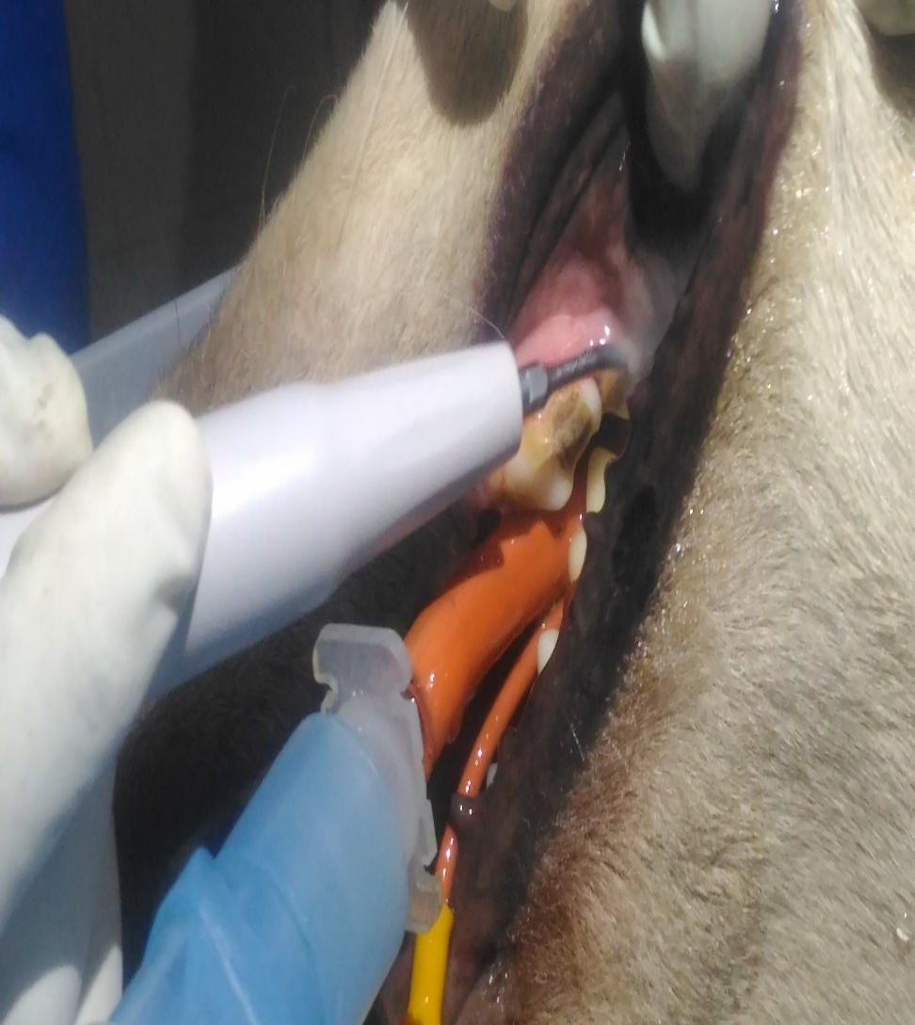
Dental scaling by ultrasonic scaler in TVCC Patna

Slide 22
Dental caries
Initially recognised as a dark spot on the teeth.
occasionally occur, most often as scooped put lesions on the occlusal surfaces of molar teeth in dogs. This condition is uncommon in cattle and occasional in buffalo and camels. The explorer tip will catch or stick in the soft tissue of a decayed tooth.
Sub gingival carries may also be present at or underneath the gingival margin in dogs.
Likewise, resorption of tooth roots can occur within periodontal pockets. A slab fracture into an open pulp chamber of an upper fourth premolar could be mistaken for caries; a portion of the crown of the tooth will be missing.

Slide 23
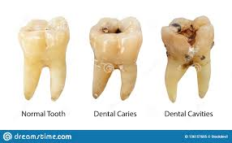
.
Clinical signs
Salivation, difficulty in mastication and simple indigestion.
Offensive smell from mouth.
In late stage, feeling of pain.
Treatment
Extraction of the affected tooth under local anesthesia may be the treatment of choice.
Post extraction oral cleaning with light potassium permanganate (1:1000) is recommended

Slide 24
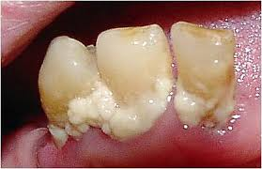
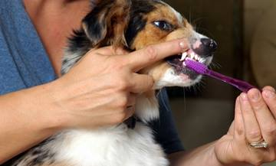
Dental plaque
Dental plaque is a biofilm or mass of bacteria that grows on surfaces within the mouth. Oral hygiene is important as dental biofilms may become acidic causing demineralization of the teeth (also known as dental caries) or harden into dental calculus (also known as tartar).

Slide 25
DENTAL TUMOUR (odontoma)
Odontomas are tumours that evolve from the tooth bud and fortunately are benign in nature.
It is generally observed in pet's and occasionally observed in cattle, buffalo and sheep. The tumour may affect either the mandible or maxilla but mostly occurrence is observed in lower jaw. In advanced stages, loose incisors are often embedded in the tumours lesions.
The radiographic picture shows a sharply defined mass of calcified material surrounded by a narrow radiolucent band or a variable number of tooth-like structures. If the tumour is properly excised by a specialist, will not reoccure and the prognosis is excellent. However, if left in mouth, they can grow and become locally damaging.

Slide 26
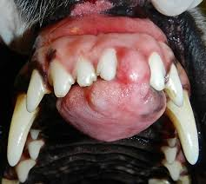
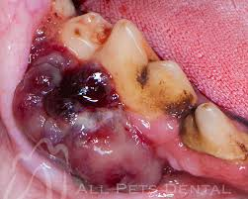
Treatment
Surgical enucleation of the tumours growth as well as fibrovascular stroma from which they are growing by curetting or chiseling out under general anaesthesia.
Extensive bleeding that may occur during extraction can be checked by cauterization.
Post-operatively, washing the mouth cavity with light potassium permanganate solution and analgesic for few days is recommended.
Soft liquid diet should be offered for one to two weeks.

Slide 27
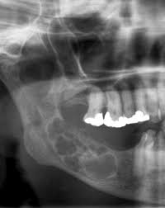
Ameloblastoma
Ameloblastoma is one of the most common odontogenic tumours, occasionally incorrectly referred to as Adamantinoma.
This tumour usually occurs in canine and sporadically in cattle, sheep and cystic changes. The canine acanthomatous ameloblastoma is a benign odontogenic tumour with similar histologic characteristics like that of centrally located ameloblastoma but appearing in the gingiva and mucosa of the tooth bearing area of the jaws. In most cases, infiltration in the underlying bone is evident.
The radiographic picture shows alveolar bone resorption and tooth displacement.
Clinical signs
There is difficulty in mastication
and deglutition due to pain.
In advanced stages, incisor teeth are
displaced and firmly embedded.

Slide 28
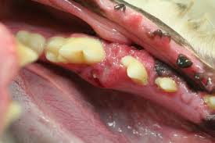
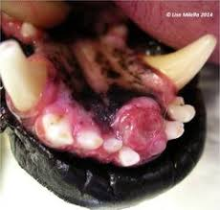
Treatment
Treatment of this condition is same like that of odontoma. Local recurrence is common after marginal excision, and wide or radical excision is therefore recommended

Slide 29
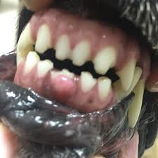
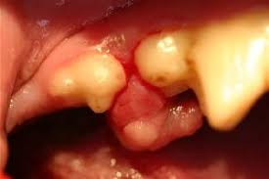
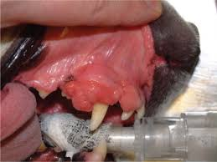
Epulis
This tumour generally develops at the dental border or in interdental spaces. The term 'epulis' is subjected to much confusion. It is probably best referred to now as a basal cell carcinoma, which describes its biological behavior much better (locally invasive, like carcinomas). Epulis is also often used wrongly to describe the gingival hyperplasia seen in breeds such as the boxer.
Epulis

Slide 30
PERIODONTAL DISEASE
Periodontal disease is a very slow, insidious disease that affects all of the supporting structures of the teeth: the free gingival margin, attached gingiva, periodontal ligaments, and alveolus or bony socket.
Periodontal disease starts with the formation of plaque, a transparent adhesive fluid composed of much in, sloughed epithelial cells and aerobic, and gram positive cocci. Plaque forming starts 12 hours after dental cleaning and can mineralize into calculus in as little as 48 to 72 hours if not removed.
The calculus mechanically irritates the gingiva, changes the pH of the mouth allowing pathogenic aerobic gram negative bacteria to survive subgingivally. The by-products of bacterial metabolism "eat away" at the tooth's support structures eventually causing the tooth to be lost.

Slide 31
There are two active phases of periodontal disease
Gingivitis Periodontitis

Slide 32
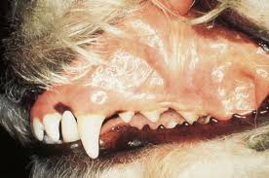
Gingivitis
Gingivitis refers to the inflammation of gums caused by bacterial infection. The bacterial population generally consists of non-motile, gram-positive, aerobic cocci. The condition is reversible to tissue surrounding the teeth.
Clinical signs
Swollen and inflamed gums.
Bad breath (halitosis) and bleeding red gums.
Plaque on the teeth perhaps with some calculus.
The animal may drop food and rub its mouth as well.
Treatment
Removing the plaque and calculus that have accumulated on the tooth.
Gingival pockets if develop may resolve after treatment of gingivitis.
Gingivectomy is considered if fibrosis is present and the pocket does not resolve.

Slide 33
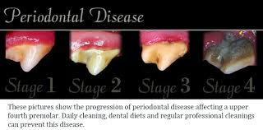
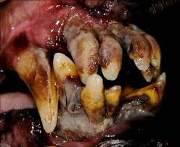
Periodontitis
Periodontitis develops if gingivitis is not treated properly and in time.
The time span for development or periodontitis from gingivitis is variable and usually may take as few as 2 weeks.
The organism responsible for gingivitis may form into motile, gram negative, anaerobic rods that cause periodontitis.

Slide 34
The condition is generally irreversible and can start in 4-6 years of age.
The anaerobic bacteria penetrate the gingival sulcus and marginal tissue and endotoxins ultimately migrate toward the root tip of the tooth. As the disease progresses, periodontal ligaments that hold the tooth to the jaw bone and the bone itself becomes damaged.
Cont.

Slide 35
Clinical signs
The animals are more reluctant to chew on hard food.
There is formation of abscess in the gum and jaw bone.
There may be bleeding and pain sensation.
There may be sneezing episodes and nasal bleeding.
In advanced stages, permanent oro-nasal fistula may develop if upper fang teeth are affected.
The animals start to loose weight and avoid having its face or head toughed.
Treatment
Treatment is preceded by dental radiographs not only to determine the degree of bone destruction and disease but also in establishing an appropriate treatment protocol to save the animal's teeth.
The following plans may be adopted for successful treatment.
Subgingival calculus is to be removed with powered scalers or a hand curette.

Slide 36
.
The root surface should be smoothed by root planning until it is glassy smooth and hard.
In case of periodontal pocket of more than 4 to 5 mm deep, a periodontal flap procedure should be performed for adequate visualization of tooth row. Subsequently, the cavity should be thoroughly cleaned and a long-acting sustained release antibiotic (doxycycline) polymer may be placed.
Finally, flap surgery is the most appropriate procedure to expose the pathology and render care in periodontal disease especially in small animal dentistry

Slide 37
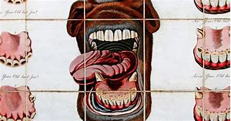
Bishoping
One of the first objectives in a pre-purchase examination is determining the age of the horse. If the horse is supposed to be seven and the teeth say the horse is eleven, often buyers quit right there.
Bishoping is tampering with cups to make the horse appear younger than it is. The artificial marks are made by staining with silver nitrate. The normal infundibulam marks disappear from centrals by six years, laterals by seven years and corners by eight years. The artificial marks are made deeper on lateral in comparison to centrals but less deep than corners.
Bishoping can be easily detected by observing the shape of table surface of the tooth. In young horse, table surface is roughly oval side ways, in aged horse, it is triangular and in very old animals, it is oval antero-posteriorly or circular in shape.

Slide 38
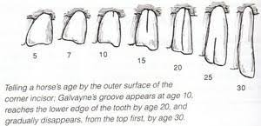

Slide 40
Clinical signs
include inapetance, weight loss, drooling, gagging/retching, bleeding from the mouth, oral pain, halitosis etc. Clinical examination may reveal an obvious mass on the gums.
Treatment
The growth is best treated by through surgical excision under general anaesthesia. The diffuse bleeding can be controlled by packing or cauterization with surgical diathermy.

Slide 41
Dental fistula
Produced by the communication of the root of tooth with out side.
It may be caused by fracture of mandible.
It may affecting the fourth upper cheek tooth in the dog usually result from alveolar periostitis. This root of this tooth is located in the antrum hence condition is properly called pus in the antrum.

Slide 42
Treatment
Removal of the teeth and necrosed tissue of bone.

Slide 43
THANK YOU

