Slide 1
Histology of glandular stomach
Laminae epithelialis is lined with simple columnar epithelium
The surface epithelium consist of gastric pits which later on differentiates into gastric glands
The gastric pits are dipper in pyloric region than in cardiac and fundic region
The laminae propria consist of tubular gastric glands
The laminae propria in carnivores consist of a subglandular layer which is made up of stratum granulosum
Laminae muscularis mucosa is made up of smooth muscles

Slide 2
The glandular part of the stomach is divided into three areas mainly cardiac,fundic and pyloric
The cardiac area presents cardiac glands distributed in laminae propria which are simple branched coiled tubular gland of mucous secreting nature
The fundic area consist of true gastric glands whose glandular epitheliuum is made up of four varieties of cells mainly mucous neck cell,chief cells,parietal cells and endocrine cells
Mucous neck cells,chief cells and parietal cells function like exocrine glands
Mucous neck cells are distributed at the neck and upper part of body of fundic gastric glands and in pig they are also distributed at the base of the gland

Slide 3
Chief cells are numerous having pyramidal or columnar shape distributed in body and base of the gland and consist of basophilic granules known as zymogen granules
The parietal cells are triangular or polyhedral cells which are placed peripheral to the chief cells
They are known as Hcl secreting cells and the nucleus is spherical and is basally placed
The endocrine cells are known as argentaphin cells or enterochromaffin cells
These cells are responsible for secretion of secretin/gastric inhibitory factors which are transported to the underlying vascular channel

Slide 4
The pyloric part of the stomach is typed as simple coiled branched tubular glands which are lined with mucous secreting cells
The tela submucosa is made up of loose connective tissue containing submucosal plexus,blood vessels,lymph vessels and lymph nodules
Tunica muscularis is made up of smooth muscle cells arranged in inner circular and outer longitudinal layer
Tunica serosa is lined with mesothelium

Slide 5
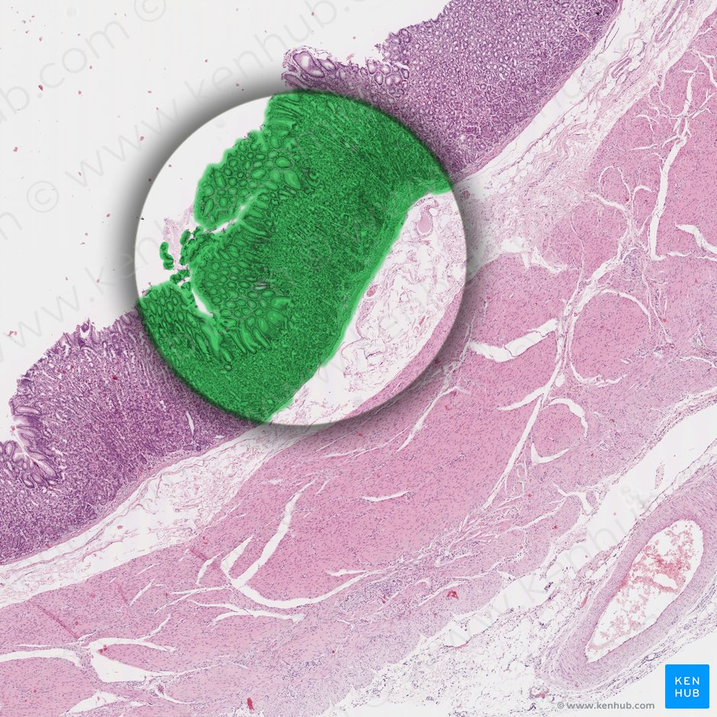
Tunica mucosa of glandular stomach

Slide 6
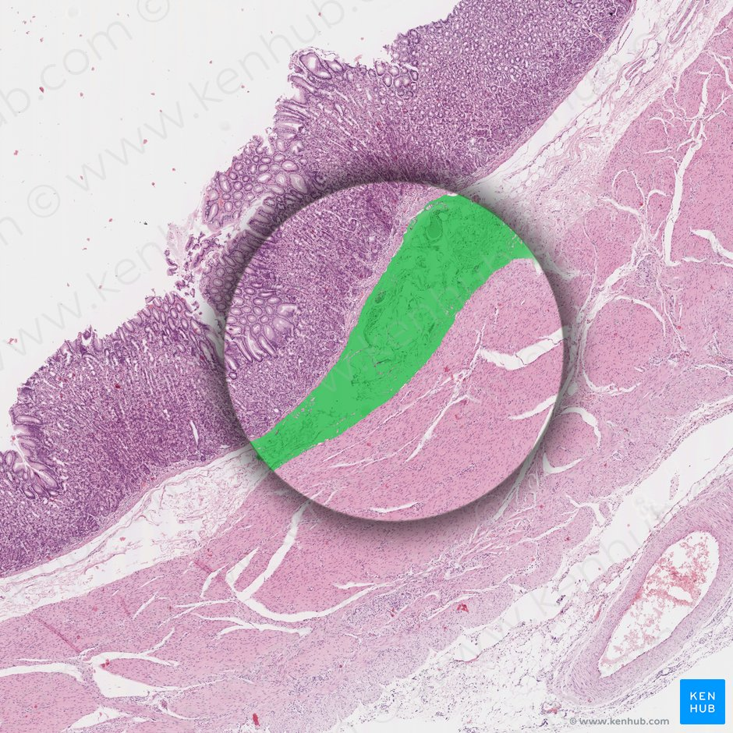
Tunica submucosa of glandular stomach

Slide 7
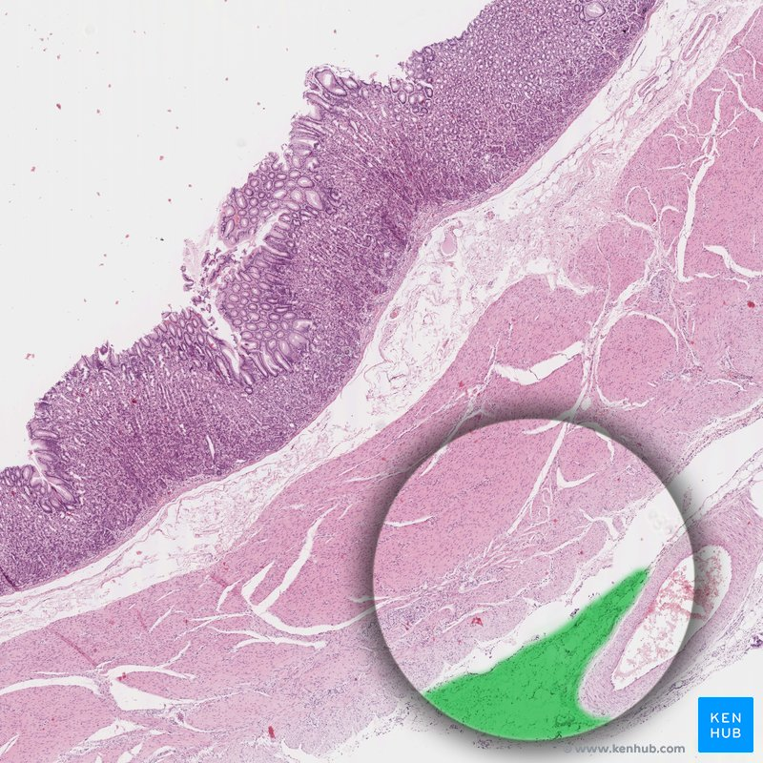
Tunica serosa of glandular stomach

Slide 8
Histology of intestine
The tunica mucosa is thrown into finger like mucosal folds called intestinal villi
In between the two intestinal villi the straight tubular intestinal glands descend in the lamina propria popularly known as glands of liberkuhn
The lminae epithelialis is lined with simple columnar epithelium whose epical border consist of numerous microvilli to produce striated border
These are responsible to increase the surface area of absorption
The surface epithelium presents random distribution of goblet cells which are not distributed at the tip of villi
The number of goblet cells increases from cranial to caudal end of small intestine

Slide 9
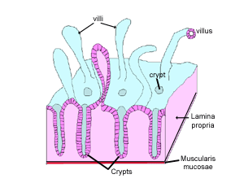
Diagram of villi

Slide 10
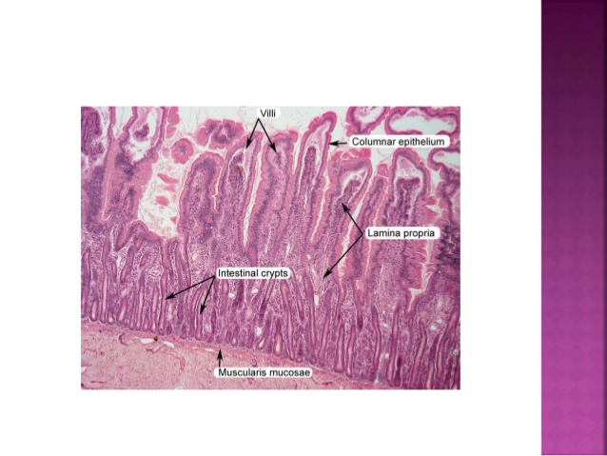
Section of small intestine

Slide 11
Laminae propria is made up of loose CT which extends upto central core of villi.It also consist of simple straight tubular glands known as mucosal glands of intestine or glands of Lieberkuhn which opens into the lumen of intestine near the base of intestinal villi
The glands are lined with undifferentiated columnar cells with few goblet cells.At the base of these glands in case of horse and ruminants there are few specialised pyramidal cells known as Paneth cell
The paneth cells are bacteriocidal and are responsible for production of peptidase and lysozyme
Laminae muscularis mucosae is made up of smooth muscle arranged in two layers

Slide 12
Section of small intestine

Slide 13
The telasubmucosa in the cranial segment of the intestine consist of simple tubulo alviolar glands of serous,mucous or seromucous in variety in different animals popularly known as brunner’s gland
These glands open at the base of intestinal villi.In horse the entire duodenum and cranial jejunum consist of Bruner’s gland and in ox it is situated in the cranial part of duodenum
Ileum presents lymph nodules in form of payer’s patches which opens into the lumen of intestine
Tunica muscularis is made up of inner circular and outer longitudinal muscles
Tunica serosa is lined with mesothelium

Slide 14
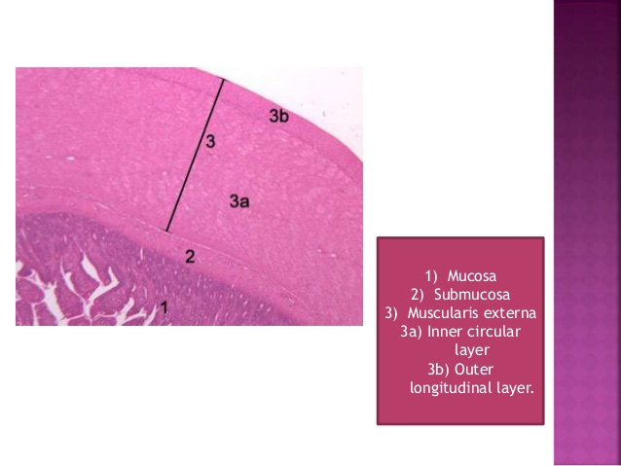
Section of small intestine

Slide 15
Large intestine
Absence of intestinal villi
Absence of Paneth cells
Absence of submucosal glands
Laminae muscularis mucosa not well developed
Large number of lymph nodules
Higher population of goblet cells
Presence of Taenia caeci and Taenia coli in horse and pig which are formed by condensation of outer longitudinal muscle layer of tunica muscularis

