Slide 1
The epithelium of dorsal surface of tongue is made up of stratified squamous epithelium which may be keratinized or non keratinized depending upon the species The epithelium of ventral side of tongue is made up of stratified squamous epithelium which is keratinized in all species The dorsal surface of the tongue consist of papillae which are grouped under gustatory and masticatory papillae
Histology of tongue

Slide 2
Filiform papillae
It is ment for mechanical function and is lined with keratinized layer of SSE having central core of connective tissue extended up to tip in most animals
In horses most of the papillae is formed by the epithelial prolongation with a small basal core of connective tissue
Lenticular papillae
They are found on torus linguae of ruminants and is made up of SSE which is keratinized. The central core of connective tissue presents secondary branching.
Conical papillae
They are similar to the conical papillae of the cheek but have less degree of keratinization

Slide 3
Fungiform papillae
They are mushroom like papillae and are distributed over the dorsal surface and lined with SSE which is non keratinized
It presents taste buds and the central core of connective tissue may show secondary branching with numerous nerve fibers
Vallate papillae
They are normally not extended over the dorsum linguae. They are surrounded by circular trench or moat. The surface epithelium consist of SSE which is non keratinized. Numerous taste buds are situated near the moat. They are classified under gustatory papillae.

Slide 4
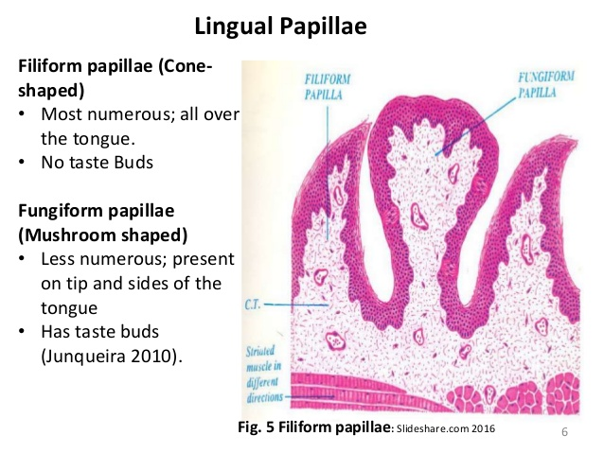
Filiform and fungiform papillae

Slide 5
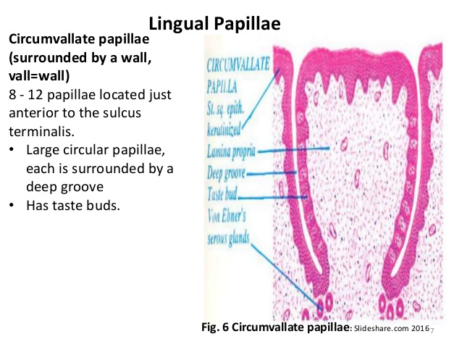
Circumvallate papillae

Slide 6
Foliate papillae
They are situated towards palatoglossal arch.They are leaf like arranged in several rows and the gap between two row is known as gustatory furrow. They are lined with SSE of non keratinized variety. The taste buds are distributed along the epithelium of the sides facing the gustatory furrow
Muscles of tongue
As per the orientation the intrinsic muscles are of three variety and classified as longitudinal, vertical and transverse which are responsible for high mobility of tongue
Taste buds
They are oval or elliptical in shape and are distributed along the epithelium of gustatory papillae. The free end consist of a taste pore. Their are three types of cells present mainly taste hair cells,sustentacular cells and basal cells.

Slide 7
Taste hair cells are elongated and faces the taste pore and consist of fine hair like cytoplasmic processes
The basal end is blunt and are associated with sensory nerve fibers which extend along the central core of papillae. They are responsible for carrying the sensation of taste
The supporting cells are responsible for protection of taste hair cells.
The basal cells are oval or polyhedral and are situated at the base of taste buds and are supposed to be progenitor of other two cell types

Slide 8
Lyssa
It is a cord like structure formed by congregation of connective tissue, skeletal muscles and fat and the term is used in case of dog
In cat similar structure is found and is predominantly filled with adipose tissue
In case of pig a cord like structure is present at the sub epithelial layer of dorsum linguae and mainly consist of hyaline cartilage
Teeth
It consist of enamel,dentine,cementum and pulp
Enamel is derived from ectoderm and the cells involved in its formation are called ameloblast cells
Dentine is formed by the cells of mesodermal origin which are known as odontoblast

Slide 9
The odontoblast are arranged along the inner margin of dentine at the junction of pulp cavity.
During mineralization some of the areas of dentine remains unmineralized throughout life and these areas constitute the interglobular spaces of owen
The cementum is formed by mesodermal cells identified as cementoblast which is very much similar to osteoblast and as such it appears like that of osseous tissue. It is covered from outside by thick layer of connective tissue known as periodontal membrane consisting mainly of collagen fibers
Pulp is the central cavity of the tooth surrounded by dentine and is formed by loosely packed mesenchymal cells along with nerve filaments and blood vessels

Slide 10
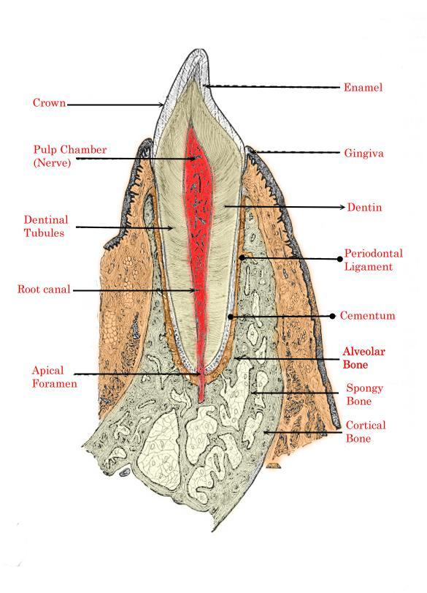
Structure of tooth

