Slide 1
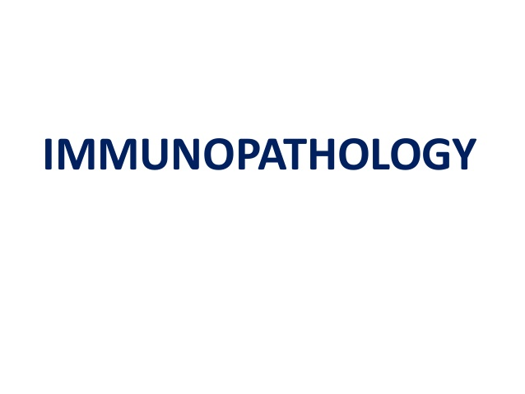
Dr. SANJIV KUMAR
DEPARTMENT OF PATHOLOGY
BVC, PATNA

Slide 3
INNATE IMMUNITY
BARRIER MECHANISM
Anatomic
Skin Mechanical barrier
Acidic environment (pH 3–5) retards growth of microbes
Mucous membrane Mucous entraps foreign microbes
Cilia propel microbes out of body
Physiologic
Temperature inhibits growth of some pathogens
Low pH kills most undigested microbes
Chemical mediators i. Interferon - antiviral defenses in uninfected cells
ii. Lysozyme - cleaves bacterial cell wall
iii. Complement - lyses microbes or facilitates phagocytosis
Phagocytic/endocytic barriers
Specialized cells (blood monocytes, neutrophils, tissue macrophages)
Inflammatory barriers

Slide 5
T cells require the action of APCs (usually dendritic cells, but also macrophages, B cells, fibroblasts and epithelial cells) to recognize a specific antigen.
The surfaces of APCs express a group of proteins known as the major histocompatibility complex (MHC). MHC are classified as either class I, which are found on all nucleated cells, or class II, which are found only on certain cells of the immune system, including macrophages, dendritic cells and B cells.
Class I MHC molecules present endogenous (intracellular) peptides, while class II molecules on APCs present exogenous (extracellular) peptides to T cells.
The MHC-antigen complex activates the TCR and this antigen presentation process stimulates T cells to differentiate primarily into either cytotoxic T cells (CD8+ cells) or T-helper (Th) cells (CD4+ cells)

Slide 7
MAJOR FUNCTIONS OF ANTIBODIES
ANTIBODY FUNCTION
IgM Primary response
Opsonizing antigen for destruction
Complement fixation
IgG secondary immune response
capable of crossing the placental barrier
Neutralization of toxins and viruses
Opsonizing (coating) antigen for destruction
Complement fixation
IgD Function unclear; appears to be involved in homeostasis
IgA protects mucosal surfaces from toxins, viruses and bacteria
IgE Associated with hypersensitivity and allergic reactions
Plays a role in immune response to parasites

Slide 9
COMPLEMENT SYSTEM
Plasma proteins - act against microbial agents
Products of activated complement
Vascular permeability
Chemotaxis
Opsonization
Lysis
Important inflammatory mediators
C3a and C5a (anaphylatoxins)
Cause release of histamine from mast cells
Lysosomal enzyme release in inflammatory cells
C5a
Activates lipoxygenase pathway
Chemotactic many inflammatory cells
Increases adhesion of leukocytes

Slide 10
COMPLEMENT SYSTEM
And Inflammation
C5b-9 membrane attack complex
Lyses cells
Stimulates arachidonic acid metabolism
Produces reactive oxygen metabolites

Slide 11
COMPLEMENT SYSTEM
Few reminders
Classical pathway
Alternate pathway
Common pathway

Slide 16
Types of hypersensitivity reactions
Type Alternate name Examples Mediators
I Allergy (immediate) Atopy IgE
Anaphylaxis
Asthma
II Cytotoxic, antibody-dependent Erythroblastosis fetalis IgG, IgM
Goodpasture syndrome
Trnasfusion reaction
III Immune complex disease SLE IgG, IgM and
Serum sickness Complements
Reactive arthritis
Arthrus reaction
IV Delayed-type hypersensitivity, Tuberculosis T cells
cell-mediated, Transplant rejection Macrophages
antibody-independent

Slide 50
Autoimmunity
Autoimmunity involves the loss of normal immune homeostasis such that the organism produces an abnormal response to its own tissue. The hallmark of autoimmunity is the presence of self-reactive T cells, auto-antibodies, and inflammation. Prominent examples of autoimmune diseases include: Celiac disease, type 1 diabetes mellitus, Addison’s disease and Graves’ disease.

Slide 51
IMMUNODEFICIENCY
Immunodeficiency refers to a state in which the immune system’s ability to fight infectious disease is compromised or entirely absent.
Immunodeficiency disorders may result from a primary genetic defect (primary immunodeficiency) or it may be acquired from a secondary cause (secondary immunodeficiency), such as viral or bacterial infections, malnutrition, autoimmunity or treatment with drugs that induce.

