Slide 1
Ketone bodies metabolism
Ajeet Kumar

Slide 2
KETONE BODIES
The entry of acetyl CoA into the citric acid cycle depends on the availability of oxaloacetate.
The concentration of oxaloacetate is lowered if carbohydrate is unavailable (starvation) or improperly utilized (diabetes).
Oxaloacetate is normally formed from pyruvate by pyruvate carboxylase (anaplerotic reaction).
Fats burn in the flame of carbohydrates.

Slide 3
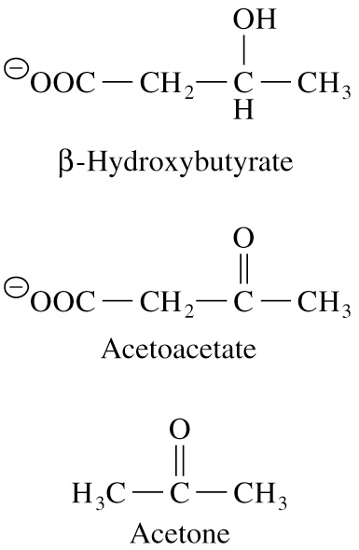
In fasting or diabetes the gluconeogenesis is activated and oxaloacetate is consumed in this pathway.
Fatty acids are oxidized producing excess of acetyl CoA which is converted to ketone bodies:
β-Hydroxybutyrate Acetoacetate Acetone
Ketone bodies are synthesized in liver mitochondria and exported to different organs.
Ketone bodies are fuel molecules (can fuel brain and other cells during starvation)

Slide 4
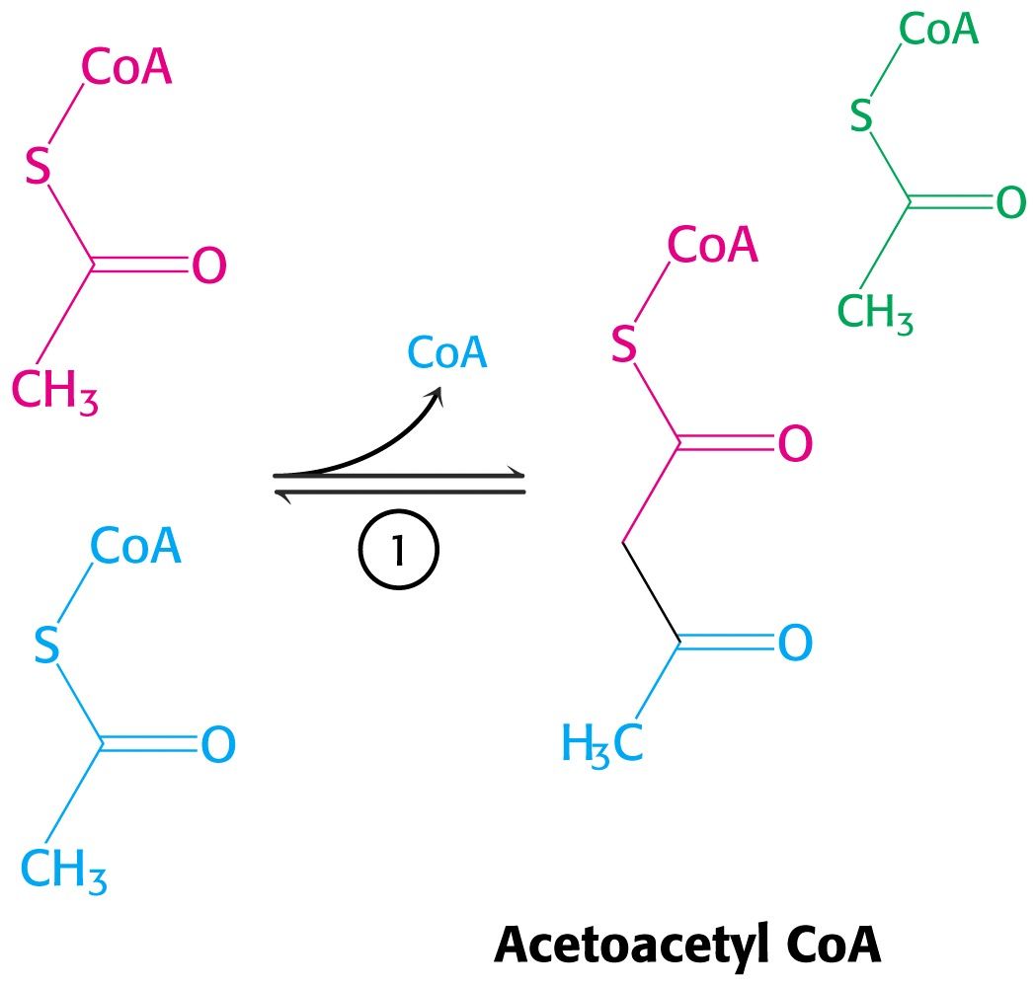
A. Synthesis of ketone bodies
Two molecules of acetyl CoA condense to form acetoacetyl CoA.
Enzyme – thiolase.

Slide 5
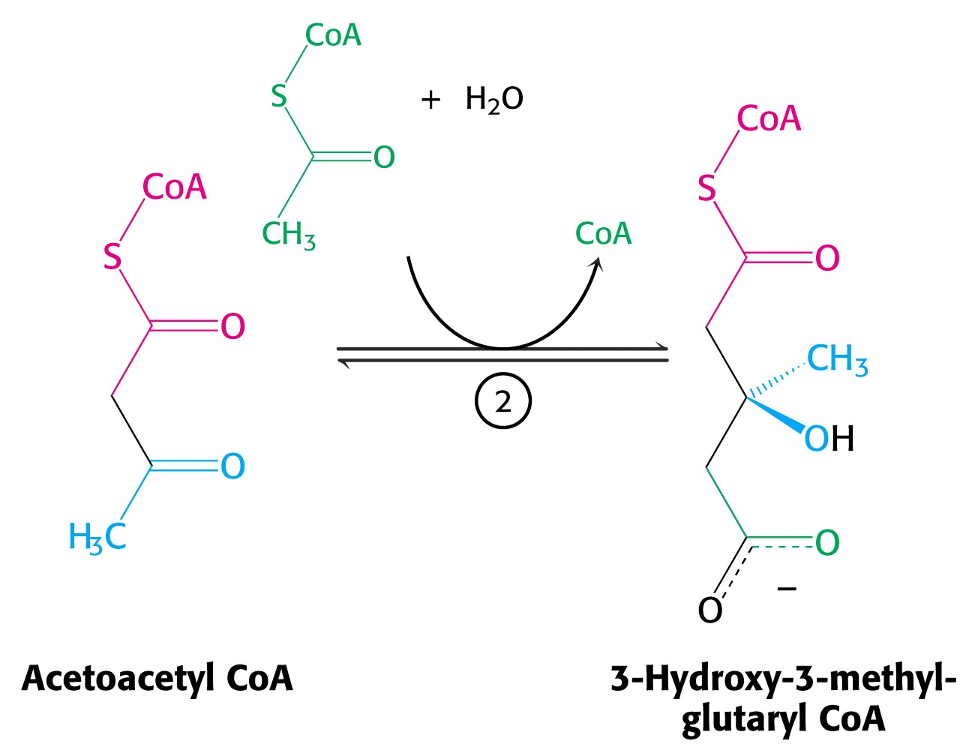
Acetoacetyl CoA reacts with acetyl CoA and water to give 3-hydroxy-3-methylglutaryl CoA (HMG-CoA) and CoA.
Enzyme: HMG-CoA synthase

Slide 6
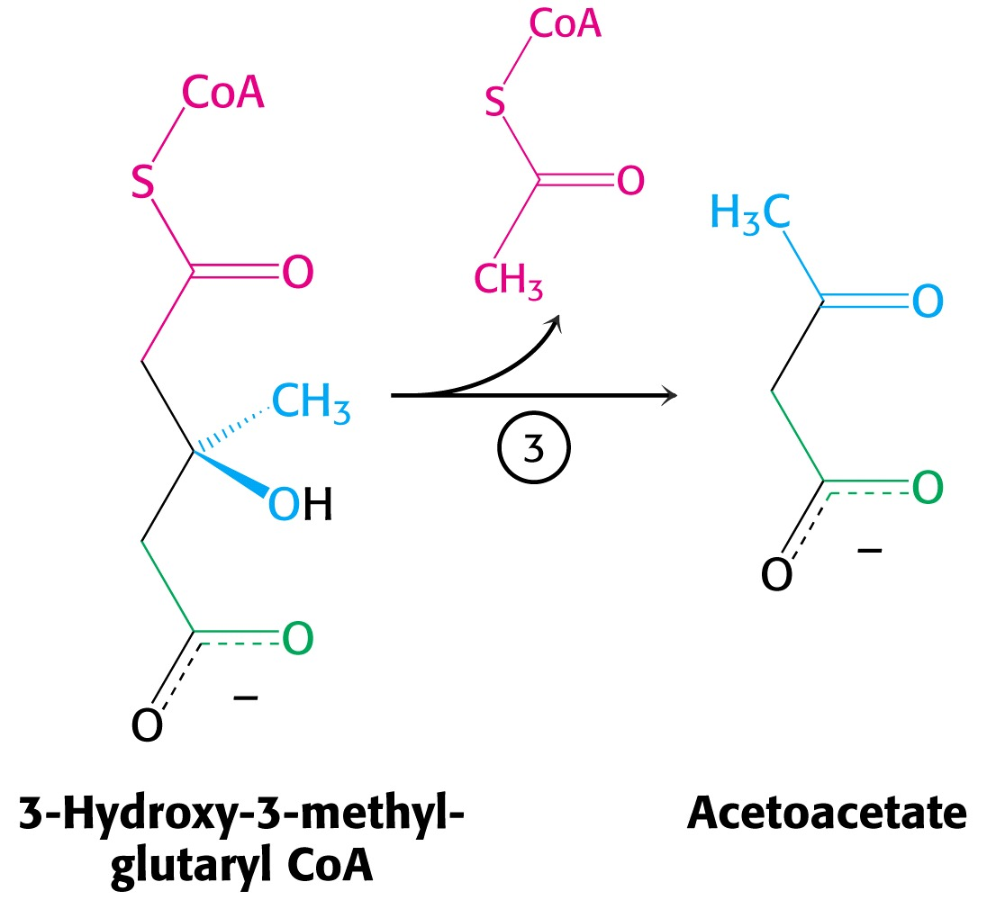
3-Hydroxy-3-methylglutaryl CoA is then cleaved to acetyl CoA and acetoacetate.
Enzyme: HMG-CoA lyase.

Slide 7
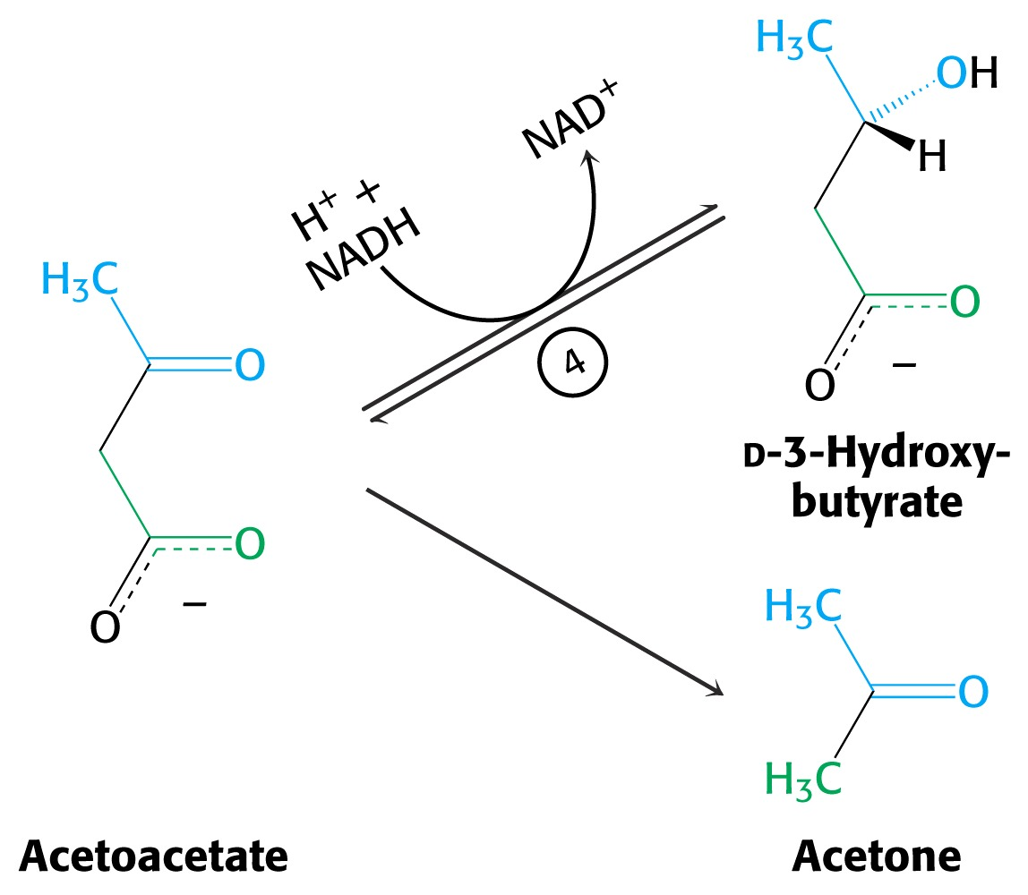
3-Hydroxybutyrate is formed by the reduction of acetoacetate by 3-hydroxybutyrate dehydrogenase.
Acetoacetate also undergoes a slow, spontaneous decarboxylation to acetone.
The odor of acetone may be detected in the breath of animal who has a high level of acetoacetate in the blood.

Slide 8
B. Ketone bodies are a major fuel in some tissues
Ketone bodies diffuse from the liver mitochondria into the blood and are transported to peripheral tissues.
Ketone bodies are important molecules in energy metabolism.
Heart muscle and the renal cortex use acetoacetate in preference to glucose in physiological conditions.
The brain adapts to the utilization of acetoacetate during starvation and diabetes.

Slide 9
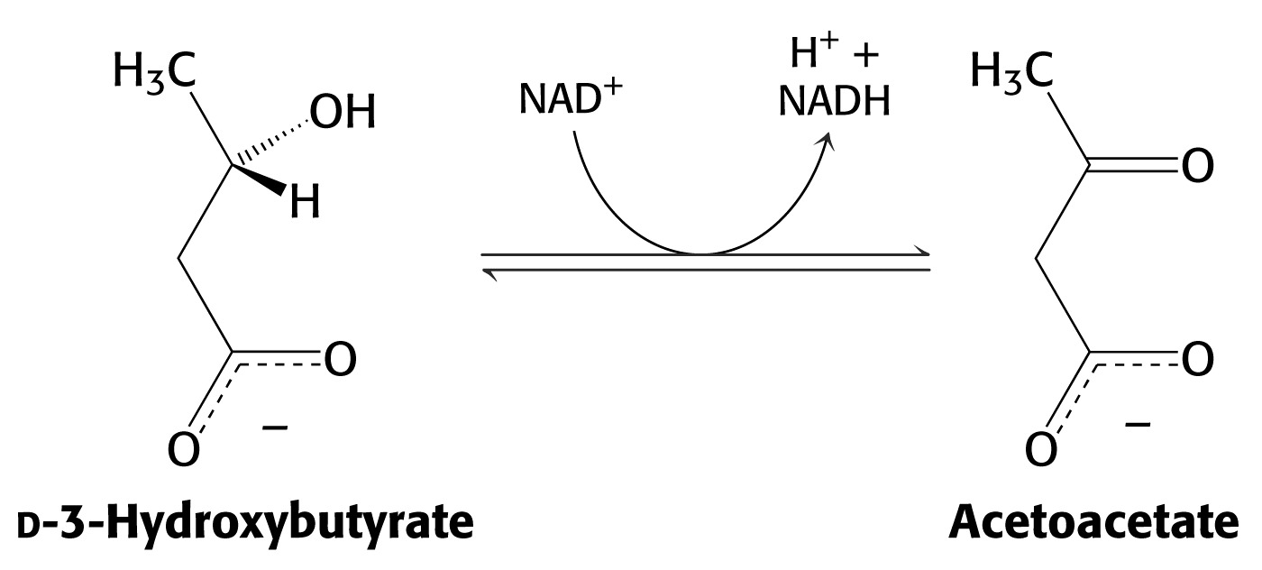
3-Hydroxybutyrate is oxidized to produce acetoacetate as well as NADH for use in oxidative phosphorylation.
3-hydroxybutyrate dehydrogenase

Slide 10
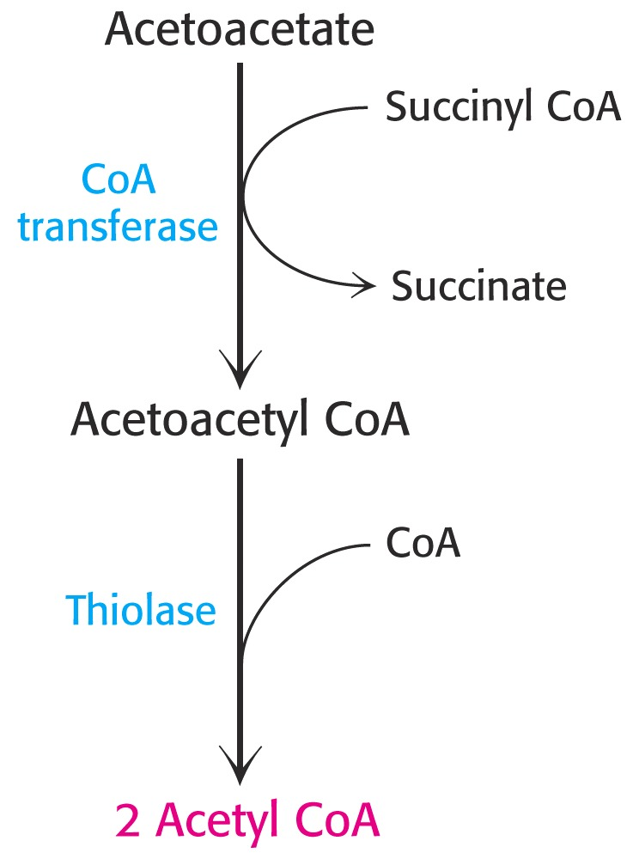
Acetoacetate is activated by the transfer of CoA from succinyl CoA in a reaction catalyzed by a specific CoA transferase.
Acetoacetyl CoA is cleaved by thiolase to yield two molecules of acetyl CoA (enter the citric acid cycle).
CoA transferase is present in all tissues except liver.
Ketone bodies are a water-soluble, transportable form of acetyl units

Slide 11
KETOSIS
The absence of insulin in diabetes mellitus
liver cannot absorb glucose
inhibition of glycolysis
activation of gluconeogenesis
activation of fatty acid mobilization by adipose tissue
deficit of oxaloacetate
large amounts of acetyl CoA which can not be utilized in Krebs cycle
large amounts of ketone bodies (moderately strong acids)
severe acidosis (ketosis)
Impairment of the tissue function, most importantly in the central nervous system

