Slide 1


‘Veterinary Epidemiology & Zoonoses’
VPH-321
(Credit Hours-2+1)

Slide 2
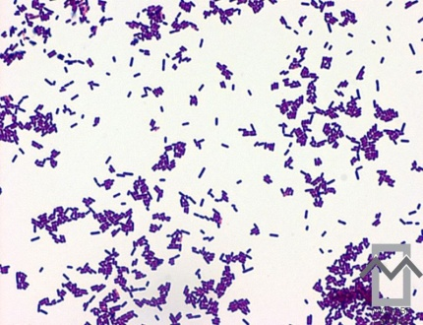
Listeriosis
Also k/as
Circling disease
Silage sickness
Caprine bacterial encephalitis (in goats),
Listerial abortion
Leucocytosis
Listerellosis

Slide 3
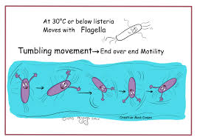
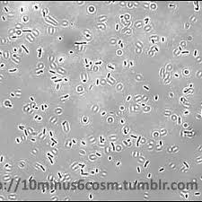
Etiology
Two pathogenic spp.: L. monocytogen & L. ivanovii
Caused by : L. monocytogenes
Small rod,
Gram-positive,
Nonsporulating,
Facultatively anaerobic rod (1-2µ x 0.5µ),
Facultative intracellular : Reticulo-endothelial cells
Grows in a range of 3-45ºC (optimum 30-37ºC)
Tumbling motility at or around 25ºC
pH B/W: 6 to 9
Serovars: 11 known to cause human listeriosis
: 1/2a, 1/2b & 4b most human / animal cases

Slide 4
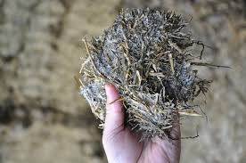
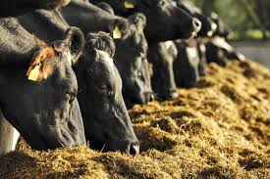
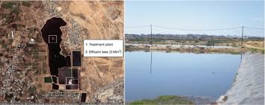
Epidemiology
Distribution of disease: Worlwide
Ubiquitous in nature
Natural habitat is the environment (Soil, vegetation)
  Human / Animal intestine
Chickens: carriers & also the prime reservoirs
The organisms isolated from:
  Surface oils
  Decaying vegetation
  Pasture herbage, Silage
  Sewage sludge,
  Factory effluents & river waters

Slide 5
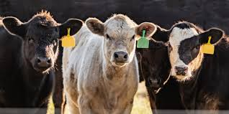
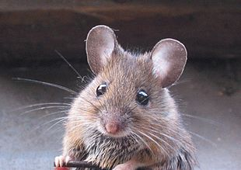
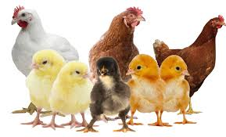
Host range and reservoir
The host range of L. monocytogenes includes:
  40 mammals, 20 birds, crustaceans, ticks & fishes,
  Domestic animals : Bovines, equines, capro-ovines, porcines, canines
  Rodents: Guinea-pigs, mice, merions, ferrets, chinchillas, gerbils etc.
  Poultry: Hens, ducks, geese, turkeys etc.
  Wild animals: Lemmings, skunks, racoons etc.
Notes:
The host range of L. monocytogenes includes 40 mammals, 20 birds, crustaceans, ticks and fishes, and the pathogen has been reported to infect almost all domestic animals (bovines, equines, capro-ovines, porcines, canines) besides many species of rodents (guinea-pigs, mice, merions, ferrets, chinchillas, gerbils etc.), poultry (hens, ducks, geese, turkeys etc.) and, wild animals (lemmings, skunks, racoons etc.).The organism is ubiquitous in nature and the natural habitat for all Listeria spp. including L. monocytogenes is the environment. The organisms has been isolated from surface oils, decaying vegetation, pasture herbage, silage, sewage sludge, factory effluents and river waters. Chickens are thought to be the carriers and also the prime reservoirs for the disease.

Slide 6
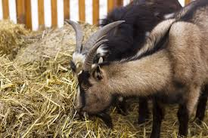
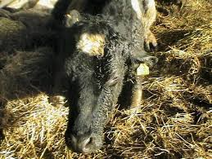
Sources and Transmission
In animals:
  Source of infection: Contaminated Silage
  Infected cows : Produce milk (1x10³ cells per litre)
  Contaminated milk: Contaminate environment & milk products
  Main route of transmission: Ingestion
    Food & water contaminated with faeces, saliva, nasal secretions, milk & aborted material from infected animals
Notes:
In animals: Silage contaminated with L. monocytogenes has been thought to be a source of infection for animals. Listeria infected cows can produce milk with populations of 1x103 cells per litre, thus, such milk can also act as source of contamination for the environment and other milk products.
The main route of transmission of pathogen is the ingestion of food and water contaminated with faeces, saliva, nasal secretions, milk and aborted material from infected animals.

Slide 7
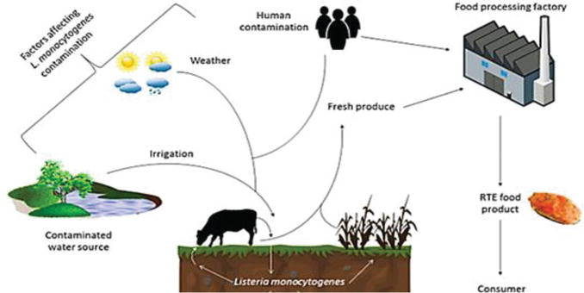
Sources and Transmission
In Human
Foodborne transmission: Prominant means
(Sources: Milk, soft cheese, ice cream, cook-chill foods, raw meats, ready-to-eat poultry, pates, unprocessed vegetables, salads, raw fish, fish products, sandwiches & fried rice)
Infected mother to foetus/ infants
Handling of newborn calves & infected material
Nosocomial and person-to-person spread
Direct contact with animals
Cross infections among infants in a hospital
Notes:
Foodborne transmission is the prominant means of infection. A wide variety of food stuffs including milk, soft cheese, ice cream, cook-chill foods, raw meats, ready-to-eat poultry, pates, unprocessed vegetables, salads, raw fish, fish products, sandwiches and fried rice have been found to be contaminated with L. monocytogenes. However, handling of newborn calves and infected material may also result in the infection. Nosocomial and person-to-person spread, though recognized, are uncommon. Direct contact with animals is also of little importance in transmission except in case of highly susceptible persons. Cross infections among infants in a hospital through mother, or nursing or medical staff through unsterilized instruments have also been reported.

Slide 8
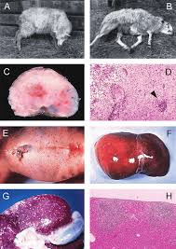
Disease in Animals
Infection ranging from asymptomatic infection
Uncommon cutaneous lesions
Susceptibility: Sheep> Goats> Cattle
Various focal infections such as
  Septic arthritis,
  Conjunctivitis,
  Urethritis,
  Endocarditis,
  Often leading to severe gait disturbance followed by death
  Abortions & perinatal deaths in cattle & sheep are common

Slide 9
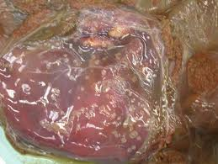
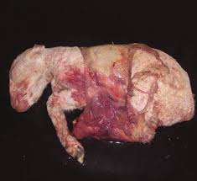
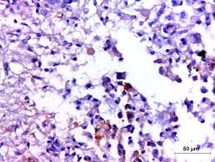
Disease in Animals
Sheep, goats and cattle
  Incubation period: Sheep & goat-2 to 3 days, Cattle-2 to 6 weeks
  Circling disease: Unilateral facial nerve paralysis/ partial pharyngeal paralysis
  Mastitis: Acute/ chronic/ symptomless
  Adult sheep, mostly pregnant: pyrexia & profuse diarrhoea
Swine
  Mostly : acute form (characterized by meningoencephalitis)
  Other symptoms: Dyspnoea, cough & abortion
Birds
  Sporadic/ epizootic, acute /chronic; no typical symptom
  Septicaemia & myocardial necrosis & occasionally CNS form is seen
Rabbits & rodents
  Distended belly, progressive emaciation & sudden death
Nervous listeriosis
Notes:
Circular movement of the diseased animals with head turned or twisted to one side, dullness, unilateral facial nerve paralysis causing dropping of the eyelid and ear, & the drooling of saliva because of partial pharyngeal paralysis

Slide 10
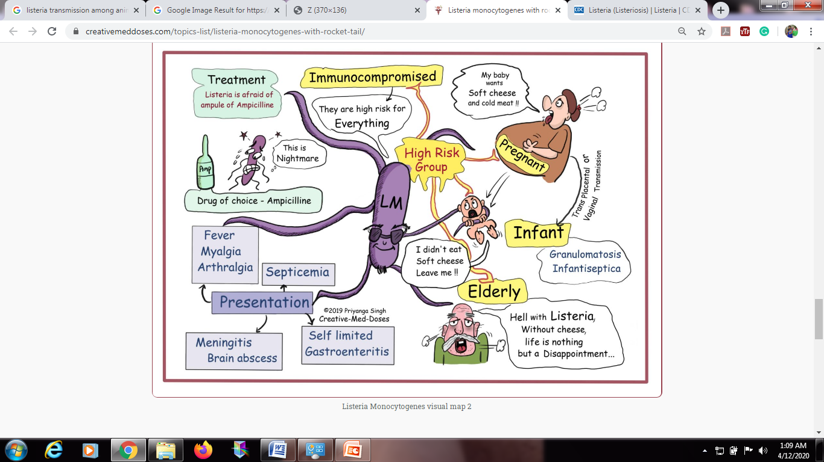
Disease in Human
Susceptible Groups are:
  Immunocompromised person
  Pregnant Women
  Elder (over 50 years of age)
  Infants
Pregnant women : Abortion: Third trimester
  (Miscarages, chills, increased body temperature, cephalgia, slight dizziness, gasterointestinal symptoms)
After delivery: No symptoms
  (excrete organism from vagina, cervix, urine from few days to several weeks)
In infants:
  (Disseminated granulomatosis (Granulomatosis infantisepticum)
  Respiratory tract disorder
In adult:
  (Meningitis or meningoencephalities)

Slide 11
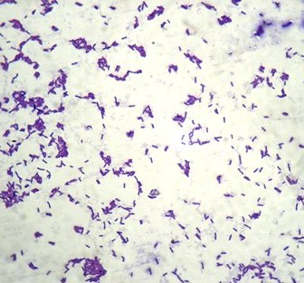
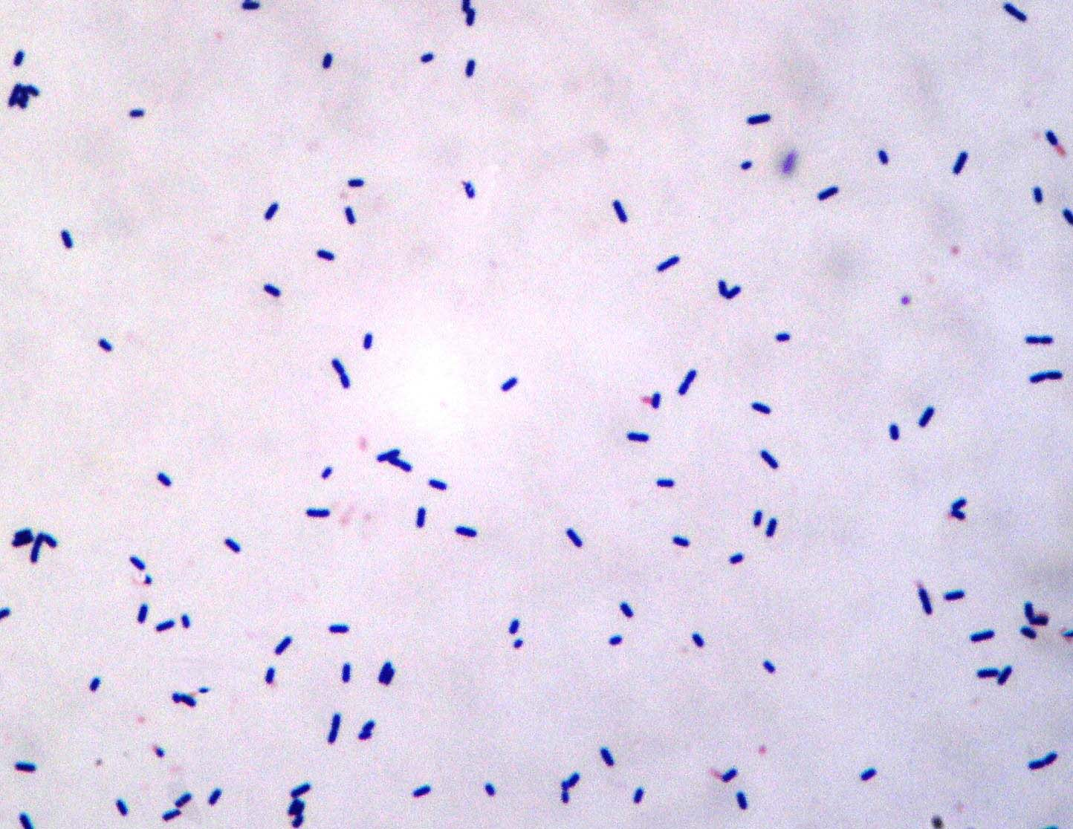
Diagnosis
Clinical symptoms
Demonstration of the organisms in smear:
  (Gram's staining, peroxide-anti-peroxide method; or by FAT)
Listeria monocytogenes
Listeria ivanovii
Notes:
(i) clinical symptoms and
(ii) demonstration of the organisms in smear by Gram's staining, peroxide-anti-peroxide method; or by FAT, but its confirmation is done by
(iii) isolation of the pathogen from clinical specimens such as blood, CSF and muconium of newborns or foetus in abortion cases, and faeces, vomitus, food stuffs/animal feed and vaginal secretions of infection individuals or animals, as the case may be.
(iv) Pathogenicity testing of Listeria isolates should be done either by in vitro methods such as assay for PI-PLC (Phosphatidylinositol-specific phospholipase C activity or by in vivo tests such as inoculation of mice (3 weeks old) through i/p route and inoculation of 10-day old chicken embryo through CAM (chorioallantoic membrane) route,
(v) detection of soluble antigen in CSF especially in meningitic cases of humans, but it is not reliable,
(vi) PCR (vii) examination of CSF for any rise in protein concentration (>0.4g l-1) and WBC count about 1.2x107 l-1 may be taken as suspected for listeriosis in encephalitic cases of animals
(viii) serodiagnostic methods such as, serum agglutination (widal test), CFT, haemagglutination test haemagglutination inhibition test, antibody precipitation test, growth inhibition test, Recently, the detection of antibodies against LLO by ELISA has been reported to be useful for diagnosis of both septicaemic and abortion forms of listeriosis.

Slide 12
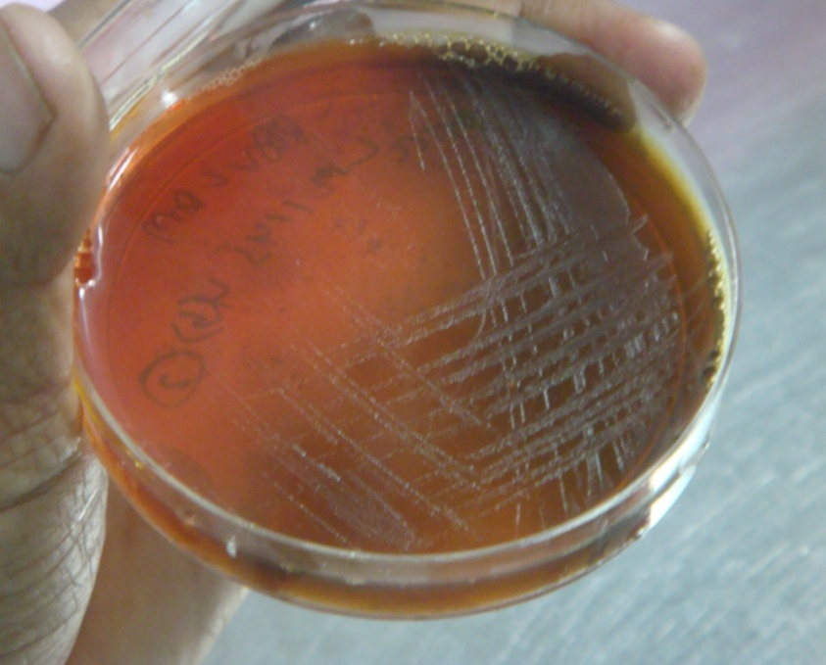
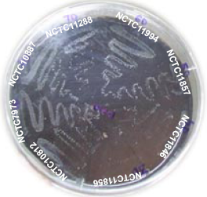
Diagnosis
Isolation of the pathogen
  (Clinical specimens: blood, CSF and muconium of newborns or foetus in abortion cases, & faeces, vomitus, food stuffs/animal feed & vaginal secretions)
PALCAM
DRIA

Slide 13
Diagnosis
Pathogenicity testing
  In vitro: PI-PLC (Phosphatidylinositol-specific phospholipase C activity)
(i) Pathogenic Listeria showing blue green colonies with halo
(MTCC1143, NCTC7973, MSV6, PHP7 and NHU9)
(ii) Non-pathogenic Listeria showing blue green colonies without
halo (PHP25 and PHV25)
(iii) Non-Listeriae showing white colonies

Slide 14
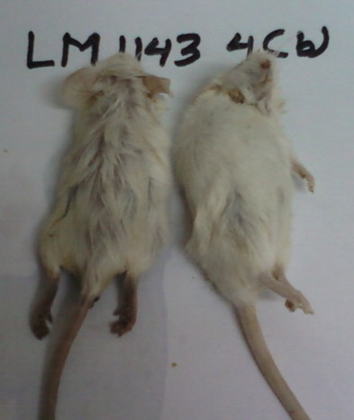
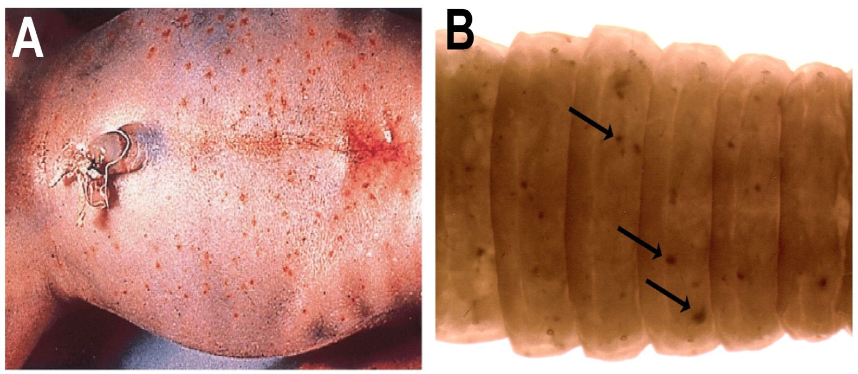
Diagnosis
Pathogenicity testing
  In vivo: Mice (3 weeks old) , i/p route
: Chicken embryo (10-day old) through CAM route
        : G. mellonella larvae inoculation
Mice lethality test
Galleria mellonella larvae melanization assay

Slide 15
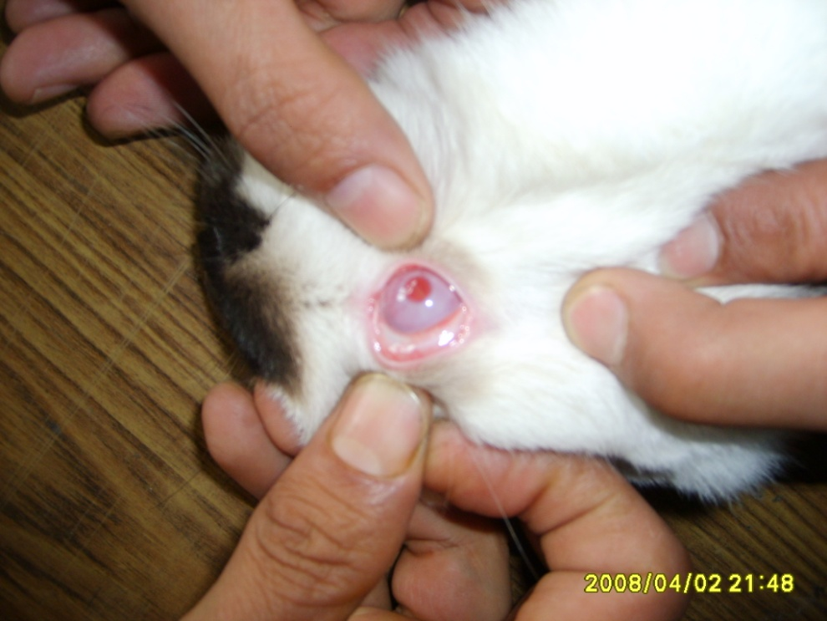
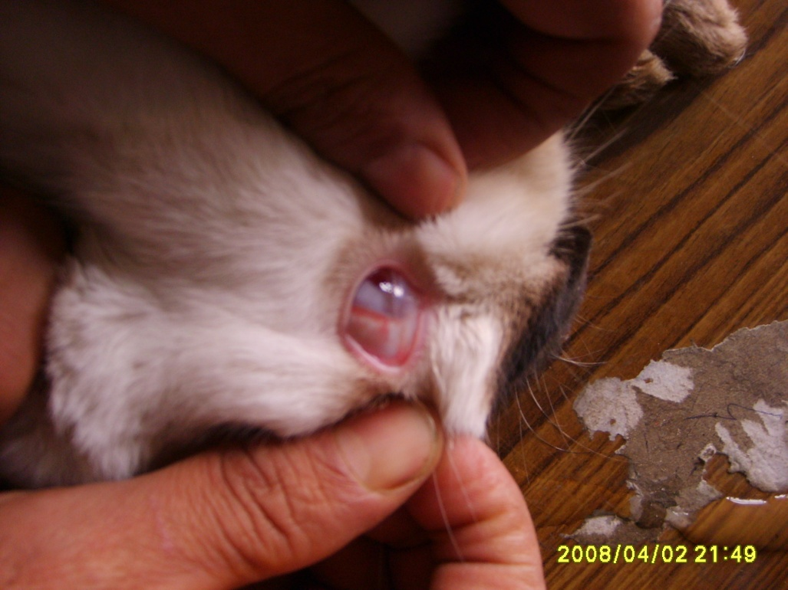
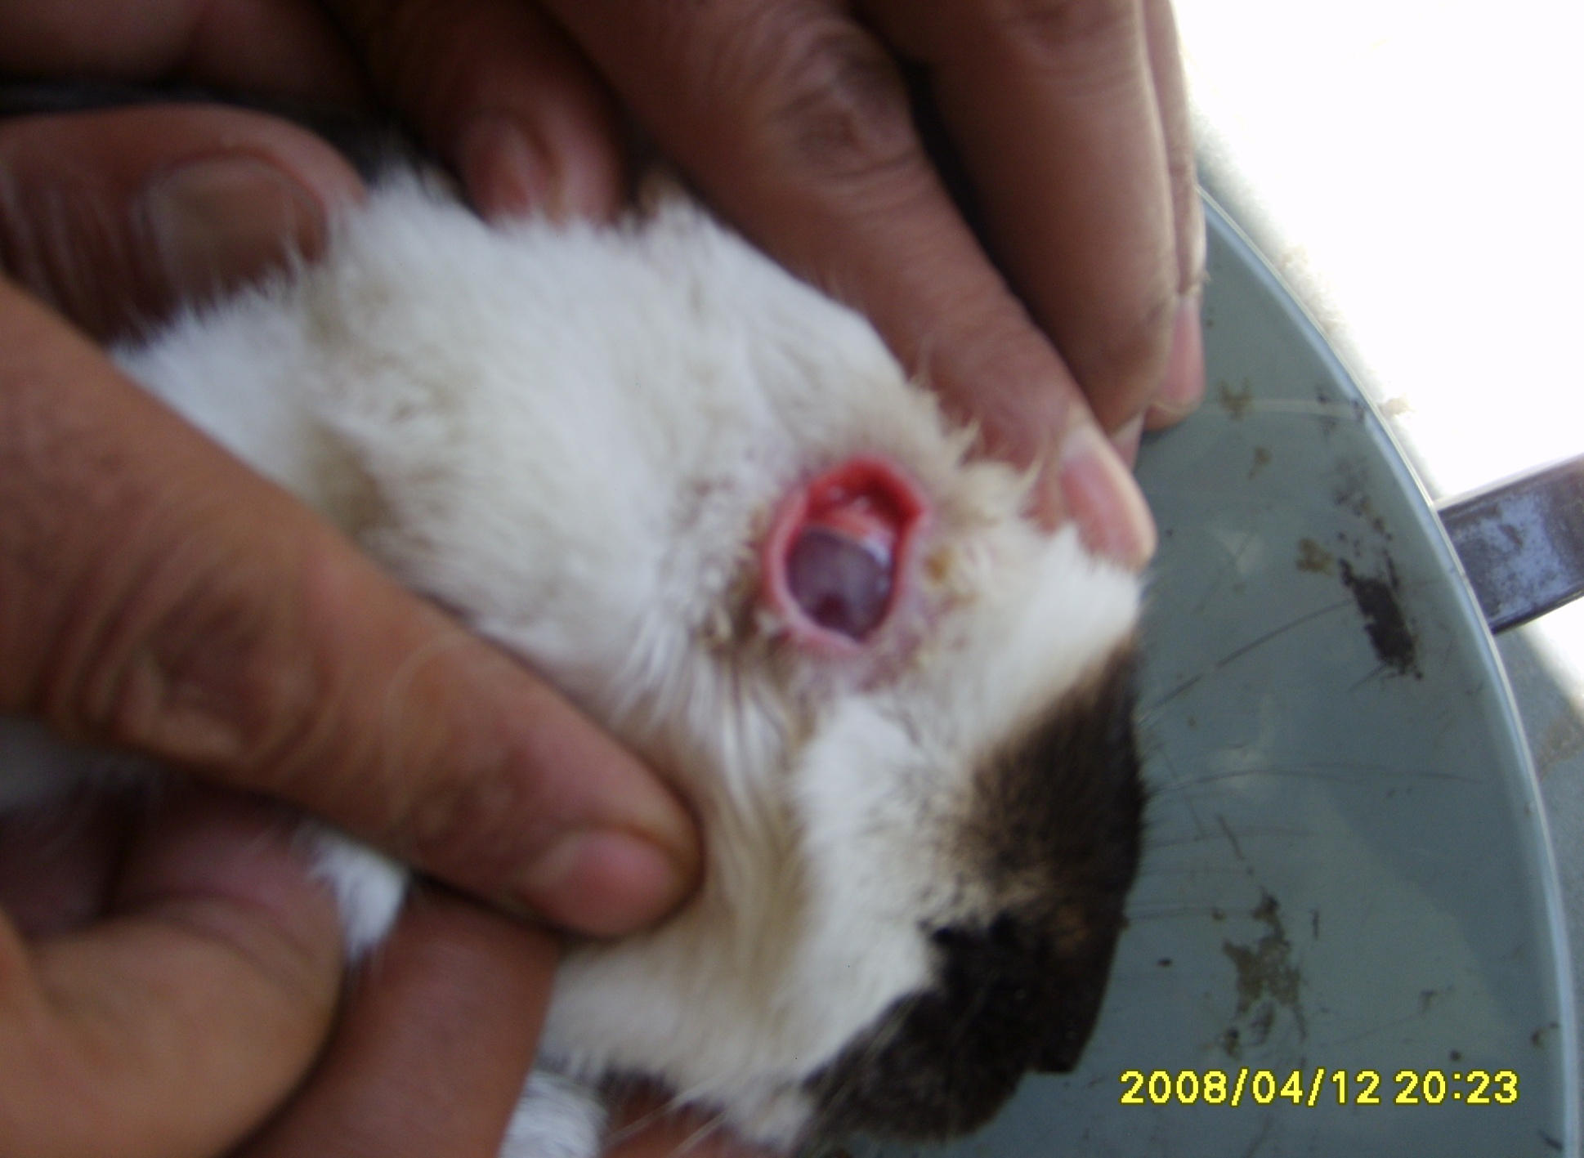
ANTON TEST
Normal eye of Rabbit
Conjunctivitis in eye of Rabbit

Slide 16
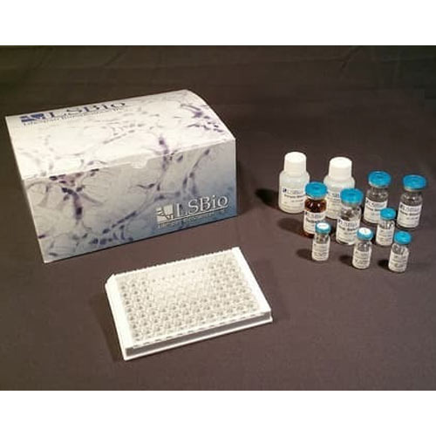
Diagnosis
Examination of CSF: Detection of soluble antigen, protein concentration (>0.4g l-1) & WBC count about 1.2x10⁷
PCR
Serodiagnostic
  Serum agglutination (widal test)
  Latex agglutination test (LAT)
  Complement Fixation Test (CFT)
  Haemagglutination test (HA)
  Haemagglutination inhibition (HI)
  Antibody precipitation test, growth inhibition test
  ELISA: detection of antibodies against LLO
Notes:
(i) clinical symptoms and
(ii) demonstration of the organisms in smear by Gram's staining, peroxide-anti-peroxide method; or by FAT, but its confirmation is done by
(iii) isolation of the pathogen from clinical specimens such as blood, CSF and muconium of newborns or foetus in abortion cases, and faeces, vomitus, food stuffs/animal feed and vaginal secretions of infection individuals or animals, as the case may be.
(iv) Pathogenicity testing of Listeria isolates should be done either by in vitro methods such as assay for PI-PLC (Phosphatidylinositol-specific phospholipase C activity or by in vivo tests such as inoculation of mice (3 weeks old) through i/p route and inoculation of 10-day old chicken embryo through CAM (chorioallantoic membrane) route,
(v) detection of soluble antigen in CSF especially in meningitic cases of humans, but it is not reliable,
(vi) PCR (vii) examination of CSF for any rise in protein concentration (>0.4g l-1) and WBC count about 1.2x107 l-1 may be taken as suspected for listeriosis in encephalitic cases of animals
(viii) serodiagnostic methods such as, serum agglutination (widal test), CFT, haemagglutination test haemagglutination inhibition test, antibody precipitation test, growth inhibition test, Recently, the detection of antibodies against LLO by ELISA has been reported to be useful for diagnosis of both septicaemic and abortion forms of listeriosis.

Slide 17
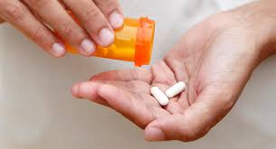
Treatment
Ampicillin: Drug of choice in cases of encephalitis
  Amoxicillin,
  Tetracyclins,
  Chloramphenicol,
  β-lactum
Immunocompromised patient:
  Ampicillin alongwith gentamicin
Keratoconjuctivitis & Iritis:
  Combined use of corticosteroid & Antibiotic

Slide 18
Prevention & Control
In animals
  Culling of infected animals
  Care in use and preparation of silage
  Avoid silage contamination with faeces
  Immunization: So far no vaccination is available, although a live, attenuated vaccine developed in Bulgaria, based upon serovars 1/2a and 4b of L. monocytogenes
In Human
  Taking care during handling the abortion cases
  Avoiding consumption of contaminated food-stuffs
  Avoiding cross-infections especially in hospitals among infants
Notes:
Care in use and preparation of silage as the pathogen grows luxuriantly at pH greater than 5, particularly when fermentation is ineffective and mould growth takes place. The silage, a few inches from the front top and sides of a clamp should not be fed to animals, especially sheep. There should be some physical barrier between silage feeds and animals so as to avoid silage contamination with faeces
Immunization: So far no vaccination is available, although a live, attenuated vaccine developed in Bulgaria, based upon serovars 1/2a and 4b of L. monocytogenes is available in some European countries and claimed to be effective in sheep but the field trial results are equivocal and no experimental model is available to test its efficacy

