Slide 1
Lipoprotein metabolism
Ajeet Kumar & Anil gattani

Slide 2
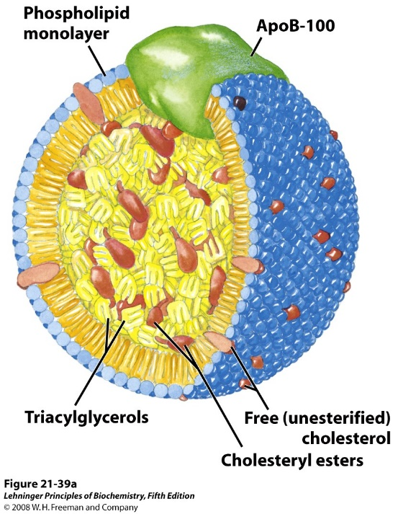
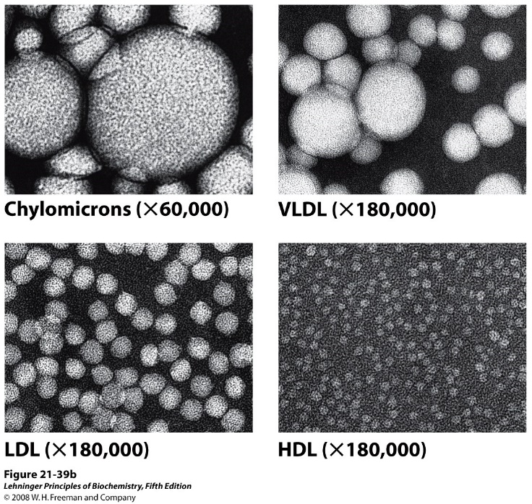
Human Plasma Lipoproteins
Notes:
TABLE 21-1 Major Classes of Human Plasma Lipoproteins: Some Properties

Slide 3
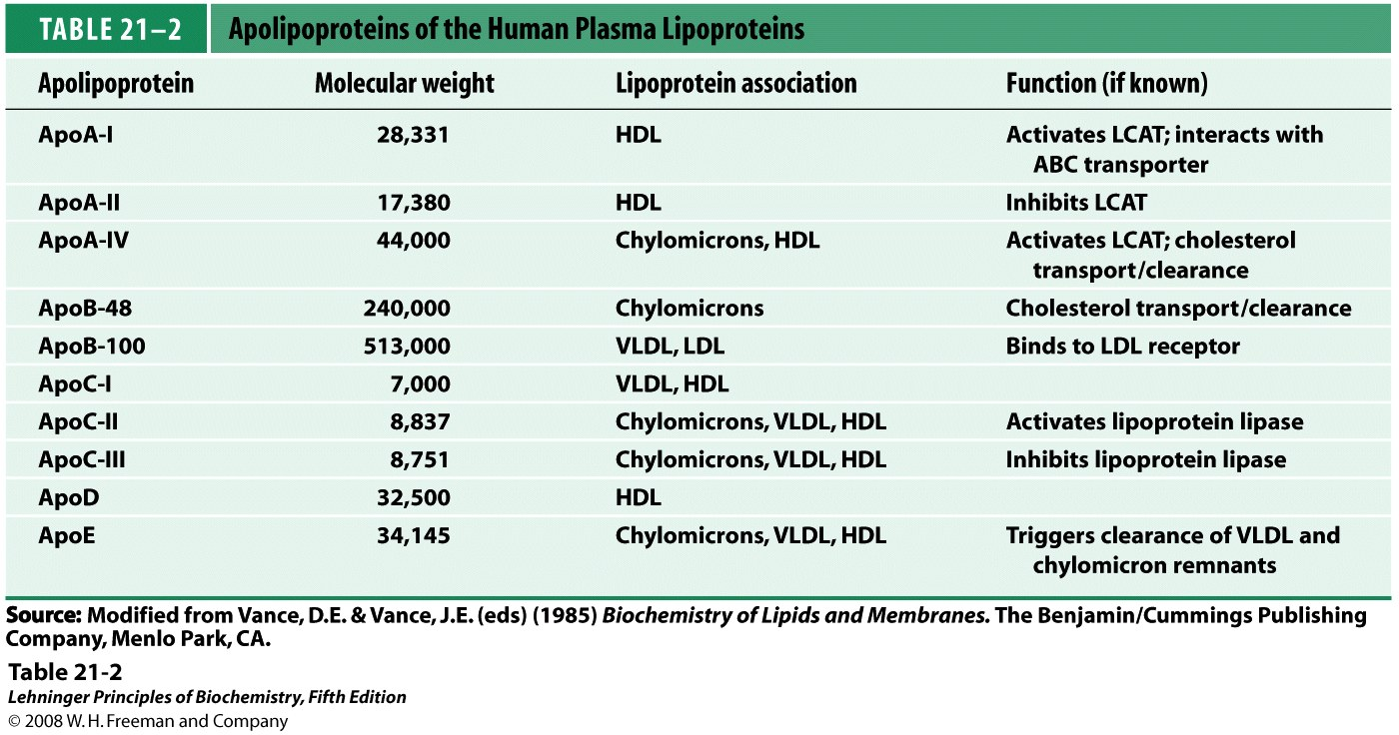
Apolipoproteins of the Human Plasma Lipoproteins
Notes:
TABLE 21-2 Apolipoproteins of the Human Plasma Lipoproteins

Slide 4
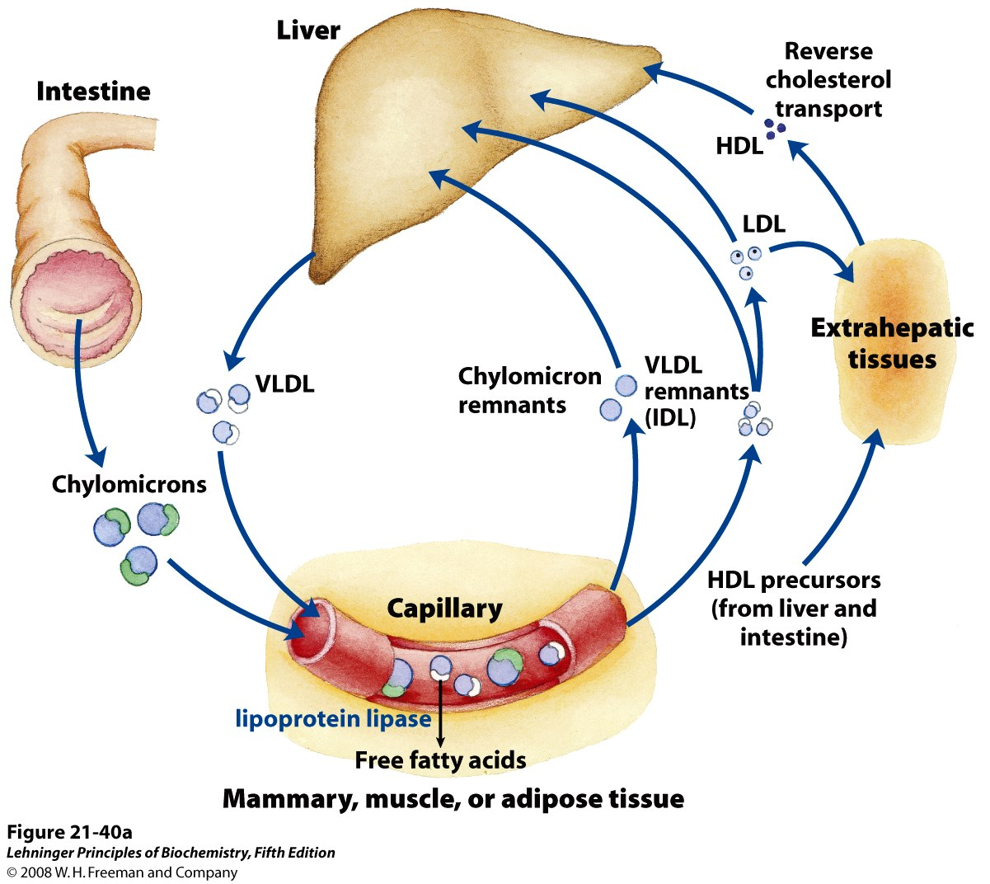
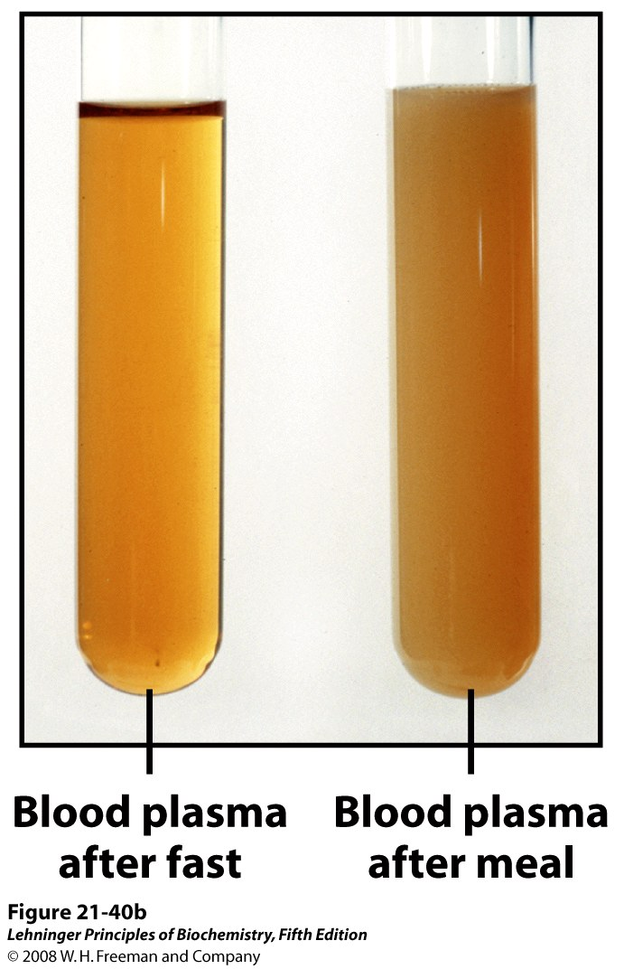
Lipoproteins and lipid transport
Notes:
FIGURE 21-40a Lipoproteins and lipid transport. (a) Lipids are transported in the bloodstream as lipoproteins, which exist as several variants that have different functions, different protein and lipid compositions (see Tables 21-1, 21-2), and thus different densities. Dietary lipids are packaged into chylomicrons; much of their triacylglycerol content is released by lipoprotein lipase to adipose and muscle tissues during transport through capillaries. Chylomicron remnants (containing largely protein and cholesterol) are taken up by the liver. Endogenous lipids and cholesterol from the liver are delivered to adipose and muscle tissue by VLDL. Extraction of lipid from VLDL (along with loss of some apolipoproteins) gradually converts some of it to LDL, which delivers cholesterol to extrahepatic tissues or returns to the liver. The liver takes up LDL, VLDL remnants (called intermediate density lipoprotein, or IDL), and chylomicron remnants by receptormediated endocytosis. Excess cholesterol in extrahepatic tissues is transported back to the liver as HDL. In the liver, some cholesterol is converted to bile salts.

Slide 5
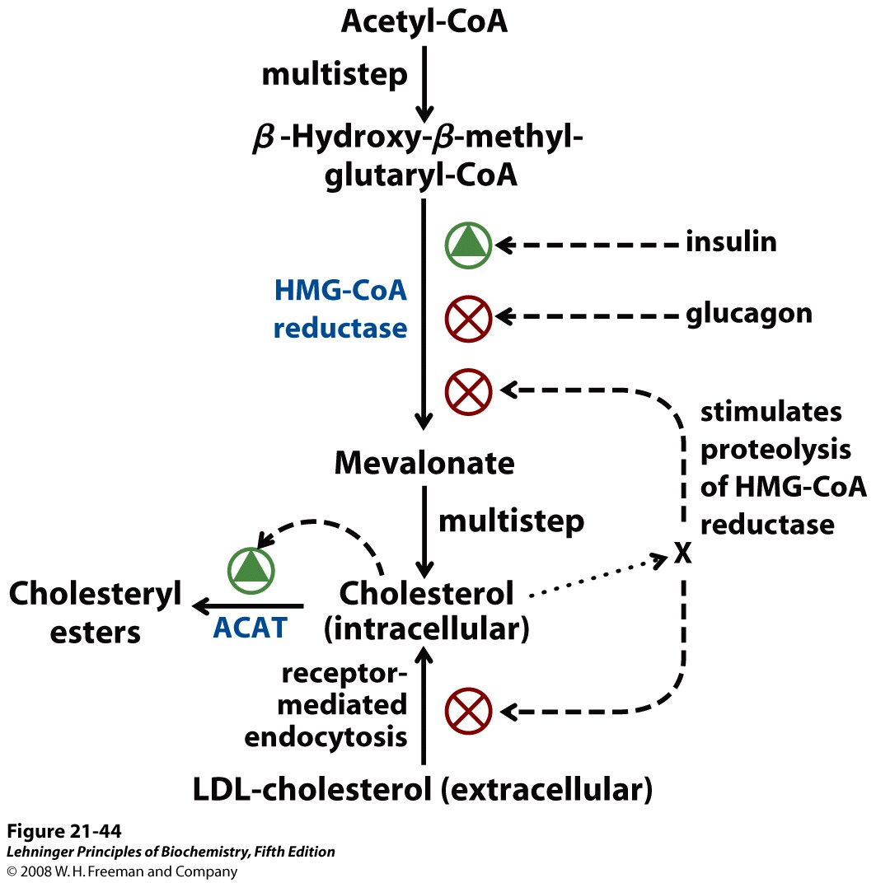
Regulation of Cholesterol Biosynthesis
Insulin “high glucose”
Glucagon “low glucose”

Slide 6
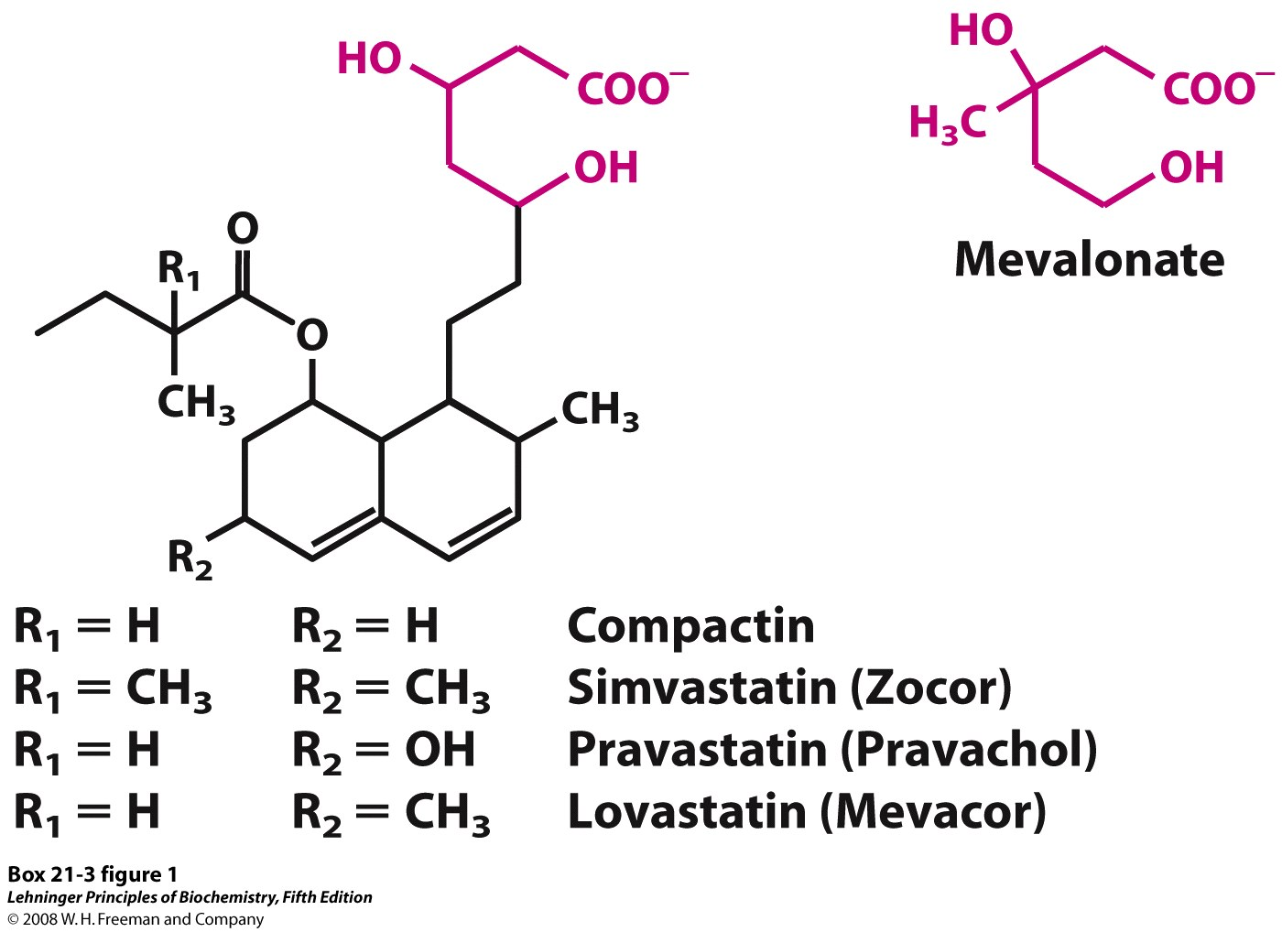
Statins inhibit HMG-CoA reductase
Notes:
BOX 21-3 FIGURE 1 Statins as inhibitors of HMG-CoA reductase. A comparison of the structures of mevalonate and four pharmaceutical compounds (statins) that inhibit HMG-CoA reductase.

Slide 7
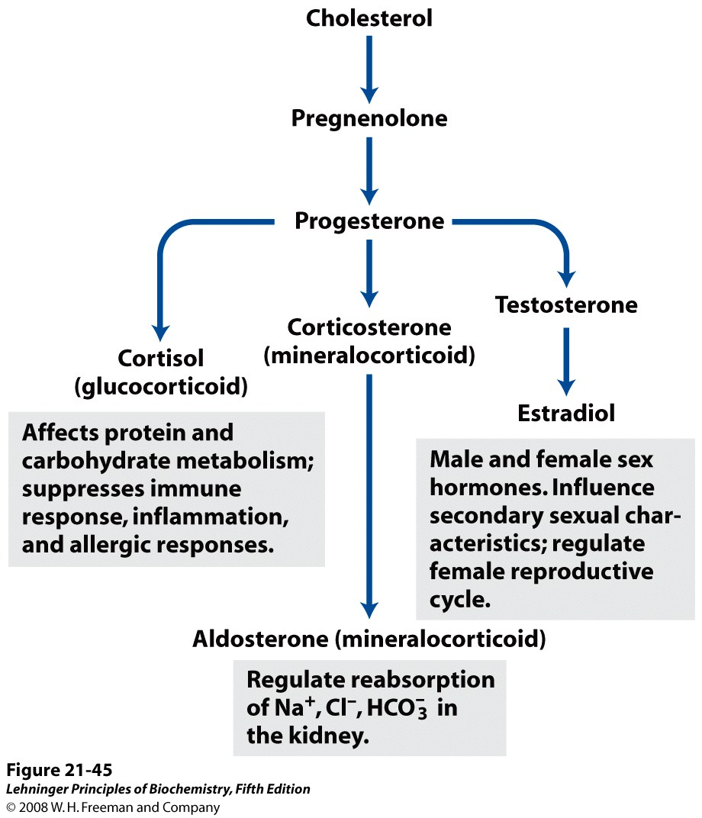
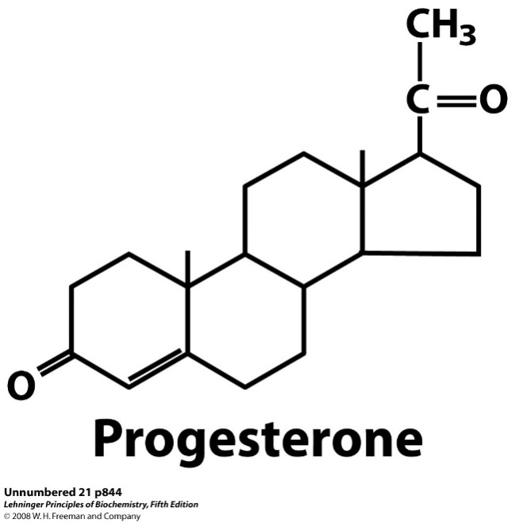
Steroid hormones derived from cholesterol
Notes:
FIGURE 21-45 Some steroid hormones derived from cholesterol. The structures of some of these compounds are shown in Figure 10-19.

Slide 8
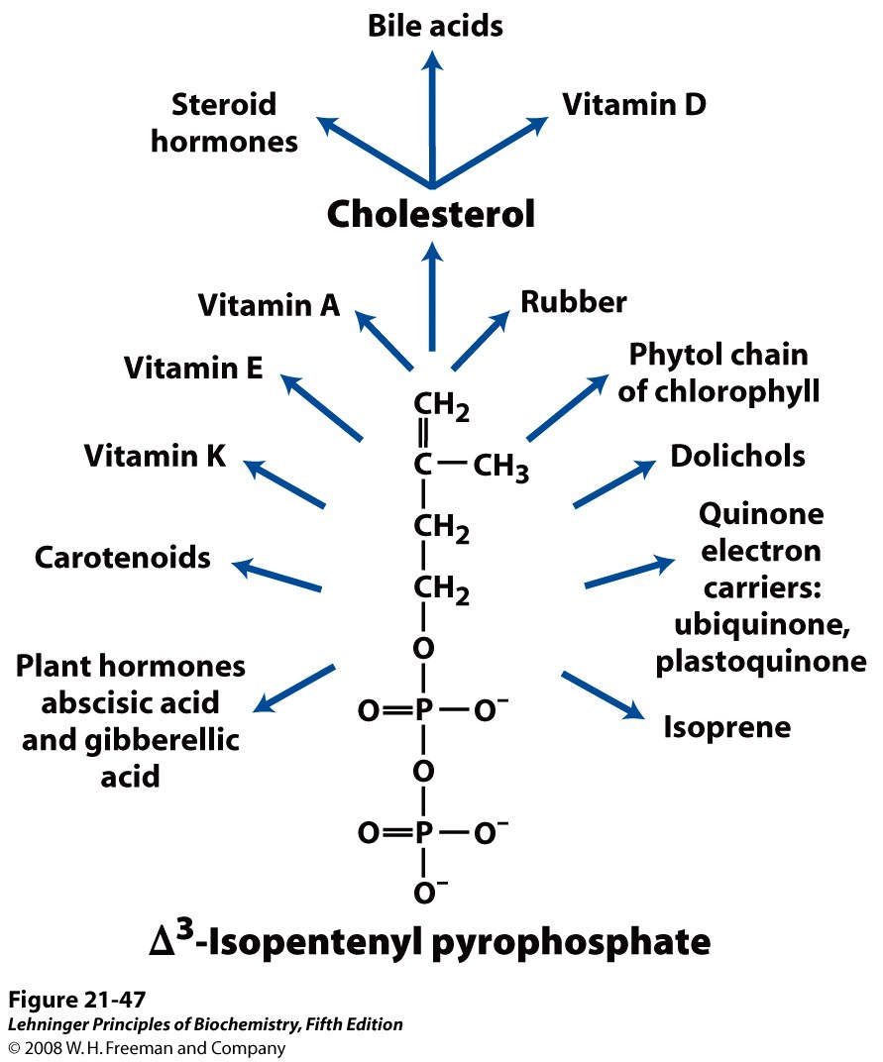
Overview of isoprenoid biosynthesis
Notes:
FIGURE 21-47 Overview of isoprenoid biosynthesis. The structures of most of the end products shown here are given in Chapter 10.

Slide 9
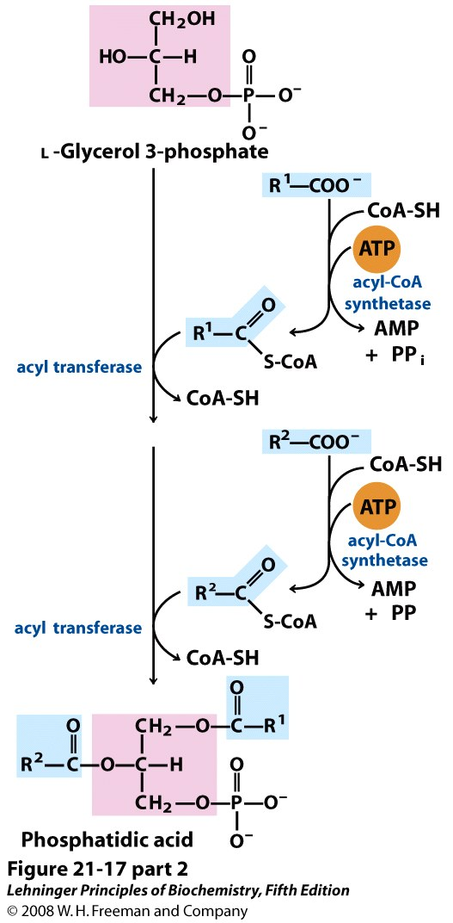
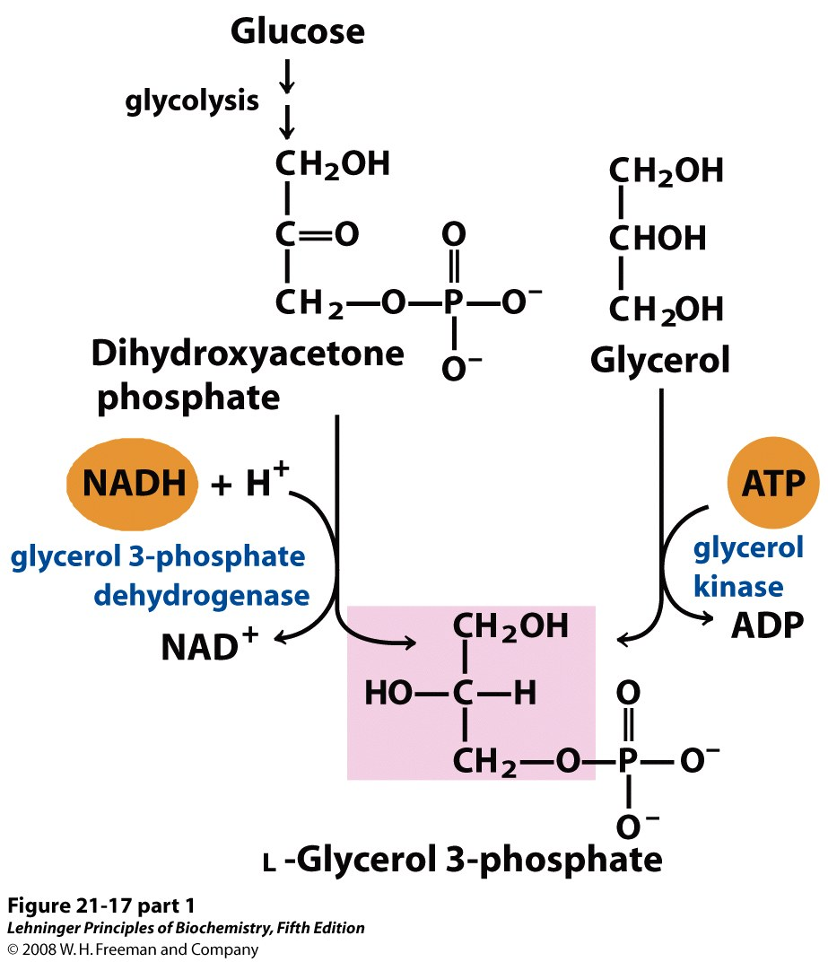
Biosynthesis of phosphatidic acid
Notes:
FIGURE 21-17 (part 1) Biosynthesis of phosphatidic acid. A fatty acyl group is activated by formation of the fatty acyl-CoA, then transferred to ester linkage with L-glycerol 3-phosphate, formed in either of the two ways shown. Phosphatidic acid is shown here with the correct stereochemistry at C-2 of the glycerol molecule. To conserve space in subsequent figures (and in Figure 21-14), both fatty acyl groups of glycerophospholipids, and all three acyl groups of triacylglycerols, are shown projecting to the right.

Slide 10
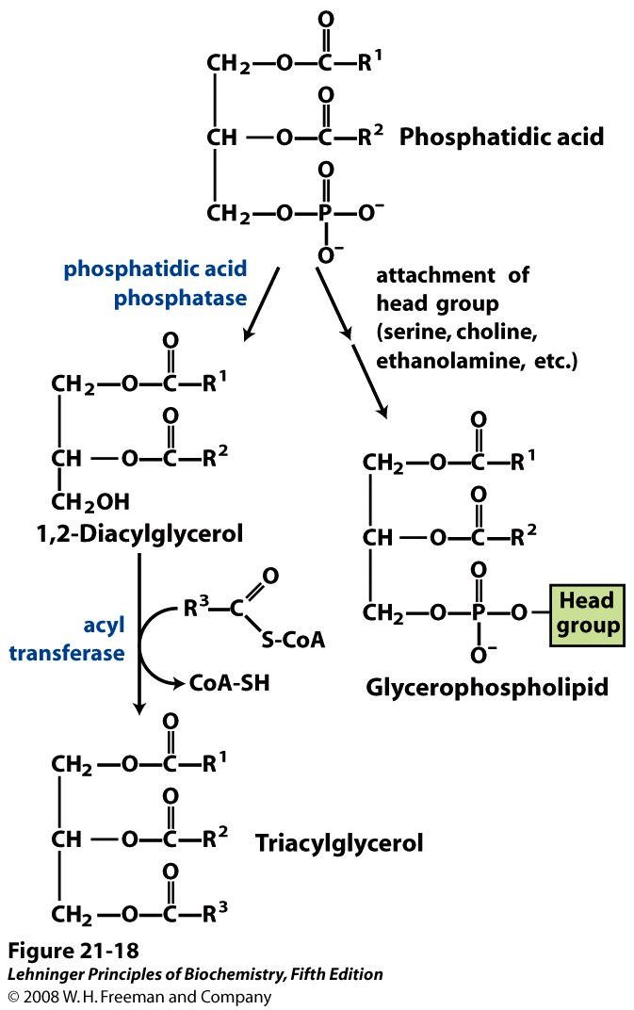
Notes:
FIGURE 21-18 Phosphatidic acid in lipid biosynthesis. Phosphatidic acid is the precursor of both triacylglycerols and glycerophospholipids. The mechanisms for head-group attachment in phospholipid synthesis are described later in this section.

Slide 11
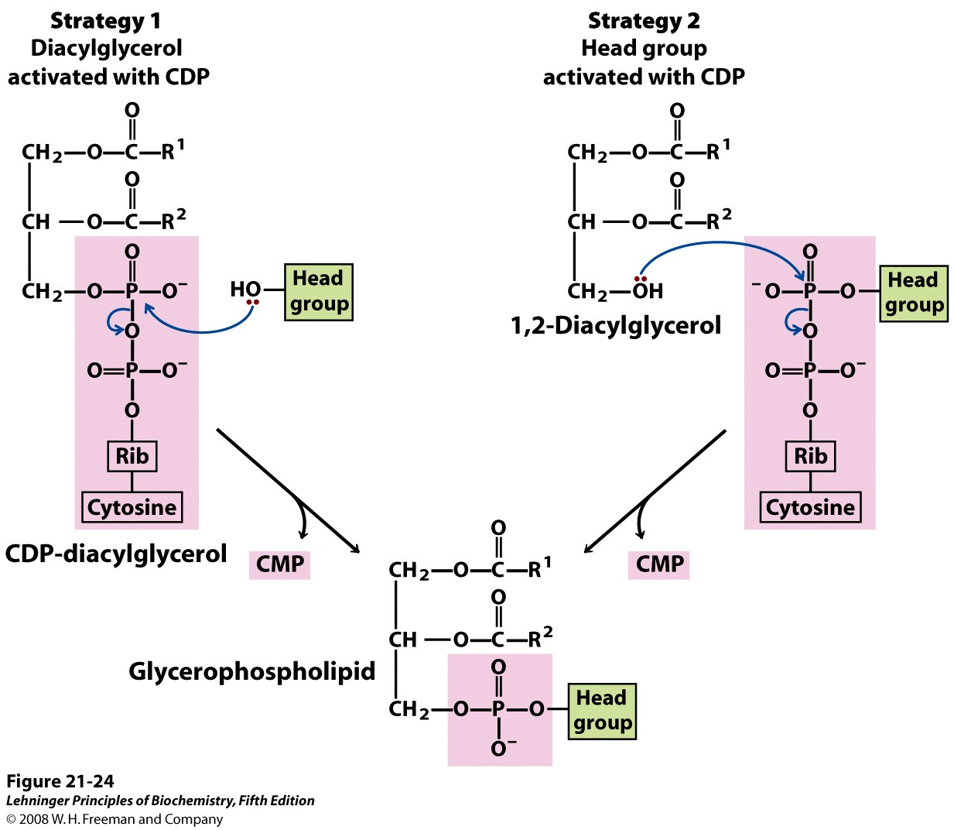
Phosphodiester Bond Formation
Notes:
FIGURE 21-24 Two general strategies for forming the phosphodiester bond of phospholipids. In both cases, CDP supplies the phosphate group of the phosphodiester bond.

Slide 12
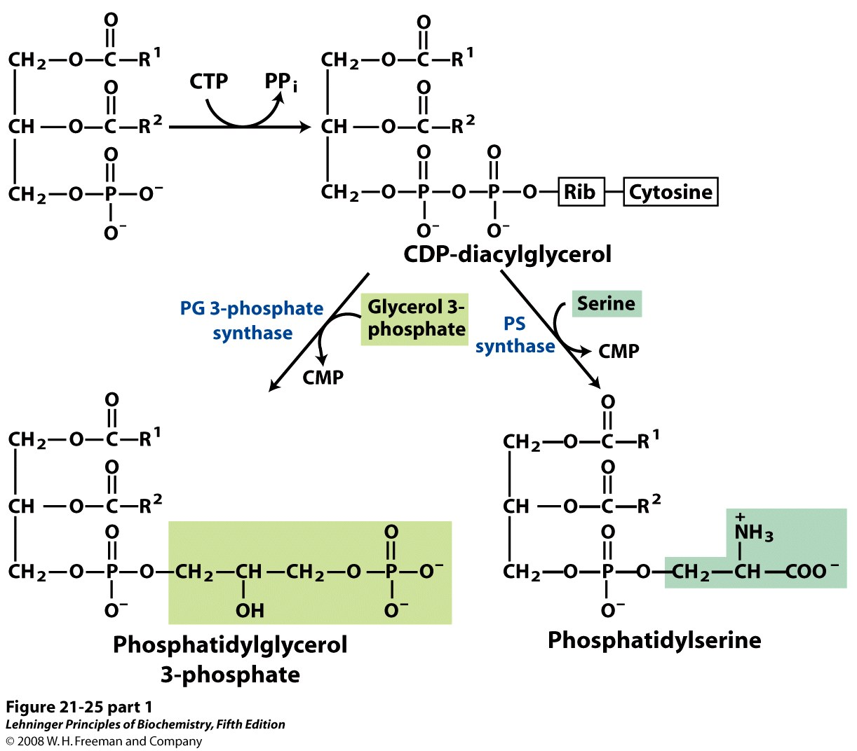
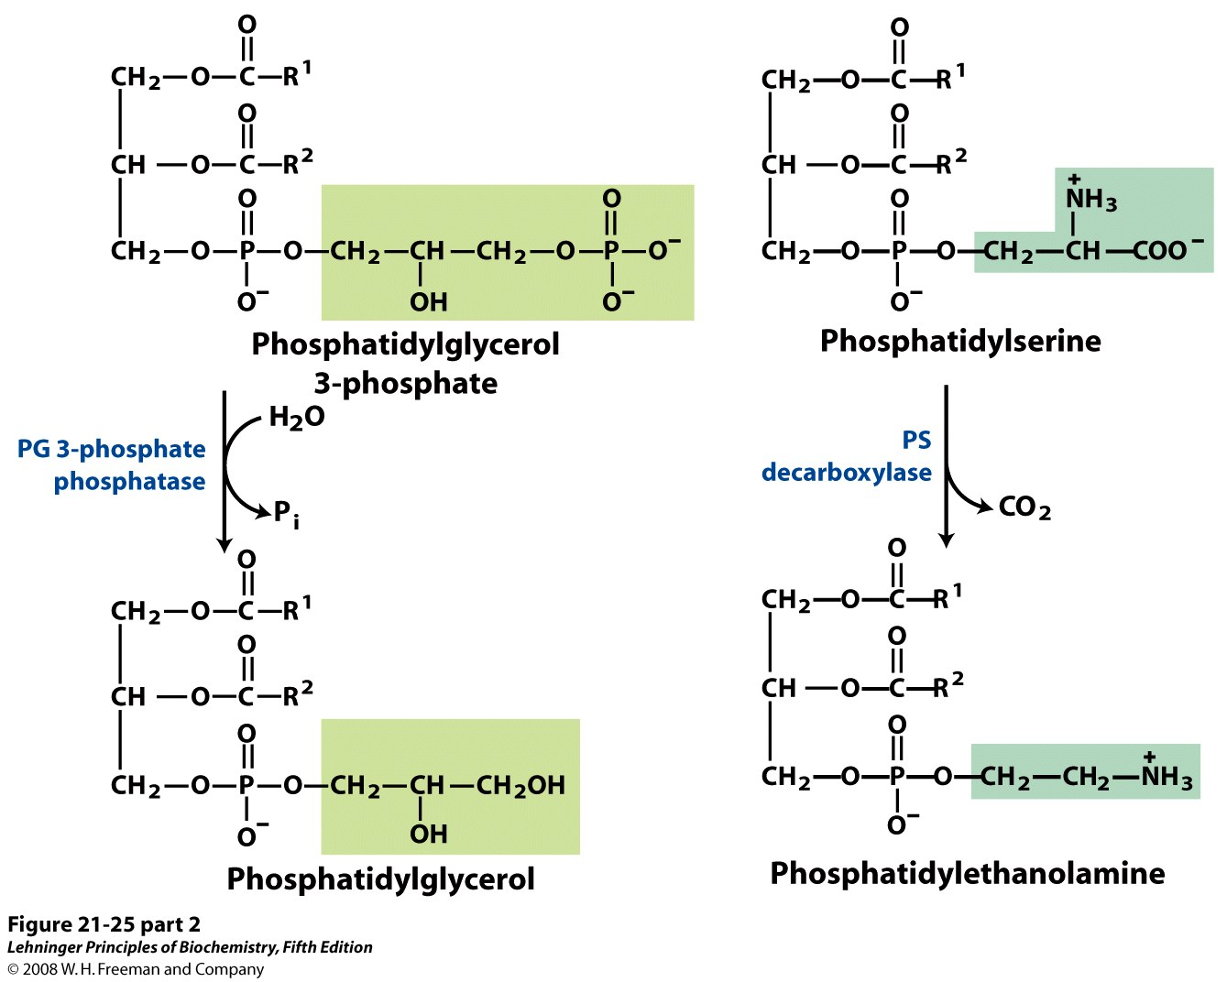
Phosphatidylglycerol (PG), Phosphatidylserine (PS) Phosphatidylethanolamine (PE)
Notes:
FIGURE 21-25 (part 1) Origin of the polar head groups of phospholipids in E. coli. Initially, a head group (either serine or glycerol 3-phosphate) is attached via a CDP-diacylglycerol intermediate (strategy 1 in Figure 21-24). For phospholipids other than phosphatidylserine, the head group is further modified, as shown here. In the enzyme names, PG represents phosphatidylglycerol; PS, phosphatidylserine.

Slide 13
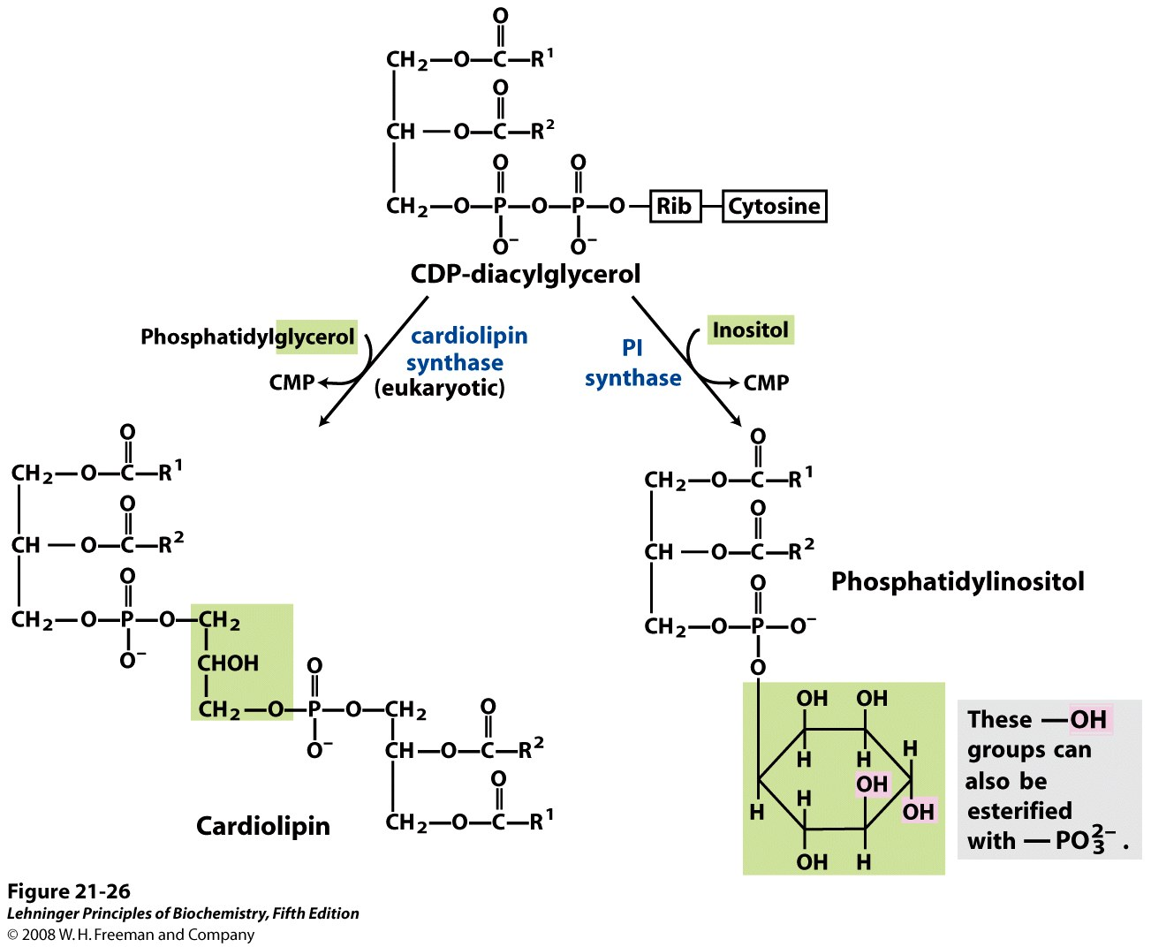
Cardiolipin and Phosphatidyl Inositol
Notes:
FIGURE 21-26 Synthesis of cardiolipin and phosphatidylinositol in eukaryotes. These glycerophospholipids are synthesized using strategy 1 in Figure 21-24. Phosphatidylglycerol is synthesized as in bacteria (see Figure 21-25). PI represents phosphatidylinositol.

Slide 14
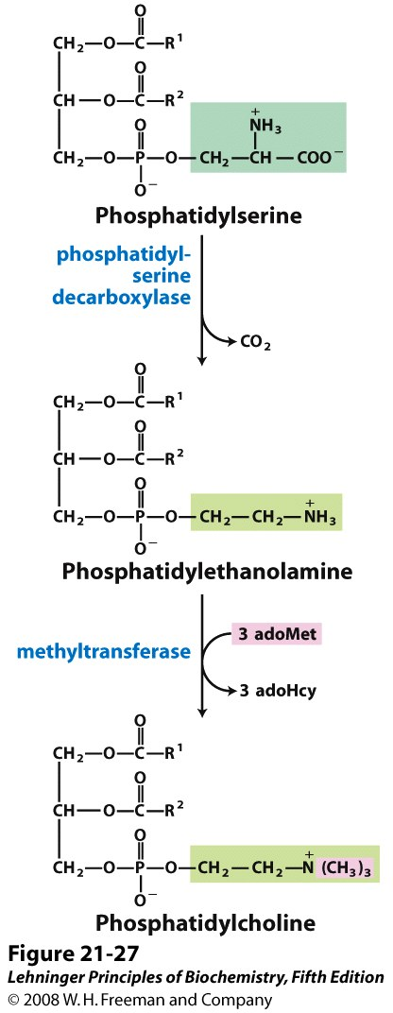
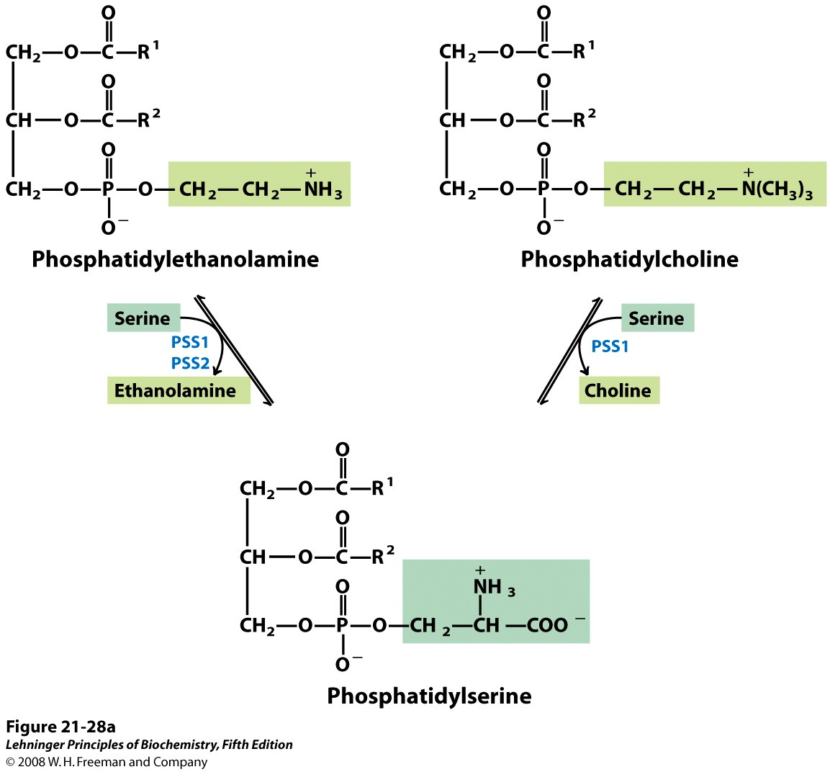
PS to PE to phosphatidyl-choline (PC) in eukaryotes
Notes:
FIGURE 21-27 The major path from phosphatidylserine to phosphatidylethanolamine and phosphatidylcholine in all eukaryotes. AdoMet is S-adenosylmethionine; adoHcy, S-adenosylhomocysteine.

Slide 15
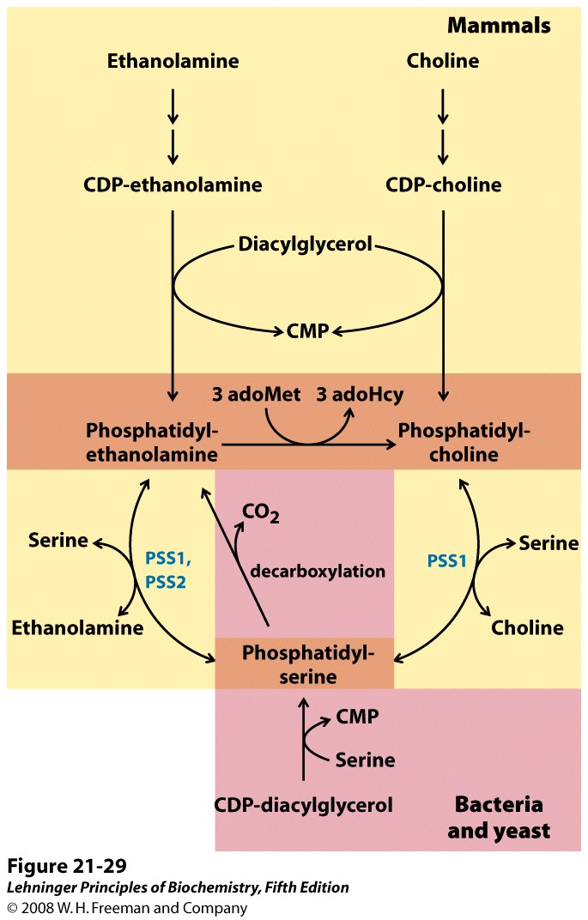
Phospholipid synthesis pathways: Summary
Notes:
FIGURE 21-29 Summary of the pathways for synthesis of major phospholipids. The pathways vary in different classes of organisms. In this diagram, pathways used by mammals are highlighted in yellow; those used by bacteria and yeast are highlighted in pink. Orange highlighting shows where the paths overlap. In mammals, phosphatidylethanolamine and phosphatidylcholine are synthesized by a pathway employing diacylglycerol and the CDP-derivative of the appropriate head group. Conversion of phosphatidylethanolamine to phosphatidylcholine in mammals takes place only in the liver. The pathways for phosphatidylserine synthesis for various classes of organisms are detailed in Figures 21-27 and 21-28.

Slide 16
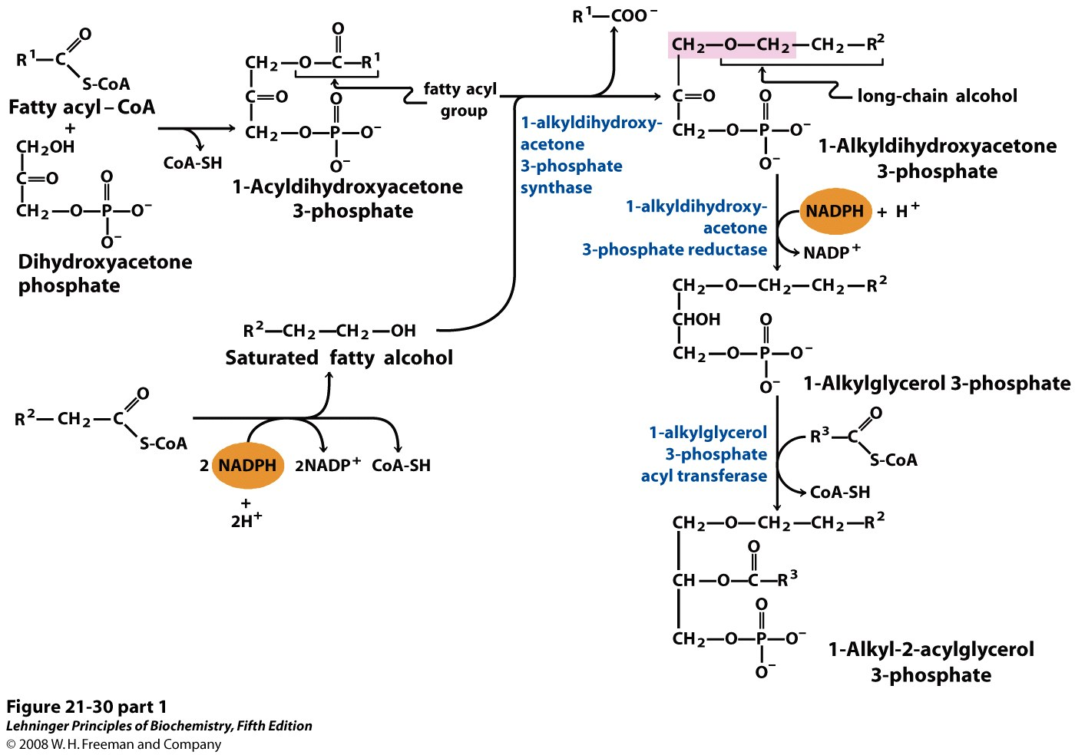
Synthesis of ether lipids and plasmalogens
Notes:
FIGURE 21-30 (part 1) Synthesis of ether lipids and plasmalogens. The newly formed ether linkage is shaded pink. The intermediate 1-alkyl-2-acylglycerol 3-phosphate is the ether analog of phosphatidic acid. Mechanisms for attaching head groups to ether lipids are essentially the same as for their ester-linked analogs. The characteristic double bond of plasmalogens (shaded blue) is introduced in a final step by a mixed-function oxidase system similar to that shown in Figure 21-13.

Slide 17
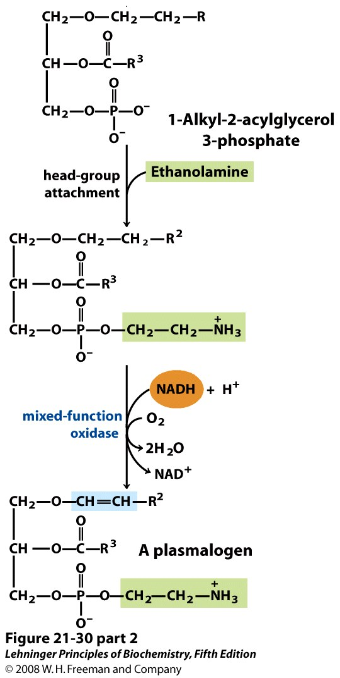
Notes:
FIGURE 21-30 (part 2) Synthesis of ether lipids and plasmalogens. The newly formed ether linkage is shaded pink. The intermediate 1-alkyl-2-acylglycerol 3-phosphate is the ether analog of phosphatidic acid. Mechanisms for attaching head groups to ether lipids are essentially the same as for their ester-linked analogs. The characteristic double bond of plasmalogens (shaded blue) is introduced in a final step by a mixed-function oxidase system similar to that shown in Figure 21-13.

Slide 18
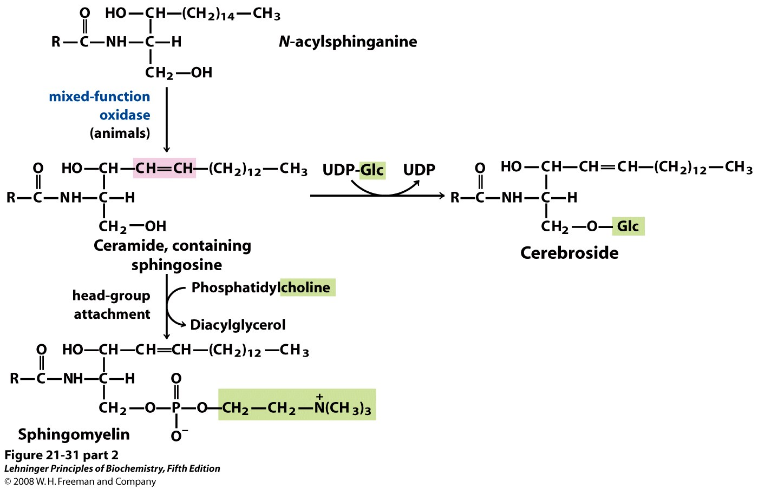
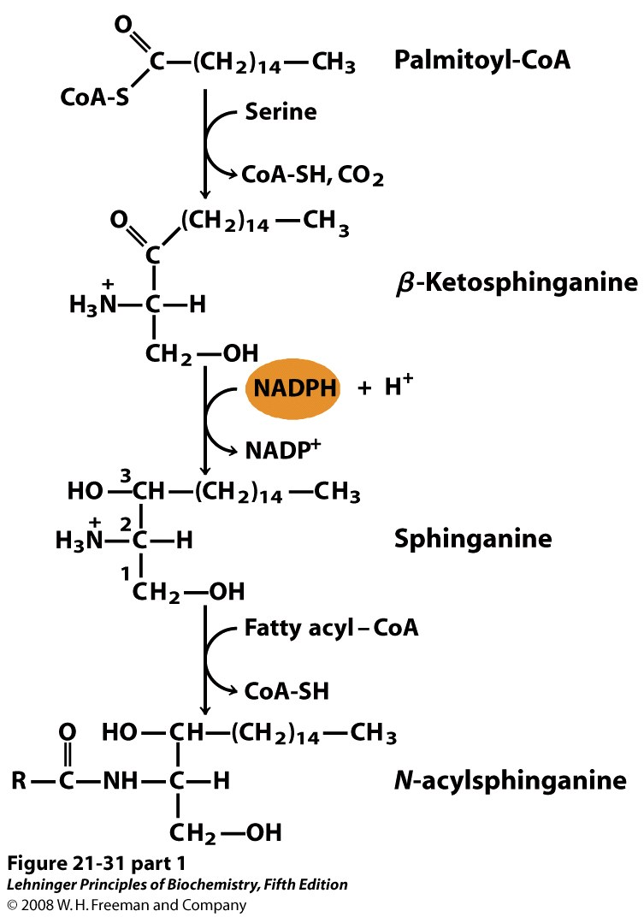
Biosynthesis of sphingolipids
Notes:
FIGURE 21-31 (part 2) Biosynthesis of sphingolipids. Condensation of palmitoyl-CoA and serine (forming β-ketosphinganine) followed by reduction with NADPH yields sphinganine, which is then acylated to N-acylsphinganine (a ceramide). In animals, a double bond (shaded pink) is created by a mixed-function oxidase before the final addition of a head group: phosphatidylcholine, to form sphingomyelin, or glucose, to form a cerebroside.

Slide 19
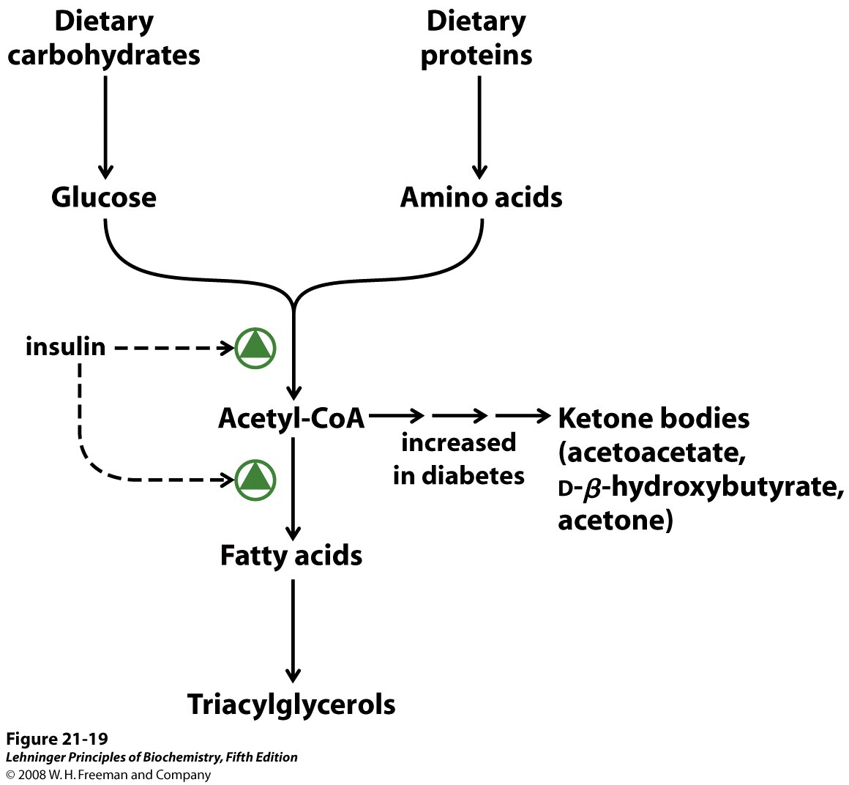
Notes:
FIGURE 21-19 Regulation of triacylglycerol synthesis by insulin. Insulin stimulates conversion of dietary carbohydrates and proteins to fat. Individuals with diabetes mellitus lack insulin; in uncontrolled disease, this results in diminished fatty acid synthesis, and the acetyl-CoA arising from catabolism of carbohydrates and proteins is shunted instead to ketone body production. People in severe ketosis smell of acetone, so the condition is sometimes mistaken for drunkenness (p. 929).

Slide 20
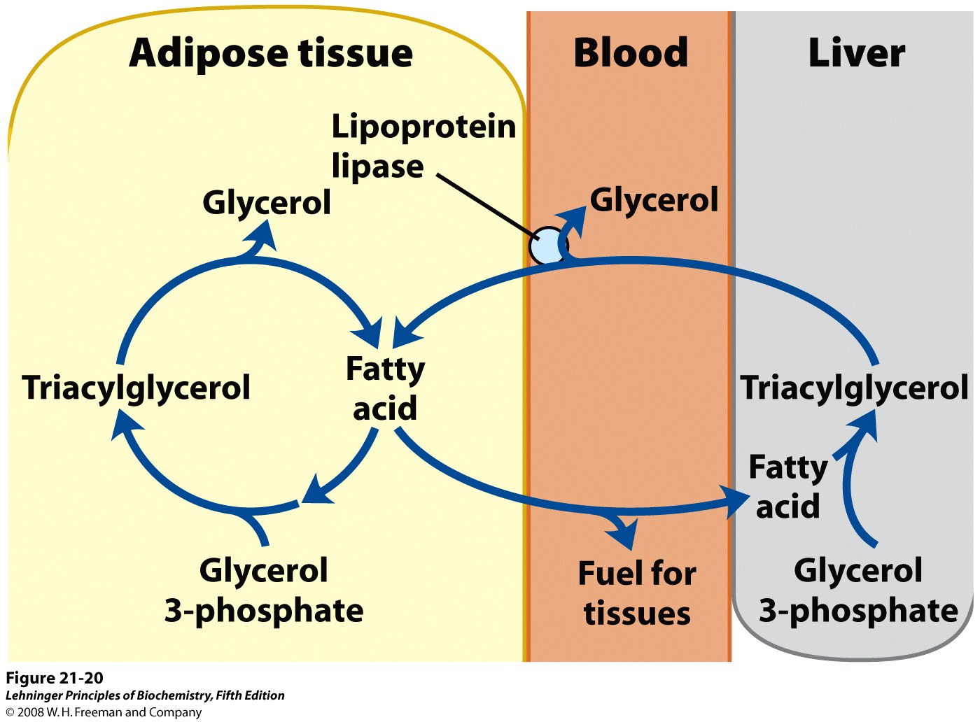
Notes:
FIGURE 21-20 The triacylglycerol cycle. In mammals, triacylglycerol molecules are broken down and resynthesized in a triacylglycerol cycle during starvation. Some of the fatty acids released by lipolysis of triacylglycerol in adipose tissue pass into the bloodstream, and the remainder are used for resynthesis of triacylglycerol. Some of the fatty acids released into the blood are used for energy (in muscle, for example), and some are taken up by the liver and used in triacylglycerol synthesis. The triacylglycerol formed in the liver is transported in the blood back to adipose tissue, where the fatty acid is released by extracellular lipoprotein lipase, taken up by adipocytes, and reesterified into triacylglycerol.

