Slide 1
Spare Parts Inventory Tools and Lubricants
Dr. J. Badshah
University Professor – cum - Chief Scientist
Dairy Engineering Department
Sanjay Gandhi Institute of Dairy Science & Technology, Jagdeopath, Patna
(Bihar Animal Sciences University, Patna)

Slide 2
Introduction to spare parts and Inventory
Importance of spare part Programmes
To upkeep the all machineries for production.
Practically no uniform standard of equipments in dairy plant due to manysuppliers
Necessary to keep various types of spares
To contain consumable items such as gaskets, standard lubricants and paints
To keep three basic groups of engineering accessories:
Equipment spare parts.
Complete components.
Pipes and fittings, bolts, nuts and washers, bars and plates of different metals, electric components and other general types of engineering accessories.

Slide 3
Recommendations of Inventory
The quantities to be kept should ensure regular and trouble-free plant performance without overstocking the stores.
The selection of spare parts kept in the store is based on the manufacturers' recommendations and on the plants own experience of local operating conditions.
Relatively steady demanded parts must be available
Rubber gaskets for milk pipes, plate gaskets for heat exchangers, graphite and rubber sealing for pumps, electric relays and special bulbs, selected bearings, springs and automatic switches, etc.
Some consumable items such as automatic recorder charts and inks, special lubrication components and even packaging materials to which packaging machines are particularly sensitive, such as aluminum capping foils for bottling.

Slide 4
Recommendations of Inventory
It is much more difficult to decide on items which are used sporadically. The demand for them is erratic and only experience can tell what deserves to be stored in the plant.
After all, poor spare parts control and planning can lead to inefficient inventory storage and a shortage of parts when you need them most, which causes unplanned downtime and unforeseen costs.
For the overall success of your business, it’s in your best interest to invest in optimized spare parts inventory management, starting with these nine tips.

Slide 5
9 Tips for Inventory control
1. Choose a Method for Labeling Critical Components (ABC analysis and XYZ analysis)
ABC analysis “is an approach for classifying inventory based on the items’ consumption value,” wherein the consumption value is “the total value of the item consumed over a specified time period.”
A parts have the highest consumption value, B parts have an intermediate consumption value, and C parts have the lowest consumption value.
ABC analysis involves reviewing inventory items, then labeling them with an A, B or C:
A parts make up about 80 percent of all parts used, but account for 20 percent or less of inventory stock.
B parts make up about 25 percent of usage, but account for about 30 percent of inventory stock.
C parts make up about 5 percent of usage, but account for about half of the inventory stock.

Slide 6
9 Tips for Inventory Control
2. Balance Inventory Volume With Sawtooth Diagrams
It can help you contextualize how your inventory stock is depleted and replenished over time.
The y axis of the diagram should represent the inventory level, while the x axis should represent time. The lines that make up the “saw teeth” should represent the steady decrease of inventory over time.
Each peak represents the maximum inventory level, and the distance between each peak represents the amount of time between shipments, otherwise known as the cycle time.
Additional markers within your sawtooth diagram should represent the reorder point and lead time.
In order for your sawtooth diagram to be an accurate reflection of your spare parts inventory volume, you must first establish minimum and maximum inventory levels for each spare part.

Slide 7
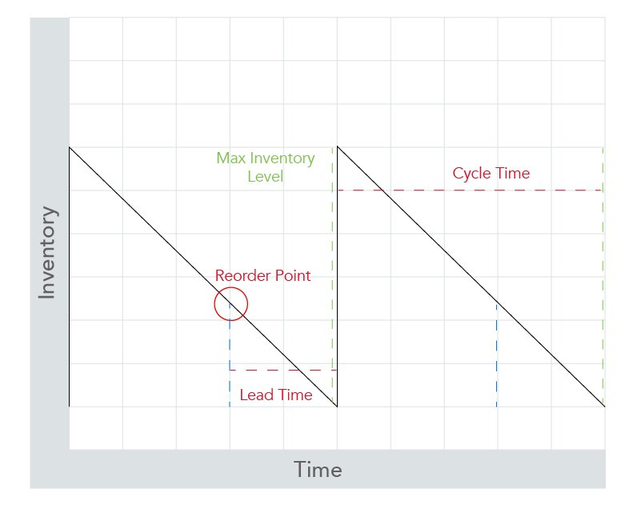
Sawtooth Diagram for Inventory

Slide 8
9 Tips for Inventory Control
3. Keep Your Bill of Materials up to Date
Your bill of materials (BOM) is the winning formula for manufacturing an end product that’s light-years ahead of its competition. As a result, it’s vital that you keep your BOM up to date in order to prevent inventory inaccuracies and spare parts shortages and to better plan for preventative maintenance or servicing. Take time to review your BOM on a regular or semi-regular basis to add or remove parts from it as needed.
4. Calculate Optimal Economic Order Quantity
According to Investopedia, economic order quantity (EOQ) “is the ideal order quantity a company should purchase for its inventory given a set cost of production, a certain demand rate, and other variables,” and “is done to minimize inventory holding costs and order-related costs.”
You can use EOQ to determine the quantity of spare parts you need to order based on annual demand by using the following formula:

Slide 9
Economic Order Quantity (EOQ)

Slide 10
9 Tips for Inventory Control
5. Develop a Standard Work Order Process
There are a few things you can do to make your work order process more efficient:
Hold employees accountable for following standard procedures
Define consequences for failure to file a formal work order
Introduce automated systems to reduce manual paperwork
Simplify your process wherever possible
Invest in quality employee training
6. Focus on Inventory Control During Employee
Training by selecting one that covers both standard processes and procedures, as well as any technology your business might use to optimize spare parts inventory management.

Slide 11
9 Tips for Inventory Control
7. Perform Cycle Counts on a Regular Basis
Cycle counts are more convenient than total inventory counts because they don’t interfere with normal business operations, which means they can be performed on a more frequent basis.
In order to ensure a successful cycle count, set the following parameters:
Which spare parts inventory group do you need to cycle count (A, B, or C)?
How many SKUs do you need to cycle count?
Who will be responsible for the cycle count?
How many people will be responsible for the cycle count?
How frequently do you need to perform cycle counts for the inventory group in question?

Slide 12
9 Tips for Inventory Control
8. Make Spare Parts Easily Accessible
Make it easy for your employees to submit work orders and pull parts from warehouse shelves by storing spare parts within a centralized inventory. With a clear idea of where everything is located within your warehouse, you can better guarantee overall inventory accuracy.
9. Invest in a Quality CMMS
A computerized maintenance management system (CMMS) can make it easier to implement some of the spare parts inventory management best practices listed above, as well as to analyze spare parts, to optimize reorder points, and more. The real challenge, however, is to find a CMMS that can do it all. With Parts Forecasting, you can:
Improve spare parts inventory turn time
Reduce inventory inaccuracies and shortages
Eliminate service delays due to out of stock items
Reduce inventory costs
Increase service satisfaction and first-time fix rates

Slide 13
Lubrications of Machineries
The principal causes of equipment breakdown and actions to be taken
No lubrication or unplanned lubrication
The best solution is to have a regular lubrication schedule,
A lubrication chart for each machine
Setting the frequency of lubrication
Type of lubrication and lubricants needed and place of lubrications
Light, high speed bearing will require a light oil, whereas a heavy duty, low speed bearing will require heavier oil.
Bearings that are operated at high temperatures must have a lubricant specially adapted for this use, just as those bearings that operate at extremely low temperatures will require zero oil.
Many dairy plants have rather high humidity and for that reason the moisture problem should be considered. Certain lubricants are available that resist rusting and corrosion due to moisture

Slide 14
Lubrication
ix. There are also oils that resist emulsification with water and are advantageous for flooded systems of lubrication where gears and chains run in oil.
x. The most tightly enclosed oiling system will with time allow moisture to accumulate. It is essential to occasionally check the oil in an enclosed drive to make certain it is not contaminated with water. Usually the water will collect at the bottom and may be drawn off easily.
Benefits of Lubrication
Less production downtime with all its related in-plant savings and customers' benefits.
Fewer major overhauls, hence less costly repair bills.
Fewer repetitive repairs.
Less spoilage and product waste, hence a factor in better quality control.

Slide 15
Benefits of Lubrications
Postponement or elimination of cash outlays for premature replacement of physical plant and/or equipment/ because of better conservation of assets and increased life expectancy.
Requirement of less standby equipment thus reducing capital investment.
Shift from inefficient “breakdown” maintenance to less costly scheduled maintenance/ hence better work control and saving due to
Less plant outage and reduced maintenance costs.
Better spare parts control, leading to minimum inventory yet having appropriate spares at hand when needed.
Greater safety for workers and improved protection for plant.
Reduced utility and fuel costs.
Lower unit costs of manufacture.
Greater certainty in meeting production schedules.
.

Slide 16
THANK YOU

