Slide 1
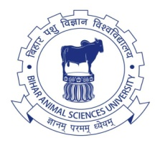
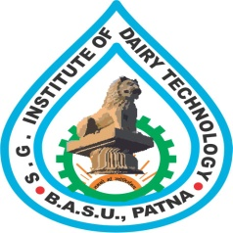
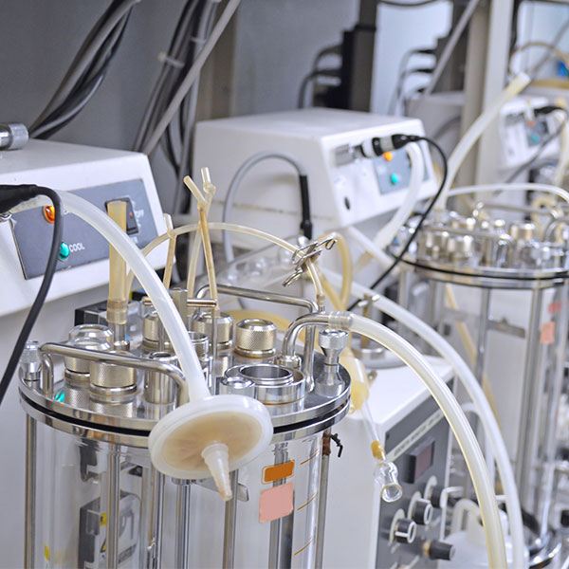
Course Title: Food and Industrial Microbiology Course No. - DTM-321: Credit Hrs-3 (2+1)
Fermentation processes: Historical development, components of fermenter and types (i.e. submerged, surface and solid-state fermentation)
RAKESH KUMAR
ASSOCIATE PROFESSOR (DAIRY MICROBIOLOGY)
FACULTY OF DAIRY TECHNOLOGY
S.G.I.D.T., BVC CAMPUS,
P.O.- BVC, DIST.-PATNA-800014

Slide 2
Fermentation is a metabolic process that produces chemical changes in organic substrates through the action of enzymes.
In biochemistry, it is defined as the extraction of energy from carbohydrates in the absence of oxygen.
Fermentation in food processing is the process of converting carbohydrates to alcohol or organic acids using microorganisms yeasts or bacteria under anaerobic conditions.
Fermentation usually implies desirable action of microorganisms. In microorganisms, fermentation is the primary means of producing adenosine triphosphate (ATP) by the degradation of organic nutrients anaerobically. The science of fermentation is known as zymology.
(en.wikipedia.org › wiki › Fermentation)

Slide 3
Historical development
Since ancient times, humans have exploited the fermentation process. The earliest archaeological evidence of fermentation is 13,000-year-old residues of a beer found in a cave near Haifa in Israel.
Another early alcoholic drink made from fruit, rice, and honey, dates from 7000-6600 BC, in the Neolithic Chinese village of Jiahu and wine making dates from 6000 BC in Georgia.
Seven-thousand-year-old jars containing the remains of wine, now on display at the University of Pennsylvania were excavated in the Zagros Mountains in Iran.
There is strong evidence that people were fermenting alcoholic drinks in Babylon 3000 BC, ancient Egypt 3150 BC, pre-Hispanic Mexico 2000 BC and Sudan 1500 BC.

Slide 4
Traditional fermentation technology is more than 3000 year old in India as mentioned in ancient literature.
A sweet substance known as Soma juice prepared by the Vedic Aryans is supposed to be the first product of fermentation in India. The Rigveda (1500 BC) shows that fermentation technology took its first step in connection with the preparation of Soma juice in India.
There is also another drink known as Sura (wine/beer) prepared by fermentation. So, it is believed that acetic fermentation was known to India since the early times.
Curd is another very popular fermentation product described in the Rigveda . It still remains a popular food and the technology of curdling milk is also found in a number of texts associated with Yajurveda.
In the beginning, fermentation was mainly associated with the preparation of spiritual drinks, but later on it was used for other purposes also.

Slide 5
Finally, the term fermentation is derived from the Latin word Fermentum that stands for boiling. The French chemist Louis Pasteur founded zymology (study of fermentation), when in 1856 he connected yeast to fermentation process.
Food fermentation is the conversion of sugars and other carbohydrates into alcohol, organic acids and carbon dioxide. All three products have showed their importance in human uses.
The production of alcohol is made use of when fruit juices are converted to wine, when grains are made into beer and when foods rich in starch, such as potatoes, are fermented and then distilled to make spirits such as gin and vodka.

Slide 6
So, Fermentation is one of the oldest technologies used for food preservation and it is a process of digesting certain substances that leads to chemical conversion of organic substances into simpler compounds.
Over the centuries, it has evolved, been refined and diversified. Today a variety of fermented foods is produced both in industrialized and developing countries. A wide range of raw materials is used as substrates in fermentation and resulted end products derived from fermentation are major constituents of the human diet all over the world. Many benefits are attributed to fermentation. It preserves and enriches food, improves digestibility, and enhances the taste and flavour of foods.
Fermentation systems may be liquid, also known as submerged or solid state, also known as surface.
Most fermentors used in industry are of the submerged type, because the submerged fermentor saves space and is more susceptible to engineering control and design.
Much work still needs to be done to identify the best fermentation technique for each bioactive compound.

Slide 7
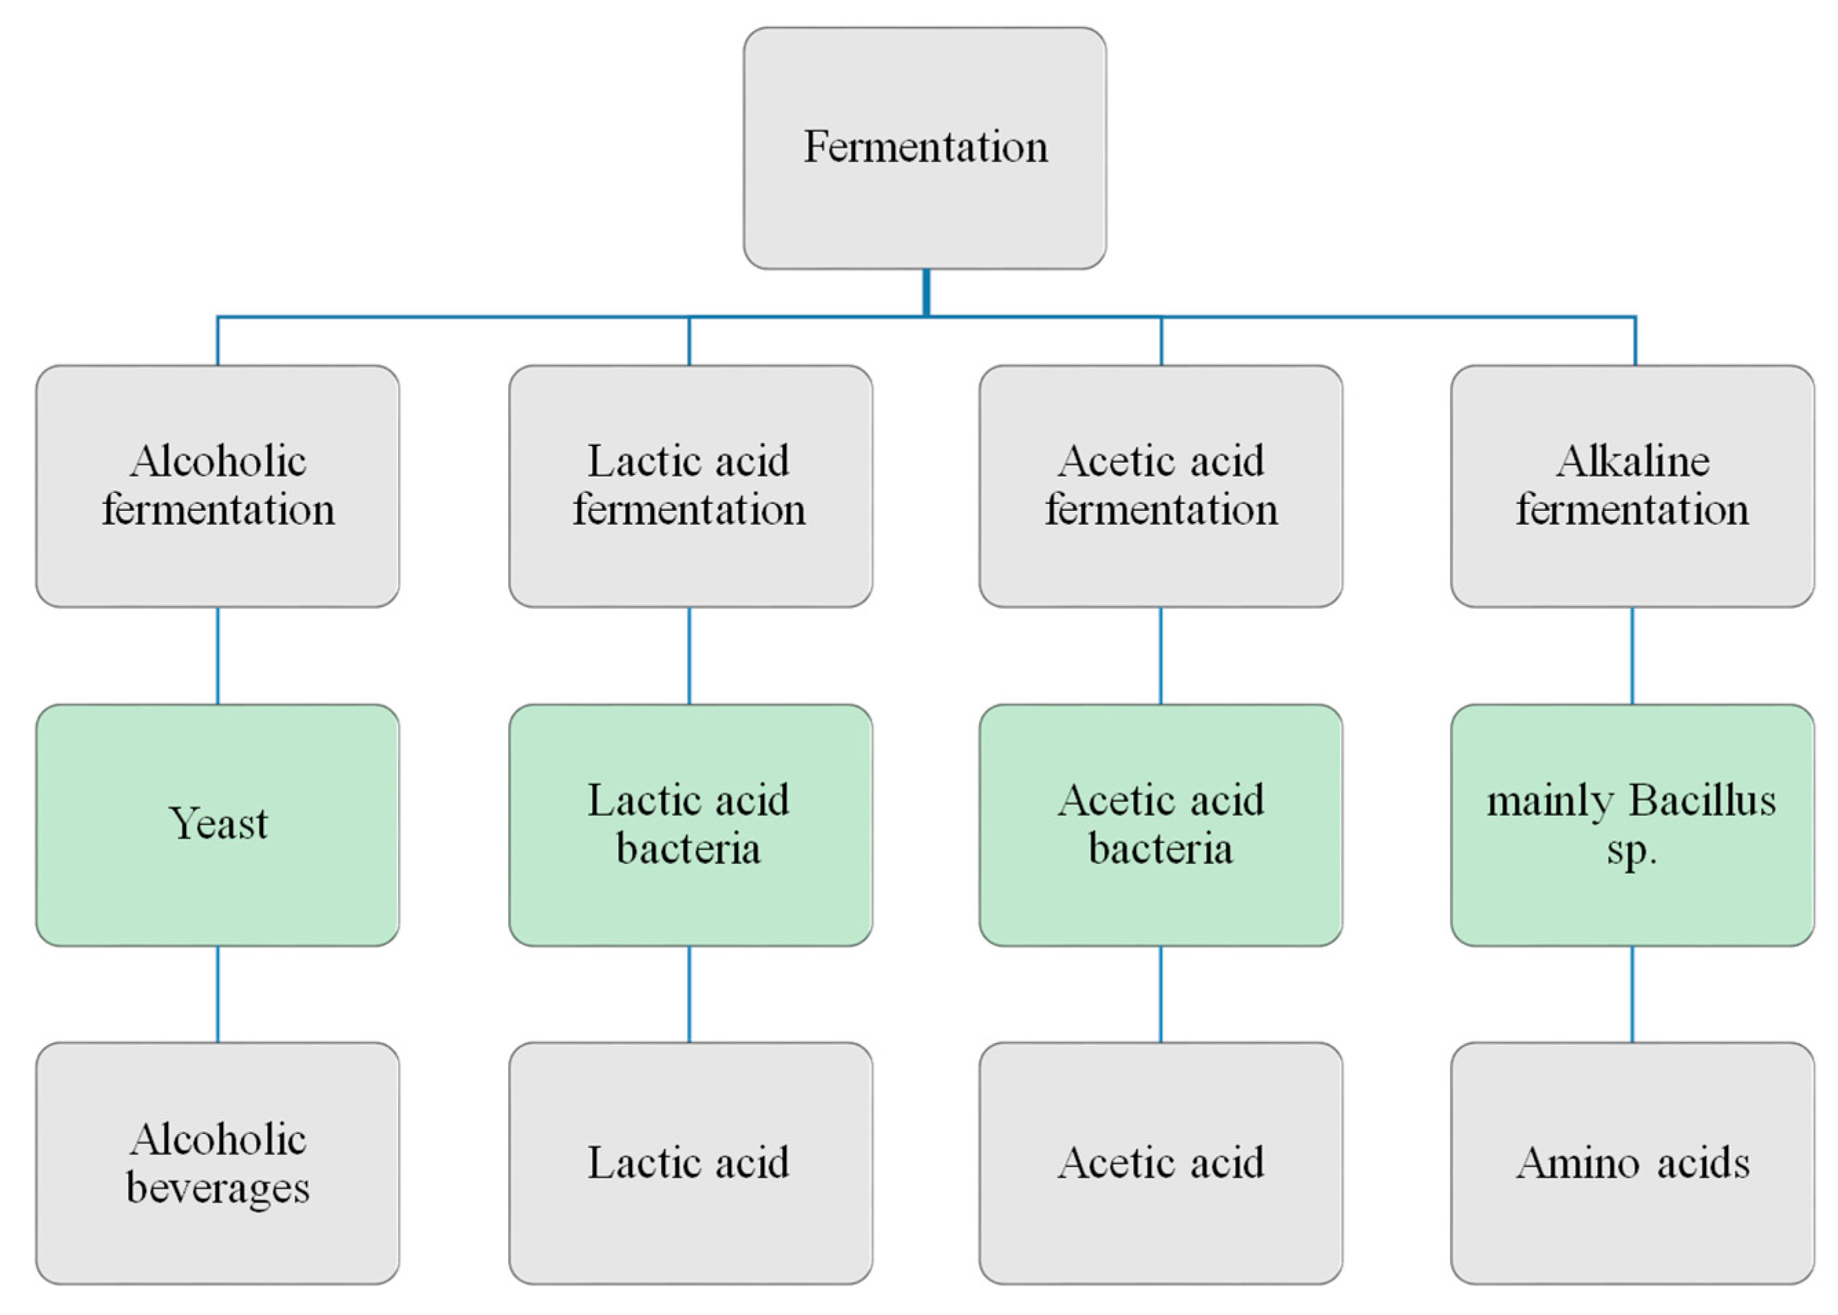
Schematic representation of the common types of fermentation,
the microorganisms involved, and the end products

Slide 8
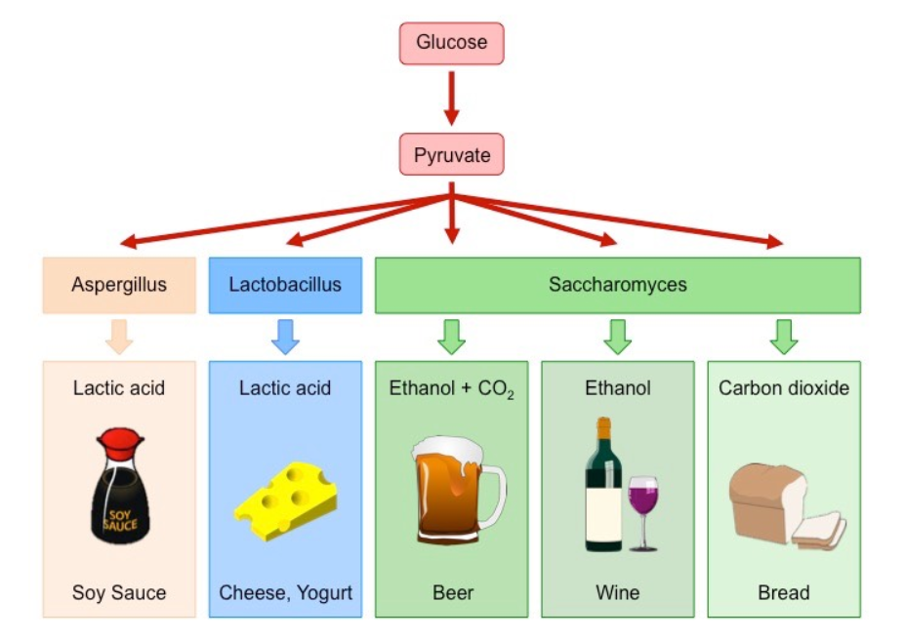
Production of Fermented Foods by Bacteria and Yeast (Saccharomyces)

Slide 9
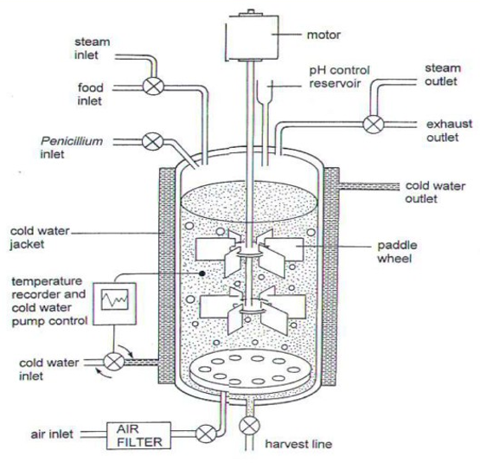
Design of an Ideal fermenter

Slide 10
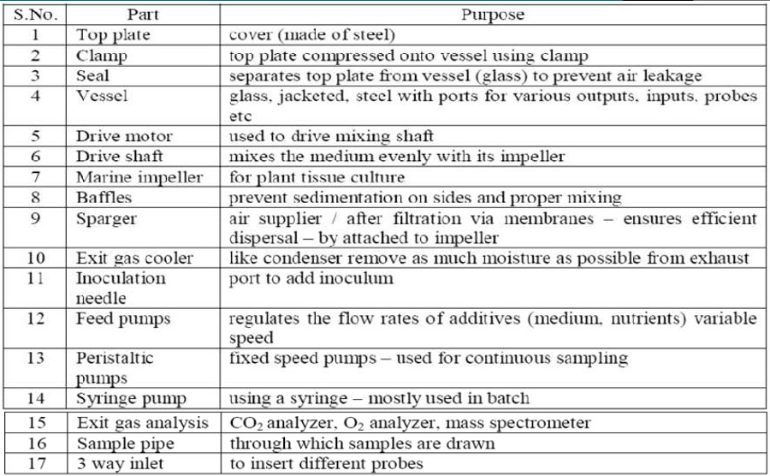
Various components of an ideal fermenter are:

Slide 11
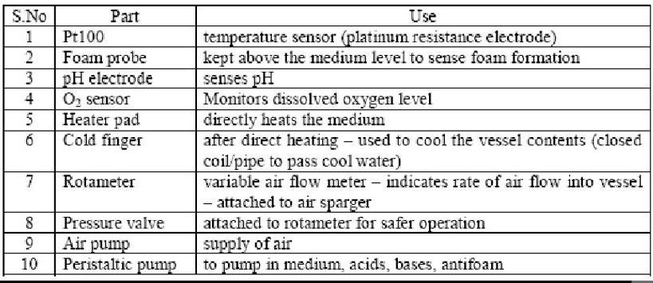
Monitoring and controlling parts of fermenter are:

Slide 12
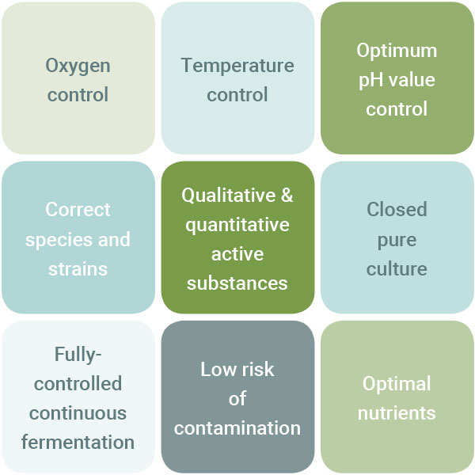
Beneficial properties

Slide 13
Fermentation is the chemical transformation of organic substances into simplex compounds by the action of enzymes, complex organic catalysts which are produced by microorganism such as yeast, molds or bacteria.
In another words, fermentation is the technique of biological conversion of complex substrates into simple compounds by various microorganism.
FERMENTATION, classified on the basis of substrate used
Solid state fermentation (SSF)
Submerged fermentation (SmF)
Development of this fermentation techniques has leads to industrial level production of bioactive compounds such as antibiotics, pigments, antioxidants, antitumor agent, bio-surfactants, bioactive peptides etc. The metabolism exhibited by microorganism is different in SSF and SmF.

Slide 14
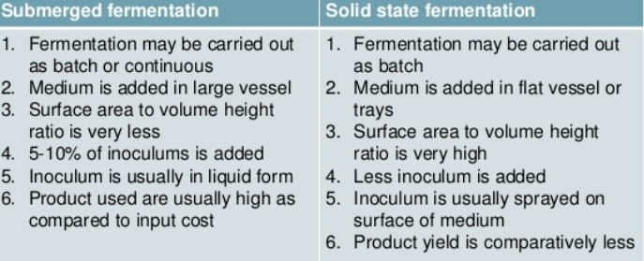
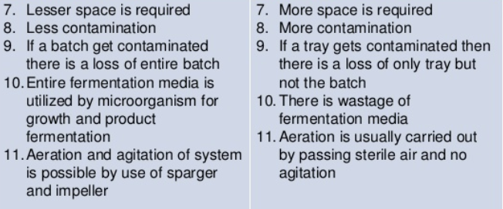

Slide 15
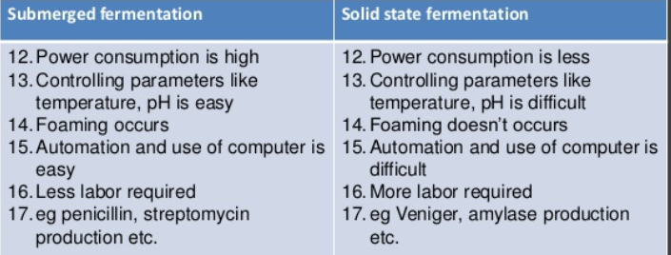
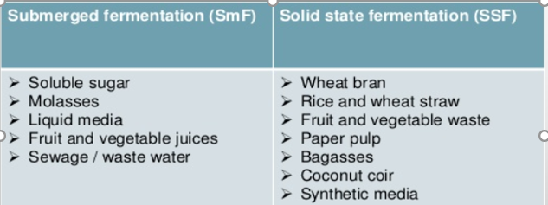
Substrate Used

Slide 16
Solid state fermentation (SSF)
Solid state fermentation (SSF) has been defined as the fermentation process occurring in the absence of free water. Solid state fermentation is a method used for the production of enzymes, which involves the cultivation of microorganisms on a solid substrate, such as grains, rice and wheat bran.
SSF employs natural raw materials as carbon source such as cassava, barley, wheat bran, sugarcane bagasse, various oil cakes like palm kernel cake, soybean cake, ground nut oil cake, fruit pulps (e.g. apple pomace), saw dust, seeds (e.g. tamarind, jack fruit), coffee husk and coffee pulp, tea waste etc.
Important Features
Solid state fermentation has been defined as the fermentation process occurring in the absence or near absence of free water utilizing the solid substrate.
It is a biomolecule manufacturing process used in the food, pharmaceutical, cosmetic, fuel and textile industries. These biomolecules are mostly metabolites generated by microorganisms grown on a solid support selected for this purpose.
This technology for the culture of microorganisms is an alternative to liquid or submerged fermentation, used predominantly for industrial purposes

Slide 17
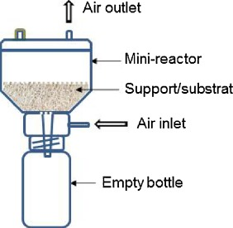
Why solid state fermentation ?
Simple and cost effective
Less effluent release, reduce pollution
Aeration is easy
Resembles the natural habitat of some fungi and bacteria
SSF utilizes solid substrate, thus nutrient rich waste materials can be easily recycled as substrate
Substrate are used very slowly and steadily so the same substrate can be used for longer fermentation period
SSF is best suited for fermentation techniques involving fungi and microorganism that require less moisture content

Slide 18
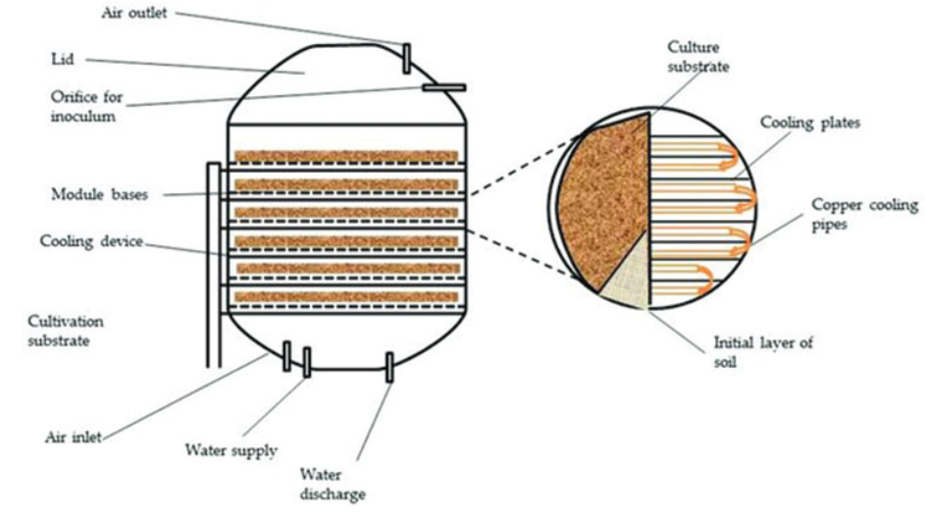
Solid state (substrate) fermentation

Slide 19
Factors Involved in SSF Process
Selection of Micro-organisms
Substrate
Process Optimization
Product Isolation & Purification
Selection of Micro-organism -- This is one of the key factor for improved yields of the product. Bacteria, Yeast and Filamentous Fungi can be used. Filamentous Fungi has shown better results growing in the solid substrate fermentation.
Substrate -- Substrate also plays important role in determining the growth of micro-organisms, there by increasing the product yield. Substrate is chosen such a way that it should provide physical support as well as nutrients to the growing culture.
Substrate is of two types:
One is Specific substrate, which requires suitable value-addition and / or disposal.
The second is for producing a specific product from a suitable substrate.

Slide 20
Process Optimization – It is the optimization of physico-chemical and Biochemical Parameters which includes size, initial moisture, pH and pre-treatment of the substrate, Relative humidity, temperature of incubation, agitation and aeration and age and size of the inoculum. Nutrient Supplementation such as N, P and trace elements and supplementation of additional carbon source and inducers. Extraction of product and its purification.
Applications: Solid State fermentation is being employed in various fields ranging from pharmacology to bioremediation, covering various aspects of biodiversity conservation.
These are the applications of Solid State fermentation --
Production of Industrial Enzymes as almost all the known microbial enzymes can be produced under SSF systems. Enzymes of industrial importance, like proteases, cellulases, ligninases, xylanases, pectinases, amylases, phenolic acid esterases, microbial rennets, oligosaccharide oxidases etc. using SSF systems.
Production of Bio pesticides -- The infamous Bacillus thurengenesis (Bt)’s protein can be produced in large scale in order to address the issues of pest attacks-yield damage.

Slide 21
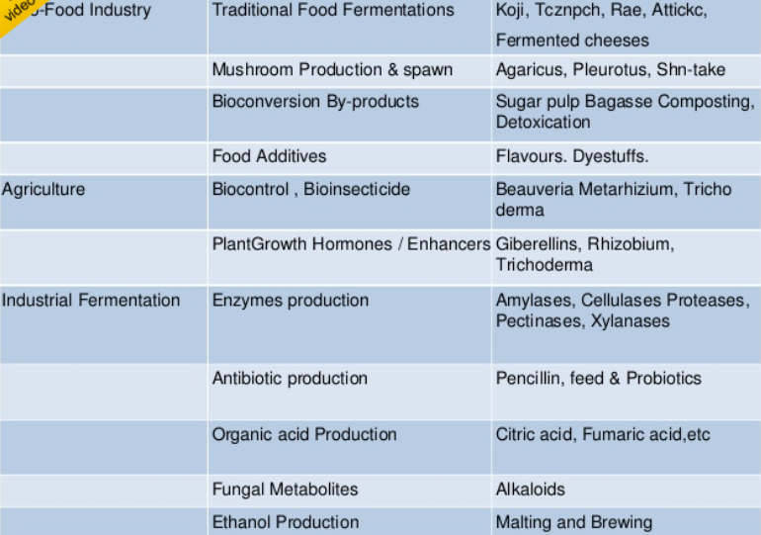
Applications of Solid State fermentation

Slide 22
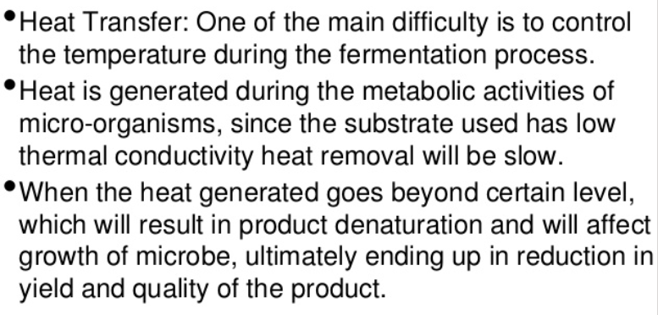
Problems in Solid state (substrate) fermentation

Slide 23
Submerged fermentation
Submerged fermentation / liquid fermentation
It is a techniques of cultivation of microorganism in liquid broth which breaks down the nutrient to release the desired bio-active compound into solution. In this method, selected microorganism are grown in closed vessels containing a broth rich in nutrients and high concentration of oxygen. In SmF substrate are utilized quite rapidly hence need to be constantly replaced or supplemented with nutrients. Bacteria that requires high moisture content or high water activity are best suited for submerged fermentation.
Applications of Submerged Fermentation (SmF) / Liquid Fermentation (LF) -- SmF utilizes free flowing liquid substrates, such as molasses and broths. The bioactive compounds are secreted into the fermentation broth. The substrates are utilized quite rapidly that’s why substrate needs to be constantly replaced / supplemented with nutrients. This fermentation technique is best suited for microorganisms such as bacteria that require high moisture. An additional advantage of this technique is that purification of products is easier. SmF is primarily used in the extraction of secondary metabolites that need to be used in liquid form.

Slide 24
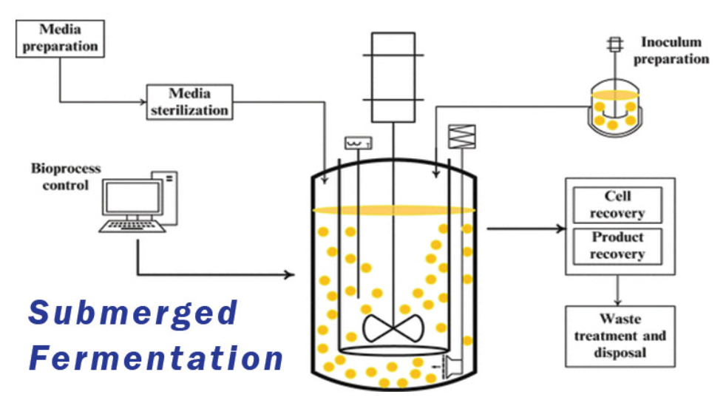
More that 75% of the industrial enzymes are produced using SmF, one of the major reasons is that SmF supports the utilization of genetically modified organisms to a greater extent than SSF.
In SmF, the accumulation of variety of intermediate metabolites results in lowered enzyme activity and production efficiency
Based on research, certain bioactive compounds have found to be produced in higher quantities in SSF, whereas other compounds have been extracted using SmF
Thank You

