Slide 1
Organophosphate Insecticides
Dr. Kumari Anjana
Assistant Professor
Deptt. of Veterinary Pharmacology & Toxicology
Bihar Veterinary College, Bihar Animal Sciences University, Patna

Slide 2
Content of the chapter
Introduction
Uses
Comparison to organochlorine compounds
History
Classification
Differences from direct acting OP compounds
indirect acting OP compounds
Mechanism of action
Clinical signs
Diagnosis
Treatment

Slide 3
Introduction
OP compound are esters of phosphoric, phosphonic, phosphorothioic or related acids which have ability to inhibit cholinesterase enzyme.

Slide 4
USES
As insecticides, organophosphates are one of the major groups in use in present time:
Insecticides,
Acaricides,
Soil nematodes,
Fungicides,
Herbicides,
Defoliants,
Rodenticides,
Insecticide synergists,
Insect repellents,
chemosterilants and
Warfare agents.

Slide 5
Compared to Organochlorins
OPs are:
Much less environmentally persistent,
Much more biodegradable,
Less subject to biomagnifications,
Usually unstable in presence of sunlight.
However, compared to organochlorins, they are much more acutely toxic to non-target species and several cases of poisoning frequently occur in man, domestic animals and wild life.
Although most OPI are not very persistent in environment and dissipate in 2-4 weeks, some OPs, such as chlorpyriphos, are sufficiently persistent to be used for control of termites.

Slide 6
History
1st OPI - tetraethyl pyrophosphate (TEPP).
Developed in Germany during Second World War as a substitute for nicotine.
This was followed by tabun and sarin.
These compounds were highly toxic to mammals and were rapidly hydrolysed by moisture.
This led to the discovery by Schrader in 1944 of more stable compound parathion and its oxygen analogue paraoxone.

Slide 7
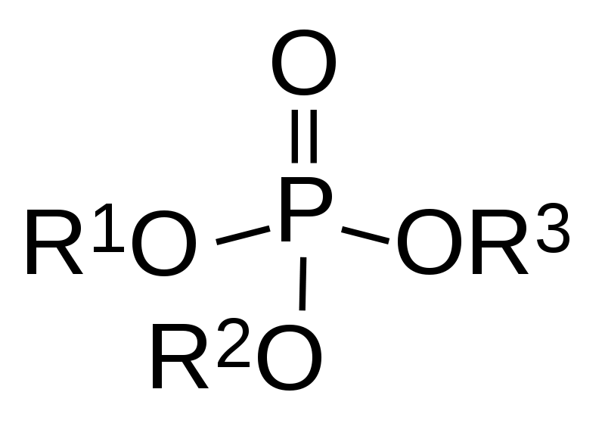
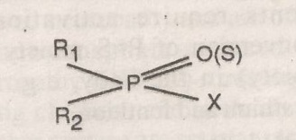
The general structure of OP insecticides is given by the formula.
where , R: alkyl, aryl, alkoxy, alkylthio or amino group.
The X is an acid radical, which may carry various substituents, particularly electron- withdrawing groups.
It is called a ‘leaving group’ because it may leave by disruption of P-X bond.

Slide 8
Classification of OPI
Based on chemical structure –
Phosphate & pyrophosphate- Paraoxon, tetraethyl pyrophosphate (TEPP), schraden, dichlorvos.
Phosphorothioates - Parathion, fenthion, diazinon, runnel
Phosphonates - Trichlorphon
Phosphoramidates- Phospholan, mephospholan
Phosphorothiolates- Echothiophate, profenophos
Phosphorohalides- Diisoprophylfluorophosphate (DFP), sarin
Phosphorocyanides- Tabun.

Slide 9
Based on mode of action (Classification)
Direct acting OP insecticides
Indirect acting OP insecticides
These insecticides contain P=O group.
So, they directly inhibit cholinesterase enzyme and produce toxicity.
TEPP, trichlorphon and dichlorvos.
These insecticides are basically phosphorothioates containing P=S groups.
Sulphur is not electrophilic so, such compounds are inactive as anticholinesesterases.
These agents require activation to oxon (conversion of P=S moiety to a P =O moiety) in the body.
Malathion, parathion and fenthion.

Slide 10
Mechanism of action
OPI owe their toxicity by irreversible inhibition of AChE enzyme, which is responsible for hydrolytic degradation of acetylcholine (NT released at cholinergic synapses).
This leads to Ach accumulation in nerves and neuro-effector junctions, which causes excessive synaptic neurotransmitter activity in the parasympathetic nervous system and at neuromuscular sites and affected animals show parasympathetic or chlolinergic signs.

Slide 11
MOA of AChE inhibition by OP compounds closely resembles the catalytic hydrolysis of Ach but, unlike Ach, OP compounds interact with only the active esteric site of the enzyme and the enzyme – OP complex formed is extremely stable that does not undergo significant spontaneous hydrolysis.
Restoration of acetylcholinesterase activity often requires synthesis of new enzyme molecule that may take several weeks.
In initial stages, some spontaneous hydrolysis may occur (mostly negligible) or complex can be dissociated with the use of chemical agents called cholinesterase enzyme reactivators like pyridine-2-aldoxime.

Slide 12
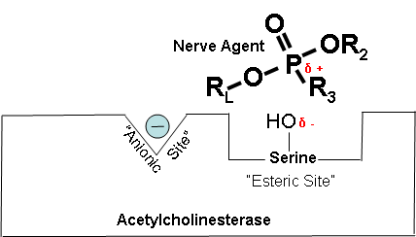
Fig. Mechanism of action of organophosphorus insecticides

Slide 13
However once covalent modification of enzyme occurs and the phosphorylated enzyme looses one of its alkyl group (called aging), it is impossible for chemical reactivators to break the bond between the inhibitor and the enzyme.
Aging is very rapid for nerve gases.
soman (aging half life 2 minutes),
less for DFP (approx. 4 hrs)
and more (up to 36 hrs) for many other OPI.

Slide 14
Phosphorylation of AChE enzyme occurs when organophosphate occupies esteratic site of the enzyme.
Spontaneous hydrolysis resulting in regenerated enzyme may occur poorly.
When aging occurs (loss of esterified moiety ‘R’), recovery of cholinesterase does not occur due to formation of irreversible stable bonds.
This needs synthesis of new enzymes.

Slide 15
In addition to acetylcholinesterase enzyme (also called true cholinesterase), OPI inhibit plasma cholinesterase (also called pseudocholinesterase or butyryl cholinesterase), a non specific enzyme, and some other esterases with serine residue at active sites called as neurotoxic esterase.
Inhibitions of these non-specific enzymes may interfere with metabolism of a wide variety of esters that occur in plasma, nervous tissue and some other systems in the body.

Slide 16
Some OPI like
tri-ortho cresyl phosphate (TOCP),
diisopropyl phosphorofluoridate (DFP),
EPN (Ethyl nitrophenyl phosphonothioate), leptophos, mipafox .
produce
These compounds are weak ChE inhibitors but strongly inihibit neurotoxic esterase (NtE) in brain and spinal cord causing axonal swelling, breakdown and demyelination of spinal and peripheral neurons.

Slide 17
The signs of delayed neurotoxicity include muscle weakness, ataxia, flaccid paralysis of limbs.
Poultry birds are the most sensitive spp.
This delayed toxic axonopathy is called organophosphorus induced delayed neuropathy (OPIDN) or dying back axonopathy (so called because it starts at periphery and then goes upward into spinal cord and up into spinocerebellar, vestibulospinal and other tracts).
Larger diameter fibres appear to be more affected then small diameter fibres.

Slide 18
Clinical sign
Muscarinic signs:
Profuse salivation (watery drooling), bronchial secretions and constriction, diarrhoea, frequent urination and miosis.

Slide 19
Nicotinic signs: Muscular tremors, convulsions, paralysis of respiratory muscles and dyspnoea.
CNS signs: Restlessness, ataxia, depression of respiratory and vasomotor centres, paralysis, coma and death due to respiration failure followed by cardiovascular failure.

Slide 20
Diagnosis
History,
circumstantial evidence,
Clinical signs,
Estimation of blood ChE activity (25% or more decrease in OPI and carbamate toxicity)
Identification of the insecticide in feed, water, ruminal content or tissues.

Slide 21
Treatment
Specific antidotes: a) Muscarinic blockers
b) ChE reactivators
Reduce absorption
Atropine SO₄:
Dogs and Cats: 0.2-2 mg/kg 1/ iv and rest sc.
Repeat every 3-6 hr as required.
Horse and Pig: 0.1-0.2 mg/kg I/V,
repeat every 10-15 min as needed;
Cattle and sheep: 0.5-1 mg/kg 1/3 iv and rest im or sc, repeat as needed.
Over dosage of atropine to be avoided.

Slide 22
2-PAM (2-Pyridine aldoxime methiodide, 2-PAM chloride) @ 20-50 mg/kg as 10% sol im or slow iv (if rapid respiration arrest) repeat if necessary.
ChE activation decreases with time (after exposure), better to use within 24-48 hr.
If ingestion: Emetics, purgatives, activated charcoal (3-6 g/kg as slurry in water.
If dermal: wash with soap and cool water.

Slide 23
Thank You

