Slide 1
Herbicides
Dr. Kumari Anjana
Assistant Professor
Deptt. of Veterinary Pharmacology & Toxicology
Bihar Veterinary College, Bihar Animal Sciences University, Patna

Slide 2
Content of the chapter
Introduction
Classification
Mechanism of action
Clinical signs
Diagnosis
Treatment

Slide 3
Herbicide
Introduction
Herbicides are used routinely to control noxious plants.
Most of these chemicals, particularly the more recently developed synthetic organic herbicides, are quite selective for specific plants and have low toxicity for mammals; other less selective compounds (e.g. arsenicals, chlorates, dinitrophenols) are more toxic to animals.

Slide 4
Most toxicity problems in animals result from exposure to excessive quantities of herbicides because of improper or careless use or disposal of containers: When used properly, problems are rare.
Vegetation treated with herbicides at proper rates normally will not be hazardous to animals, including humans.
Particularly after the herbicides have dried on the vegetation, only small amounts can be dislodged.

Slide 5
When herbicide applications have been excessive, damage to lawns, crops, or other foliage is often evident.
The residue potential for most of these agents is low. However, the possibility of residues should be explored if significant exposure of food-producing animals occurs.
Herbicide poisoning is a rare finding in veterinary practice. With few exceptions, it is only when animals gain direct access to the product that acute poisoning occurs.
Acute signs usually will not lead to a diagnosis, although acute GI signs are frequent.

Slide 6
Classification of Herbicides
2 major groups:
Inorganic Herbicides
Arsenicals- Sodium arsenite
Chlorates- Sodium chlorates
Organic Herbicides

Slide 7
Organic Herbicides
On the basis of chemical nature:
Dinitro compound- dinitro ortho cresol (DNOC), dinitrophenol
Phenoxyacetic acids - 2,4-D, 2,4,5-T etc.
Bipyridium compounds- diquat, paraquat etc.
Heterocyclic compounds or triazenes- atrazine, propazine, simizine.
Chloroaliphatic acids - dalapon, sodium chloroacetate,
sodium trichoroacetate etc.
Substituted urea - monouron, diuron, isoproturon etc.
Substituted dinitroaniline - pendimethalin.

Slide 8
Mechanism of Toxicosis:
Not known. These uncouple oxidative phosphorylation and depress ribonuclease synthesis.
Cause cytotoxicity to visceral and reproductive organs. Interfere with neuromuscular transmission. Increase HCN and nitrate content and palatability of such plants.
Signs and Symptoms: Anorexia, diarrhoea, muscle weakness, incoordiantion and metabolic acidosis.

Slide 9
Sources
Accidental ingestion of herbicide spills.
Improper disposal of herbicide spills.
Grazing in recently herbicide-sprayed fields.
Malicious poisoning.

Slide 10
Chlorophenoxy Compounds (Phenoxyacetic acid compounds)
The most important and most frequently used herbicides.
It can potentiate the toxic effects of some plants .
Increases the nitrate content of certain plants and increases the palatability of certain toxic plants, thus increases the poisoning risk.
Dogs are most sensitive animals.

Slide 11
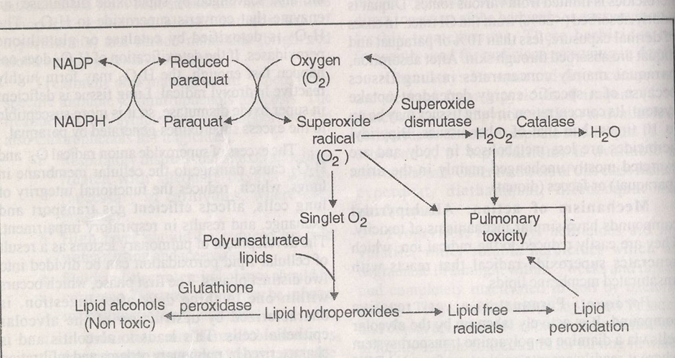
Bipyridal/Bipyridinium Compounds

Slide 12
Paraquat is a very reactive compound.
It is actively taken up by the alveolar cells via a diamine where it readily accepts an electron from NADPH to become reduced paraquat.
When the reduced paraquat is reoxidized by loss of electron, a superoxide anion radical O₂- is generated.
The superoxide radical is unstable and spontaneously breaks down to the reactive singlet oxygen.
The reactive singlet oxygen attacks the polyunsaturated lipids associated with cell membranes to form lipid hydroperoxides.

Slide 13
These lipid hydroperoxides are normally converted to non toxic lipid alcohols by the selenium – containing enzyme glutathione peroxidase.
Selenium deficiency, depletion of glutathione or excess lipid hydroperoxides allow the lipid hydroperoxides to form lipid free radicals.
The action of paraquat in lungs is similar to that produced by carbon tetrachloride in liver.

Slide 14
Small amount of superoxide that are produced normally in tissues are also scavenged by superoxide dismutase, an enzyme that converts superoxide to H2O2
The H2O2 is detoxified by catalase or glutathione peroxidases.
If the detoxification of H2O2 does not happen fast enough, the H2O2 may form highly reactive hydroxyl radical.
Lungs tissue is deficient in super oxide dismutase, so it is more susceptible to the excess superoxides generated by paraquqte.

Slide 15
Signs and Symptoms
Anorexia,
abdominal pain,
vomiting,
pulmonary oedema,
dyspnoea,
jaundice,
tachycardia,
corneal opacity,
ulceration of mm, skin, cyanosis.

Slide 16
Dinitrophenol Derivatives
The dinitro phenol derivatives possess: insecticidal,
fungicidal,
acaricidal
herbicidal actions.
It highly toxic to mammals.

Slide 17
Machanism of Toxicosis:
These uncouple oxidative phosphorylation.
In ruminants – the dinitro derivatives are converted to nitrates, which in turn to nitrites, which after absorption cause methaemoglobinemia. Deplete liver glycogen.
Signs and Symptoms:
Hyperthermia, dyspnoea, acidosis, tachycardia, convulsions, coma and death. Yellow skin, conjunctiva or hair. Corneal opacity (cataract).

Slide 18
Sodium Chlorate:
Rarely used.
Causes hemolysis and methaemoglobin formation.
Chlorobenzoic acid derivatives:
2,3,6 – Trichlorobenzoic acid (2,3,6-TBA).
Mechanism of Toxicosis: Not known.
Signs and symptoms: Like Chlorophenoxy compounds.

Slide 19
Treatment
No specific antidotes.
Symptomatic and supportive treatment.

Slide 20
Thank You

