Slide 1
Herbicides
Dr. Kumari Anjana
Assistant Professor
Deptt. of Veterinary Pharmacology & Toxicology
Bihar Veterinary College, Bihar Animal Sciences University, Patna

Slide 2
Content of the chapter
Introduction
Classification
Mechanism of action
Clinical signs
Diagnosis
Treatment

Slide 3
Herbicides
Herbicides are used routinely to control noxious plants.
Most of these chemicals, particularly the more recently developed synthetic organic herbicides, are quite selective for specific plants and have low toxicity for mammals; other less selective compounds (e.g, arsenicals, chlorates, dinitrophenols) are more toxic to animals.
Most toxicity problems in animals result from exposure to excessive quantities of herbicides because of improper or careless use or disposal of containers: When used properly, problems are rare.
Vegetation treated with herbicides at proper rates normally will not be hazardous to animals, including humans.

Slide 4
Particularly after the herbicides have dried on the vegetation, only small amounts can be dislodged.
When herbicide applications have been excessive, damage to lawns, crops, or other foliage is often evident.
The residue potential for most of these agents is low. However, the possibility of residues should be explored if significant exposure of food-producing animals occurs.
Herbicide poisoning is a rare finding in veterinary practice. With few exceptions, it is only when animals gain direct access to the product that acute poisoning occurs.
Acute signs usually will not lead to a diagnosis, although acute GI signs are frequent.

Slide 5
Classification of Herbicides
On the basis of chemical nature:
Dinitro compound- dinitro ortho cresol (DNOC), dinitrophenol etc.
Phenoxyacetic acids - 2,4-D, 2,4,5-T etc.
Bipyridium compounds- diquat, paraquat etc.
Heterocyclic compounds or triazenes- atrazine, propazine, simizine.
Chloroaliphatic acids - dalapon, sodium chloroacetate, sodium
trichoroacetate etc.
Substituted urea - monouron, diuron,isoproturon etc.
Substituted dinitroaniline - pendimethalin.

Slide 6
Sources
Accidental ingestion of herbicide spills.
Improper disposal of herbicide spills.
Grazing in recently herbicide-sprayed fields.
Malicious poisoning.

Slide 7
Bipyridal/Bipyridinium Compounds
Mechanism of Toxicosis:
Paraquat causes pulmonary toxicity due to damage of the pneumocytes and alveolar fibrosis; release of PGs and proliferation of fibroblasts in lungs – interfere with exchange of gases.
The paraquat cytotoxicity is due to formation of superoxide and oxygen free radicals (O2-).
Inhibit synthesis of DNA and phospholipids.
Lungs are deficient in super oxide dismutase enzyme activity, which converts superoxide to H2O2 and O2.
Hence pulmonary lesions are caused by paraquat.

Slide 8
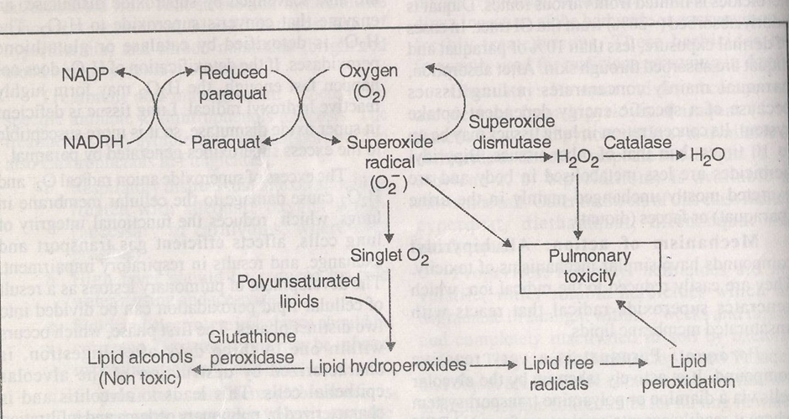

Slide 9
Paraquat is a very reactive compound.
It is actively taken up by the alveolar cells via a diamine where it readily accepts an electron from NADPH to become reduced paraquat.
When the reduced paraquat is reoxidized by loss of electron, a superoxide anion radical O₂- is generated.
The superoxide radical is unstable and spontaneously breaks down to the reactive singlet oxygen.
The reactive singlet oxygen attacks the polyunsaturated lipids associated with cell membranes to form lipid hydroperoxides.
These lipid hydroperoxides are normally converted to non toxic lipid alcohols by the selenium- containing glutathione dependent enzyme glutathione peroxidase.

Slide 10
Selenium deficiency, depletion of glutathione or excess lipid hydroperoxides allow the lipid hydroperoxides to form lipid free radicals.
The action of paraquat in lungs is similar to that produced by carbon tetrachloride in liver.
Small amount of superoxide that are produced normally in tissues are also scavenged by superoxide dismutase, an enzyme that converts superoxide to H2O2.
The H2O2 is detoxified by catalase or glutathione peroxidases.
If the detoxification of H2O2 does not happen fast enough, the H2O2 may form highly reactive hydroxyl radical.
Lungs tissue is deficient in super oxide dismutase, so it is more susceptible to the excess superoxides generated by paraquqte.

Slide 11
Signs and Symptoms
Anorexia, abdominal pain, vomiting, pulmonary oedema, dyspnoea, jaundice, tachycardia, corneal opacity, ulceration of mm, skin, cyanosis.

Slide 12
Dinitrophenol Derivatives
The dinitro phenol derivatives possess insecticidal, fungicidal, acaricidal and herbicidal actions; highly toxic to mammals.
Machanism of Toxicosis: These uncouple oxidative phosphorylation. In ruminants – the dinitro derivatives are converted to nitrates, which in turn to nitrites, which after absorption cause methaemoglobinemia. Deplete liver glycogen.
Signs and Symptoms: Hyperthermia, dyspnoea, acidosis, tachycardia, convulsions, coma and death. Yellow skin, conjunctiva or hair. Corneal opacity (cataract).

Slide 13
Sodium Chlorate: Rarely used. Causes hemolysis and methaemoglobin formation.
Chlorobenzoic acid derivatives: 2,3,6 – Trichlorobenzoic acid (2,3,6-TBA).
Mechanism of Toxicosis: Not known.
Signs and symptoms: Like Chlorophenoxy compounds.

Slide 14
Treatment
No specific antidotes.
Symptomatic and supportive treatment.

Slide 15
Thank You

