Slide 1
SYSTEMIC PATHOLOGY AFFECTIONS OF EYE AND EAR
DR. SANJIV KUMAR
ASSISTANT PROFESSOR,
DEPTT. OF PATHOLOGY, BVC, PATNA

Slide 3
Structure of eye

Slide 4
Anatomical features
The eye ball is located the orbit. It is protected by eyelids, which have stratified squamous epithelium (the conjunctiva) lining the surface that comes into contact with the eyeball.
Just behind the eyelashes are a row of tiny sebaceous glands, the meibomian glands, the secretion of which serves to lubricate the eyelashes, preventing their adhesion.
The lens is a peculiar structure composed entirely of epithelium. It has neither stroma nor vascular tissue. In front it is bathed by the aqueous humor and is nourished by it.
Actually the anterior surface of the lens forms the posterior boundary of the anterior chamber. Its anterior surface is in contact partly with the iris.
Its posterior surface fits into the depression of the vitrous- the hyaloid fossa.
Usually, the conjunctival mucosa is free of bacteria either due to the flushing action of the tears or to the bacteriostatic property of the lysozyme.

Slide 5
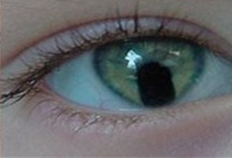
CONGENITAL ANAMOLIES
Anophthalmia congenitus | Complete absence of one or both eyes.
Microphthalmia | One or both eyes are small.
Cyclops | There is only one eye due to fusion of the orbits.
Ankyloblepharon | Both the eyelids are fused together
Starbismus (Squint) | In animals this condition is bilateral with the two eye globules tuning inwards.
Entropion | Turning in of the eyelids
Ectropion | Turning out of eyelids. Usually the lower eyelid is affected.
Coloboma | Failure of the closure of embryonic ocular cleft.

Slide 6
Dermoids of cornea | Due to the sublethal factor. The cornea of one or both eyes is partly covered by skin.
Congenital anterior synechia | There is adhesion between iris and the posterior surface of the cornea.
Microphakia | The lens is small and is spherical.
Luxation of the lens | The dislocated lens is opaque.
Cataract | A condition in which the lens becomes opaque.
Congenital aplasia of retina and hypoplasia of the optic nerve | May be met with in calves and they are born blind.

Slide 7
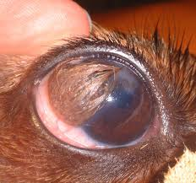
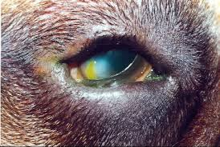
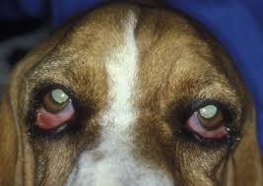
Dermoids of cornea
Cyclops
Entropion
Ectropion

Slide 8
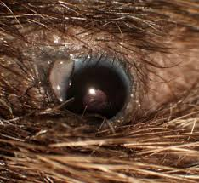
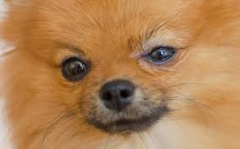
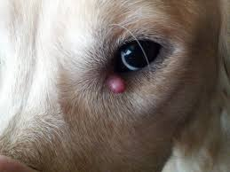
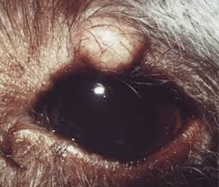
PATHOLOGY OF THE EYELIDS
Trichiasis: Turning in of the eyelashes.
Blepharitis: Inflammation of eyelids.
Hordeolum or stye: Inflammation or even abscess formation of the follicles of an eyelid.
Chalazion: Abscess formation of the
meibomian glands.

Slide 9
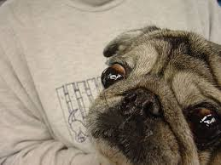
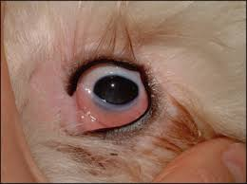
PATHOLOGY OF ORBIT
Exophthalmos:Exophthalmos means
protrusion of the eyeball.
Enophthalmos: Enophthalmos means
sinking of the eyeball into the orbit.
Orbital cellulitis: Inflammation of the
orbit is called orbital cellulitis.

Slide 10
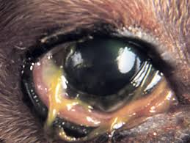
PATHOLOGY OF LACHRYMAL GLAND
Dacryoadenitis: Dacryoadenitis is the inflammation of the lachrymal glands.
Occlusion of lachrymal canal

Slide 11
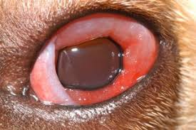
PATHOLOGY OF THE CONJUNCTIVA
Conjunctivitis: Inflammation of the
conjunctiva is called conjunctivitis.
Clinical signs
There is congestion of the conjunctiva and increased production of tears which flow over the face as the lachrymal canal may be closed due to the swelling of the membrane.
Croupous or diphtheritic conjunctivitis is mostly encountered in fowls. In cattle infection by S. necrophorous causes croupous conjunctivitis.

Slide 12
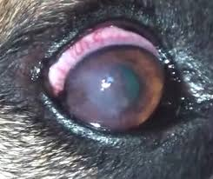
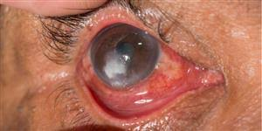
PATHOLOGY OF THE CORNEA
Pannus: Pannus is a condition in which
vascular granulation tissue is found
between the corneal epithelium and the
Bowman’s membrane.
Keratitis: Inflammation of the cornea
is called keratitis.
Corneal ulceration occurs during acute or chronic conjunctivitis. There may be prolapse of the iris through the rupture (Staphyloma), followed by dislocation of the lens.
Infectious keratoconjunctivitis in cattle (Pink eye)
The causative organism is Moraxella bovis which is gram negative and is found in the tears. An endotoxin that causes necrosis of the skin is produced by this organism.

Slide 13
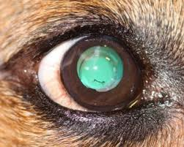
PATHOLOGY OF THE LENS
Luxation of the lens
The lens is anchored by the suspensory ligaments to the ciliary body. If these ligaments are ruptured, the lens may be displaced into the anterior chamber or into the hyaloid fossa or into the vitreous.
Cataract : Opacity of the lens is known as cataract.
Congenital: Failure of the hyaloid artery to regress and disappear completely or Impairment of translucence of the lens due to abnormal arrangements of the lens fibres .
Acquired: Degeneration of the lens due to Trauma, Luxation, Senility, Diabetes mellitus, deficiency of vitamin D; deficiency of vitamin C in the lens; deficiency of cystein

Slide 14
Types of Cataract
Cataract may be partial or complete depending on its situation.
Depending on the nature of the lesion, cataract is classified as follows:
Subcapsular cataract: In this condition there is abnormal proliferation of the lens epithelium.
Cortical cataract: This is the most common form and involves the lens fibres.
Lamellar cataract : It may be congenital or acquired and results due to some injury during development.
Nuclear cataract: Are probably the results of senile changes in which the fibres at the centre become denser thereby making the nucleus dull or hazy.

Slide 15
PATHOLOGY OF THE UVEAL TRACT
Anterior synechia: Anterior synechia is the condition in which there is adhesion of the iris to the posterior surface of the cornea.
Posterior synechia: Posterior synechia is the adhesion of the posterior surface of the iris to the anterior surface of the lens capsule.
Iridocyclitis: This is the inflammation of iris and ciliary body and is also known as anterior uveitis. This condition in horses is known as periodic opthalmia.

Slide 16
PATHOLOGY OF THE IRIS
Mydriasis: Dilatation of the pupil is known as mydriasis. This can be brought about by various drugs like atropine, hyocyamine and stramonium, cocaine, adrenaline and amphetamine.
Myasis: Constriction of the pupil is known as myasis. This can be brought about by pilocarpine, physocarpine and ergotamine.

Slide 17
PATHOLOGY OF THE RETINA
Progressive retinal atrophy in dogs
Detachment of retina

Slide 18
PATHOLOGY OF THE OPTIC NERVE
Atrophy
Etiology
o Congenital
o Acquired: Retinitis, glaucoma; choroidoretinitis, trauma on occiput, hemorrhages; poisons; morphine, deficiency of vitamin A.
Sequelae
o The optic papillae become thinned with disappearance of the interstitial capillaries.
o Retinal degeneration follows atrophy of the optic nerve fibre.
o Total blindness results ultimately.

Slide 19
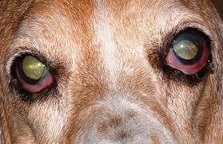
GLAUCOMA
Glaucoma is a condition in which there is increased intraocular pressure leading to secondary changes in the eyeball like enlargement of eye ball, opaque cornea and increase aqueous humor.
It may be unilateral or bilateral
Increased intraocular pressure may result from a) too excessive a secretion of the aqueous humor or b) hindrance in its drainage.
Primary glaucoma: If the causes that give rise to obstruction of the flow, leading to glaucoma cannot be determined with certainty, the condition is known as primary glaucoma.
Secondary glaucoma: If the causes for such obstruction can be determined, the condition is known as secondary glaucoma .

Slide 20
PATHOLOGY OF EYE BALL
Ophthalmitis is Inflammation of the eye ball.
Xerophthalmia is abnormal dryness of the eye ball, with inflammation and ridge formation, typically associated with vitamin A deficiency.

Slide 21
NEOPLASMS OF THE EYE
Primary neoplasms
Squamous cell carcinoma, especially in the bovines, is the most common neoplasm.
Adenomas and adenocarcinomas of the lachrymal gland and Harderian glands may be met with.
Adenoma and Adenocarcinoma of the ciliary epithelium and iris may occur.
Secondary matastases
Secondary matastases of carcinoma, sarcomas, melanoma, lymphosarcoma, meningioma and the venereal tumor may be met with.

Slide 22
POSTMORTEM CHANGES
Postmortem changes in the eye includes dryness of the eyeball, pupillary dilatation and detachment of the retina.

Slide 24
Structure of ear

Slide 25
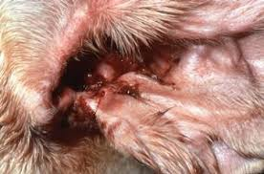
External ear Consists of the concha, the external auditory meatus and the ceruminous glands
Otitis externa: Inflammation of the external ear.
Macroscopic features
Swelling and congestion leading to obstruction of ear canal.
Excessive production of thick, tenacious and brownish wax.
Granulomatous lesions filling the external auditory meatus
Microscopic features
Granulomatous lesions of actinomycosis in subcutaneous region around the cartilage

Slide 26
AURICULAR HAEMATOMA

Slide 28
MIDDLE EAR Consists of the tympanic cavity, the ossicles and the eustachian tubes. In horse, guttural pouches are diverticula of the eustachian tubes
The epithelium lining the tympanic cavity is continuous with the nasal mucosa through the eustachian tubes and so infection from the nose and pharynx can extend into the middle ear.
Otitis media: Inflammation of the middle ear.
Features
Occlusion of Eustachian tube
Purulent inflammation

Slide 29
INTERNAL EAR (LABYRINTH OF THE EAR) The bony labyrinth, a cavity in the temporal bone, is divided into three sections: the vestibule, the semicircular canals, and the cochlea. Within the bony labyrinth is a membranous labyrinth, which is also divided into three parts: the semicircular ducts; two saclike structures, the saccule and utricle, located in the vestibule; and the cochlear duct, which is the only part of the inner ear involved in hearing.
Otitis interna: Inflammation of internal ear.
Macroscopic features
Disturbance in equilibrium
Deafness
Microscopic features
Suppurative inflammation

