Slide 1
VETERINAY ANATOMY,
UNIT- 6,
TOPIC- Details Description of TARSAL Bones along WITH muscles OF DIFFERENT ANIMALS
Instructor- DR. SANJAY KUMAR BHARTI
HOD, VETERINARY ANATOMY

Slide 2
STUDY ABOUT TARSAL BONES WITH ITS MUSCULATURES- OX, SHEEP,GOAT,HORSE,PIG,DOG,FOWL
TARSAL BONE- OX
The tarsus is composed of five short bones arranged in below:
Medial Lateral
Proximal row Tibial tarsal Fibular tarsal
Central row Fused Central and 4th tarsal
Distal row First tarsal Fused second & third tarsal

Slide 3
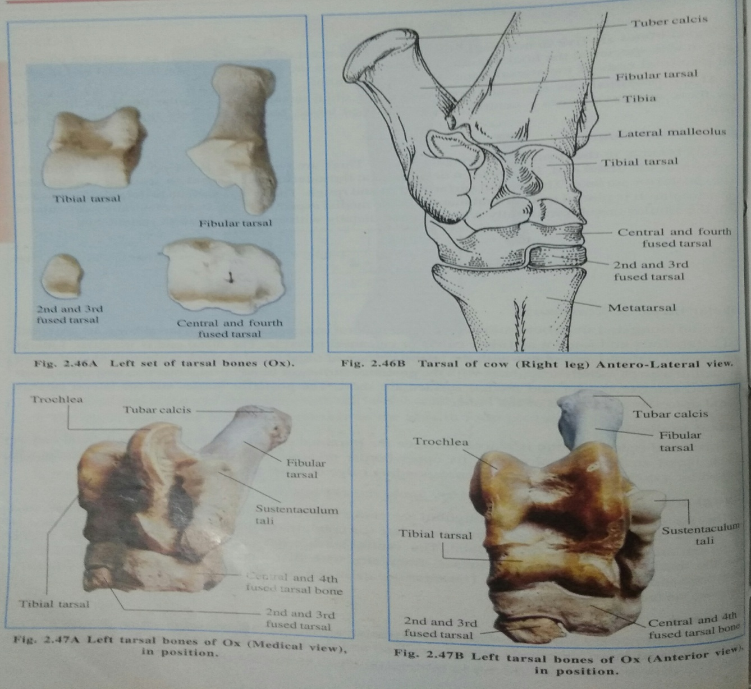
Location of Tarsal Bone in ox

Slide 4
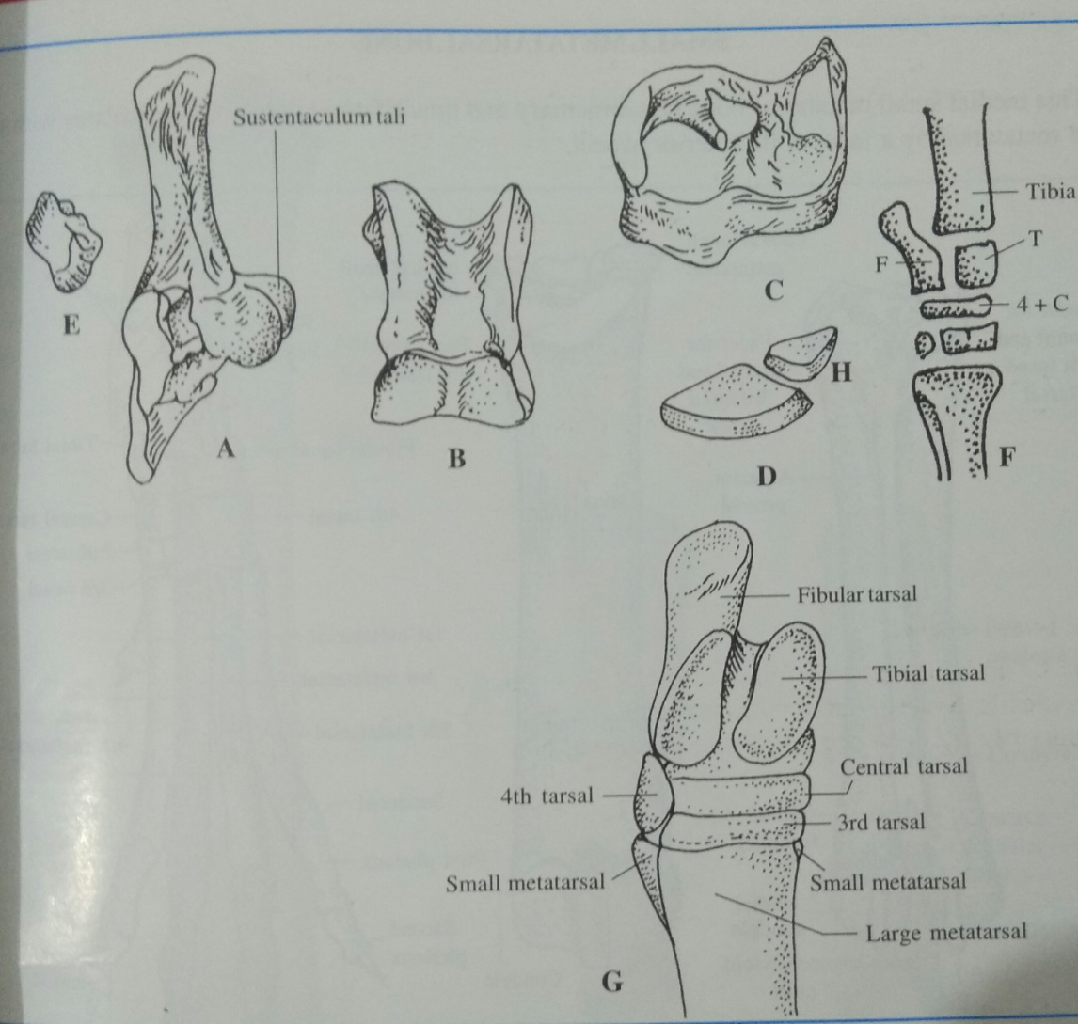
Tarsal bones of Ruminanats

Slide 5
Fibular tarsal (os calcis or Calcaneous )
It is the largest tarsal, is placed postero-lateral to tibial tarsal.
It has body and medial process
The body is prolonged above as tuberous to form the tuber calcis or calcaneal tubercle or Point of Hock + Achilles Tendon-Gastrocnemius.
Medial process – from here thick projection extended which articulated with tibial tarsal that is known as the sustentaculum tali.
The lateral face of the body is flat and rough while the medial face presents two facets for the tibial tarsal.
.

Slide 6
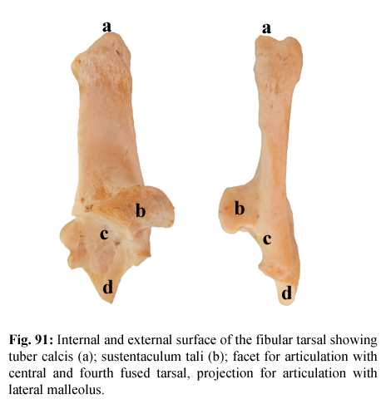
Internal and external surface of the fibular tarsal showing tuber calcis (a), sustentaculum tali (b), facet for articulation with tibial tarsal (c); projection for articulation with lateral malleolus (d).

Slide 7
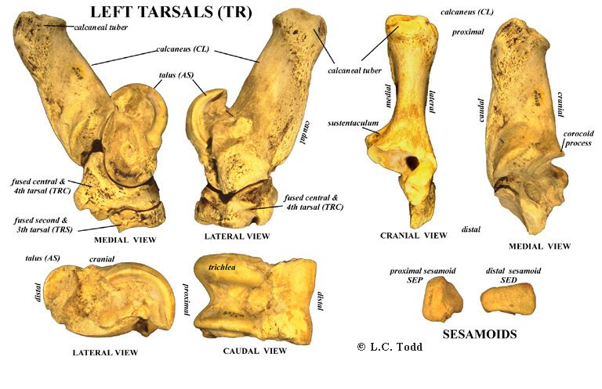
Tarsal Bone – OX-(Sheep and Goat
Similar to that of ox)

Slide 8
Tibial tarsal (Talus or astragalus)
Tarsal bone located just below the tibia bone & elongated pully like. It has six surfaces. Proximal, Distal, Anterior, Posterior, Lateral & Medial.
The proximal face form a trochlea with two vertical ridges + Tibia bone.
Distal face having 2 condyles articulates with the fused central and 4th tarsal.
The Anterior face having a deep fossa. The Posterior face- smooth.
The Lateral face is more depressed and shows two facets for the fibular tarsal
The Medial face is flat and rough
.

Slide 9
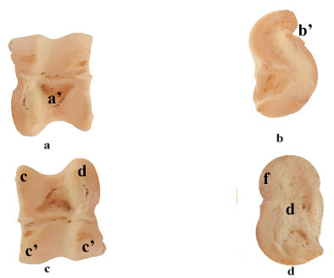
Surfaces of the tibial tarsal showing anterior surface (a) having synovial fossa (a’), posterior surface (b)bearing large oval facet (b’) for articulation with fibular tarsal, proximal surface (c) bearing trochlea (c’) for articulation with tibia and fibula, distal surface (d) bearing condyles (d’) for articulation with central and fourth tarsal, medial surface (e) non articular surface and lateral surface (f) articular facet for fibular tarsal

Slide 10
Fused central and fourth tarsal (scapho-cuboid)
- Plate like bone extends throughout the entire thickness of the joint Having 6 surfaces- Proximal, Distal, Anterior, Posterior, Lateral & Medial
The proximal/Dorsal face presents two concave areas for the condyle of tibial tarsal.
The distal/ face is uneven.
The medial half is higher in level and presents a large facet in front for second and third tarsal and a small facet behind for the first tarsal.
The lateral half presents two facets separated by a transverse groove and articulates with the large metatarsal bone.
Anterior, Lateral & Medial- Rough and continuous (semicircle in outline)
Posterior- Irregular

Slide 11
First tarsal (cuneiform parvum)
It is a small round piece of bone or small nodules like bone situated at the postero-medial aspect of the tarsus.
Having 3 articular surface-
The Proximal face articulates with the fused central and 4th tarsal.
The Distal face with the large metatarsal
The Anterior face with the fused second and third tarsal.

Slide 12
Fused 2nd and 3rd tarsal (cuneiform magnum)
Look like one-fourth piece of a thick coin
It is placed beneath the fused central and 4th tarsal on its medial aspect.
Having 6 surfaces
The Proximal face is concavo-convex from before backward and articulates with the fused central and 4th tarsal.
The Distal face articulates with the large metatarsal.
The Plantar face has a facet for the first tarsal.
The Anterior, Lateral and Medial faces are continuous, convex and rough.

Slide 13
Tarsal Bone – OX-(Sheep and Goat
Similar to that of ox)

Slide 14
TO STUDY ABOUT Tarsal Bones and its musculature of horse, SHEEP & GOAT, PIG, DOG AND FOWL
The tarsus is composed of Six short bones arranged in below:
Medial Lateral
Proximal row Tibial tarsal Fibular tarsal
Central row Central
Distal row Fused 1st & 2nd tarsal 3rd Tarsal 4th Tarsal

Slide 15
Tarsal Bone- Horse-Conti….
In the tibial tarsal, the ridges of the trochlea curve obliquely downward and outward. The lateral face has no facets for the fibular tarsal.
The fibular tarsal is short and thick. It does not articulate with the lateral malleolus. The medial process is larger.
The central tarsal (scaphoid) is not fused to the fourth tarsal (cuboid).
It is flat and irregularly quadrilateral. The proximal face is concave and articulates with the tibial tarsal. The distal face is convex and articulates with the third tarsal and the fused 1st and 2nd tarsal. The dorsal and the medial borders are continuous and rough. The lateral border is oblique and has two faces for the cuboid.
.

Slide 16
Tarsal Bone- Horse-Conti….
The fused 1st and 2nd tarsal (cuneiform parvum) is irregular in shape. The medial face is convex. The lateral face is concave. The proximal face is concave and has two facets for the central tarsal. The distal face articulates with the large and the medial small metatarsals. The plantar end is prolonged downward into a nodular projection.
The third tarsal (cuneiform magnum) is triangular in outline. The proximal face is concave and articulates with central tarsal. The distal face is convex and is for the large metatarsal. The medial border has no facet for the fused 1st and 2nd tarsal and the lateral has two facets for the fourth tarsal.
The fourth tarsal (cuboid) has six surfaces. It is not fused to the central tarsal. The proximal face is convex transversely and is for the fibular tarsal and the tibial tarsal. The distal face presents two facets separated by a sagittal ridge for the lateral small metatarsal bones. The medial face has facets for the central and the third tarsal. The dorsal, lateral and the plantar surfaces are convex and rough

Slide 17
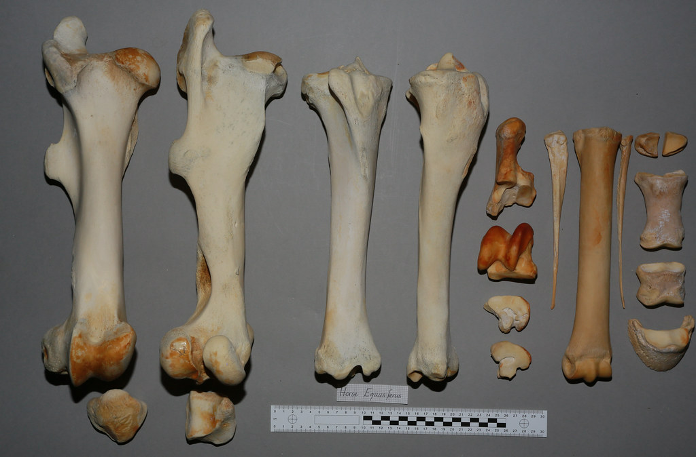
Femur, Tibia, Fibula, Patella, Tarsal, Metratarsal, Splint & Digits of Horse

Slide 18
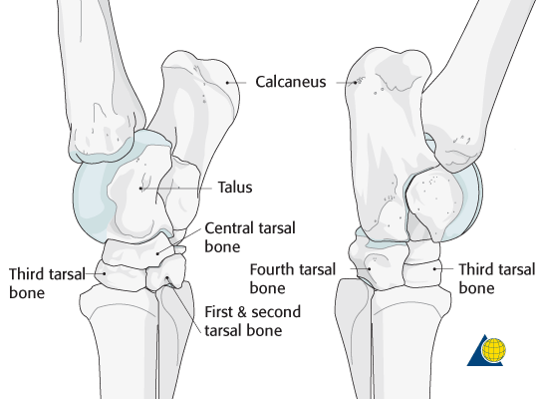
Tarsal Bone- Horse.

Slide 19
TARSAL - PIG
The tarsus is composed of Seven short bones arranged in below:
Medial Lateral
Proximal row Tibial tarsal Fibular tarsal
Central row Central Tarsal
Distal row 1st Tarsal 2nd Tarsal 3rd Tarsal 4th Tarsal

Slide 20
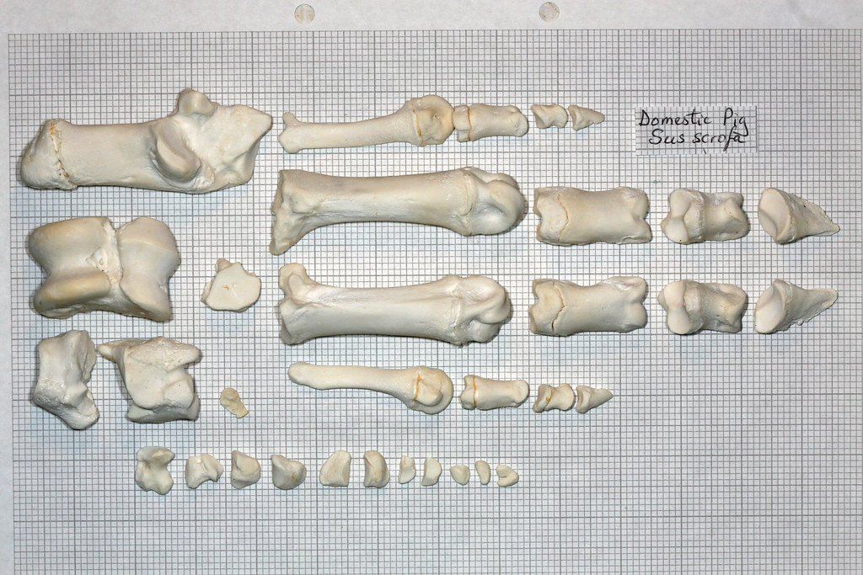
Tarsal, Metratarsal, & Digits of pig

Slide 21
TARSAL- Dog
The tarsus is composed of Seven short bones arranged in below:
Medial Lateral
Proximal row Tibial tarsal Fibular tarsal
Central row Central Tarsal
Distal row 1st Tarsal 2nd Tarsal 3rd Tarsal 4th Tarsal

Slide 22
TARSAL OF DOG
1- Fibular tarsal is elongated.
2-Tibial tarsal has a head, body and neck.
3-Central tarsal articulates with little with all.
4- First tarsal is quadrilateral in shape.
5- Second tarsal is smallest.
6- Third tarsal is wedge shaped.
7-Fourth tarsal irregular cube like.

Slide 23
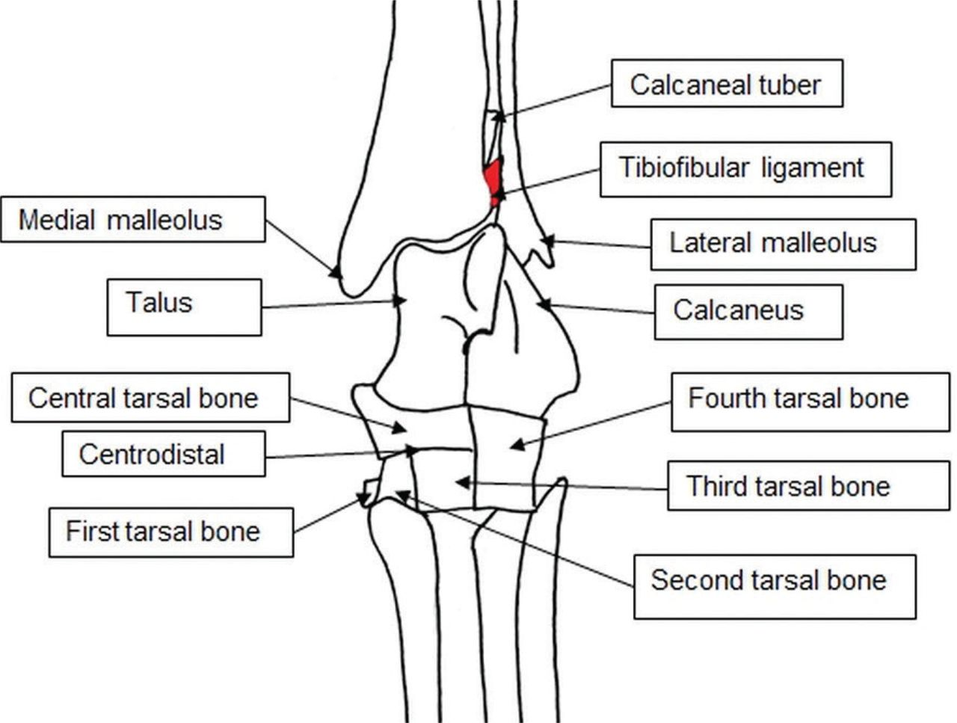
TARSAL BONE-DOG

Slide 24
TARSAL BONE - FOWL
Fowl
The tarsus bone is absent as such in the adult.
In the proximal row the embryonic elements fuse with the tibia and in the distal row with the metatarsus.

