Slide 1
VETERINAY ANATOMY, UNIT- 6, TOPIC-Details Description of Metatarsal Bones along muscles of with of Different domesticated animals
Instructor- DR. SANJAY KUMAR BHARTI
HOD, VETERINARY ANATOMY

Slide 2
STUDY ABOUT METATARSAL BONE ALONG WITH ITS MUSCULATURES - OX, SHEEP,GOAT, HORSE, PIG DOG AND FOWL
Ox -The metatarsus has fusion two bones -the large (third and fourth) and the medial small (second) metatarsal bones.
Large metatarsal bone (third and fourth)
-Long bone, ODV in Position, In between Hock Joint- Fetlock Joint, Having 2 Extremities and a Shaft.
It resembles with large metacarpal except for the following differences
The bone is longer than metacarpal.
The proximal extremity presents a flattened facet laterally for the fused central and 4th tarsal and a large facet on the medial aspect for the fused 2nd and third tarsal behind which is another small facet for the first tarsal.
At its postero medial aspect, this extremity presents a facet for the small metatarsal bone

Slide 3
METATARSAL OF OX……

Slide 4
METATARSAL BONE ox Cont..
Proximal Extremity- The dorso-medial aspect presents a tuberosity for the attachment of the tendon of the peroneus tertius.
The Shaft is four sided- Having- dorsal metatarsal groove i.e deeper
Plantar face/ Posteriorly presents a shallow groove. Commencing at the upper part of the groove is a vascular tunnel passing obliquely upward and forward through the proximal extremity to open on the articular face of the extremity behind and between the facets.
The Distal extremity resembles that of the large metacarpal. Having- Distal foramen, Two Condyles (Medial & Lateral) Ridge & Intercondyloid cleft.

Slide 5
METATARSAL BONE ox Cont..

Slide 6
SMALL METACARPAL-OX
Medial small metatarsal
The medial small metatarsal is disc shaped piece of bone situated at postero-medial aspect of the proximal extremity of the large metatarsal bone.
It presents small facet on its dorsal face for the large metatarsal. The rest of the bone is rough.

Slide 7
METATARSAL- SHEEP & GOAT SIMILAR TO THAT OF OX.

Slide 8
METATARSAL & SPLINT BONE- HORSE
It has three metatarsal -one large-3rd (third) and two small (second and fourth) medial and lateral metatarsals (SPLINT BONE) .
The large metatarsal resembles the large metacarpal.
The vertical groove presents in the ox are absent.
The proximal extremity presents facets for the third tarsal, the fourth tarsal and sometimes the second tarsal. The shaft is cylindrical.
The small metatarsals, each has two small facets in front for the large metatarsal.

Slide 9
METATARSAL – HORSE cont..

Slide 10
METATARSAL - HORSE

Slide 11
METATARSAL - HORSE
The lateral (fourth) metatarsal is relatively massive, especially in its upper part.
The proximal extremity is large and outstanding and bears one facet above for the fourth tarsal.
The medial bone (second metatarsal) is much more slender than the lateral especially in its proximal part, which bears two facets above for the first the second tarsal and sometimes one for the third tarsal

Slide 12
METATARSAL-DOG Five metatarsals are present. The first is small flat in shape, and the other four are well developed , longer and resemble the metacarpals.

Slide 13
METATARSAL-DOG

Slide 14
METATARSAL- PIG FOUR IN NUMBER The second and fifth are placed more towards the plantar aspect of the large bones

Slide 15
TARSOMETATARSAL- FOWL
The tarso-metatarsus is a single bone formed by the fusion of the distal row the tarsals with the second, third and fourth metatarsals.
The proximal extremity presents two glenoid cavities for the distal end of the tibio-tarsus.
The shaft is two-sided.
The first metatarsal is attached by ligament to the postero-medial border of the large metatarsus. In the male, a conical projection arises from the medial aspect of the body of the metatarsus and serves as a core for the horny spur or calcar.

Slide 16
FEMUR,TIBIAOTARSAL & TARSOMETATARSAL- FOWL

Slide 17
TARSOMETATARSAL- FOWL
The distal extremity divides into three processes.
Each process is in the form of an articular convexity. The medial one is the shortest and articulates with the second digit.
The middle one is the longest and articulates with the third-digit.
The lateral one articulates with the fourth digit.

Slide 18
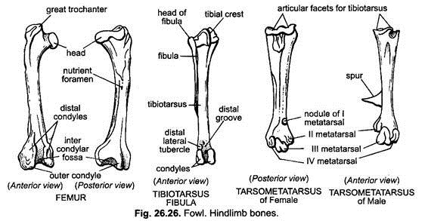
FEMUR,TIBIAOTARSAL & TARSOMETATARSAL- FOWL
FEMUR,TIBIAOTARSAL & TARSOMETATARSAL- FOWL

