Slide 1
AZOTURIA
Dr Sonam Bhatt
Asstt Prof
Veterinary Medicine
BVC, Basu

Slide 2
Exertional rhabdomyolysis
Tying-up
“Cording-up” Syndrome of Horses
Paralytic myoglobinuria
Monday Morning Disease

Slide 3
Multifactorial myopathy
Mainly affects draft horses
Metabolic muscular disorder of horses
Clinically characterised by –
Stiffness in gait & reluctance to move
Lameness
Hardening of massive muscles
In severe cases ----myoglobinuria

Slide 4
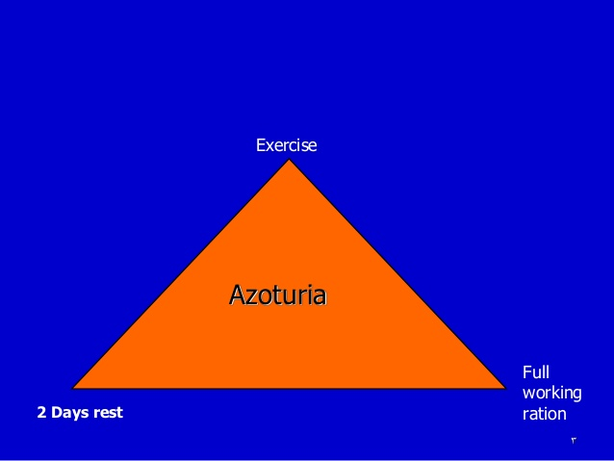
Disease occurs during exercise after a period of atleast 2 days of complete rest on a full working ration

Slide 5
PATHOGENESIS
During exercise the large store of glycogen formed during the period of rest in the muscles metabolized to sarcolactic acid
2- Accumulation of lactic acid leads to:
a- Degeneration of the muscles and liberation of myoglobin (muscle haemoglobin)
b- Swelling of muscle because lactic acid is hydrophilic

Slide 6
Clinical Signs
In very mild cases: only poor performance
Mild cases: stiffness in gait
Severe cases:
Profuse sweating, stiffness in gait & reluctance to move
Horse assumes a dog-sitting position followed by lateral recumbency, laying down & repeated attempts to rise, often with nervous signs

Slide 7
Rapid respiration, weak pulse & temp. may rise to 40.5 C
Hard board like muscles particularly of hind legs
Dark-red brown urine (myoglobinuria)

Slide 8
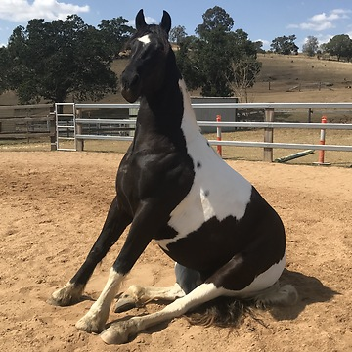
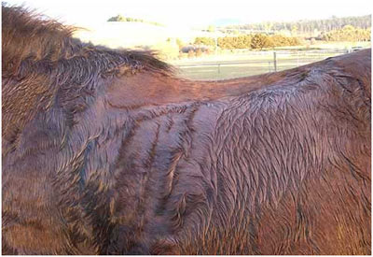
Dog sitting posture
Red color urine
Sweating

Slide 9
Prognosis
Good if animal remains standing
Death occur in recumbent horse due to decubital septicemia or myoglobinuric nephrosis & uraemia

Slide 10
DIAGNOSIS
History
Clinical signs
Laboratory diagnosis:
Determination of muscle specific enzymes CPK & AST
Histopathology:
Hyaline degeneration of heavy muscles (Zenker’s necrosis), myonecrosis

Slide 11
TREATMENT
Animal should be kept as quiet as possible, and attempts should be made to keep it standing
Good nursing care & precautions taken to prevent development of decubital ulcers
Nervous, restless animals, or those showing evidence of pain, should be given sedatives such as chloral hydrate or tranquilizers

Slide 12
Give Na bicarbonate IV or orally for alkalization of urine to minimise nephrotoxicity
I/V injection of large quantities of fluids and electrolytes to maintain high rate of urine flow to avoid renal tubule blockage and subsequent uraemia
I/M injection Thiamine daily to increase the tolerance of blood to lactic acid by increasing lactic acid metabolism

Slide 13
NSAIDs such as Flunixin and Phenylbutazone may be used to control the pain
Antihistaminics, Vit. E & selenium may be useful

