Slide 1
Anaplasma
Dr. AJIT KUMAR
HoD
Department of Veterinary Parasitology
Bihar Veterinary College
Bihar Animal Sciences University
Patna-800014
Image source: Google image

Slide 2
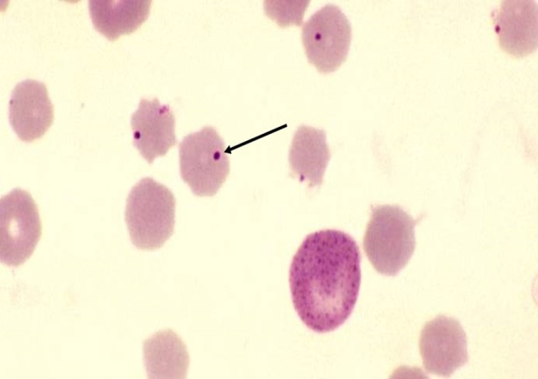
Order : Rickettsiales Genus: Anaplasma
Anaplasma species appear as small (0.2-0.5 µm in diameter), round, dark red bodies with no cytoplasm and with a light halo may found around them inside the erythrocytes.
One erythrocytes may occasionally have more than one organisms.

Slide 3
Genus: Anaplasma
Species | Definitive host | Location | Transmission/ Vector
Anaplasma marginale | Cattle | usually near the margin of RBCs | Various species of ticks, flies, contaminated surgical instruments etc.
Anaplasma centrale | -do- | In the centre of RBCs | -do-
Anaplasma ovis | Sheep and goat | RBC | -do-

Slide 4
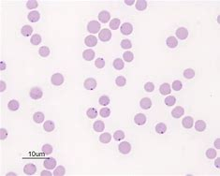
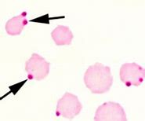
Anaplasma marginale
Anaplasma marginale found on or near the margin of erythrocytes in stained blood films.
Image source: Google image

Slide 5
Anaplasma marginale
Transmission:
Transmitted through various species of ticks (transovarian transmission), biting flies and even mosquitoes (mechanical transmission) help in transmission of anaplasmosis.

Slide 6
Anaplasma marginale
Transmission:
Disease can also be transmitted mechanically by infected blood contaminating the hypodermic needle, use in mass vaccination and castration, ear tagging and dehorning instruments.
Source of infection is always the blood of an infected animal.

Slide 7
Life- cycle of A. marginale
Image source: Google image

Slide 8
Anaplasma marginale
Disease : Anaplasmosis or gall sickness
Pathogenesis :
Anaplasmosis is a disease of adult cattle and clinical anaplasmosis is mostly seen in cattle above 18 months of age.
Younger animals are susceptible to infection but clinical symptoms do not occur.

Slide 9
Anaplasma marginale
Pathogenesis
Anaplasma organisms infected erythrocytes are engulfed (erythrophagocytosis) by the cells of reticuloendothelial system (Spleen and bone marrow) and cause extra vascular haemolysis leading to anaemia.

Slide 10
Anaplasma marginale
Symptoms:
Fever, anorexia, anaemia, jaundice and may be abortion in pregnant cows.

Slide 11
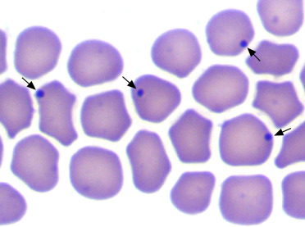
Anaplasma marginale
Diagnsosis:
On the basis of symptoms.
Microscopic examination of stained blood smear revealed round and dark red bodies inside the erythrocytes.

Slide 12
Anaplasma marginale
Treatment :
Oxytetracycline @6-10 mg/kg b.wt i/m is drug of choice in treatment of anaplasmosis.
Amvac and Anaplaz vaccines have been prepared against Anaplasma marginale.

Slide 13
THANK YOU

