Slide 1
APOPTOSIS
DR. SANJIV KUMAR
ASSTT. PROFESSOR, DEPTT. OF PATHOLOGY
BVC, BASU, PATNA

Slide 2
CONTENTS
INTRODUCTION
EXAMPLES
BIOCHEMICAL FEATURES
MORPHOLOGICAL FEATURES
MECHANISM

Slide 3
INTRODUCTION
A pathway of cell death induced by a tightly regulated suicidal programme
Word “ptosis” means Shedding off or fall off.
Active form of cell death
Requires energy
Mediated by Caspases (a family of proteins)
Does NOT elicit inflammation like typical necrosis
Acts at the individual cell level or small clusters
Balance to mitosis

Slide 4
Often called Programmed cell death which helps in:
Deletion of un-needed cells during embryogenesis
Normal involution
Regression of hyperplasia /tumour
Removal of viruses
Immunity

Slide 5
Caspases
KEY PLAYER
What is this
Cysteine dependent
aspartate directed
Proteases

Slide 6
Examples
In which situation
APOPTOSIS
PATHOLOGICAL
PHYSIOLOGICAL

Slide 7
Physiologic Situations
Death by apoptosis is a normal phenomenon that serves to eliminate cells that are no longer needed
Embryogenesis - Implantation - Organogenesis
Hormone dependent involution
Cell deletion in proliferating pools
Death of senile cells
Elimination of self reactive lymphocytes
Cell death induced by cytotoxic T-cells

Slide 8
Pathologic Situations
Cell death following an injury
Cell injury in some viral diseases - Viral hepatitis
Pathogenic atrophy in some organs - Duct obstruction
Cell death in some tumors

Slide 9
Biochemical Features

Slide 10
Biochemical Features
Apoptotic cells usually exhibit a distinctive constellation of biochemical modifications that underlie the structural changes in cells
Protein cleavage
Activation of endonucleases
Phagocytic recognition

Slide 11
protein cleavage
Occurs via activation of several members of cysteine protease family (caspases)
Activates several proteases which acts on microfilaments like laminin, actin etc.
Break up nuclear scaffold & cytoskeleton

Slide 12
DNA breakdown
Apoptotic cells exhibit characteristic breakdown of DNA into 50-300 kb pieces –
There is intra-nucleosomal cleavage into multiple 180-200 bp fragments by CA2+ & Mg2+ dependent endonucleases
Resembles ladders on a gel (on agarose gel electrophoresis)

Slide 13
Phagocytic recognition
Apoptotic cells express phosphatidylserine in outer layer of the membrane - Allows for early recognition of apoptotic cells by macrophages resulting in phagocytosis without the release of proinflammatory cellular components

Slide 14
Morphological features

Slide 15
Morphological features
Cells shrink & round up
Cells become more dense
Cells detach from neighbors
Chromatin becomes very dense & separates into homogeneous masses
Cells will undergo budding & blebbing -Buds break off to become apoptotic bodies
Phagocytosis by surrounding cells
Removal of apopotic bodies

Slide 16
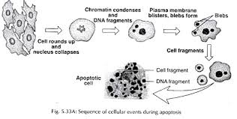

Slide 17
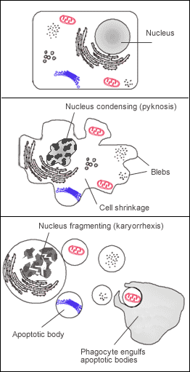

Slide 18
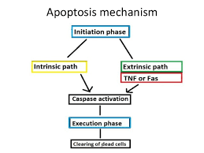
Mechanism

Slide 19
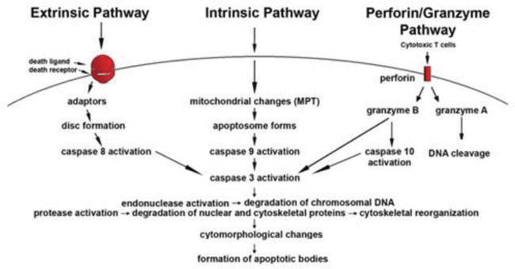

Slide 20
Extrinsic (Death Receptor) pathway
Initiated by engagement of cell surface death receptors
Type 1 TNF receptor (TNFR1), Fas (aka CD95)
Fas is cross-linked by a ligand (FasL)
3 or more FasL molecules come together & their cytoplasmic death domains from a binding site for FADD
FADD then binds pro-caspase 8 (10 in humans) which cleave each other to become active
Initiation of caspase cascade
APOPTOSIS

Slide 21
Intrinsic (mitochondrial) Pathway
Withdrawl of growth factors or cell stress
Increased permeability of mitochondrial membrane
Result of increased mitochondrial permeability & release of pro-apoptotic molecules into the cytoplasm
Leakage of cytochrome C
Cytochrome C binds to Apaf-1 in the cytoplasm
Caspase 9 is activated
Caspase cascade
APOPTOSIS

Slide 22
Cytotoxic T-cell (by-pass) method
Bypass mechanism for cells that refuse suicide via extrinsic or intrinsic
Cytotoxic T-lymphocytes recognize foreign Ag present on infected cell membranes
On recognition, CTLs release perforins (allows entry of granzyme B, a serine protease )
Gransyme B cleaves proteins at aspartate residues & activates several caspases
Most commonly seen with viral infections

Slide 23
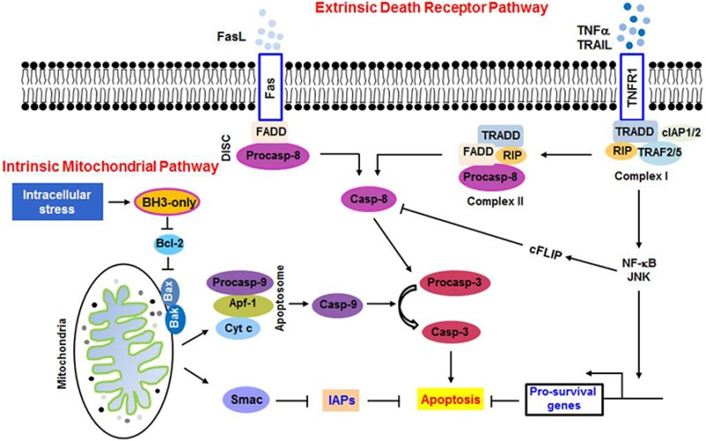

Slide 24
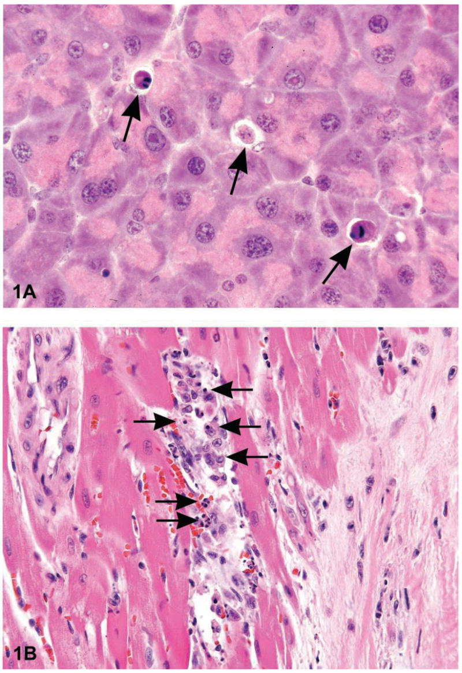
HISTOPATHOLOGY

Slide 25
DON’T CONFUSE WITH
Necrosis: death of cells & tissues while the body is whole (still living) - Note it is an inflammatory response - Some cells & tissues are dead.
Autolysis: also called self-digestion - destruction of tissues by certain substances (such as enzymes) that are produced within the organism

Slide 26
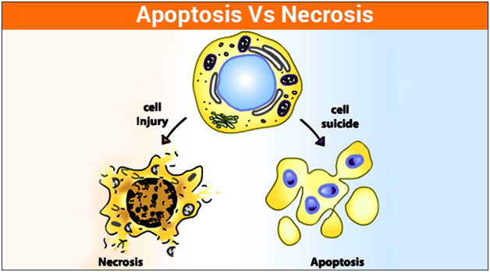

Slide 27
THANK YOU

