Slide 1
AVIAN INFECTIOUS BRONCHITIS
DR. SANJIV KUMAR
ASSISTANT PROFESSOR,
DEPTT. OF PATHOLOGY, BVC, PATNA

Slide 2
INTRODUCTION
Highly infectious and contagious respiratory disease of chicks
Also affect the oviduct, intestine and kidneys
Great economic importance due to its adverse effect on egg production in layers, and on production in broilers
Other pathogens such as mycoplasma or E. coli increases the severity and duration of the disease

Slide 3
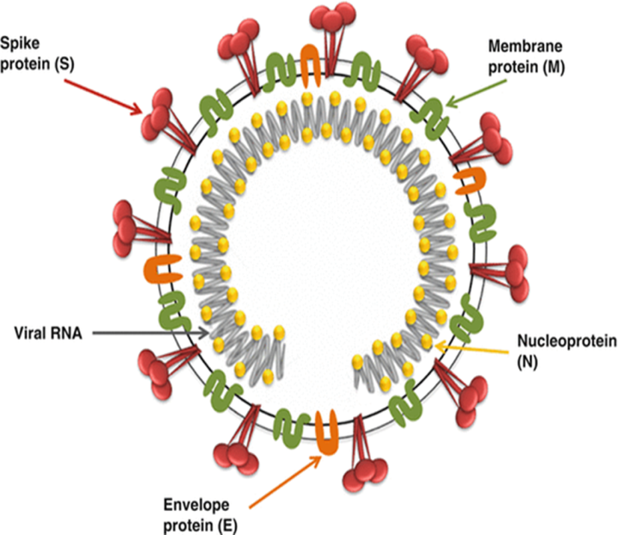
ETIOLOGY
Avian infectious bronchitis virus
(IBV), a coronavirus.
Affect only chickens
Direct spread by Airborne transmission
Egg transmission is exceptional.

Slide 4
PATHOGENESIS
Different serotypes
o Respiratory tract - massachusetts and connecticut
o Nephrotoxic - T, Gray and Holte
New virus appear 3-4 hours after infection
Maximum output per cell within 10-12 hrs.
Incubation period: 1-3 days.
The virus first attack tracheal cells, multiply and then reaches different organs like kidneys, oviduct etc.

Slide 5
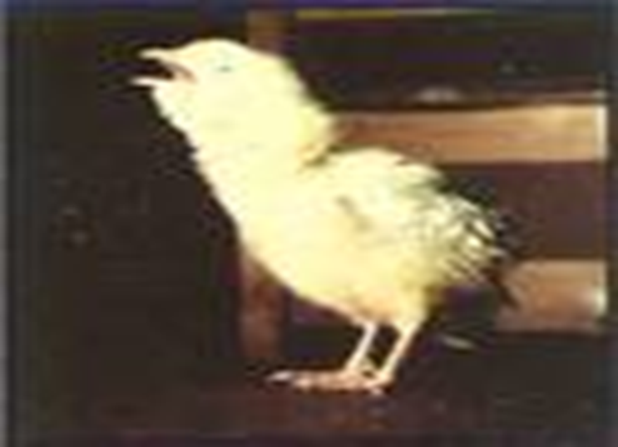
CLINICAL SIGNS
Spread very fast.
Morbidity is 100%, Mortality varies according to the virus strain.
Respiratory form
In young chicks IB, causes asphyxia, preceded by severe respiratory distress.

Slide 6
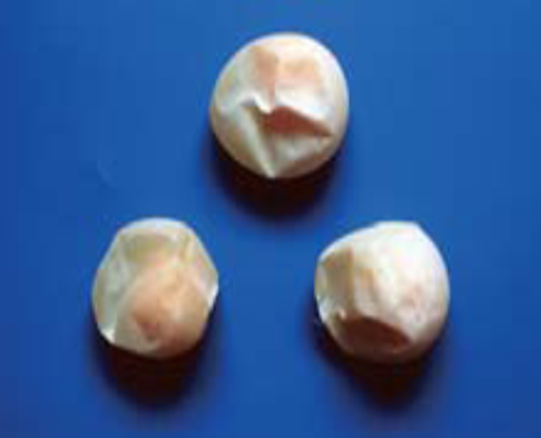
Reproductive form
Damage oviduct.
Egg internal quality changes (watery albumin)
Egg deformed.
Renal (Nephritic) form
Young growing birds
Mortality upto 30 %.

Slide 7
Macroscopic lesions
Respiratory tract
Mucus and redness (no haemorrhage) in trachea, froth in air sacs in older chickens.
In young chicks a yellow cheesy plug at the tracheal bifurcation is indicative of IB infection.
Reproductive tract
Fluid yolk material may be found in the abdominal
Abnormal ovary having the misshapen follicles
Egg- Outer surface - Ridges or concretions
Watery albumin
Nephrotic form
Swollen, pale kidneys, with tubules and ureters distended with urates
In layers, urolithiasis is associated with certain dietary factors

Slide 8
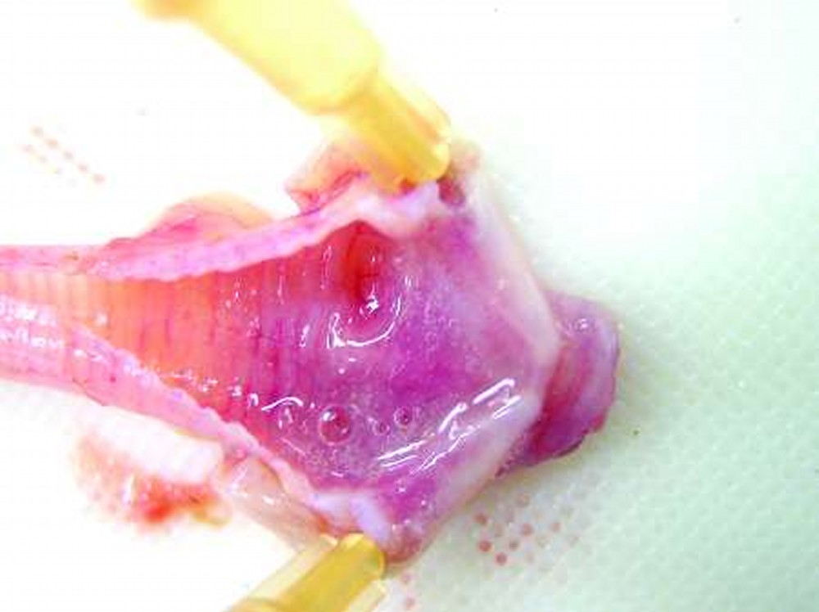
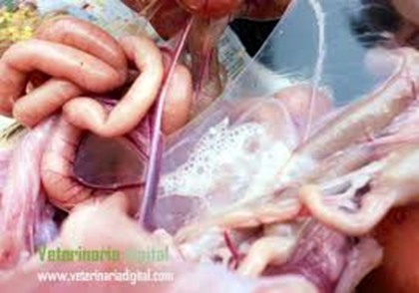
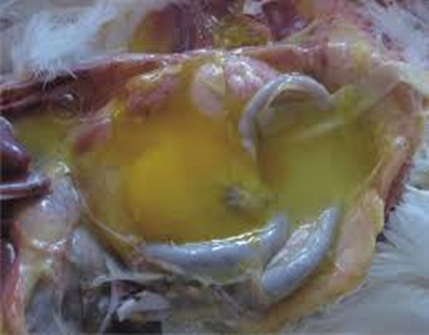
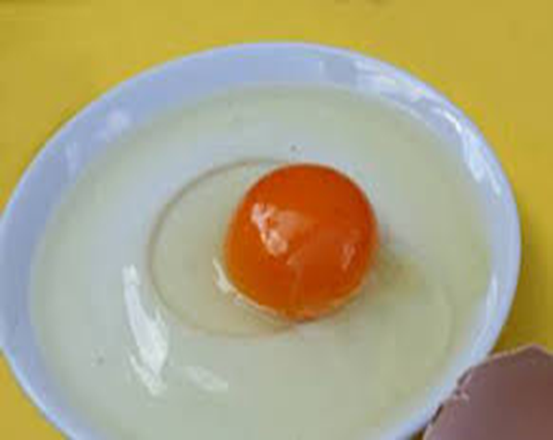

Slide 9
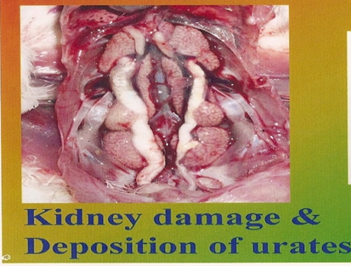

Slide 10
Microscopic lesions
Trachea & Bronchi: Inflammatory and degenerative changes
Kidney: Interstitial nephritis, Degenerative changes, Urolithiasis, urates in ureter
Oviduct: Epithelial damage, dilatation of tubular glands, infiltration of mononuclear cells, proliferation of lymphoid follicles.

Slide 11
DIAGNOSIS
Based on clinical signs
Gross and microscopic lesions
Serological tests:
o Virus neutralisaton (VN)
o Immunodiffusion (ID)
o Haemagglutination inhibition (HI)
o Immunofluorescence (IF) and ELISA
ELISA - more sensitive

Slide 12
THANK YOU

