Slide 1
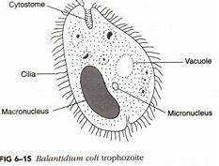
Balantidium coli
Dr. AJIT KUMAR
HoD
Department of Veterinary Parasitology
Bihar Veterinary College
Bihar Animal Sciences University
Patna-800014
Image source: Google image

Slide 2
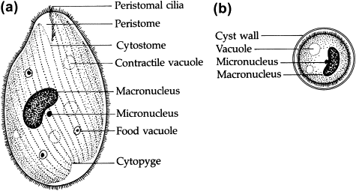
Phylum: Ciliophora
Balantidium coli
Highly organized protozoan having two dissimilar nuclei.
A large macronucleus responsible for cytoplasmic activities of the organisms and a small vesicular micronucleus concerned with reproductive process.
Image source: Google image

Slide 3
Balantidium coli
Locomotion: by cilia.
Reproduction: Asexual reproduction by transverse binary fission and sexual reprocess by conjugation.

Slide 4
Balantidium coli
Host: Pig, dog, cattle, monkey and man.
Location: large intestine ( caecum and colon).
Two developmental stages: Trophozoite and cyst

Slide 5
Balantidium coli
Trophozoite
Active motile stage and 50-60µm in length.
At the anterior end funnel shaped peristome which leads to cytopharynx or mouth.
Two dissimilar nuclei i.e. macronucleus kidney shaped and micronucleus lies in the notch of macronucleus.
Cytopyge
Image source: Google image

Slide 6
Balantidium coli
Trophozoite
Two contractile vacuoles one at each end.
An excretory organelle i.e. cytopyge present at the posterior end of the organism.
Cytopyge
Image source: Google image

Slide 7
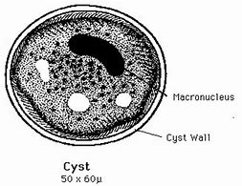
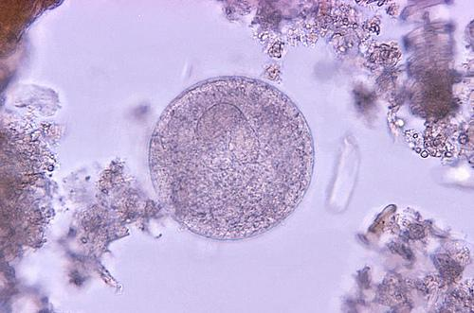
Balantidium coli
Cyst:
Ovoid to spherical in shape, double walled, yellowish in colour and 40-60 µm in diameter.
Cysts are formed both inside and outside the host body.
Image source: Google image

Slide 8
Balantidium coli
Transmission:
Pig is considered as primary hot and in it B. coli exists as commensal in the large intestine of most pigs.
Pig is probable the persistent source of infection for man, cattle etc.
Hosts get infection through the ingestion of contaminated food and water with cyst of B. coli.

Slide 9
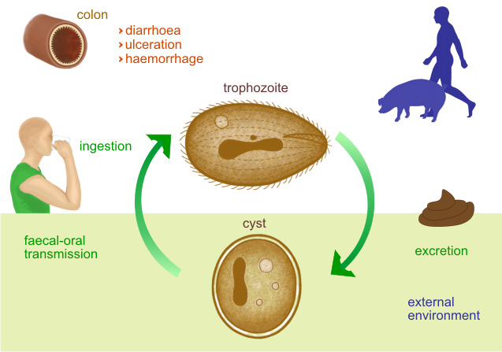
Life-cycle of Balantidium coli

Slide 10
Balantidium coli
Pathogenesis and symptoms:
In pigs normally it is non-pathogenic but occasionally invade the mucosa and producing superficial to deep ulcer with enteritis. It produces diarrhoea and dysentery with hemorrhage.

Slide 11
Balantidium coli
Pathogenesis and symptoms:
In man, B. coli produce superficial to deep ulcer associated with enteritis. The initial lesions may resemble those produce by Entamoeba histolytica but do not show the similar tendency to enlarge or spread.

Slide 12
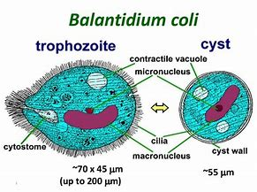
Balantidium coli
Diagnosis:
Microscopic faecal examination reveals cysts.
Trophozoite stage may be found in diarrhoeic stool.
Cyst
Image source: Google image

Slide 13
Balantidium coli
Treatment:
Tetracycline, Metronidazole etc.
Control:
Good hygiene and proper sanitation.
Proper disposal of faces of pig and man.

Slide 14
THANK YOU

