Slide 1
VSR-UNIT 5: Castration in Animals

Slide 2
Anorchid or Anorchism:Congental absence of both testes
Monorchid or Monorchism: Congenital absence of one testis usually left
Cryptorchid: Testicles fail to descend into the scrotum and retained in the· abdomen or in the inguinal canal.
The condition may be unilateral or bilateral.
Ectopia (Ectopic) testis : the testicle has
come out of the inguinal canal but not come up to
the scrotal sac. (It occupies a subcutaneous position
along side the penis).
A cryptorchid horse is called a rig or rigling.

Slide 3
Normal Time To Descent Testicles From Abdomen To Scrotum
● Cattle: 3.25 to 4 months of gestation
● Sheep: 80 days of gestation
● Pigs: 90 days of gestation
● Horses: 9 to 11 months of gestation
● Dogs: 5 days after birth

Slide 4
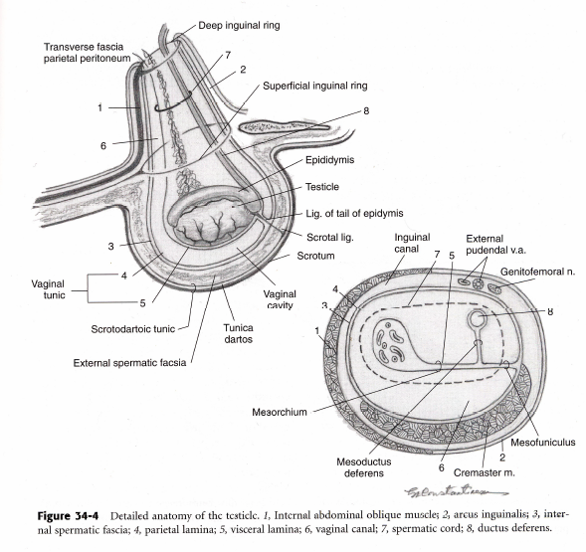
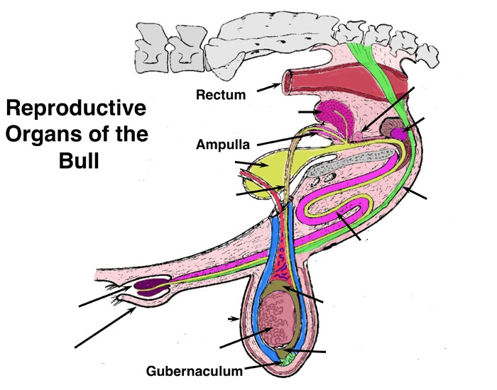
Surgical Anatomy

Slide 5
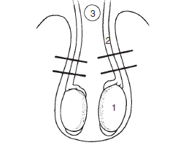
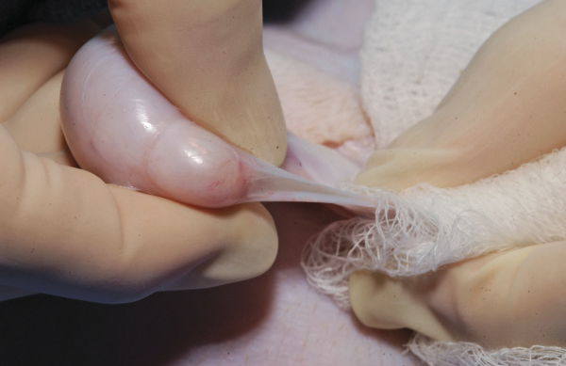
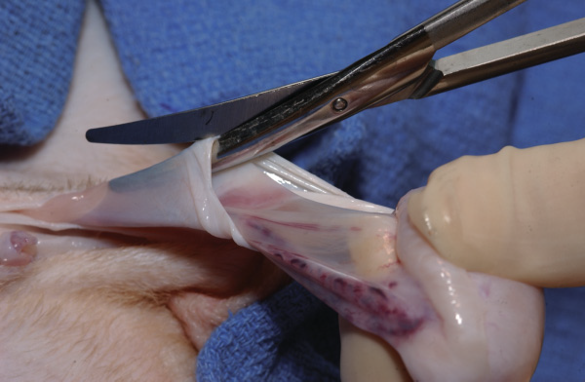
Classification
Closed (Blood less)
Open Closed (TV-Intact)
Open-Open (TV-Open)

Slide 6
Canine Castration
Indications
Prevention of hormonally induced behaviour
Unwanted breeding
Testicular tumors, which occur in 29% of intact male dogs.
Castration is also indicated for removal of infected, torsed, or traumatized testicles
Prevention or treatment of perianal adenomas, prostatic cysts, prostatitis, benign prostatic hyperplasia, prostatic abscesses,
sex hormone – associated alopecia.
In dogs with uncomplicated benign prostatic hyperplasia, prostate size decreases by 50% within 3 weeks of castration, and clinical signs resolve within 2 to 3 months.
Resolution of perianal adenomas is reported in 95% of dogs after castration.

Slide 7
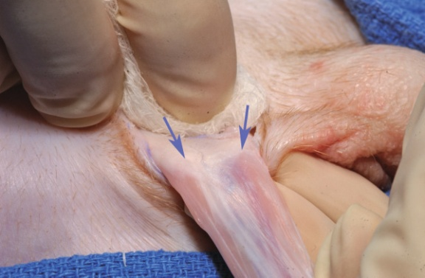
Open Closed
Push the testicle cranially and incise overlying prescrotal skin and subcutis to the level of the parietal tunic.
Break down the scrotal ligament.
Identify the junction between the spermatic cord and surrounding soft tissues

Slide 8
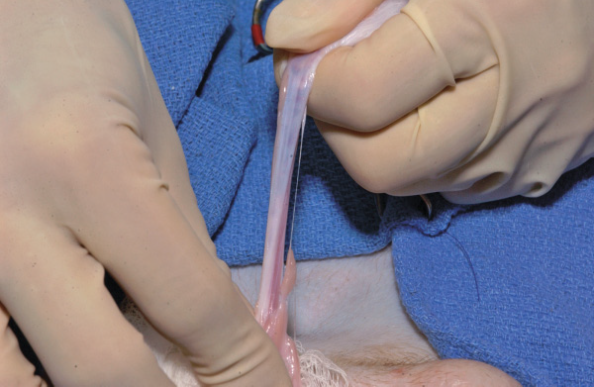
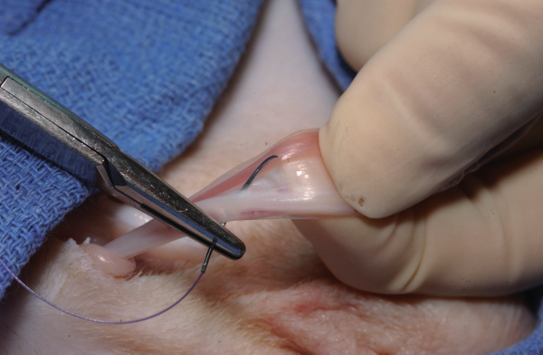
Conti.......
Lift the testicle upwards the cord will elongate as it separates from the soft tissues
Flatten the cord between thumb and index finger to separate the cremaster from the vessels, and pass a suture through the cord and around the vessels.

Slide 9
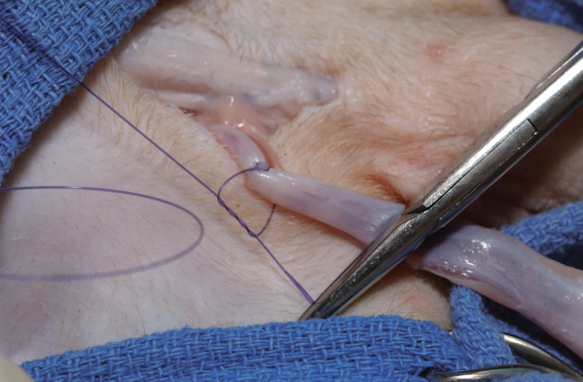
Conti.......
Ligate the vessel side first,then pass the end of the suture around the entire cord and tie.
Remove the part distal to ligature
Repeat procedure to opposite side
Close the prescotal incision

Slide 10
Open-Open castration
Incise through the parietal tunic.
Extend the parietal tunic incision with scissors to expose the vessels.

Slide 11
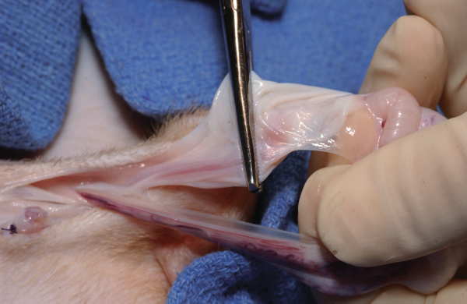
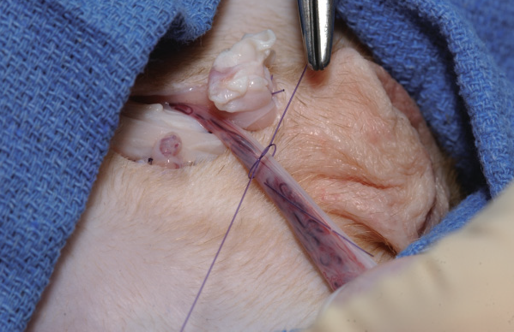
Separate the vessels from the cremaster muscle.
If necessary, the cremaster muscle and parietal tunic enmasse before transecting the tissues.
Double ligate the vessels the ductus deferens.
Transect below ligature
Close prescrotal incision

Slide 12
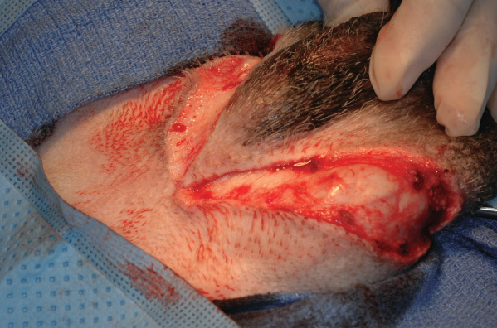
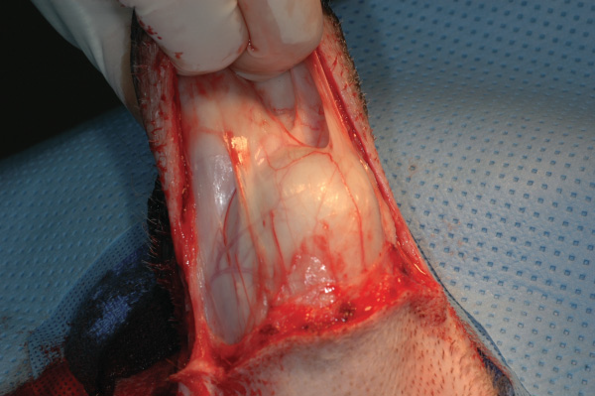
Scrotal ablation with castration
Incise the skin around the base of the scrotum.
Transect the subcutaneous tissues and scrotal ligaments to expose the testicles.

Slide 13
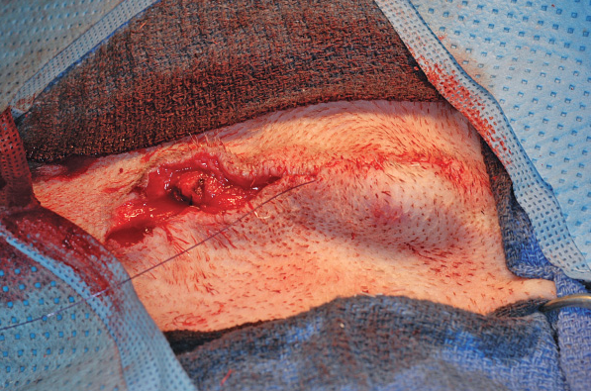
After apposing the subcutaneous tissues, close the skin with Simple interrupted pattern.

Slide 14
Chemical castration
Injection of zinc gluconate (0.2 – 1.0 mL) into each testicle causes atrophy and loss of semen production in 99.6% of dogs.
Testosterone production is reduced but not eliminated; therefore, hormonally driven behaviours or prostatic disease are not prevented or resolved.
Chemical castration will not kill sperm present at the time of injection, so treated male dogs should be kept away from intact females for at least 60 days.

Slide 15
Cryptorchid Castration
Retention of testicles in the inguinal region or abdominal cavity.
Most commonly unilateral.
The right testicle is most likely to be affected.
Removal of the retained testicle is recommended because of continued hormone production, increased risk for Sertoli cell tumors and torsion and trait heritability.
Cryptorchid testicles nine times more likely to be neoplastic than scrotal testes.
Dogs with Sertoli cell tumors may have mammary gland
development, alopecia, prostatitis, and bone marrow hypoplasia.
Cryptorchidism can also be diagnosed by measuring increased blood testosterone concentrations after stimulation with
gonadotropin - releasing hormone or human chorionic gonadotropin.
USG
Palpation

Slide 16
Feline Castration
Castrated male cats are more affectionate toward people and less aggressive to other animals.
Castration also reduces marking behavior and “ toileting” problems (urination and defecation outside of the litter box).
Roaming behaviour decreased, less exposure to intestinal parasites and other diseases.
Castrated cats, however, prone to weight gain and therefore to diseases associated with obesity.
Physeal closure is delayed in cats castrated at ≤ 7 months of age, increasing the risk for physeal fractures.

Slide 17
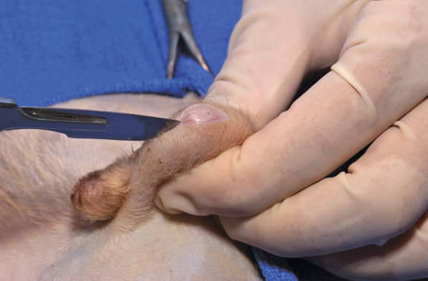
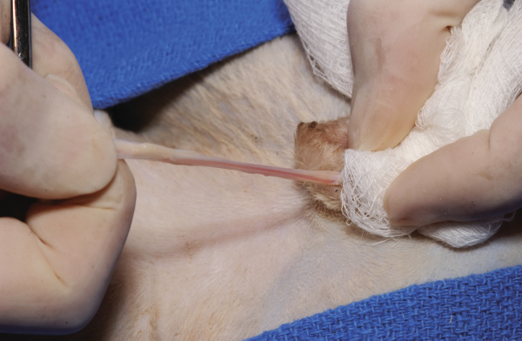
Surgical Procedure
Elevate the testicle firmly into the scrotum and incise the skin longitudinally.
Strip away the scrotal
attachments, then break the cremaster with slow steady traction.

Slide 18
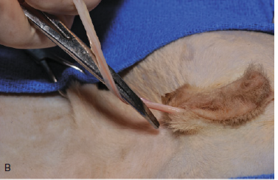
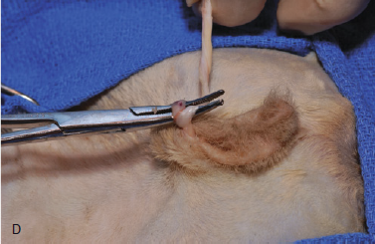
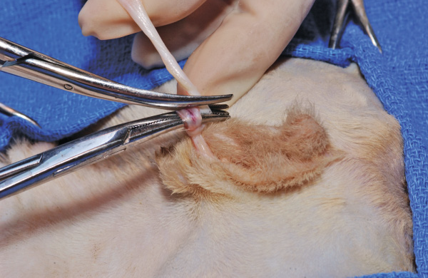
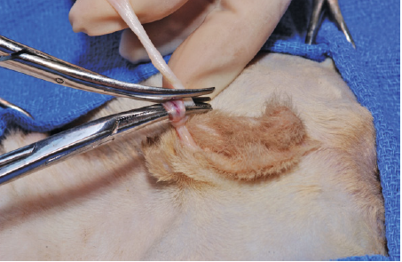
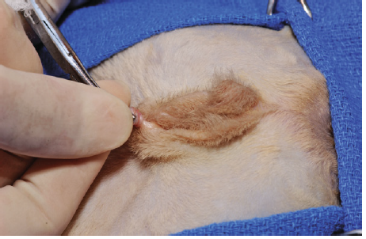
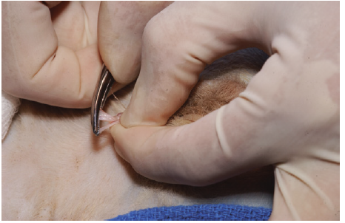
Slide towards cat to tighten

Slide 19
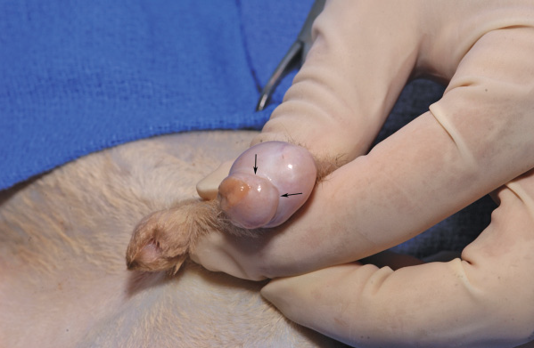
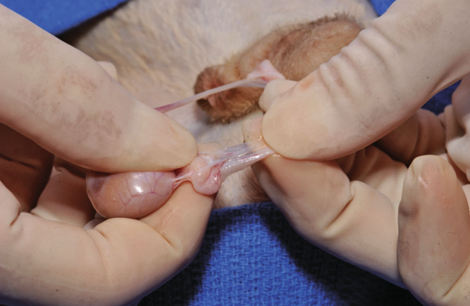
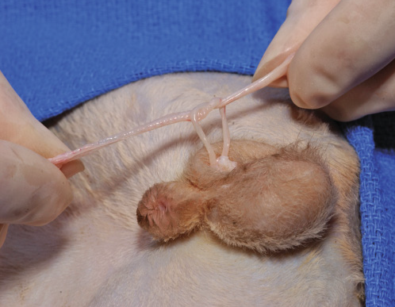
Incise parietal tunic (arrows).
Separate parietal tunic from testis
Separate the ductus deferens and testicular vessels
Tie four square throws

Slide 20
Castration in Horses/Gelding
Castration can be performed at any time of the year, but a dry season when insect numbers are low is preferred.
Age 12-18 month
Prophylactic Tetanus toxoid
Anaesthesia: Detomidine hydrochloride (20–40 μg/kg) or xylazine hydrochloride (0.3–0.5 mg/kg) and butorphanol tartate (0.01–0.05 mg/kg)
Ketamine@2mg/kg IV-15 to 20 minutes-If required second half dose
2% lignocaine 10 ml in each testis with 20-gauge needle

Slide 21
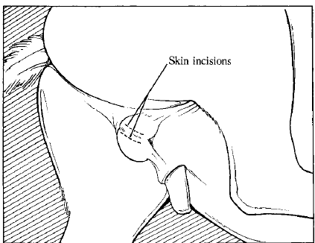
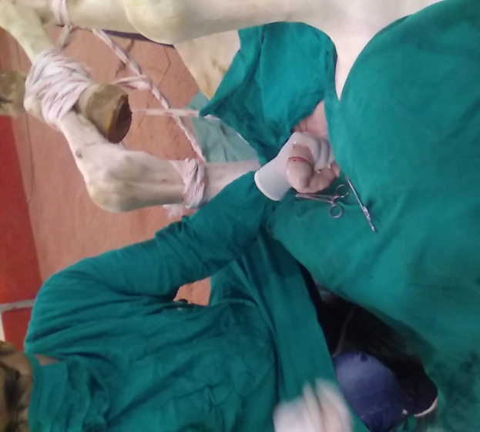
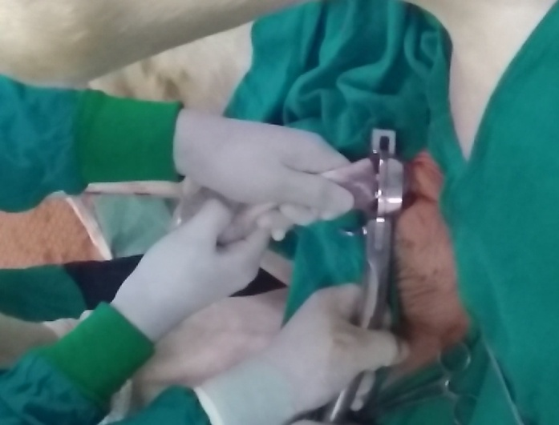
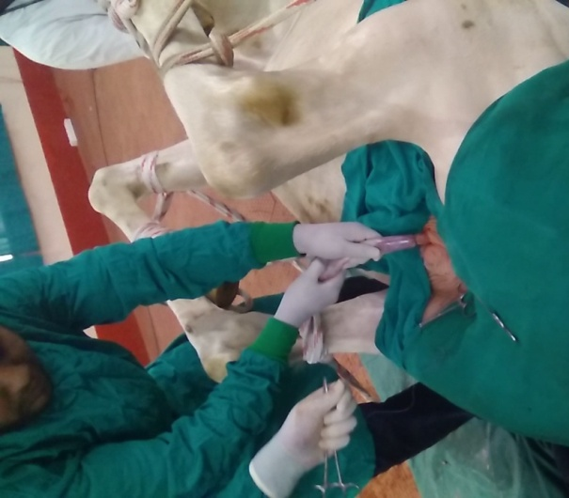
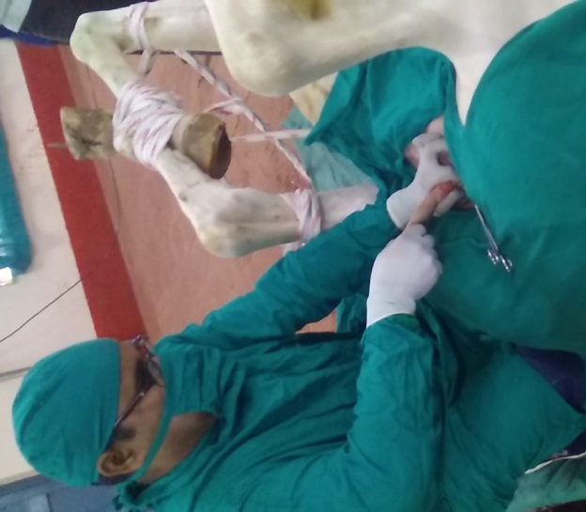
Open Closed

Slide 22
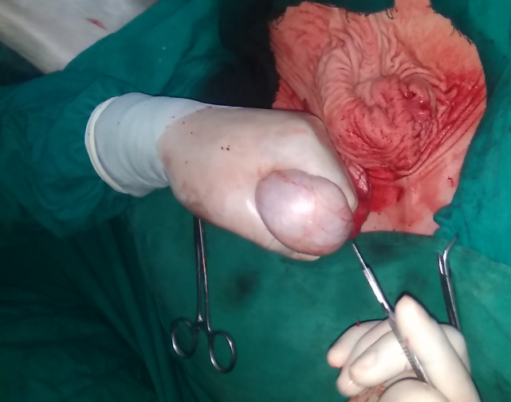
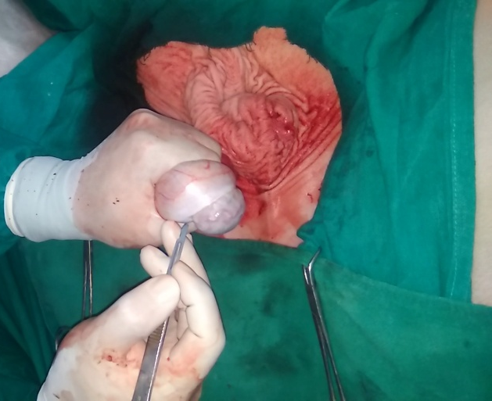
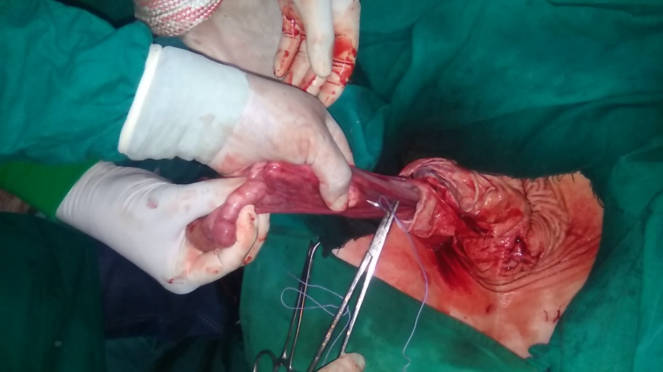
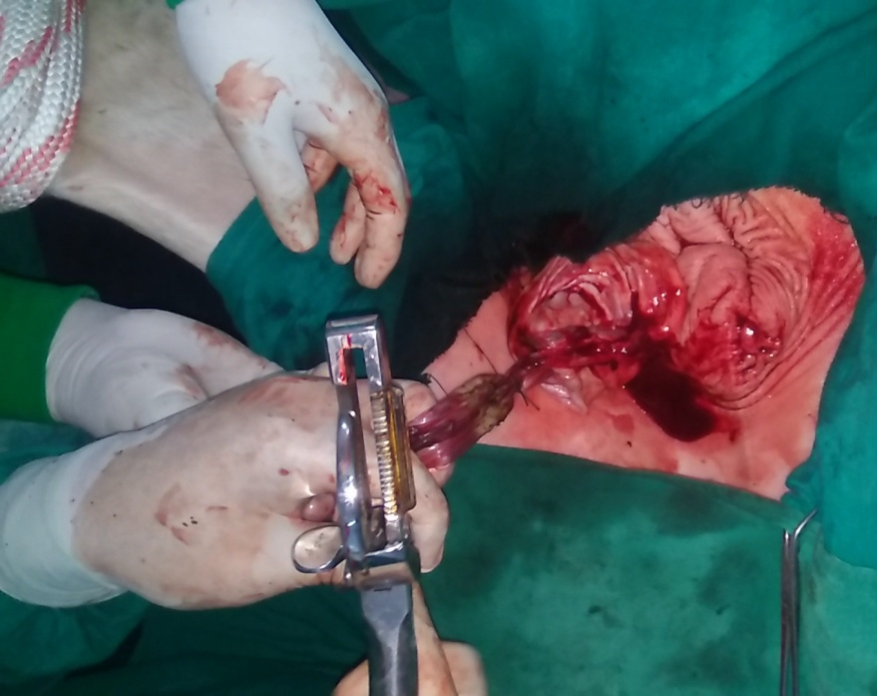
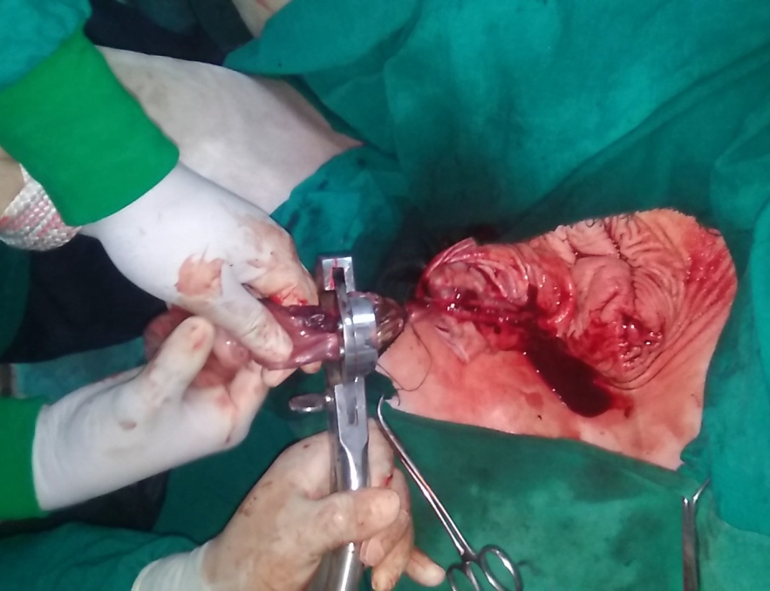
Open-Open

Slide 23
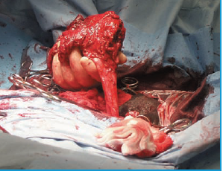
Scirrhous Cord (Champignon; Funiculitis)
A complication of castration in pigs. horses and cattle.
Thickening of the cord due to infection.
The infection is usually of Bortryomyces.
Gram positive bacteria
Generally four wk post castration

Slide 24
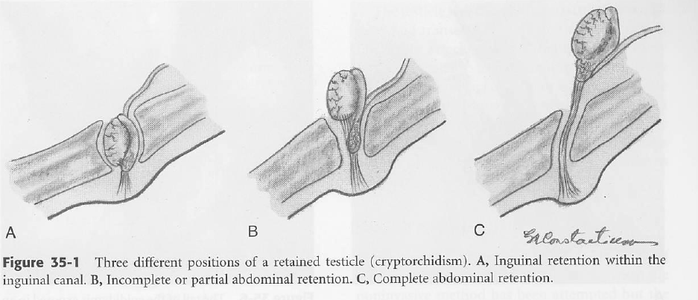
Cryptorchid horse/Rig
Testicles fail to descend into the scrotum and retained in the· abdomen or in the inguinal canal.

Slide 25
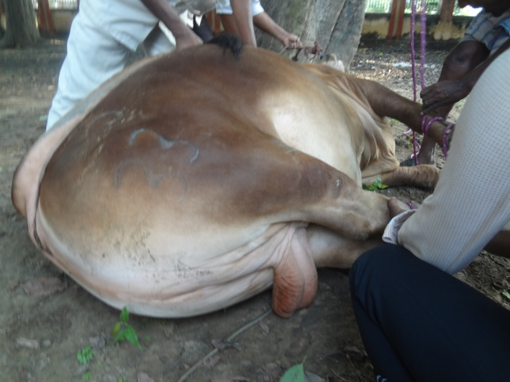
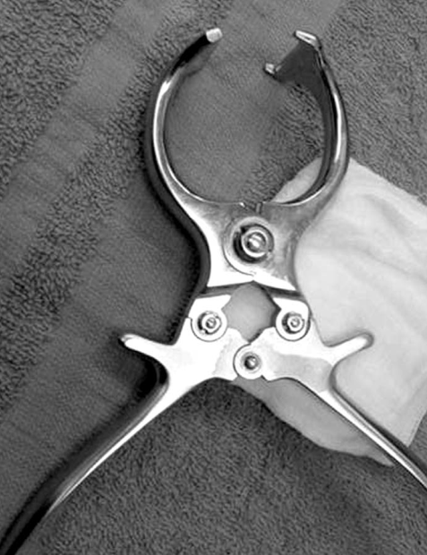
Castration of the Bovine
Force the spermatic cord to the lateral side of the scrotum.
Crush the spermatic cord dorsal to all testicular tissue at two point for 30 second
Repeat the process on opposite side
Burdizzo Forceps/Castrator

Slide 26
Vasectomy in the Bull
Vasectomy (removal of a segment of the ductus (formerly
vas) deferens to render a male animal infertile).
A vasectomized bull can be used to identify cows in heat.
Incise the skin and dartos and pull out portion of the spermatic cord enclosed in the tunica vaginalis.
Incise the tunica vaginalis and identify the vas deferens.

Slide 27
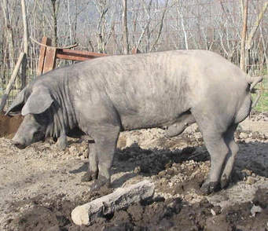
Castration in Pig
TKX solution is made by combining one vial (500 mg) of Telazol (tiletamine plus zolazepam) reconstituted with 250 mg (2.5 ml) of ketamine + 250 mg (2.5 ml) of xylazine.
1 ml/75 lb of body weight, given intramuscularly.

