Slide 1
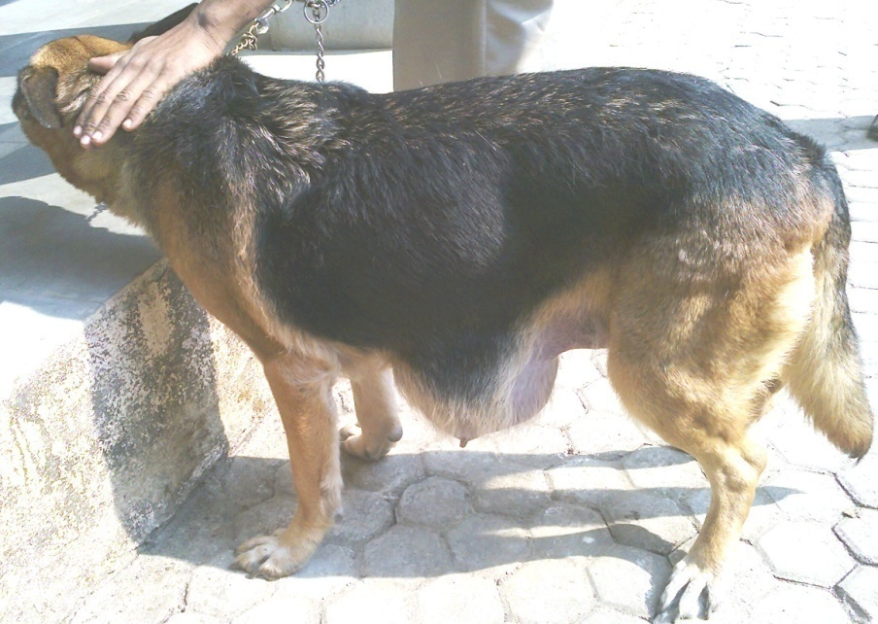
VSR Unit 5:Canine Mammary Neoplasm
Dr. Ramesh Tiwary
Assistant Professor
Deptt. of Veterinary Surgery and Radiology

Slide 2
Mammary Tumor
Tumors of the epithelial cells of the mammary gland, which are either (malignant) carcinoma or (benign) adenoma or Complex adenoma and carcinoma
The most common neoplasms in intact female dogs
Very rare in male dogs, mostly benign
50 : 50 rule: 50% of mammary masses are benign, and 50% are malignant.
Of the 50% that are malignant, 50% will recur or metastasize following the fi rst surgical resection.

Slide 3
OVH/MGT
Before first estrus | 0.5%
Between 1 &2nd Estrus | 8%
Second estrus & 2.5 Years Age | 26%
Cat: 6M, 12M, 24M | 91% 86% 11% Reduction

Slide 4
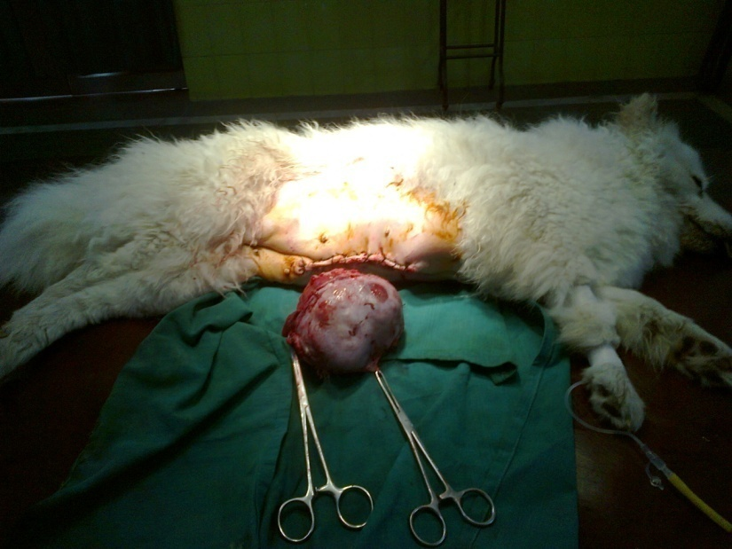
Five pair mammary gland.
Caudal 4th and 5th mammary glands mostly get affected (more mammary tissue there).

Slide 5
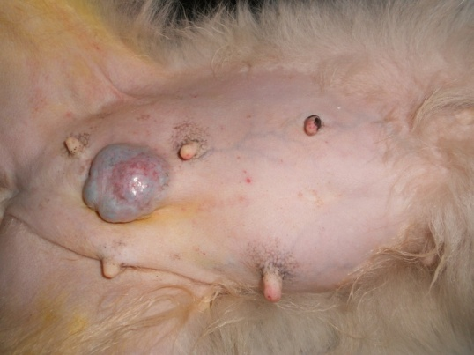
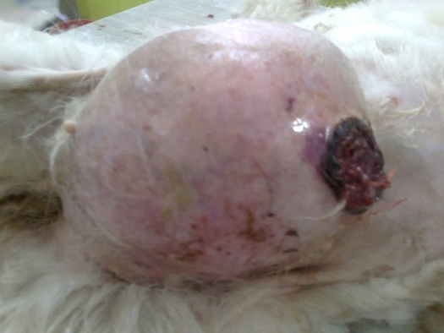
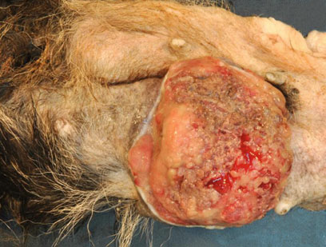
Clinical Sign
Single or multiple nodules located within the mammary gland associated with the nipple or the gland itself).
Benign lesions tend to be small, well circumscribed, firm on palpation.
Malignant tumors are >5cm in size tendency to develop ulceration

Slide 6
Inflammatory mammary carcinomas rare, aggressive tumor c/by macroscopic resemblance to acute mastitis, presenting with edema, firmness, erythema, and pain.

Slide 7
Palpation of Lymph nodes
Regional lymph nodes should also be examined
Inguinal (inner thigh)
Axillary (armpit)
Prescapular nodes in front of the shoulder
Popliteal nodes behind the knee
Abdominal lymph nodes

Slide 8
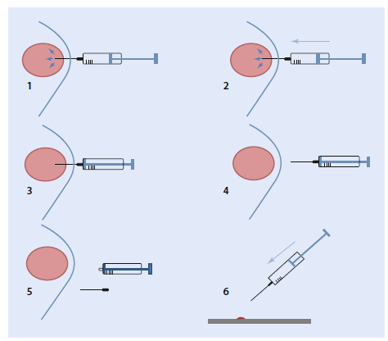
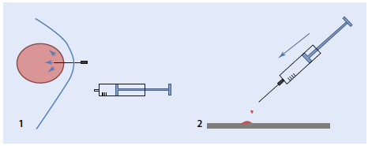
Diagnosis
FNAC:
Inflammation
Infection
Tumor
The aspirate almost never show whether itbenign or malignant
Biopsy must be performed.

Slide 9
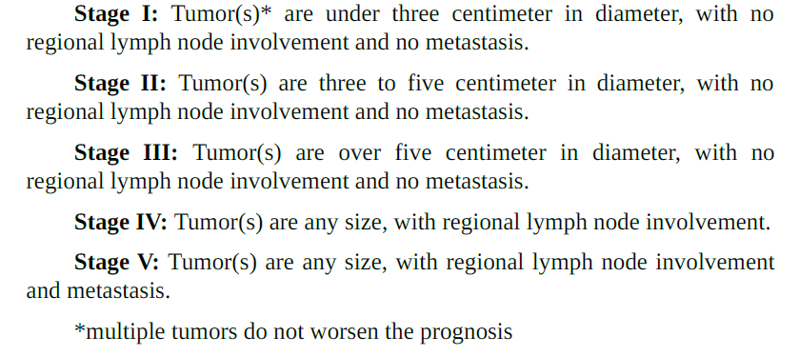
WHO Clinical Staging System for MGT
The higher the stage, the worse the prognosis

Slide 10
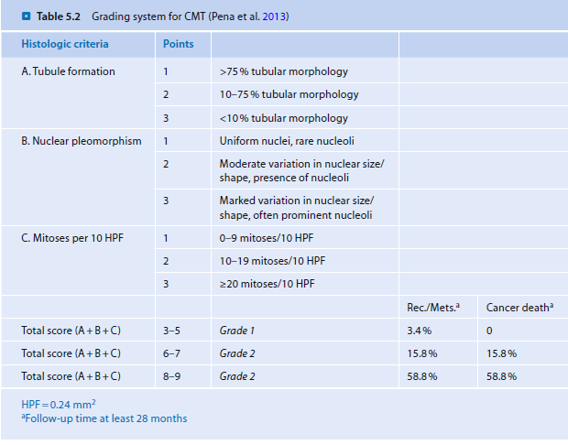

Slide 11
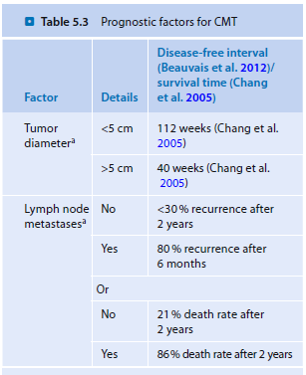

Slide 12
Surgery
Surgery is the treatment of choice to remove mammary tumors, with the exception of IMC
IMC- due to the inflammatory nature of the cancer, surgical incision often does not heal well, Blood clotting abnormalities and edema can also occur.
Treatment for IMC is usually palliative, not curative.
Supportive care for any systemic illness and daily administration of piroxicam (0.3 mg/kg per os).
Duration of survival for dogs with IMC is 6 months with piroxicam therapy and less than 1 month with other treatments

Slide 13
100% of benign and 50% of malignant tumors are cured with surgery alone
Approximately 75% of dogs with mammary
tumors are treated with simple surgeries
Lymph nodes Removal:Tumor Near Rear Leg-Inguinal Lymph node even seems normal
Axillary (armpit) node: If metasatsis
Radical mastectomies are usually not necessary for
Spayed dogs – a lumpectomy or a simple mastectomy (which removes just the mammary gland involved in the tumor) can suffice.

Slide 14
Lumpectomy: removal of a mass or part of a mammary gland
Simple mastectomy: excision of an entire gland
Unilateral mastectomy: Removal of all mammary glands, subcutaneous tissue, and associated lymphatics on one side of the midline.
Bilateral mastectomy:Simultaneous removal of both mammary chains.

Slide 15
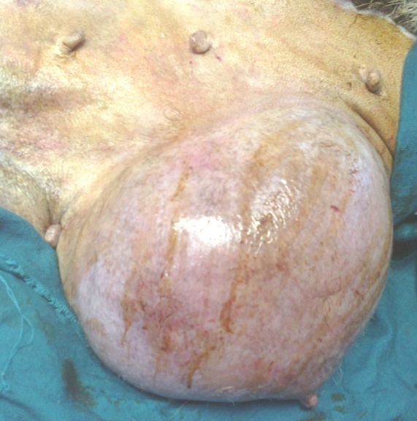
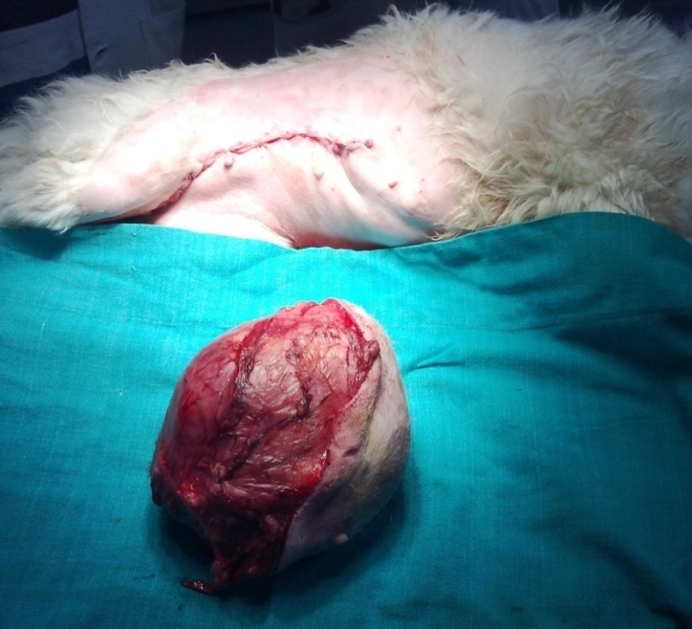
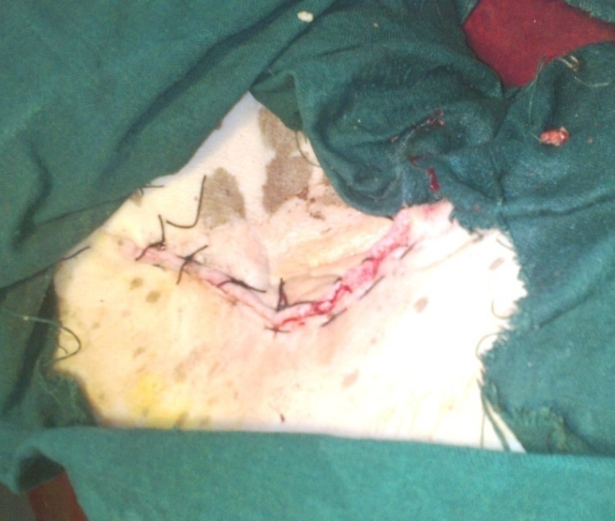
MAMMARY TUMOR IN DOG

