Slide 1
Care and Management of Pigs (Part-2)
Dr. Sanjay Kumar
Asst. Prof., Dept. of LPM,BVC
Bihar Animal Sciences University, Patna

Slide 2
Scope of Pig Farming in India
Pigs grow faster than any other animals. higher feed conversion efficiency.
Pigs can eat and consume almost all types of feed including grains, damaged food, forage, fruits, vegetables, garbage, sugarcane etc. Sometimes they even eat grasses and other green plants or roots.
Pigs become mature earlier than other animals. A sow can be bred for first time at their age of 8-9 months. They can farrow twice a year. And in each farrowing they give birth of 8-12 piglets.

Slide 3
A pig become suitable for slaughtering purpose at their age of 7-9 months. Within this period they reach marketable weight of 70-100 kg.
Dressing percentage high ( 75% av.).
Pig meat has a good domestic demand. We can also earn good income by exporting pig products like bacon, ham, lard, pork, sausages etc. to the foreign countries.

Slide 4
Setting up pig farming business is easy and it requires little capital/investment for building houses and buying equipment.
Pig manure is a great and widely used fertilizer for both crop production and in pond for fish farming purpose.
Pig fat also has a huge demand in poultry feed, paints, soap and chemical industries.

Slide 5
Pig Terminology
Boar - An uncastrated male pig of more than six months of age.
Hog: A growing or aging pig.
Sow- a mature female that has produced young.
Gilt- an immature female, who is yet to have its first litter.
Shoat - an immature male.
Barrow- a castrated male.
Farrow- act of giving birth in pigs.
Ear Notch- method of permanent identification. Litter number is placed in the right ear, pig number in the left ear.

Slide 6
Needle Teeth- set of 8 very sharp teeth in swine that are usually cut off 1 to 3 day old piglets to prevent injury to other piglets and sow's udder
Weaner-A piglet who is separated from its mother and fed solid food. This can take place anywhere between the ages of five and ten weeks.
Gestation- The length of a pregnancy. In pigs, this is three months, three weeks and three days(114 days).
Piglet- young one of pig.
Pork- Meat of pig

Slide 7
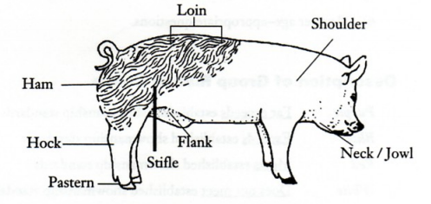
Pig- External Parts

Slide 8
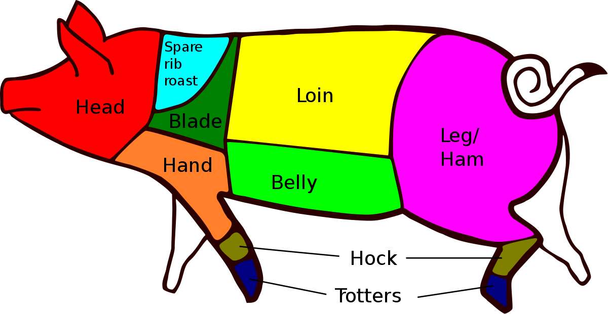
Body Cuts of Pig

Slide 9
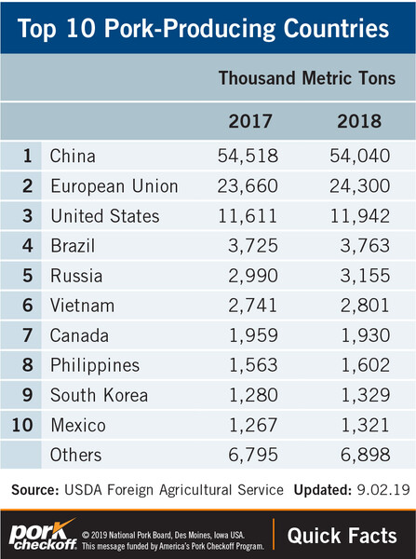

Slide 10
Pig population in India
The total Pigs in the country is 9.06 Million in the current Census(2019).
Assam- Rank 1st in India in pig population(Pig population more than 2 million)
Jharkhand- Rank 2nd in India
Meghalaya- Rank 3rd in India

Slide 11
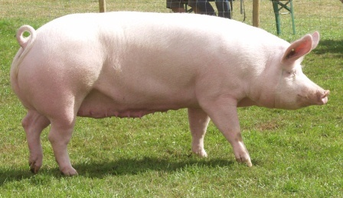
Exotic breeds of pigs
Large White Yorkshire
Home tract- England
Colour- white with freckles (black pigmented spot)
Head –long
Snout- broad
Mature boar wt.-300-450kg
Mature sow wt.- 250-350kg
Good for meat putpose

Slide 12
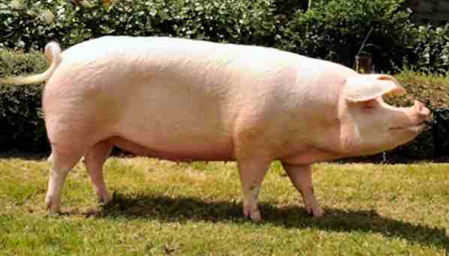
Landrace
Home tract- Denmark
Colour- white with freckles
Leg- short
Ear- lop (drooping)
FCR- high
Meat- leaner (low fat)
Mature boar wt.- 380kg
Mature sow wt.-320kg

Slide 13
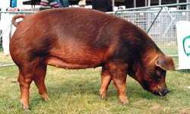
Duroc
Home tract- United States
Colour- red with shades golden to cherry red colour.
Sow mature early and produces upto 15 piglets
Mature boar wt.-400kg
Mature sow- 350kg

Slide 14
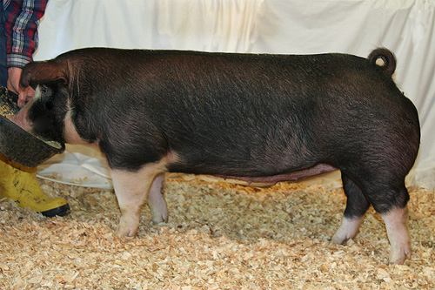
Poland China
Home tract- United States
Colour- black with white patches on face, feet and snout.
Leg- well developed
Prolofic breeder- 16-17 piglete/ farrow
Mature boar- 250-360kg
Mature sow- 225-300kg
Poland China

Slide 15
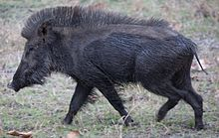
Indigenous Breed of Pigs
The Indian boar differs from its European counterpart by its large mane which runs in a crest along its back from its head to lower body, larger, more sharply featured and straighter skull, its smaller, sharper ears and overall lighter build.
GHUNGROO- West Bengal
DOME-Assam , Nagaland (NE)
JHARSUK- Jharkhand

