Slide 1
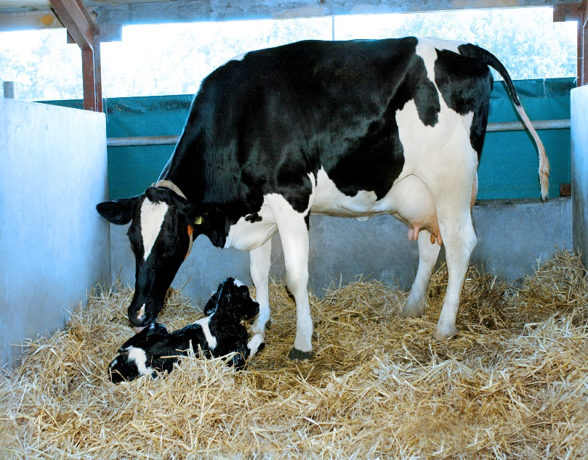
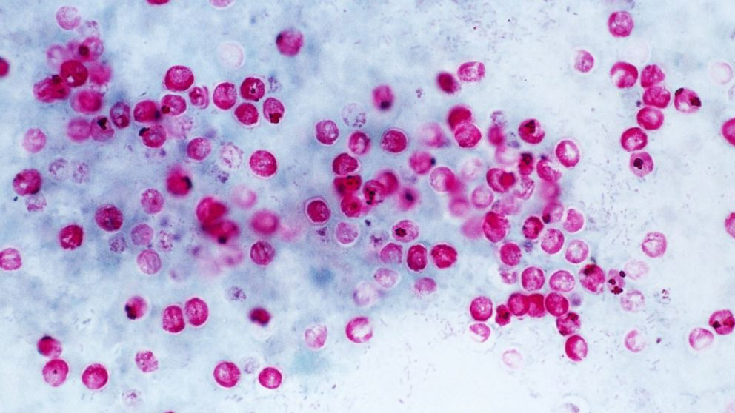
Cryptosporidium
Dr. AJIT KUMAR
HoD
Department of Veterinary Parasitology
Bihar Veterinary College
Bihar Animal Sciences University
Patna-800014
Image source: Google image

Slide 2
Genus: Cryptosporidium
It is an intracellular extra cytoplasmic organism located in the notch of microvillus membrane of the digestive epithelium of gut wall and enclosing the parasite within a parasitophorus envelope apparently derived from microvilli.

Slide 3
Genus: Cryptosporidium
It also found in respiratory epithelium.
It is a emerging coccidian parasite found in animals, birds and man.
Monoxenous parasite with direct life-cycle.

Slide 4
Genus: Cryptosporidium
It has smallest oocyst ( 5-7.4 µm X 4.5 -5.6µm ) among all coccidian.
Ocysts are spherical to ovoid in shape and ocyst wall is bilayered, smooth and colourless.
Sporogony occurs inside the host.

Slide 5
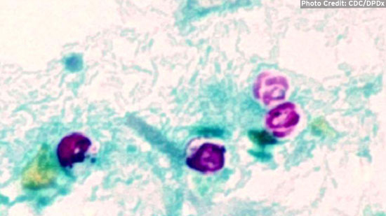
Genus: Cryptosporidium
Sporulated oocysts excreted though the faeces of the infected host .
Each sporulated oocyst contains four naked sporozoites without sporocyst.
Image source: Google image

Slide 6
Cryptosporidium species
Species | Host
Cryptosporidium parvum | Ruminants
C. hominis | man and monkey
C. bovis | cattle
C. canis | Dog
C. suis | Pig
C. baileyi | Birds

Slide 7
Genus: Cryptosporidium
Life- cycle : Direct
Infective stage : thick walled sporulated oocysts.
Transmission:
Host gets infection through ingestion of sporulated oocysts through contaminated feed and water or through inhalation (aerosol).

Slide 8
Genus: Cryptosporidium
Transmission:
Auto-infection occurs in Cryptosporidium because thin walled oocysts do not leave the host’s intestine and initiate a new developmental cycle.

Slide 9
Genus: Cryptosporidium
Unlike the members of the eimeriidae, it does not enter the cells of the host and lacks host specificity so that cross infection occurs between domestic and laboratory animals and birds.

Slide 10
Genus: Cryptosporidium
Two types of oocysts are formed i.e. thin walled and thick walled oocysts.
Thick walled oocysts pass out in the faeces of infected hosts whereas thin walled oocysts excyst in the gut and released sporozoites cause auto-infection.

Slide 11
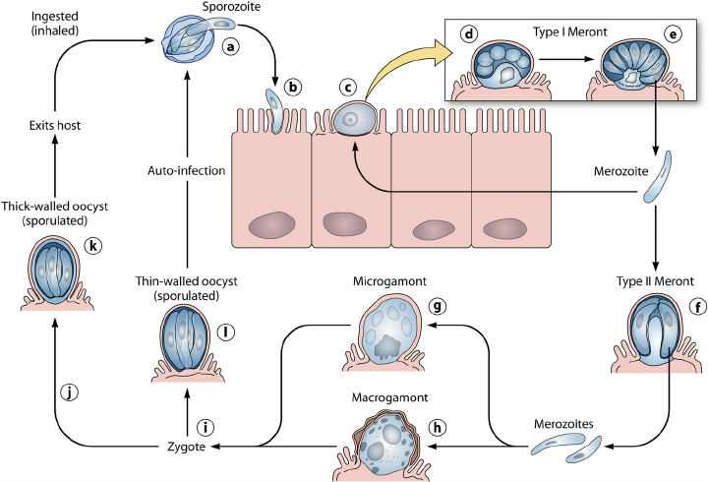
Life- cycle of Cryptosporidium
Image source: Google image

Slide 12
Pathogenesis of Cryptosporidium
Generally young hosts like calves, kid, lam, children etc. are most affected.
It causes villus atrophy, degeneration, sloughing of enterocytes, crypt hypertrophy, inflammation of epithelial cells etc.

Slide 13
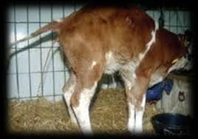
Cryptosporidium
Symptoms:
Depend upon species of parasites and the age and immunity status of the host.
Watery cholera like diarrhoea is the cardinal sign.

Slide 14
symptoms of Cryptosporidium
Symptoms:
Other symptoms are weight loss, abdominal discomfort, dehydration etc.
Cryptosporidia is also regarded as potential cause of traveler’s diarrhoea.

Slide 15
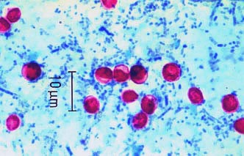
Genus: Cryptosporidium
Diagnosis :
On the basis of symptoms like Watery cholera like diarrhoea in young hosts.
Diagnosis is made by observing very small sporulated oocysts in Ziehl- Neelsen stained (Acid Fast Staining or Kinyoun acid fast stain) faecal smears.
Image source: Google image

Slide 16
Genus: Cryptosporidium
Treatment –
Drug like Azithromycin, Paromomycin etc. are used used in treatment.

Slide 17
Genus: Cryptosporidium
Control-
Proper disposal of faeces/stool.
Uncooked vegetables like salad should be taken after proper washing.
Proper washing of hands before meal.

Slide 18
THANK YOU

