Slide 1
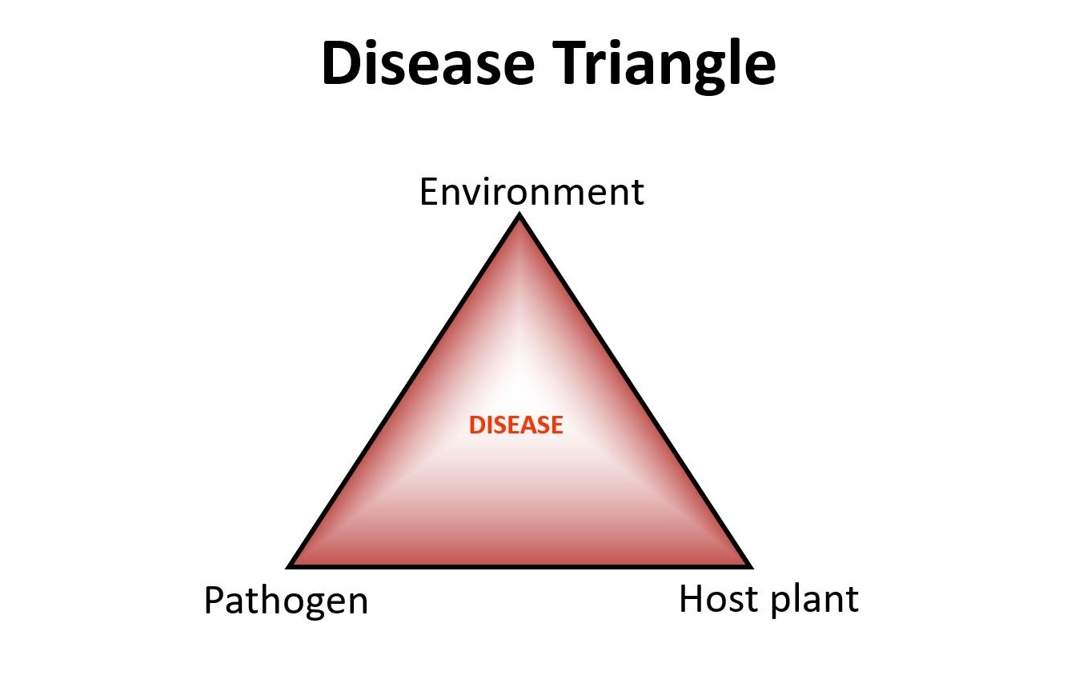
Ecology of diseases

Slide 2
What is ecology??
Ecology (Greek: oikos= house; logo- = discoursing)
The study of animals and plants in relation to their habits and habitation (habitat) is ecology
The study of a disease's ecology (also termed its natural history) is frequently a part of epidemiological investigations

Slide 3
Objectives of ecology
1. An increase in the understanding of the pathogenesis, maintenance and, for infectious agents, transmission of disease
2. The use of knowledge of a disease's ecology to predict when and where a disease may occur, to enable the development of suitable control techniques

Slide 4
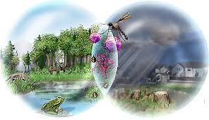
Basic ecological concepts
Factors: Determine the occurrence of disease
Distribution of animal populations
Distribution of suitable food
Distribution of suitable food
Distribution of suitable food
Size of animal populations
Availability of food,
Availability of mates & the species'
Breeding potential
The balance of nature
Vegetation zone
Tundra
Savannah
Desert
Control of population size by competition
Dispersal
Predation
Biomes
Home range
Territoriality
Social dominance

Slide 5
Factors effecting the disease spread
The distribution of host
Home range:
if home range increase: increase disease
3. Other behavioral activities of host:
ex. Rabies in foxes in Europe
Dump rabies: solitary existence
Furious rabies: approach other animals

Slide 6
The Niche
This is the functional position of an animal‘s
The match of a species to a specific environmental condition
How an organism or population responds to:
Distribution of resources
Competitors
(for example, by growing when resources are abundant when predators, parasites and pathogens are scarce)
(How it in turn alters those same factors (for example, limiting access to resources by other organisms, acting as a food source for predators and a consumer of prey)

Slide 7
The Niche
Competition: Intra species competition
Inter species competition
Coexistence of two strongly competing species is impossible
This led to the principle of competitive exclusion: that competition will exclude all but one Species from a particular position defined by an animal's feeding habits, physiology, mechanical abilities and behavior
Competitive exclusion has been used as a means of disease control
(Ex. The snail Biompholaria glabrata (I/H of Schistosomiasis)
Marisa cornuarietis (more competitive snail)

Slide 8
The Niche
Other example:
Louse infestation: Host specific so avoid competition
Intracellular parasitism: Occupy niche in cell
All viruses
Some bacteria (Mycobacterium, Rickettsiae, Brucella spp.)
Some protozoa (Babesia spp.)

Slide 9
Epidemiological interference
One type of respiratory adenovirus prevents infection with other types, even though the latter are common in surrounding community
Can effect the time of occurrence of disease:
Ex. altering age specific incidence rate
2. Alters the rate of natural immunization:
Ex. Interference by other enterovirus delays natural poliovirus immunization in man

Slide 10
The relationships between the different types of plant and animals
Food chain:
Simplistic view of the relationship between an animal and its food

Slide 11
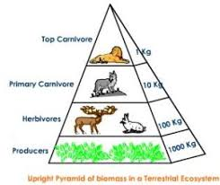
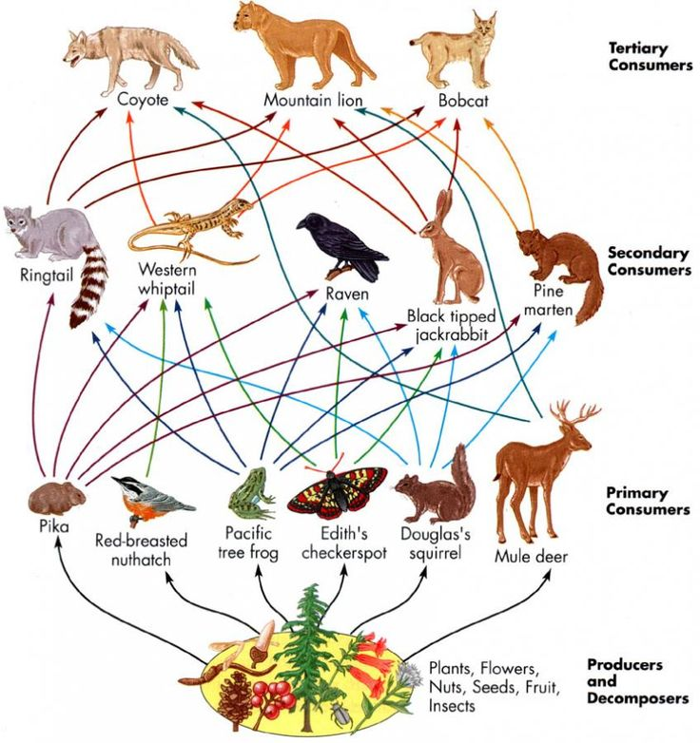
The relationships between the different types of plant and animals
Food webs and size of animals:

