Slide 1
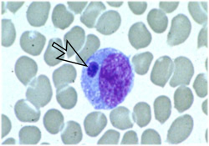
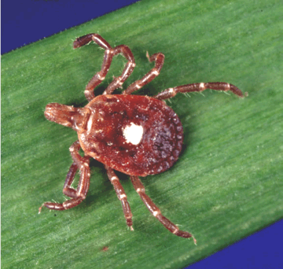
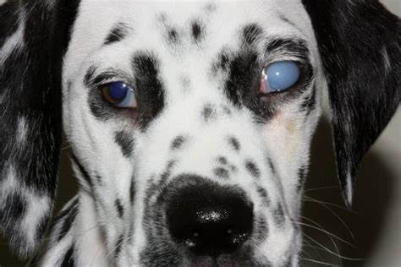
Ehrlichia
Dr. AJIT KUMAR
HoD
Department of Veterinary Parasitology
Bihar Veterinary College
Bihar Animal Sciences University
Patna-800014
Image source: Google image

Slide 2
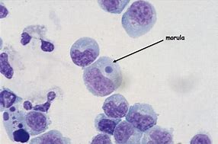
Order : Rickettsiales Genus: Ehrlichia
Morphology:
It is small pleomorphic gram negative coccoid intracytoplasmic inclusion bodies found in circulating leucocytes.
Image source: Google image

Slide 3
Genus: Ehrlichia
Morphology:
Organisms may occur singly or generally in compact colonies as morula in the cytoplasm of leucocytes.
Image source: Google image

Slide 4
Order : Rickettsiales Genus: Ehrlichia
Species | Definitive host | Location | Vector
Ehrlichia canis | Dog | Monocyte | Rhipicephalus sanguineus (Brown dog tick)
Ehrlichia ewingi | Dog | Neutrophil
Ehrlichia chaffeensis | Dog and human | Monocyte

Slide 5
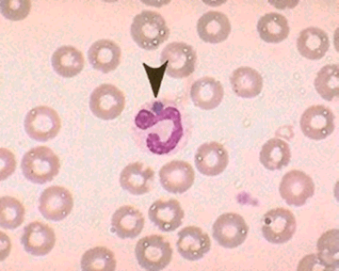
Genus: Ehrlichia
Transmission:
• It is transmitted transtadially by the tick and also through infected blood transfusion.
Image source: Google image

Slide 6
Genus: Ehrlichia
Disease:
Ehrlichia canis causes disease in dog known as canine rickettsiosis or tracker dog disease or canine typhus or canine haemorrhagic fever or tropical canine pancytopenia or emerging silent tick born disease of dog or AIDS of the canine world.

Slide 7
Order : Rickettsiales Genus: Ehrlichia
Pathogenesis
Puppies may remain as carrier for a long time. Stress, immunological depression and concurrent with other infections may precipitate the disease.

Slide 8
Order : Rickettsiales Genus: Ehrlichia
symptoms:
Symptoms includes undulating temperature, anaemia, polyarthritis, thrombocytopenia, corneal opacity, renal failure, clotting abnormalities leading to epistaxis, haematuria, haematemesis and haemorrhagic diarrhoea.

Slide 9
Ehrlichia
Corneal opacity in E. canis infected dog
Image source: Google image

Slide 10
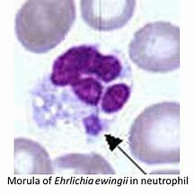
Genus: Ehrlichia
Diagnosis :
Microscopic examination of stained blood smear revealed morula stage of Ehrlichia in leucocytes.
Ehrlichia canis commonly found in mixed infection with Babesia canis or Hepatozoon canis.
Persistence and duration of ehrlichiosis is usually unnoticed by the owner for long time due to variability in clinical signs.
Morula of E. canis in monocyte
Image source: Google image

Slide 11
Genus: Ehrlichia
Treatment :-
Doxycycline and Oxytetracycline are used in treatment of ehrlichiosis.

Slide 12
Genus: Ehrlichia
Control :-
treatment of infcetde animals
By vector (tick) control

Slide 13
THANK YOU

