Slide 1
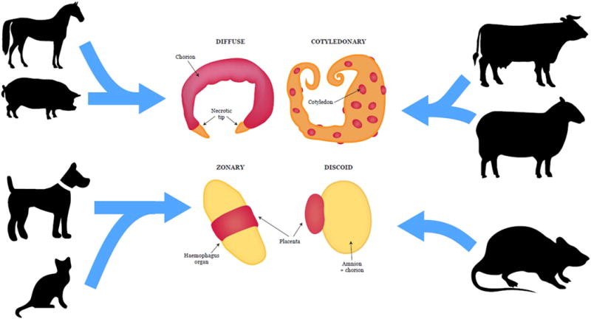
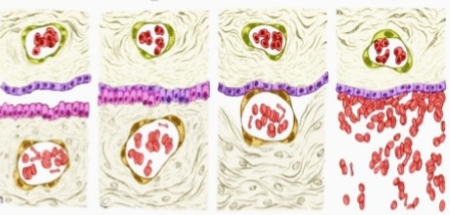
Unit-8 EMBRYOLOGY
TYPES OF PLACENTA
Date of Lecture 23.05.2020
Course Instructor – Dr. Manoj Kumar Sinha
Asst. professor-cum-Jr. scientist
Department of veterinary Anatomy

Slide 2
TYPES OF PLACENTA
The types of placenta is classified on different ways and varied from species to species :
1) Classification on the Basis of Mode of Attachment : It can be classified on the basis of mode of attachment of the chorion to maternal tissue (endometrium) – Three types
Folded Placenta: The surface of chorion and endometrium are interlocked by means of primary and secondary ridges and infoldings Eg. Sow
Villous Placenta: The surface of chorion bears villi made up of vascular mesenchymal cones surrounded by trophoblastic and binucleated giant cell. Theses villi either penetrate directly into endometrium Eg. Bitch or simply interdigitate with vascular folds of endometrium eg, Mare and cow , In monkey the chorionic villi are exposed to mternal blood
Labryrinthine Plcenta: The chorionic protrusion forming network called chorionic labyrinthine placenta Eg. Canines

Slide 3
continue….
2) Classification Based on Distribution of Chorionic villi :
i) Diffuse Placenta : Eg. Horse, Pig, lemur and Camel
The chorionic villi are scattered all over the surface of chorion, thus it forms multiple contact between chorion and uterine tissue
ii) Cotyledonary placenta : Eg.Ruminants (cud chewing) Cow, Goat,Sheep and Deer .
The chorionic villi are present on multiple button like caruncles
The tuffts of chorionic villi is called cotyledones which fuses with uterine caruncles to form cotyledonary placenta
In ruminants uterus 90-100 carancules are present and arranged into 4 rows which become highly developed on the 30th day of fertilization
The uterine caruncles are convex in cow and concave in ewe

Slide 4
Continue..
iii) Zonary Placenta : Eg. Carnivores (Dog and Cat), Raccoon has incomplete zonry placenta
The chorionic villi are develop in the form of belt or girdle like band around the middle of their blastocyst or chorionic sac which is elliptical in shape
iv) Discoidal Placenta: Eg. Human, Monkey Bat Rodents and Rabbit
The chorionic villi are located on a large flattened area in the form of circular disc or plate on the dorsal surface of blastocyst (Monodiscoidal)
In Monkey the villi are distributed in two disc, called Bidiscoidal placenta

Slide 5
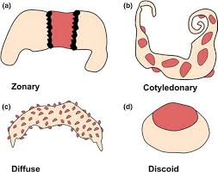

Slide 7
Continue…
3) Classification on the Basis of Histological Structure:
Between the maternal and foetal blood there remain a composite layer of tissue
In placenta formation six tissue or membranes are participated (3 layer of maternal and 3 layer of foetal tissue )
Three layer of Foetal Side:
Chorionic epithelium –outer layer of foetal membrane derived from trophoblast
Connective tissue in the form of chorioallantoic mesoderm
Endothelium lining allantoic capillaries
Three layer of Maternal Side:
Endometrial epithelial cells
Connective tissue of the endometrium
Endothelium lining endometrial blood vessels

Slide 8
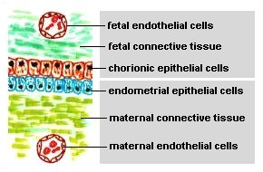

Slide 9
Continue..
According to these barriers there are 5 types of Placenta
1. Epithelio-Chorial Placenta : Most primitive type of placenta and all 6 layers are intact
Epithelium of uterine mucosa and chorion are lie in apposition to each other
At the time of birth the chorion is pulled off the uterine wall without damage of maternal tissue
This type of placenta is non-deciduate type
Eg. Pig and Mare
2. Syndesmo-chorial Placenta : The uterine epithelium is damaged and stromal tissue of uterus remains in contact with the trophoblast cell of the chorion ,only 5 barriers/tissues are present
Eg. Cattle, Sheep, and Deer

Slide 11
Continue…
3. Endothelio-Chorial Placenta :
The uterine mucosa is reduced and chorionic epithelium comes in contact with endothelial wall of the maternal (uterine) blood vessels
Only 4 barriers/tissues are present between maternal and foetal blood streams
Eg. Carnivoers: (dog, cat, bears)

Slide 12
Continue…
4. Haemo-Chorial Placenta:
A reduction of three barriers i.e. The endothelial walls of maternal (uterine) blood vessels also disappear and the chorionic epithelium is bathed directly in maternal blood sinuses
Eg. Primates(Humans), Insectivores (Moles, Shrews), Chiropterans(Bat)

Slide 13
Continue..
5. Haemo-Endothelial Placenta:
Only 2 barriers/tissues are present between maternal and foetal blood streams
The chorionic villi lose their epithelial and connective tissue layer and bare endothelial lining of their blood vessels alone separates the foetal blood from the maternal blood sinuses
This is the most intimate type of union and cause extensive hemorrhage during parturition due to loss of both syntrophoblast and cytotrophoblast
Eg. Higher Rodents (Rat, Guinea Pig and Rabbit)

Slide 14
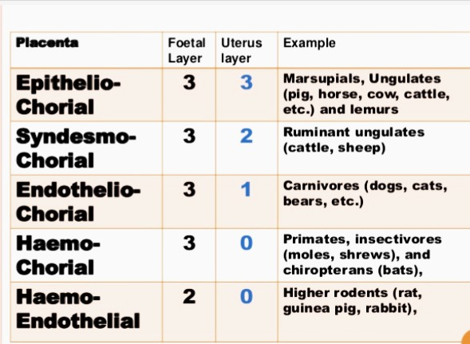

Slide 15
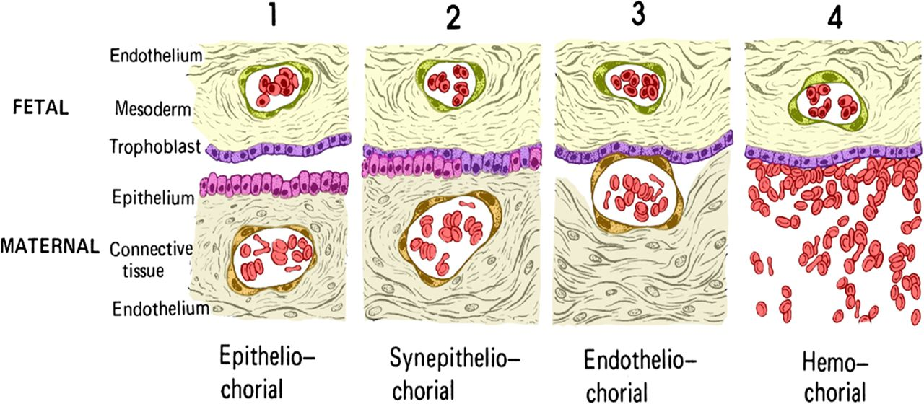

Slide 16
THANK YOU
For your kind attention….

