Slide 1
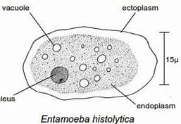
Entamoeba
Dr. AJIT KUMAR
HoD
Department of Parasitology
Bihar Veterinary College
Bihar Animal Sciences University
Patna-800014
Image source: Google image

Slide 2
Sub-Phylum: Sarcodina Family: Endamoebidae
Family members are called parasitic amoebae which occur in the digestive tract of vertebrates and invertebrates.
Movement by Pseudopodia.
Holozoic type of nutrition.
Binary fission type of asexual reproduction.
Encystment is common feature.

Slide 3
Family: Endamoebidae Genus : Entamoeba
Location: Digestive tract.
Usually form cyst.
Cysts have 1-8 nuclei depending upon the species.

Slide 4
Genus: Entamoeba
Species | Host | No. of nucleus present inside cyst
Entamoeba histolytica | Man, dog, cat, monkey, pig etc. | Quadrinucleated cyst
Entamoeba coli | Man, dog, monkey, pig etc. | 8-nucleated cyst
Entamoeba bovis | Cattle | Uninucleated cyst

Slide 5
Entamoeba histolytica
It is a zoonotic protozoan parasite.
Mainly two developmental stages are found :- Trophozoite and Cyst.
Trophozoite :-
Size about 10-60 µm.
It has clear ectoplasm and granular endoplasm.
Image source: Google image

Slide 6
Entamoeba histolytica
Trophozoite :-
Endoplasm of trophozoite contain food vacuoles containing ingested erythrocytes and a vesicular nucleus
Trophozoites move by finger-like pseudopodia.
Presence in freshly dysenteric stool.
Image source: Google image

Slide 7
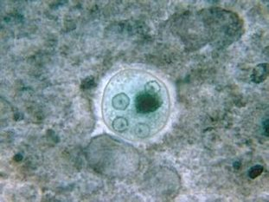
Entamoeba histolytica
Cyst :
Trophozoite discharges undigested food and condenses into a spherical mass called cyst.
Usually Round in shape and 5-15 µm in size.

Slide 8
Entamoeba histolytica
Cyst :
Young cyst contains 1-4 chromatoid bars, glycogen vacuoles and single nucleus whereas Mature cyst contains four nuclei without chromatoid bars and glycogen vacuoles.
Resistant to averse condition.
Sensitive to desiccation, putrefaction and temperature above 40⁰C and below -50⁰C

Slide 9
Entamoeba histolytica
Transmission:
through cysts contaminated food or water , as trophozoites do not survive more than 30 minutes after passing with stools.
Eating of raw and uncleaned vegetable usually in the form of salad.
Eating of food contaminated by flies, use of night soil polluted water etc.

Slide 10
Entamoeba histolytica
Life- cycle:-
Hosts get infection by the ingestion of cysts.
Excystment occurs in the intestine in the presence of trypsin enzyme and released metacystic form.
Meatcystic form undergo nuclear and cytoplasmic division and form eight nucleated daughter trophozoites which migrate to the large intestine and grow into full size and invade the bowel mucosa.

Slide 11
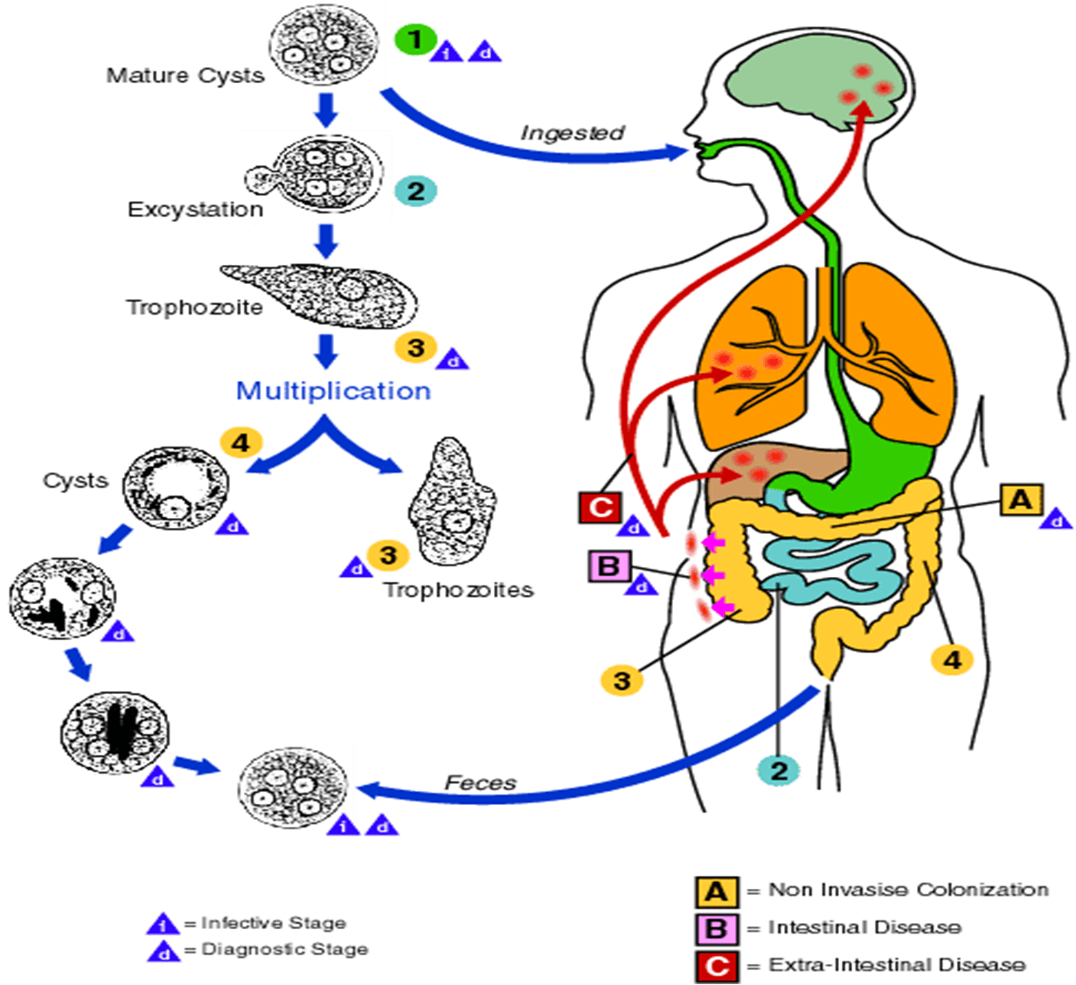
Life-cycle of Entamoeba histolytica
Image source: Google image

Slide 12
Entamoeba histolytica
Pathogenesis:
Pathogenesis depends on various factors like strain variation, presence of Escherichia coli or Aerobactor aerogenes , nutritional status of hosts, concurrent disease, immunity etc.
Parasites penetrates the intestinal wall by the lysis of the epithelium by the action of phosphohydrloae release by liposomes.

Slide 13
Entamoeba histolytica
Pathogenesis:
Amoebae multiply and invade mucosa to produce inverted flask shaped ulcers.
Amoebae may reach other body parts like liver where it may produce inflammation and abscesses.

Slide 14
Entamoeba histolytica
Symptoms:
Acute amoebic dysentery- faces consists of almost entirely blood and mucus with amoebae, abdominal pain, with straining.
Chronic dysentery – recurrent dysentery, occasional abdominal pain, nausea, irregular bowels, headache, flatulence etc.

Slide 15
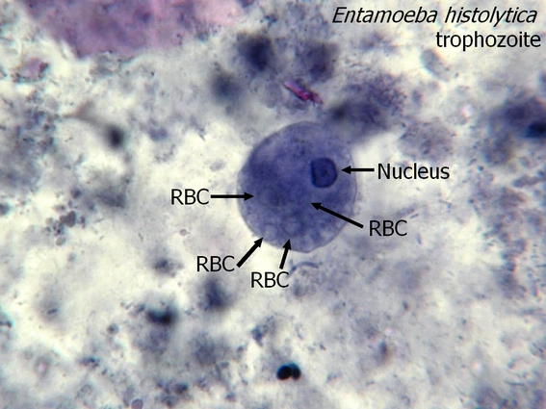
Entamoeba histolytica
Diagnosis :-
On the basis of symptoms like faeces with blood and mucus, abdominal pain etc.
Microscopic examination of faeces reveals for the presence trophozoites (in diarrhoeic faeces) or quadrinucleated cysts (Entamoeba histolytica) or eight nucleated cysts (Entamoeba coli).
2 % iodine is also used for clearly detection of cysts.
Four nucleated
cyst
Image source: Google image

Slide 16
Entamoeba histolytica
Treatment :
Metronidazole , Tinidazole etc.
Control :
Adoption of proper sanitation, personal hygiene, proper disposal of sewage and night soil, avoidance of faecal contamination of food and water, supply of clean drinking water etc.

Slide 17
THANK YOU

