Slide 1
Estrous Cycle in Farm Animals
Dr Bhavna
Assistant Professor cum Junior Scientist
Deptt. of Veterinary Gynaecology and Obstetrics

Slide 2
Rhythmic sexual behavior patterns develops in female animals on attainment of puberty.
This behavior change i.e. sexual receptivity is called estrus, a Greek term which means mad-desire.
The combination of physiological events which begin at one estrus period and end at the next is termed as estrous cycle.
Day of estrus is considered as day zero of the cycle.

Slide 3
Estrous cycle
Follicular phase
Luteal phase
Proestrus
Metestrus
Estrus
Diestrus

Slide 4
Proestrus
Immediately precedes estrus phase.
Characterized by follicular growth, regression of CL and increased production of estrogen.
Estrogen increases blood supply of genital tract, thus, produces edema of genitalia.
Uterus enlarges very slightly, endometrium becomes congested and oedematous, increased glandular secretory activity.

Slide 5
Vaginal mucosa becomes hyperaemic.
In bitches, number of cell layers in epithelium increase and superficial layers becomes cornified.
Also, vulval edema, hyperaemia and proestrual bleeding.

Slide 6
Estrus
Period of acceptance of male.
Onset and end are defined and can be accurately measured, thus, used as reference points for determining the cycle length.
The uterine, cervical and vaginal glands secrete increased amounts of mucus; the vaginal epithelium and endometrium become hyperaemic and congested; the cervix is relaxed.

Slide 7
Ovulation occurs in all species except in cows (12 hours after end of estrus).
Behavioural signs of estrus:
Restlessness
Loss of appetite
Bellowing
Frequent micturition
Mounting behaviour (Standing heat)
Decreased milk production
Mucus discharge (clear, stringy)

Slide 8
Metestrus
Follows cessation of estrus.
Granulosa cells of ovulated follicle give rise to lutein cells.
Formation of corpus luteum.
Scanty discharge, blood tinged (Metestrual bleeding).
If fertilization occurs, mucus secretion from uterine glands increases.

Slide 9
Diestrus
Phase of CL and progesterone dominance.
Development of mammary gland and uterine myometrium.
Uterine glands produce thick, viscid fluid (uterine milk) for nourishing zygote.
CL regresses after 15-16 days, if fertilization fails.

Slide 10
Anestrus
Prolonged period of sexual rest, genital tract quiescence.
Minimal follicular development.
CL regressed and non-functional.
Scanty and tenacious secretions.
Constricted cervix and pale vaginal mucosa.

Slide 11
Estrus- cycle, estrus and time of ovulation in some of the domestic animals
Species | Length of Estrous Cycle (days) | Duration of Estrus | Time of ovulation
Cow | 21-22 | 18-19 hrs | 10-11 hours after the end of estrus
Mare | 19-25 | 4-8 hrs | 1-2 days before the end of estrus
Ewe | 16-17 | 24-36 hrs | 24-30 hours from the beginning of estrus
Goat | 21 | 32-40 hrs | 30-36 hours from the beginning of estrus
Sow | 19-20 | 48-72 hrs | 35-45 hours from the beginning of estrus
Bitch | Size dependent | 7-9 days | 1-2 days after onset of estrus
Queen | 16 | 5-6 days | Induced 14-36 hours after coitus

Slide 12
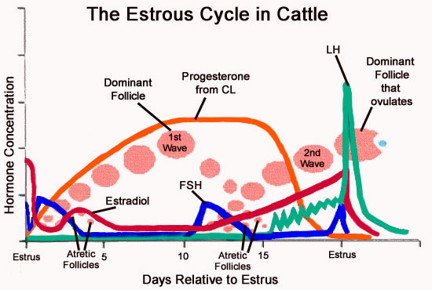

Slide 13
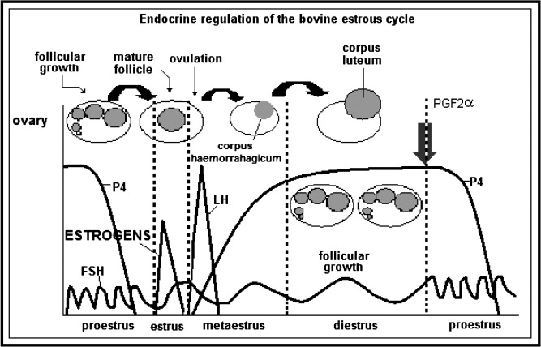

Slide 14
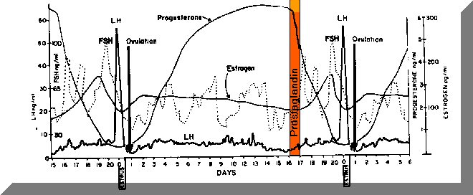

Slide 15
Diestrus
Proestrus
Estrus
Met estrus
Pregnancy
Pseudo pregnancy
Anestrus

