Slide 1
Factors Determining Selection Of Antimicrobial Agent
Dr. Rashmi Rekha Kumari
Asstt. Prof. cum Jr. Scientist
Deptt. Of Vety. Pharmacology and Toxicology
B.V.C, BASU,Patna

Slide 2
Slelection of Antimicrobial agent is determined by following factors

Slide 5
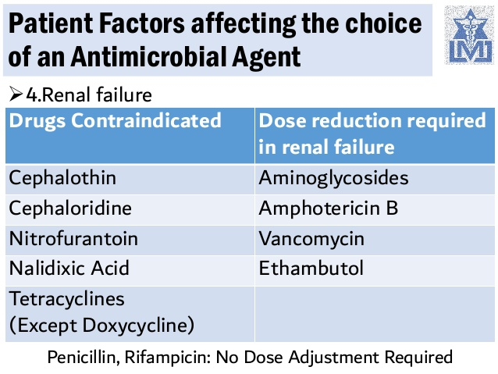
Flucytosine

Slide 8
Spectrum of activity:
For definitive therapy a narrow spectrum drug is preferred over broad spectrum(advantage ?)
For empirical therapy, broad spectrum is preferred to cover all likely pathogens
Type of activity:
Patient with normal host defence: either bacteriostatic or bacteriocidal drug may be used
Severe acute infection: Resolve faster with cidal AMA (why?)
Impaired host defence: Bactericidal AMA(why?)

Slide 9
Sensitivity of organism: Accessed on the basis MIC value and consideration of their post antibiotic effect
Relative Toxicity: Less Toxic antibiotic should be preferred, e.g. a β-lactam over an aminoglycosides or erythromycin over clindamycin

Slide 10
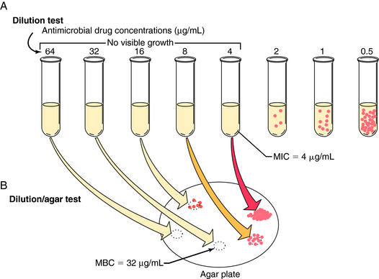
MIC

Slide 11
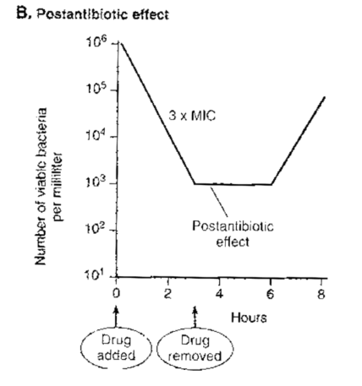
Post antibiotic effect
After a brief exposure if the organism is placed in antibiotic free medium, it starts multiplying again, but after a lag period which depends on the antibiotic as well as the organism. This lag period in growth resumption is called Post Anibiotic effect.
Long PAE is noted with fluoroquinolones and Aminoglycosides

Slide 12
Pharmacokinetic Profile: Most antibiotic are given at 2-4 half life intervals –thus attaining therapeutic concentrations only intermittently.
For many organism, aminoglycosides and fluoroquinolones produce concentration dependent inhibition – inhibitory effect depends on the ratio of peak concentration to MIC.
The same daily dose of Gentamicin produces better action when given as a single dose than if it is divided into 2-3 portion.
While Some other antibiotic produce ‘Time dependent action’

Slide 14
Time dependent inhibition: Antimicrobial action depends on the length of time the concentration remains above MIC; division of daily dose have better effect
β lactam antibiotic,glycopeptides, and macrolid produce time dependent inhibition
The fluoroquinolones have excellent tissue penetration – attain high concentration in soft tissue, lungs, prostrate joints, etc
Ciprofloxacin and rifampin have very good intracellular penetration.
Cefuroxime, ceftriaxone, chloramphenicol, ciprofloxacin attain high CSF concentration.

Slide 15
Route of administration: Aminoglycosides, Penicillin G, carbenicillin and many cephalosporins, Vancomycin, etc have to be given by injection only.
For less severe infection: oral formulations are preferred
For Severe infection(meningitis, septicaemia) : Intravenous formulations
Cost: Less expensive drugs are to be preferred.

Slide 17
Thank You

Slide 19
Genetic/metabolic variation:
– Peripheral neuropathy: Slow vs. Fast acetylators (isoniazid)
Hemolysis: – Glucose-6-phosphate dehydrogenase – Sulfonamides, nitrofurantoin, nalidixic acid, antimalarials, dapsone, and chloramphenicol

