Slide 1
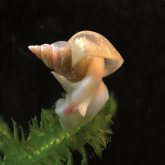
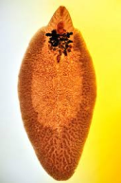
Gross and Microscopic Pathology of Flukes.
Dr Deepak Kumar
Assistant Professor
Department of Veterinary Pathology
Bihar Veterinary College, Patna
Bihar Animal Sciences University, Patna- 14

Slide 2
TREMATODES ( FLUKES )
Trematodes are flat worm, most are leaf-like in shape & have one or two suckers.
Liver flukes are important pathogens of domestic animals, particularly sheep & cattle, & are widely prevalent in India.
The most important species are Fasciola hepatica ( common liver fluke), f. gigantica ( large African liver fluke)
F. magna is large liver fluke present in liver but it has been reported in lungs.

Slide 5
Fasciolia hepatica
Fascioliasis is very important disease of cattle in India.
F. hepatica in its adult form is found in the liver, bile ducts & gallbladder in cattle & sheep.
However, it may occurred in the horse ( rarely ), goat, dog, cat, pig, deer & even Human.

Slide 11
Lymanea Spss

Slide 15
lesiones
Lesions in the liver can be divided into –
1.) Those caused by the migrating larvae &
2.) Those caused by the adults
However, the effects of both may occur together and penetrate the liver parenchyma, hepatic cells destroyed as the larva migrate, & produced tracts of blood, fibrin & cellular debris.

Slide 16
Lesions
Flukes that reach the bile ducts, start producing egg by the tenth week following oral infection & leading to cholangio-hepatitis, extensive fibrosis & calcification of the bile ducts gives rise to term “ pipe-stem liver”.

Slide 18
Extensive infection interferes with liver function.
This causes weight loss, or failure to gain normally. Raised hepatic serum enzymes, eosinophilia, hypoproteninaemia, & anaemia are common findings.

Slide 20
Histopathology

