Slide 1
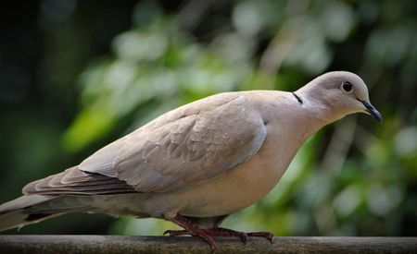
Haemoproteus
Dr. AJIT KUMAR
HoD
Department of Veterinary Parasitology
Bihar Veterinary College
Bihar Animal Sciences University
Patna-800014
Image source: Google image

Slide 2
Family: Plasmodiidae
Heteroxenous parasites.
Schizogony occurs in vertebrates and gametogony and sporogony in invertebrates.
Pigment (haemozoin) is usually formed in the host cell except Leucocytozoon spp.
Genus : Haemoproteus, Leucocytozoon and Plasmodium)

Slide 3
Haemoproteus
Definitive hosts:
Haemoproteuscolumba affects pigeon and dove whereas Haemoproteus meleagridis found in turkeys.
Image source: Google image

Slide 4
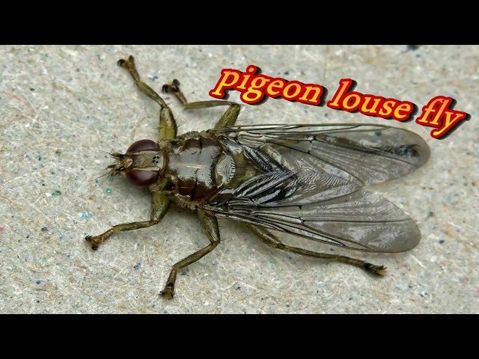
Haemoproteus
Vector : Hippoboscid fly i.e. Pseudolynchia canariensis or Pseudolynchia maura.
Image source: Google image

Slide 5
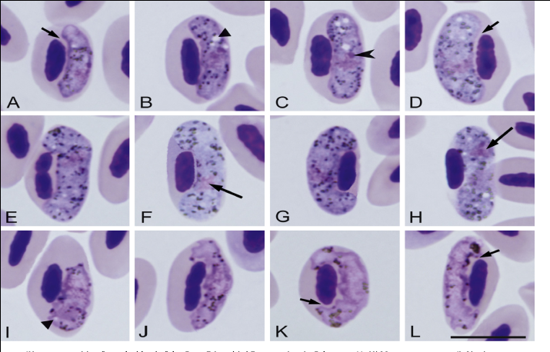
Haemoproteus
Morphology :
Gaemetocyte : Gametocyte is elongate, crescent shaped found inside the RBC which partially encircle the nucleus of RBC in the form of halter.
Image source: Google image

Slide 6
Haemoproteus

Slide 7
Haemoproteus
Morphology :
Infective stage : sporozoites which form schizonts containing 15 or more unpigmented uninucleated cytomeres.

Slide 8
Life-cycle of Haemoproteus
Image source: Google image

Slide 9
Haemoproteus
Pathogenesis and Symptoms:
Infection is usually symptomless but in heavy infection, affected bird may appear restless, anorexia, anaemia, enlarged liver and spleen etc.

Slide 10
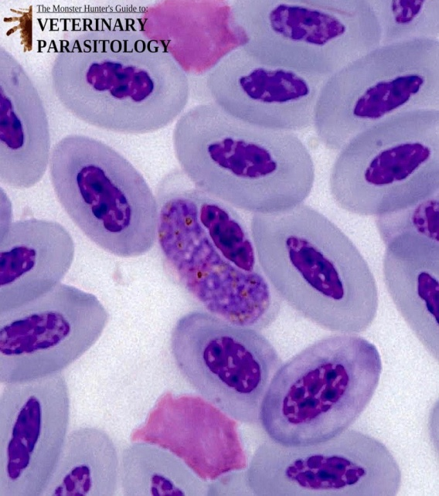
Haemoproteus
Diagnosis:-
By demonstration of halter shaped gametocytes inside the RBCs in stained blood smear.
Image source: Google image

Slide 11
Haemoproteus
Treatment:
Antimalarial drug like primaquine etc. are useful.

Slide 12
Haemoproteus
Control:
Treatment of infected birds.
By controlling vector i.e. Pseudolynchia flies by spraying insecticide

Slide 13
THANK YOU

