Slide 1
Heavy Metal Toxicity (Lead)
Presented by:-
Dr.Archana
Assistant Professor_cum_Jr .Scientist
Deptt.Of Pharmacology & Toxicology
Bihar Veterinary College, Patna

Slide 2
Content of chapter
* Sources
* Toxicokinetic
* Mechanism of toxicity
* Clinical Signs
* Treatment

Slide 3
Lead Toxicity
Lead poisoning is a medical condition caused
by increased levels of the heavy metal lead in
the body, and this can interfere with a variety
of body processes and causes toxicity to
many organs and tissues.
It’s also called plumbism, colica Pictonum or
Saturnism
In veterinary medicine lead is one of the most common cause of metallic poisoning in dogs & cattle.
Goats, swine and chickens are more resistant.

Slide 4
Source :-
Lead poisoning can result when curious animals ingest lead-based paints.
In cattle many cases of lead poisoning is associated with seedling and harvesting activities.
Feeding on crops sprayed with lead insecticides may also result in lead poisoning in animals.
Vegetation grown in lead smelters areas and near highways where plants accumulate lead are other important source of lead poisoning.

Slide 5
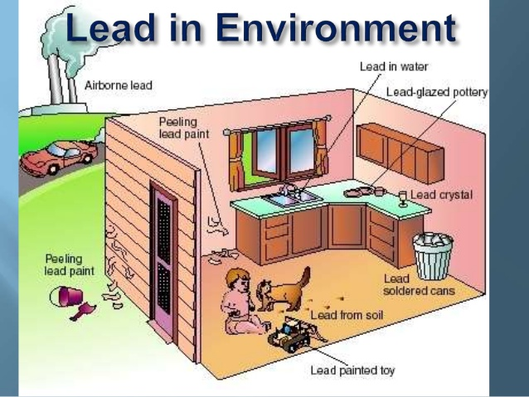

Slide 6
Toxicokinetic
Absorption:-
It is absorp through GIT & respiratory system.
The absorption of lead from GIT is very limited (1-2%) and therefore 98% of lead is eliminated in the faeces.
After absorption a large proportion (85-90% in sheep & 65-70% in cattle) of lead in blood is carried to erythrocytes membrane.
The fumes from heated lead or very fine particles (< 0.5 μm) of lead can enter the lung alveoli.

Slide 7
Distribution
After absorption lead is distributed in the soft tissue particularly in the tubular epithelium of kidney & liver.
Nearly all circulating blood is bound to erythrocyte, only small fraction is present in unbound form & cause toxicity.
It is distributed in the bone, teeth and hair. About 95% of the total body burden of lead is present in the bone & hence bone is considered to be a “sink” for lead.
It crosses placental barrier & blood brain barrier.

Slide 8
Excretion
Lead is normally excreted via kidney small amount excreted through bile & sweat.
Lead is also excreted in dangerous amount through milk

Slide 9
Mechanism of toxicity
The exact mechanism of action is poorly understood even the low concentration of lead inhibits various biochemical process :-
Leads depresses aminolevulinic acid(ALA) dehydratase enzyme ( copper containing enzyme) resulting in increase serun level of δ-aminolevulinic acid and its excretion in urine, this is considered major step invoving lead in biochemical process.
Lead appears to inhibit haem synthetase, a thiol containing enzyme which is required to incorporate iron in the haem molecule. It also prevent entry of iron from cytosol to mitochondria.

Slide 10
Clinical Sign
The major systems affected by lead poisoning are gastrointestinal, central nervous system & hematological system.
GIT Symptoms :-
Anorexia, colic, dullness and transient constipation frequently followed by diarrhea can be common clinical signs in animal exposed to excess lead.

Slide 11
Continue....
CNS symptoms :-
In cattle there is depression, weakness and ataxia can progress to more severe clinical signs of muscle tremors head pressing ,blindness, jaw champing, muscle tremor and convulsion.
Horses develop acute lead toxicosis & show clinical signs of pharyngeal paralysis (roaring) and dysphagia frequently resulting in aspiration pneumonia.
Hematological symptoms:-
Blood capillaries congested with enlarged and increased endothelial cells. Meningeal blood vessels were prominently congested with mild lymphocytic infiltration.
Basophilic stippling (the aggregation of ribonucleic acid) of erythrocytes and inhibition of hemoglobin synthesis are characteristic hematological features of lead poisoning.

Slide 12
Treatment
Specific antidotal therapy
Disodium calcium EDTA(Ethylene diamine tetra acetate)
In horse and cattle it is given intravenously or sub-cutaneously as 1-2% solution in 5% dextrose @ 110mg/kg divided in two treatment daily for 3days. skip for two days & then repeat the dose for two days.
In dogs a similar dose divided into 4 treatments a day is given S/c in 5% dextrose for 2-5 days.

Slide 13
Continue....
Thiamine has been shown to be a valuable adjunct to the treatment of lead poisoning in ruminants and is recommended for other species as well.
Corticosteroids and osmotic diuretics may reduce cerebral oedema in cattle and horses.
Diazepam and barbiturates may be used to control muscle tremor and convulsion.

