Slide 1
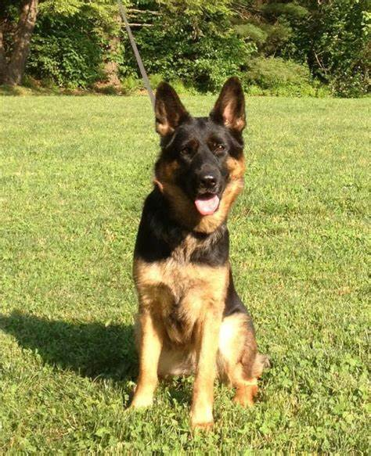
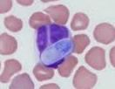
Hepatozoon
Dr. AJIT KUMAR
HoD
Department of Parasitology
Bihar Veterinary College
Bihar Animal Sciences University
Patna-800014
Image source: Google image

Slide 2
Family: Haemogregarinidae
Characters:
Micro-gamonts and macro-gamonts become attached to each other in pairs (syzygy) during development into gametes.

Slide 3
Family: Haemogregarinidae Species of Heapatoozn
Species | Final host | Vector | Location in Final host
Hepatozoon canis | Dog, cat and jackal | Rhipicephalus sanguineus (3 –host tick) | Elongated or rectangular gametocyte found in circulating neutrophils
Hepatozoon americanum | Dog | Amblyomma maculatum (Gulf coast tick) | Gamonts inside the Leucocytes
Hepatozoon muris | Brown rat and black rat | Rat mite (Echinolaelaps echidninus)) | Gametocyte found in Monocyte

Slide 4
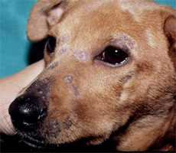
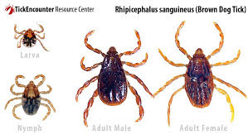
Hepatozoon canis
Final host :- Dog, cat and jackal.
Vector:- Rhipicephalus sanguineus
Image source: Google image

Slide 5
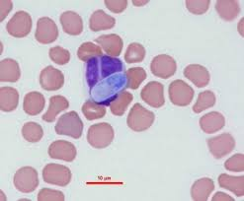
Hepatozoon canis
Morphology:
Gametocyte: Elongated or rectangular gametocyte (8-12 µm X 3-6 µm)found in circulating neutrophils.
Gametocyte
inside neutrophil
Image source: Google image

Slide 6
Hepatozoon canis
Morphology:
Oocyst : each sporocyst contains 30-50 sporocysts and each sporocysts contains about 16 banana-shaped sporozoites.

Slide 7
Hepatozoon canis
Transmission:
Dog gets the infection by the ingestion of sporocysts infected tick.
Image source: Google image

Slide 8
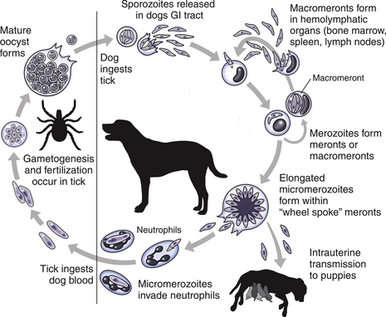
Life-cycle of Hepatozoon
Image source: Google image

Slide 9
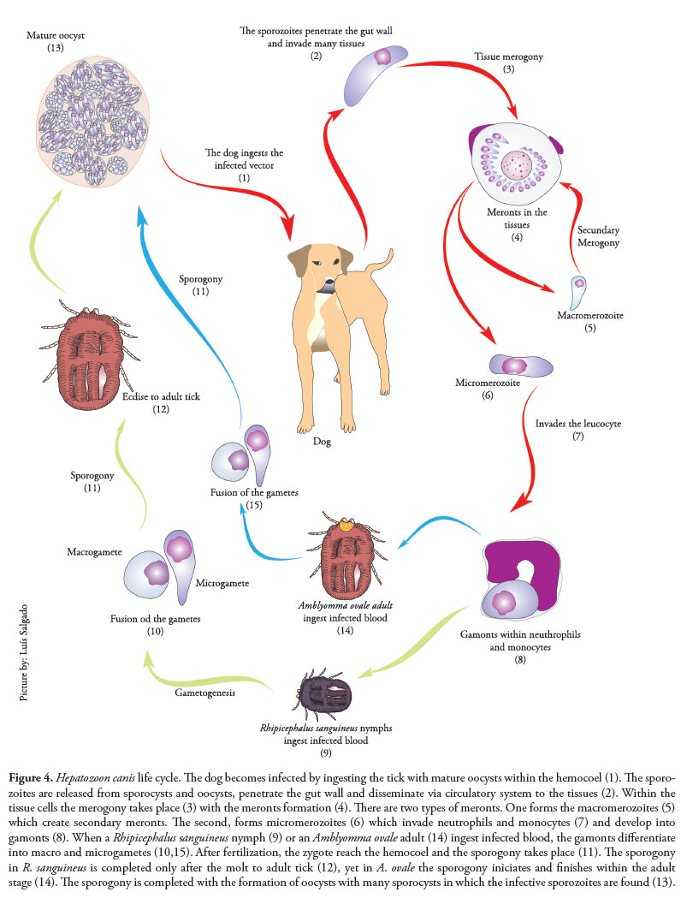
Life-cycle of H. canis
Image source: Google image

Slide 10
Hepatozoon canis
Pathogenesis and symptoms :-
H. canis may also found in apparently healthy dogs.
Recurrent fever, anaemia, progressive emaciation, splenomegaly and lumbar paralysis are clinical signs in Hepatozoonosis.

Slide 11
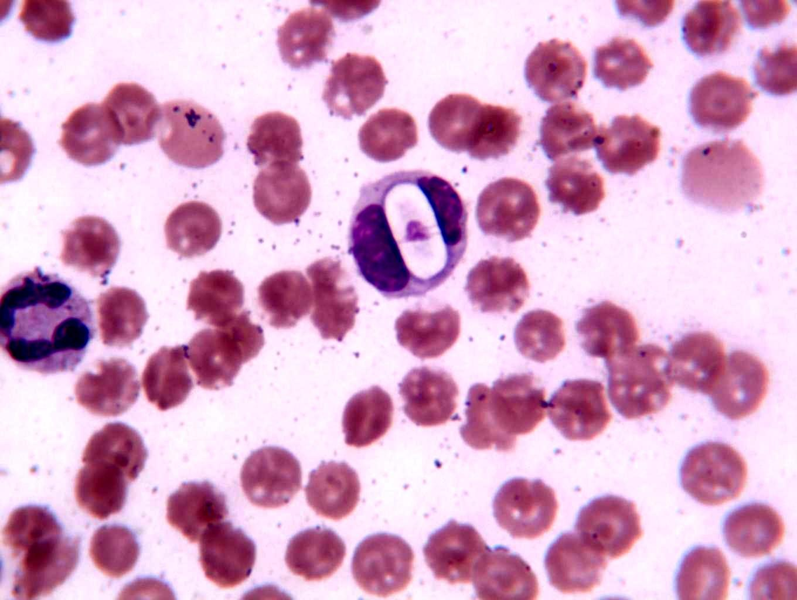
Hepatozoon canis
Diagnosis:
By the detection of elongated or rectangular gametocyte stage inside the neutrophil in stained blood smear.
Demonstration of schizonts in spleen or bone marrow biopsy smear.

Slide 12
Hepatozoon canis
Treatment :-
Imidocarb diproprionate and Doxycline (@ 5 mg/kg b.wt.) orally are the drugs used in the treatment of hepatozonosis.

Slide 13
Hepatozoon spp.
Control :-
Treatment of infected animals.
By controlling ticks and mites population.

Slide 14
THANK YOU

