Slide 1
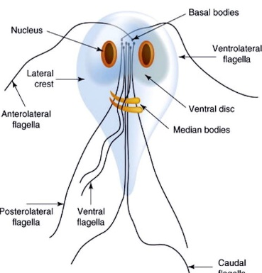
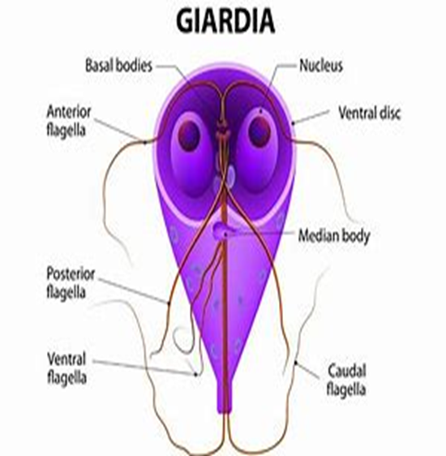
Hexamita
and
Giardia
Dr. AJIT KUMAR
HoD
Department of Veterinary Parasitology
Bihar Veterinary College
Bihar Animal Sciences University
Patna-800014
Image source: Google image

Slide 2
Family: Hexamitidae
Genus:
Hexamita and Giardia
Both have two similar nuclei.

Slide 3
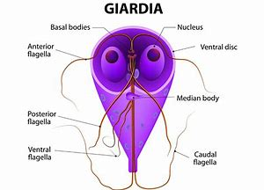
Giardia
Morphology:
Two developmental stages - trophozoite and cyst.
Trophozoite :
Pyriform to elliptical in shape and bilaterally symmetrical.
Anterior end is rounded and posterior end is pointed.
Image source: Google image

Slide 4
Giardia
Morphology:
Trophozoite :
A large adhesive disc is present on the ventral side whereas dorsal side convex.
It has two anterior nucleus, two median axostyle and eight flagella arranged in two pairs
Image source: Google image

Slide 5
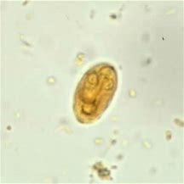
Genus: Giardia
Cyst:
Cysts are oval or elliptical in shape with 2 or 4 nuclei and a number of fibrillar remnants of the trophozoite organelles.
Image source: Google image

Slide 6
Genus: Giardia
Species | Hosts | Location
Giardia intestinalis or Giardia lamblia | Man, monkey and pig | Upper digestive tract
G. canis | Dog
G. bovis | Ox
G. cati | Cat
G. caprae | Goat

Slide 7
Genus: Giardia
Life-cycle : – Direct
Reproduction :- By binary fission
Transmission:
through the ingestion of cysts contaminated food or water.

Slide 8
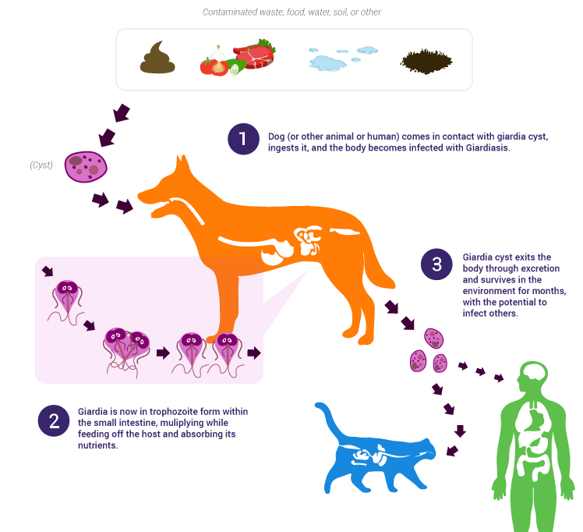
Life-cycle of Giardia
Image source: Google image

Slide 9
Giardia
Pathogenesis:
Chronic diarrhoea in man especially children.
Interference in fat digestion which results deficiency in the fat soluble vitamins.
Clinical signs :
Giardiosis (beaver fever) results diarrhoea, dysentery and steatorrhoea (fats comes with stool) and deficiency of fat soluble vitamin.

Slide 10
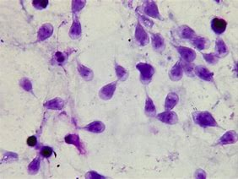
Giardia
Diagnosis:
Microscopic faecal examination reveals oval or elliptical shaped cyst contain 2 or 4 nuclei.
Trophozoite stage may be found in diarrhoeic stool.
Trophozoites
Image source: Google image
Cyst

Slide 11
Giardia
Treatment:
Metroniodazole,Tinidazole, Fenbendazole, Chloroquine etc.
Control:
Good hygiene and proper sanitation.

Slide 12
Hexamita

Slide 13
Hexamita meleagridis
Morphology
Pyriform shaped, two similar nuceli, out of eight flagella, six flagella anteriorly directed in two groups of three in each and two caudal flagella, two axostyles but adhesive disc absent.

Slide 14
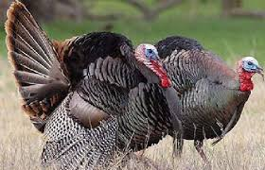
Hexamita meleagridis (Spironucleus meleagridis)
Host and location
It occurs in the duodenum and small intestine of young turkey, peafowl, quail, partridge, duck and also chicken.
Image source: Google image

Slide 15
Hexamita meleagridis
Transmission
Organisms transmitted through contaminated feed and drinking water.

Slide 16
Hexamita meleagridis
Pathogenesis
Young turkey up to two months of age are most susceptible whereas old birds act as symptomless carrier.
It causes catarrhal enteritis in the small intestine and intestinal contents become thin, watery and foamy. Myriad of Hexamita are occur in the bulbous area of caeca.

Slide 17
Hexamita meleagridis
Clinical signs
Hexamitosis disease is known as Infectious catarrhal enteritis ion turkey poults.
Symptoms include foamy and watery diarrhoea, loss of body weight, nervousness and death of affected birds.
Image source: Google image

Slide 18
Hexamita meleagridis
Diagnosis
Examination of intestinal contents or scraping of small intestine of sacrificed birds to microscopic detection of living Hexamita organisms.
Treatment
Nithiazide @ 0.02 percent in drinking water/ Furazolidone @ 0.01 percent in feed / Oxyteracycline drugs are used in treatment.
Control
Adoption of hygienic measures

Slide 19
THANK YOU

