Slide 1
Histomonas
Dr. AJIT KUMAR
HoD
Department of Veterinary Parasitology
Bihar Veterinary College
Bihar Animal Sciences University
Patna-800014
Image source: Google image

Slide 2
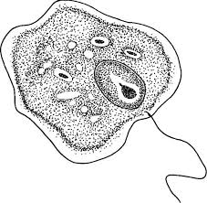
Family: Monocercomonadide Histomonas meleagridis
Morphology :-
Organisms are amoeboid (pleomorphic) with a single nucleus and single flagellum.
Image source: Google image

Slide 3
Histomonas meleagridis
Morphology :-
Four stages of parasites have been recognized :-
Invasive stage,
Vegetative stage,
Resistant stage and
flagellar stage.
Image source: Google image

Slide 4
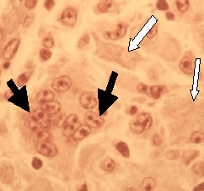
Histomonas meleagridis
Host :
Turkey (mainly) but also in chicken, pheasant, partridge and quail.
Image source: Google image

Slide 5
Histomonas meleagridis
Location : Caecal mucosa and liver parenchyma
Reproduction :- By binary fission
Image source: Google image

Slide 6
Histomonas meleagridis
Mode of Transmission:
Transmission takes place in birds by ingestion of embryonated eggs of the caecal worm (Heterakis gallinarum) containing Histomonas meleagridis organism.

Slide 7
Histomonas meleagridis
Mode of Transmission:
Infection of birds may also occur by the ingestion of earthworm which is transport host for Heterakis eggs and larvae.

Slide 8
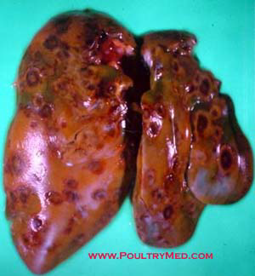
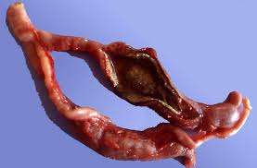
Histomonas meleagridis
Pathogenesis :-
Histomonosis produces foul smelling yellowish exudates forming a hard caseous plug in caecum and formed circular necrotic foci with yellow depressed centre (bulls eye appearance) in liver.
Circular necrotic lesions
Circular necrotic lesion s in caecum
Image source: Google image

Slide 9
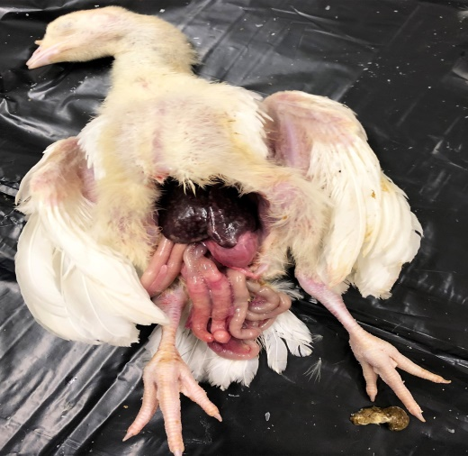
Histomonas meleagridis
Disease:
It caused diseases is called Histomonosis or Infectious enterohepatitis or Black head disease in turkey.

Slide 10
Histomonas meleagridis
Symptoms:
Sulphur yellow coloured faeces especially in turkeys which is not common sign in chicken.
A few turkeys shows cyanotic discoloration of the skin of the head and wattles from which black head name arises but it is not a constant feature of the disease.

Slide 11
Histomonas meleagridis
Diagnosis:
On the basis of symptoms like Sulphur yellow coloured faeces etc.
Characteristic necrotic lesions found in caecum and liver during P.M. examination.

Slide 12
Treatment of Histomonas meleagridis
Furazolidone, Dimetridazole, Nithiazide and 2-amino 5-nitrothiozole drugs are used in treatment.

Slide 13
Control of Histomonas meleagridis
Adoption of hygienic measures,
Avoiding overcrowding and prevent contamination of feed and drinking water with droppings,
separate rearing of different species of birds.

Slide 14
THANK YOU

