Slide 1
VETERINAY ANATOMY, UNIT- 6, TOPIC-Details Description of HOCK AND FETLOCK JOINT OFDIFFERENT ANIMALS
Instructor- DR. SANJAY KUMAR BHARTI
HOD, VETERINARY ANATOMY

Slide 2
HOCK JOINTS OF – Ox, SHEEP& GOAT , Horse, PIG,DOG & Fowl
This is a composite joint consisting of
1. Tibio tarsal articulation
2. Proximal tarsal articulations
3.Inter tarsal articulations
4. Distal tarsal articulations
5.Tarso-metatarsal articulations

Slide 3
HOCK JOINTS OF – Ox,

Slide 4
TARSAL BONES - OX,
TARSAL BONE- OX
The tarsus is composed of five short bones arranged in below:
Lateral Medial
Proximal row Tibial tarsal Fibular tarsal
Central row Fused Central and 4th tarsal
Distal row First tarsal Fused second & third tarsal

Slide 5
Tarsal Bone – OX-(Sheep and Goat Similar to that of ox)

Slide 6
Tarsal Bone- Horse.

Slide 7
TARSAL BONE-DOG=6

Slide 8
HOCK JOINTS OF – Ox, SHEEP& GOAT , Horse, PIG,DOG & Fowl
Ox
This is a composite joint consisting of
1. Tibio-tarsal articulation
2. Proximal tarsal articulations
3.Inter tarsal articulations
4. Distal tarsal articulations
5.Tarso-metatarsal articulations.
The tibio tarsal articulation is a ginglymus or Hinge . The rest are gliding or arthrodia.
The joint has common ligaments and special ligaments.

Slide 9
TIBIO-TARSAL ARTICULATION
A. Types- Hinge, B-Bone Involvement- Tibia (Distal Extremities) Tarsal ( Proximal row) C- Movement- Extension & Flexion D-Common ligaments
1. Capsular ligament may be divided into two parts-anterior and posterior.
The anterior capsular ligament is membranous and encloses and tibio-tarsal joint in front.
The posterior capsular ligament is also membranous and is attached to the tibial tarsal above, metatarsal below and blends with the lateral ligaments.
2. Collateral Ligaments- The lateral and medial collateral ligaments extending from the distal end of the tibia above on both side lateral and medial, attached to the tarsal bones and the large metatarsal bone below.
3. Posterior ligament (calcaneo-metatarsal ligament) is on the postero-lateral aspect from the posterior border of tuber calcis passes down and is attached to the central and fourth tarsal and to the large metatarsal below.
.

Slide 10
TIBIO-TARSAL ARTICULATION

Slide 11
HOCK JOINT- Contin…..
4. Dorsal oblique ligament is a narrow band placed at the antero-internal aspect of the joint. It extends from the medial side of the tibial tarsal, passed obliquely downwards and attaches on the fused central, fourth tarsal and the large metatarsal bones
5. Tarso- metatarsal ligament is on the plantar aspect of the joint. It is blended in front with plantar oblique capsular ligament and is adherent to all the tarsal bones. It also blends medially with the medial (collateral) ligament and laterally with planter tarsal ligament. Its plantar face is lines by synovial membrane and forms anterior wall of the tarsal sheath.

Slide 12
HOCK JOINT- Contin…..
6. ANNULAR LIGAMENT -Besides these ligaments, there are certain annular ligament which serve to bind the tendons of the muscles.
On the dorsal aspect, there are two-proximal and distal.
The proximal annular ligament is large and thick running across from medial to lateral malleolus. It binds fascia down the tendons of complex muscle.
The distal annular ligament is thin, arises from fibular tarsal runs obliquely downwards inward is attached to the large metatarsal.
The plantar or posterior annular ligament extends from the fibular tarsal and plantar ligament to the medial collateral ligament. This from the posterior wall of the tarsal sheath.
The tarsal sheath is formed in front by the tarso-metatarsal ligament (blended with plantar capsular ligament) and behind by the plantar annular ligament. The posterior and anterior faces respectively of these ligaments are lined by synovial membrane and this sheath for the tendon of the deep flexor, plantar arteries and nerves.

Slide 13
HOCK JOINT- Proximal tarsal articulation
Proximal tarsal articulation- 1.Type- Gliding, 2. Movement- Gliding
3. Bone Involvement-Between tibial tarsal and fibular tarsal bones.
4- Ligaments
one extends from the supero-posterior margin of the trochlea of tibial tarsal to fibular tarsal
From sustentaculum tali to adjacent part of tibial tarsal on the medial aspect
A lateral band from trochlear process of fibular tarsal to lateral ridge of the trochlea of tibial tarsus.
An interosseous ligament.

Slide 14
HOCK JOINT- Proximal inter-tarsal articulation & Distal inter-tarsal articulation
Proximal inter-tarsal articulation 1.Type- Gliding, 2. Movement- Gliding
3. Bone Involvement-Between tibial and fibular tarsals above and central & fourth tarsal.
4.Ligaments
Interosseous between tibial and centrals
Interosseous between fibular and central tarsals.
Distal inter-tarsal articulation1.Type & 2. Movement- Same as above
3. Bone Involvement-Between central & fourth tarsal above fused second and third tarsal and first tarsal below.
4. Ligaments- From central tarsal to fused second and third tarsal on the dorsal aspect.
Interosseous ligaments connecting fused central and fourth tarsal to fused second and third tarsal and to large metatarsal.

Slide 15
TARSAL BONE-DOG

Slide 16
HOCK JOINT- Contin….. Distal tarsal articulation& Tarsal metatarsal articulation
Distal tarsal articulation- 1.Type & 2. Movement- Same as above
3.Bone involvement- Between fused second and third tarsal and first tarsal 4.Ligament- Interosseous ligament between fused second and third tarsal and first tarsal.
Tarsal metatarsal articulation 1.Type & 2. Movement- Same as above
3.Bone involvement-Between central and fourth tarsal, second and third tarsal bones above and large metatarsal bone below.
On the dorsal aspect extending obliquely from medial aspect of tibial tarsal, down to large metatarsal. Synovial membranes are four in member.
4.Ligament- Interosseous ligament

Slide 17
HOCK JOINT- Contin…..
Horse
Minor differences due to the variation in number of bones.
Check ligaments are ill developed.
The supra tarsal ligament is vestigial and is represented by deep tarsal fascia, attached to both sides of tendo-achilles.
The sub tarsal ligament is the prolongation of the tarso-metatarsal ligament, which joins the deep flexor tendon.
Dog & Pig
Differences are present due to variation in the number of bones.

Slide 18
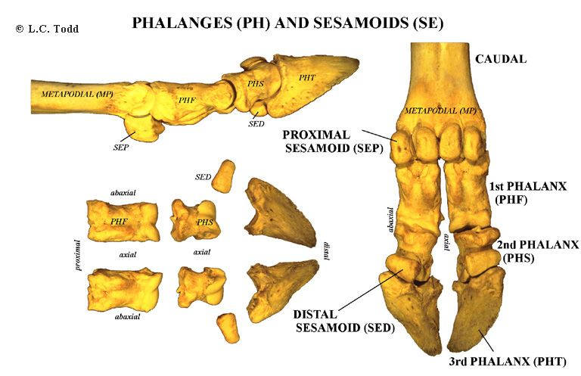
FETLOCK JOINT-METATARSAL& PHALANGES

Slide 19
DIGITS-PHALANGES-HORSE

Slide 20
FETLOCK, PASTERN and coffine JOiNT-OX, Horse, sheep,goat, dog,pig &fowl
FETLOCK JOINT-METATARSO PHALANGEAL ARTICULATION
Ox- 1.Type- Hinge, 2. Movement- Extension & Flexion
3. Bone involvement- between the distal extremity of the large metacarpal, the proximal extremity of the first phalanx below and the proximal sesamoids behind.
4. Ligaments
The joint has A- capsular, B- collateral and C- sesamoidean ligaments.
The capsular ligaments enclose the joints distal extremities of metatarsal over the proximal ends of first phalanges .
The collateral ligaments are in the form of axial and abaxial ligaments.
The abaxial ligaments extend from the lateral aspects of the distal extremity of the large metatarsal to the abaxial sesamoids and the proximal extremity of the first phalanx below means in a crossing manner .
.

Slide 21
FETLOCK JOINT-METATARSAL& PHALANGES

Slide 22
FETLOCK JOINT-METATARSO PHALANGEAL ARTICULATION CONT……
The axial ligaments arise common from the cleft of the large metatarsal bone and each spreads out on the cleft of the large metatarsal bone.
It then spreads out and attached to the proximal part of the inter digital space of the first phalanx, where its fibres blend with the superior interdigital ligament.

Slide 23
FETLOCK JOINT-METATARSO PHALANGEAL ARTICULATION CONT……Sesamoidean ligaments
Sesamoidean ligaments are-4 in number
A- superior (2 in number)
B- Inter sesamoidean- (3 in number)
C- Collateral (2 in number- lateral & medial )
D-Inferior-(4 in number in crossing manner two deep and two superficial )
Total Number of Sesamoidean ligament= 2+3+2+4=11

Slide 24
FETLOCK JOINT-METATARSO PHALANGEAL ARTICULATION CONT……Sesamoidean ligaments

Slide 25
FETLOCK JOINT-METATARSO PHALANGEAL ARTICULATION CONT……Sesamoidean ligaments

Slide 26
FETLOCK JOINT-METATARSO PHALANGEAL ARTICULATION CONT……Sesamoidean ligaments
A- The superior sesamoidean or suspensory ligament (musculus interossei) arises from the volar face or planter face of the distal row of tarsal bones and the proximal extremity of the large metatarsal descends on the volar face of the latter and divides about its middle into two branches -anterior and posterior.-
B- Inter sesamoidean- (3 in number)
Located between four sesamoid bones like-
SB-SL-SB-SL-SB-SL-SB, here total 3 Inter sesamoidean ligamnets present between 4 sesamoid bones

Slide 27
FETLOCK JOINT-METATARSO PHALANGEAL ARTICULATION CONT……Sesamoidean ligaments

Slide 28
FETLOCK JOINT-METATARSO PHALANGEAL ARTICULATION CONT……Sesamoidean ligaments
C- Collateral (2 in number- lateral & medial )
Located between distal extremities of Metatarsal and proximal extremity of First Phalanx on its lateral and medial aspect.
D-Inferior-or-Distal (4 in number in crossing manner two deep and two superficial )
Located between distal extremities of Metatarsal, tubercle of proximal extremities of first Phalanx

