Slide 1
INFECTIOUS Canine hepatitis (ich / Rubarth's disease)
Dr. Anil Kumar
Asst. Professor
Dept. of VCC
Unit-5

Slide 2
canine adenovirus 1(CAdV-1), a DNA Virus
Systemic disease
Any age but, young dogs, in the first 2 years of life, are more likely to die than older one
ETIOLOGY:
Dogs and other candis including foxes, wolves, coyotes, skunks, and bears
The virus has a predilection for hepatocytes, vascular endothelium, and mesothelium
In dogs, causing acute hepatitis, respiratory or ocular disease.
HOST RANGE
Most often via the oral route by contact with urine from infected dogs.
Recovered animal shed virus up to 6 months in their urine
TRANSMISSION

Slide 3
PATHOGENESIS
VIRUS ENTERS THROUGH
ORAL ROUTE
VIREMIA (4-8Days) & MULTIPLICATION AT TONSILS AND SPREAD TO LOCAL LYMPH NODES
GOES TO THE SYSTEMIC CIRCULATION & DISSEMINATED TO OTHER TISSUES AND BODY SECRETIONS
Cytotoxic effect
of Virus
BONEMARROW
&LYMPHOID TISSUES
HEPATIC/RENAL/OCCULAR PARENCHYMA
ENDOTHELIAL CELLS OF MANY TISSUES
LEUKOPENIA, ANAEMIA AND FEVER
HEPATITIS/ Ag &Ab complex GLOMERULONEPHRITIS/UVEITIS
SEROSALHAEMORRHAGE

Slide 4
CLINICAL FINDINGS
PERACUTE FORM:
Death within few hour after the onset of clinical signs
Survived viraemic period animals have vomition, abdominal pain and diarrhoea with or without haemorrhage.
High temperature, enlarged tonsils and red colouration of buccal mucosa.
ACUTE FORM:
Starts with apathy, anorexia and High body temperature, followed by vomition or diarrhoea
Faeces often blood tinged with abdominal pain.
‘’Saddle curve” like fever.
Increased pulse and respiration
Tonsilitis, pharyngitis, laryngitis, coughing and hoarse lower respiratory sounds and pneumonia.
Dog shows intense thirst, haemorrhagic buccal mucosa and abdominal tenderness
Tucked up abdomen with pain on palpation at liver region
Defective clotting mechanism
“ Blue Eye disease”, a transit corneal opacity due to haemorrhage and ulceration of eyes
Subacute form:
Common >1 year of age
Mild rise of body temperature (103-104 ⁰F)
Mild photophobia
Enlarged tonsils
Recovered easily but weight regaining is very slow.

Slide 5
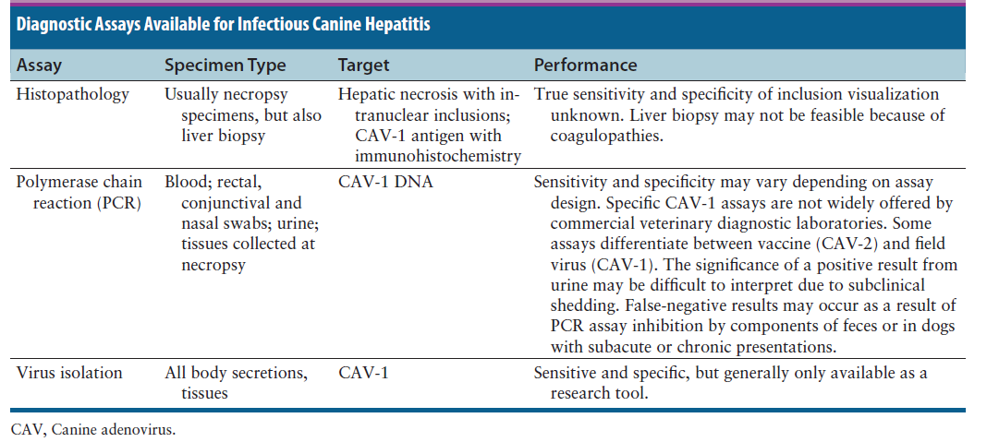
Diagnosis:
It may be suspected in any dog less than 1 year of age that has a questionable vaccination history and signs of fever, respiratory, gastrointestinal, and hepatic disease, and certainly in any young dog that develops corneal edema.

Slide 6
Treatment and Control:
Dogs with acute ICH require supportive care and consists primarily of fluid therapy, including crystalloid fluids and blood products.
Antiemetics, antacids, sucralfate, whole blood or plasma transfusions, and colloids such as hetastarch.
Partial or total parenteral nutrition for those that do not tolerate enteral feeding.
Management of hepatic encephalopathy with lactulose enemas, oral lactulose (in the absence of vomiting), and poorly absorbed oral antimicrobial drugs such as ampicillin may also be indicated.
The use of parenteral broad-spectrum antimicrobial drugs should be considered for dogs with hemorrhagic gastroenteritis that may develop bacteremia as a result of bacterial translocation.
For severe corneal edema and uveitis, use topical ophthalmic preparations that contain glucocorticoids and atropine to prevent development of glaucoma.

Slide 7
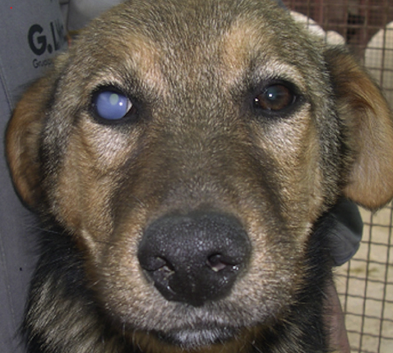
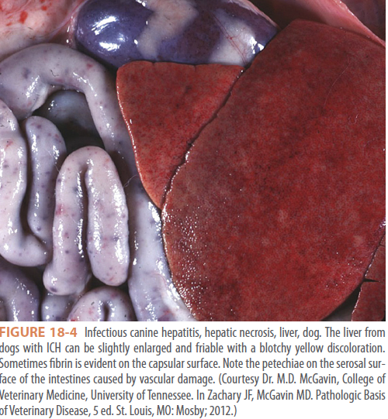
Prevention:
Immunization:
Vaccines should be administered every 3 to 4 weeks from 6 weeks of age, with the last .vaccine given no earlier than 16 weeks of age.
Proper disinfection, isolation, and prevention of overcrowding and other co-infections, which may worsen disease.
There is no evidence that CAV-1 infects humans.
Young adult dog with corneal edema

