Slide 1
INFECTIOUS BURSAL DISEASE
Dr. SANJIV KUMAR
ASSTT. PROFESSOR, DEPTT. OF PATHOLOGY,
BVC, BASU, PATNA

Slide 2
INTRODUCTION
SYNONYMS: Gumboro disease, Infectious bursitis and Avian nephrosis
Acute highly contagious infection of chickens
B- Lymphocytes are the primary target cells
Bursa, lymphoid organ, is severely affected
First report in Gumboro (Delware District of USA)
Economically significant, because heavy mortality in 3 – 6 wks old chickens and severe prolonged immunosuppression of chickens infected at an early age.

Slide 3
Etiology
Birna virus ( ds RNA) - Birna = two
Serotype 1 IBDV
Variation in virulence - from apathogenic to highly virulent strains
Serotype 2 IBDV
Non pathogenic or Immunosuppressive

Slide 4
Transmission
Mainly oro faecal route but may be by conjuctiva or respiratory route
Affected birds excrete the virus in faeces for 10-14 days
Virus is very stable
Remains highly infectious for many months (up to 122 days) in the poultry environment
Role of mechanical vectors (Human, wild birds, insects)
No vertical transmission and carriers

Slide 5
PATHOGENESIS
After ingestion, the virus multiplies in macropahges of small intestine (Duodenum, jejeunum and caecum).
Thereafter, reaches liver (kupffer cells).
Comes in circulation, reach Bursa (multiplies in B lymphocytes).
Second massive viremia and finally destroys the lymphoid follicles in the bursa of Fabricius as well as the circulating B-cells in the secondary lymphoid tissues such as GALT (gut-associated lymphoid tissue), CALT (conjunctiva), BALT (Bronchial) caecal tonsils, Harderian gland, etc.

Slide 6
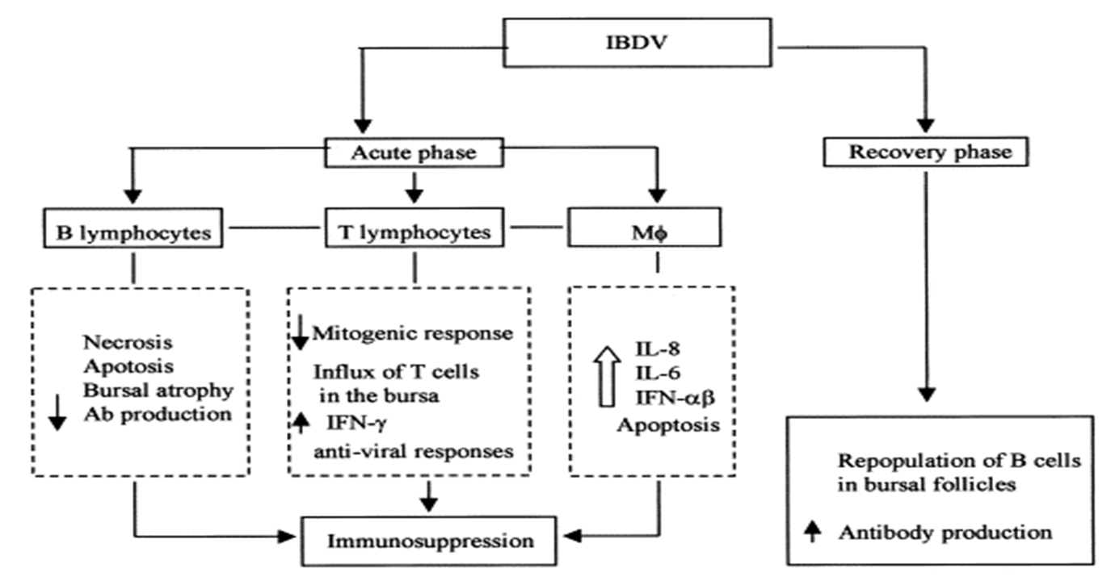

Slide 8
Susceptible age 3 -6 wks of age
B - cells and their precursors are the main target cells
T- Lymphocytes are relatively unaffected
Renal pathology (swollen with urate deposits and cell debris) are due to severely swollen bursa
Mechanism for muscular haemorrhage is not known (may be due to interference of virus with the normal blood clotting mechanism)
Acute disease and death is due to the necrotizing effect of these viruses on the host tissues.
Bursal infection in early life can result in impaired immune responses.
Kidney failure is a common cause of mortality.

Slide 9
Consequences
Lowered resistance to diseases
Negative interference with effective vaccination.
Subclinical infection in younger than 3 wks —> immunosuppression
Chemical bursectomy (using cyclophosphamide) in 3 day old chicks and subsequent challenge at 4 wks —> Resistant to disease
Similar results in surgically bursectamised 4 wks old chickens ( with mild necrosis of lymphatic tissue and 1000 times less viral production) but 100% mortality in control non-bursectamised birds

Slide 10
CLINICAL SIGNS
Severity depends upon age, breed, and MDA level of the chick as well as the virulence of virus. Incubation period: 2- 3 days. 3 -6 wks old chicks are affected.
Depression
White watery diarrhoea
Soiled vent
Anorexia
Ruffled feathers
Reluctance to move
Closed eyes and death
Morbidity - 10 – 100%
Mortality: 0 - 20% (Normally), 90 – 100% (VVIBDV)
Milder form - Little or No signs Suboptimal growth
Course of the disease
Short, leading to death or recovery (in individual bird)
Mortality reaches a peak 3-5 days after infection

Slide 11
GROSS PATHOLOGY
Dehydration of carcass
Muscular haemorrhage (thigh and pectoral), some times at the junction of proventriculus and gizzard.
Haemorrhages of pectoral leg muscles are typical of IBD
Intestine with excess mucus
Liver- Hepatomegaly and peripheral infarcts
Spleen- Splenomegaly
Kidneys- Swelling and white appearance, dilatation of tubules with urates ( cell debris, occasionally).

Slide 12
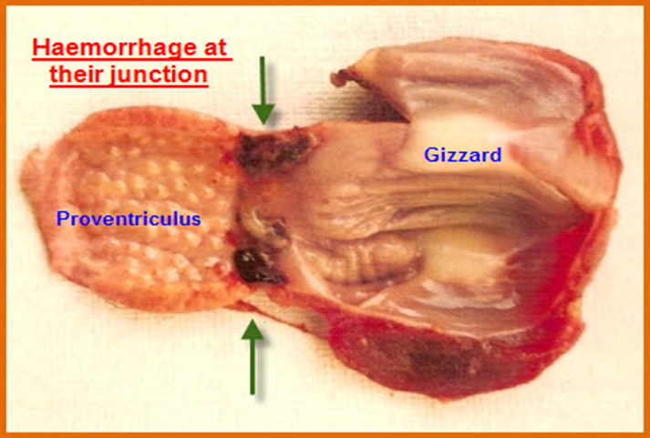

Slide 13
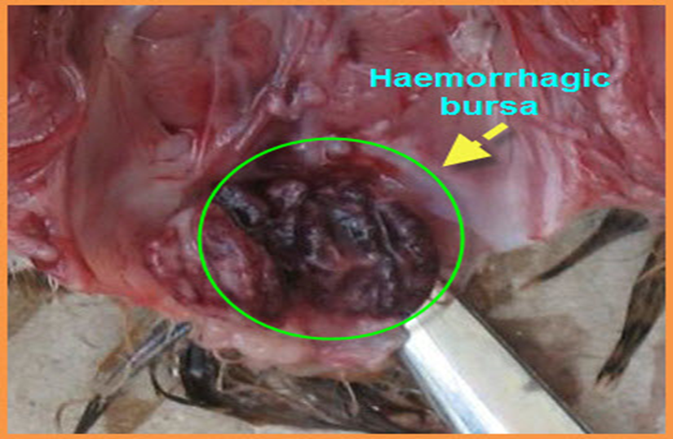
Bursa
Enlarged, inflamed, edematous and cream coloured (early)
Atrophy (after 3 – 8 days)
Haemorrhage on the internal and serosal surfaces
Caseous core within the lumen from sloughed epithelium

Slide 17
Spleen - Moderate lymphoid cell necrosis
Thymus and caecal tonsil - Lymphoid cellular reaction (early stage), but less extensive damage
Harderian gland - Depletion of plasma cells
Kidneys - Non – specific, degenerative changes
Liver - Mild perivascular infiltration of monocytes.

Slide 18
DIAGNOSIS
Based on history, clinical signs and gross lesions
Serological test
AGPT (using macerated bursa)
ELISA
To identify the presence of antigen
Immunoperoxidase staining
Immunofluorescence (in frozen bursal sections or smears)
Virus isolation (rarely) - Time consuming process
Inoculation of suspected bursa into 10 – 11 days old embryonated eggs
Some strains grow on Chick embryo fibroblast, vero cells or certain lymphoblastoid cell cultures
Abs may develop after infection (detected by NT,ELISA, Precipitation test). It is useful when MDA declines below detectable levels)
Nucleic acid probe, Ag-capture ELISA (using MCAbs.,), RT-PCR

Slide 19
DIFFERENTIAL DIAGNOSIS
Coccidiosis
Ranikhet disease
Haemorrhagic syndrome of muscles and other haemorrhages
Avitaminosis A
FLKS
Water deprivation with swollen kidneys
Excess renal urates.

