Slide 1
‘Veterinary Epidemiology & Zoonoses’
VPH-321
(Credit Hours-2+1)

Slide 2
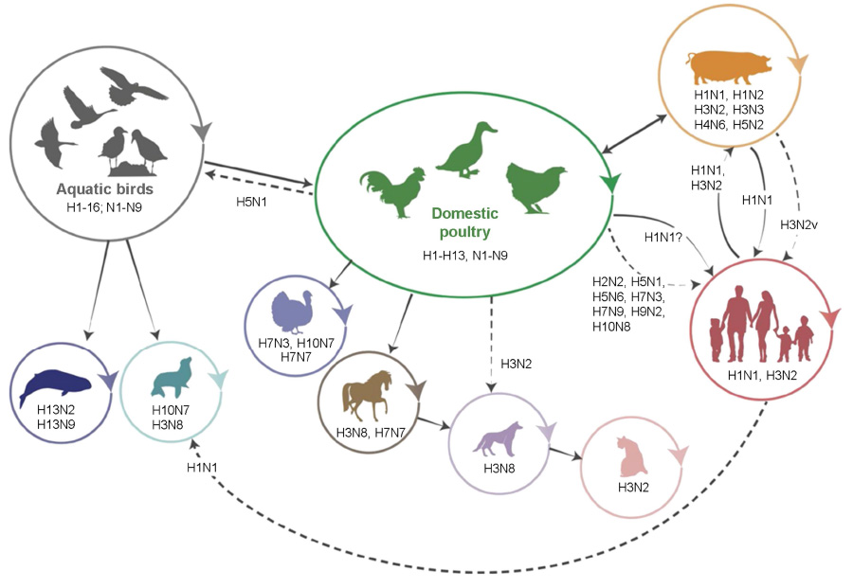
Influenza
Influenza is a contagious, acute respiratory illness caused by influenza viruses, usually influenza A or B subtypes

Slide 3
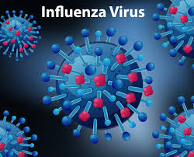
Etiology
Family-Orthomyxoviridae
RNA genome
Four types are recognized:
A: In human, pig, horse, pig: causes pandemic
B: In human
C: Mild illness
D: Effect cattle
Two surface antigens: Protein subunit of viral envelope
Haemagglutinin (H): Sixteen (H1 to H16)
Neuraminidase (N): Eleven (N1 to N11)
Immunologic & epidemiologic interest
Occur in a number of different combinations
Each combination: different subtypes of the virus
(CDC, WHO)

Slide 4
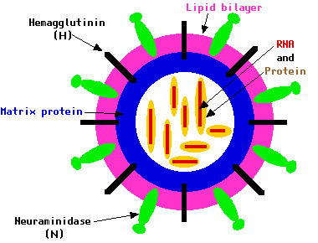
Structure of Influenza A Virus
Eight segment RNA virus
Rod shape
Mashroom shape

Slide 5
Nomenclature of the virus
1. Virus type;
2. Host of origin;
3. Geographic origin;
4. Strain number;
5. Year of isolation and
6. Antigenic description of subtype
Ex: A/Duck/Ukraine/1/63 (H3N8)

Slide 6
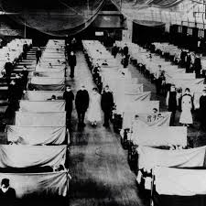
Known human Pandemic
H1N1:
Spanish flu (1918)
H2N2:
Asian flu (1957)
H3N2:
Hong Kong flu (1968)
H5N1:
Bird flu (2004) - highly pathogenic avian influenza virus of type A of subtype H5N1 (HPAI-A H5N1)

Slide 7
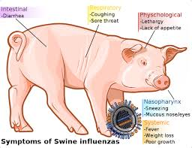
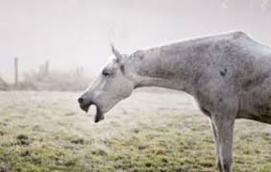
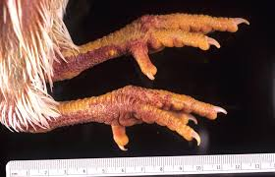
Reported influenza subtypes in animals
Swine:
H1N1 (Classical swine influenza)
H3N2
H1N2
Horses:
H7N7
H3N8
Birds:
H5N1
H3N2
H1N2

Slide 8
Antigenic Drift
Minor antigenic changes in HA or NA, results in frequent epidemics
A(H3N2) A/Sydney/05/97
A(H3N2) A/Panama/2007/99
Avian strains show less antigenic drift than mammalian strains.

Slide 9
Antigenic Shift

Slide 10
Difference Between Antigenic Drift And Antigenic Shift
S.N | Antigenic drift | Antigenic shift
1 | Minor change within subtype | Major changes between two subtypes
2 | Point mutation | Exchange of genetic material (genetic re-assortment)
3 | Occurs in A and B subtypes | Occurs in A subtypes only
4 | May cause epidemic | May cause Pandemic
5 | Example: A/Sydney/05/97 (H3N2) replaced A/Panama/2007/99 (H3N2) | Example: H3N2 replaced H2N2 in year 1968

Slide 11
Risk Factors
Age:
Adults over age 65
Children under 5 years old
Young adults & children under age 19: receiving long-term aspirin (Bufferin) therapy
People with compromised immune systems: AIDs
Pregnant women
People with chronic illnesses:
Asthma,
Heart disease,
Diabetes mellitus,
Neuromuscular disease

Slide 12
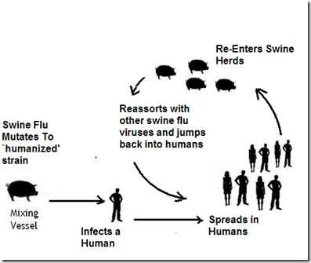
Swine flu: Transmission
Transmission usually occurs from person to person,
Spread through saliva & mucus particles
People may spread it by:
Sneezing
Coughing
Touching a germ-covered surface and then touching their eyes or nose
Can’t spread swine flu from eating properly cooked pork products

Slide 13
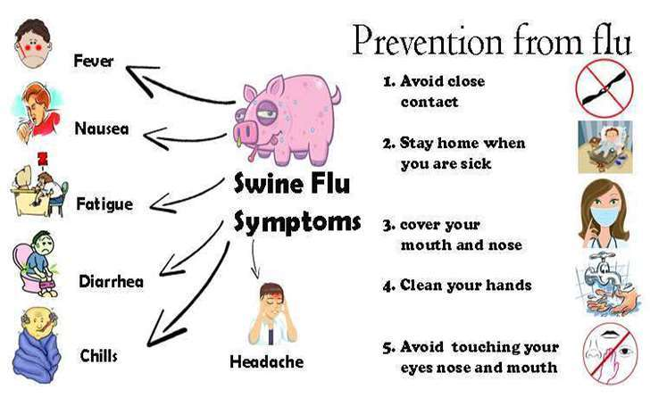
Swine flu: Clinical manifestations
In humans
Characterized by high fever & bronchitis,
Primarily in the upper respiratory tract, which may lead to secondary bacterial infections & pneumonia
More severe than a common respiratory tract infection

Slide 14
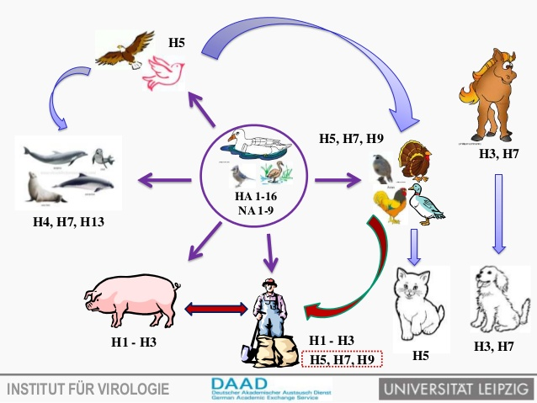
^{Avian flu}-Transmission
Transmitted to humans primarily by contact with live birds
Not by contact with meat & animal product
All patients in Hong Kong were infected by contact with infected birds not by contact with infected person

Slide 15
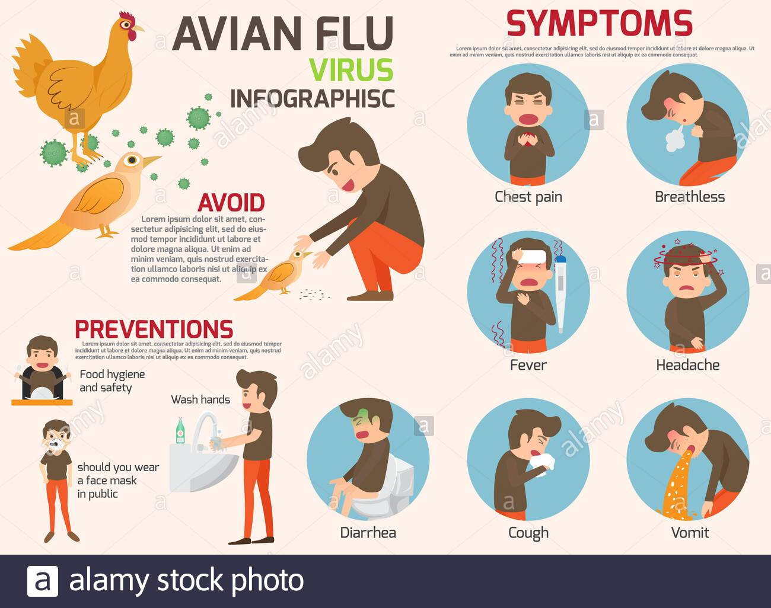
^{Avian flu}-Clinical manifestation
A 3 years-old child infected with avian influenza virus H5N1 in Hong Kong in 1997 died with sign of a systemic infection and of Reyes syndrome after the child had been treated with antipyretic drugs
Cough
Diarrhea
Respiratory difficulties
Fever (over 100.4°F or 38°C)
Headache
Muscle aches
Malaise
Runny nose

Slide 16
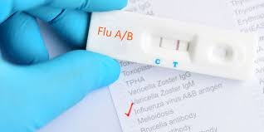
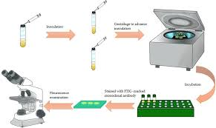
Diagnosis
Isolation and Identification-
Embryonating chicken eggs
In cell culture
Serological test:
Complement fixation test
HI test
Direct immunofluorescence assay
ELISA
Virus specific IgM can be detected in the children but not in the adults
Molecular method
PCR
RT-PCR
Rapid influenza diagnostic tests (RIDTs)

Slide 17
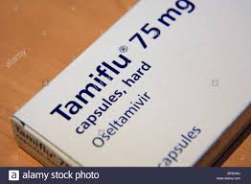
Treatment
AmantadineHCL-5mg/kg body weight/day
Rimantadine-100mg twice a day
Oseltamivir (Tamiflu)
Zanamivir (Relenza) two daily doses of 5 mg per inhalation), has become available; it inhibits the neuraminidase activity of the virus
Corticosteroids in asthma & other specific conditions

Slide 18
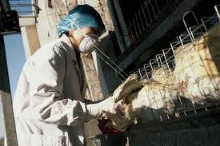
Prevention & control
Through personal protective measures
Regular hand washing with proper drying of the hands
Good respiratory hygiene –
Covering mouth & nose when coughing or sneezing,
Using tissues & disposing of them correctly
Early self-isolation of those feeling unwell, feverish and having other symptoms of influenza
Avoiding close contact with sick people
Avoiding touching one’s eyes, nose or mouth
Careful handling of dead/ live poultry
Anti-influenza drugs: prophylacticaly
Swine should not be held in close contact with fowl
Vaccines: available for animals but not for humans to protect against avian and swine influenza

