Slide 1
INTESTINAL OBSTRUCTION
DR. MITHILESH KUMAR
Assistant Professor cum Jr. Scientist
Veterinary Surgery and Radiology
Bihar Veterinary College,
Patna-800014

Slide 2
Mechanical or functional interference cause obstruction.
Simple obstruction
Strangulated obstruction
According to degree of occlusion of lumen
Partial
Complete

Slide 3
Site of location of obstruction
High obstruction
Low obstruction
AETIOLOGY
Mechanical obstruction
(i) Intraluminal mass
Heavy nodular worm infestation in calves.

Slide 4
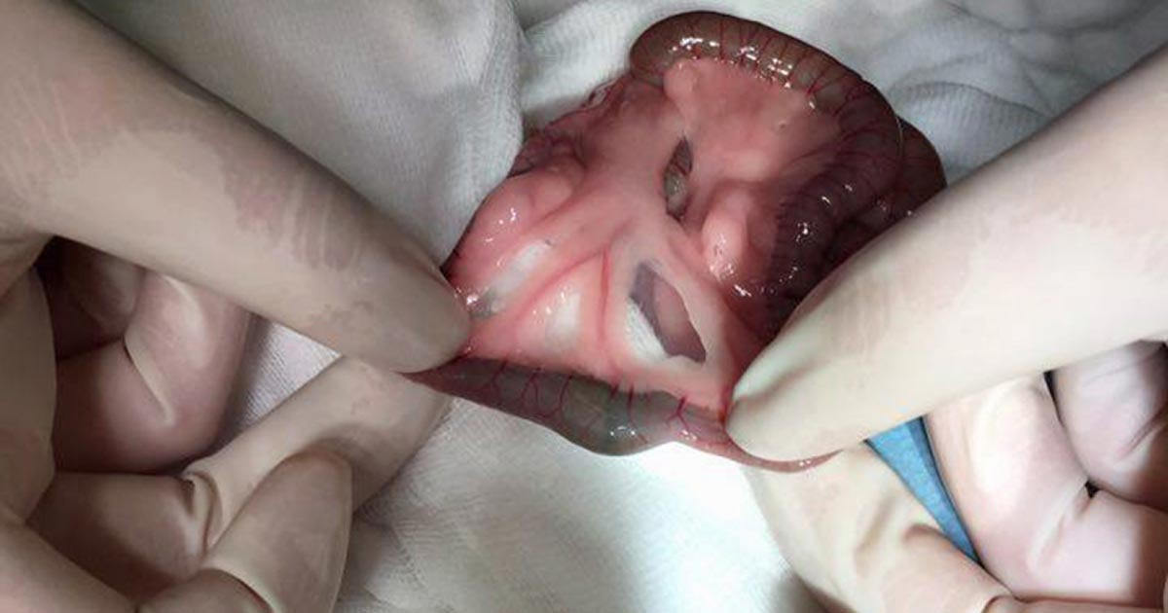
The intestinal obstruction (hair pellets) in rabbit

Slide 5
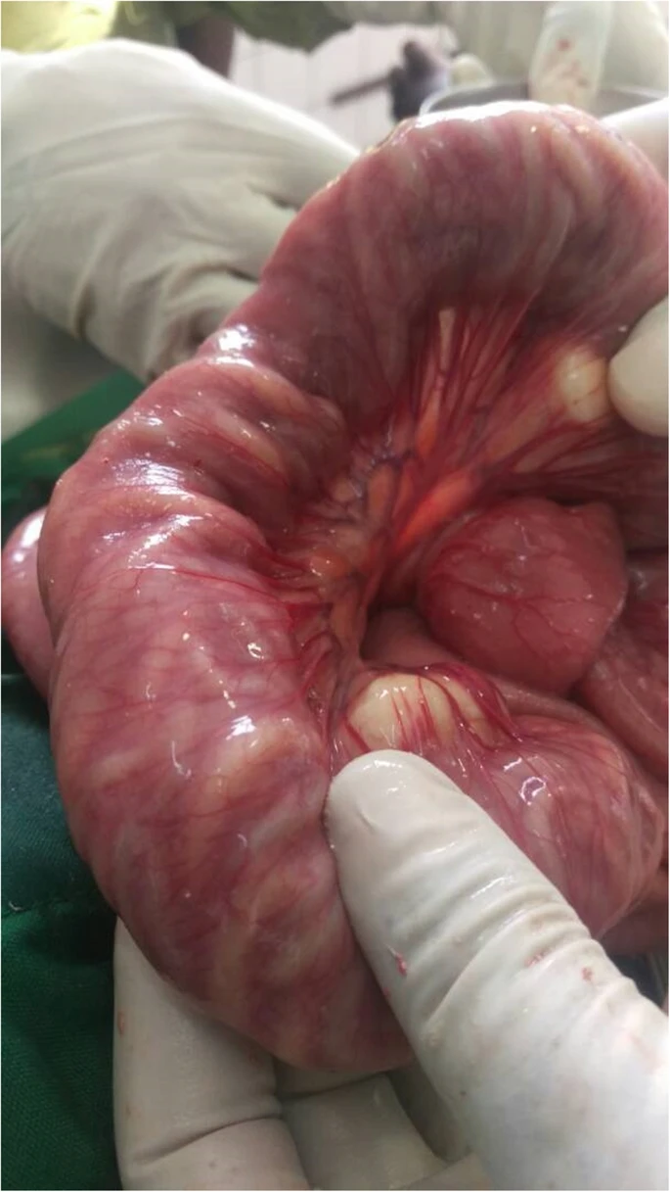
Distended small bowel obstructed by bundles of Ascaris lumbricoides worms

Slide 6
(ii) External compression of the intestinal wall
Adhesions, fibrous bands, herniation, abscess and neoplasm
Trapping of part of intestine
GUT TIE:-
Castration by traction
Vas deferens tears
Through gap intestine herniates

Slide 7
VOLVULUS
MESENTERIC TORSION
INTUSSUSCEPTION
PARALYTIC ILEUS –
Paralysis of a segment or entire length of intestine to produce
This is functional obstruction is termed paralytic obstruction

Slide 8
PATHOGENESIS:-
Obstruction in flow of ingesta
Hypermotility of intestine
Stretching of intestine
Reduce absorptive capacity
Intraluminal pressure increases

Slide 9
Cause venous congestion and fluid loss into intestinal lumen
Electrolyte imbalance
Change in acid base status
In late simple obstruction-
Anorexia of intestinal wall
Resultant increase in the permeability
Fluid loss extensive

Slide 10
Strangulated obstruction-
Distensibility of the bowel is magnified due to involvement of circulation
Rapid deterioration in animal
Hypovolemia
Acid base imbalance
Abomasal reflex and regurgitation

Slide 11
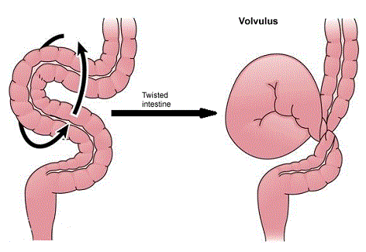
Strangulation of bowel

Slide 12
Strangulated obstruction
Veins are occluded
Some arterial supply remains intact
Extravasation of plasma
Rapid multiplication of microbes
Release of endotoxins.

Slide 13
Increase in permeability of intestine
Absorption of endotoxins and acute fluid loss
Endotoxins and hypovolemic shock.
Shock is greater than obstruction

Slide 14
More pronounced in proximal obstruction
Abomasal reflex.
Simple intestinal obstruction-
Hypochloraemic hypokalemia metabolic alkalosis
Abomasal reflex.
The pathogenesis of metabolic alkalosis in ruminants
is abomasal reflex

Slide 15
Any abnormality in the movement of gastric juices from abomasum to intestine may produce metabolic alkalosis.
Pre-renal azotaemia is observed IO
Hemoconcentration- increased PCV.

Slide 16
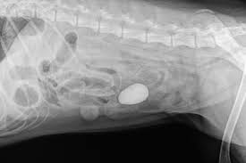

Slide 17
CLINICAL SIGNS:
Acute case – blood vessels compromised
Pain in initial stage.
Buffalo – straining
Cessation of defecation
anorexia
Distension of abdomen

Slide 18
In cattle-
colic in initial stage
Looking towards site of pain
Kicking at the abdomen
Frequent standing up lying down
Paddling of hindlimb.

Slide 19
Respiration rate normal
Pulse increased more than 100 beats/minute in cattle.
Rectal temp. elevated subnormal in later
Faeces not passed
Pasty faeces tinged with blood and thick mucus present in rectum.
Strangulated obstruction-hypovolemia and endotoximia

Slide 20
Cardiovascular embrassment and depression
Condition deteriotes
Simple intestinal obstruction – live 8-14 days
Strangulated Intestinal obstruction – live 96 hours.
LABORATORATORY EXAMINATION:-
PCV increased
Azotaemia,
hypokalaemia, hypochloraemia and metabolic alkalosis
rumen fluid chloride concentration is high

Slide 21
DIAGNOSIS
History
Clinical signs
Rectal examination
Laboratory finding
Rt flank laparotomy

Slide 22
TREATMENT
Rt flank laparotomy
Manual exploration of the peritoneal cavity
Intraluminal mass found
Enterotomy

Slide 23
Minimise and control contamination
Affected segment isolated and packed off
Inserting 14 gauge needle attached with a long tube
Intestinal clamp applied
Longitudinal incision given on healthy tissue
Cannel suture used to close the wound
Cushing suture

Slide 24
Instrument discarded
Close the abdomen
INTESTINAL RESECTION AND ANASTOMOSIS
Affected part isolated
Mesenteric vessels doubly ligated.
Intestinal clamp used
Affected segment removed

Slide 25
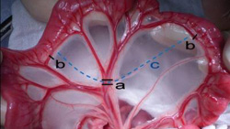
Small intestine resection

Slide 26
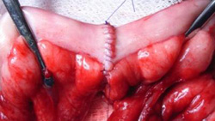
Anastomosis of small intestine

Slide 27
Anastomosis
Avoid any gap due to unequal diameter of lumen.
Oblique incision
Tapering technique
Stay suture
In large animal single layer inverting and end on pattern

Slide 28
Schmieden technique suture pattern
2/0 or 3/0 absorbable suture are suitable
First suture at mesenteric border tied within intestinal lumen
Incorporate all layers
Continuous Connell pattern are used
Suture are 3mm apart and 3-5mm from cut ends of the intestine
Knot should tied outside the lumen

Slide 29
Everting technique with horizontal mattress to evert the mucosa
Gambee’s pattern –end on technique
Check patency of lumen
Mesentery is closed with simple continuous suture

Slide 30
POST OPERATIVE MANAGEMENT
Correcting dehydration
Correcting acid base and electrolyte imbalance
Restore motility
Fluid therapy
Antibiotic
Regular wound dressing

Slide 31
POST OPERATVE COMPLICATION
Peritonitis
Paralytic ileus
Adhesions
Infection of abdominal incision

