Slide 1


‘Veterinary Epidemiology & Zoonoses’
VPH-321
(Credit Hours-2+1)

Slide 2
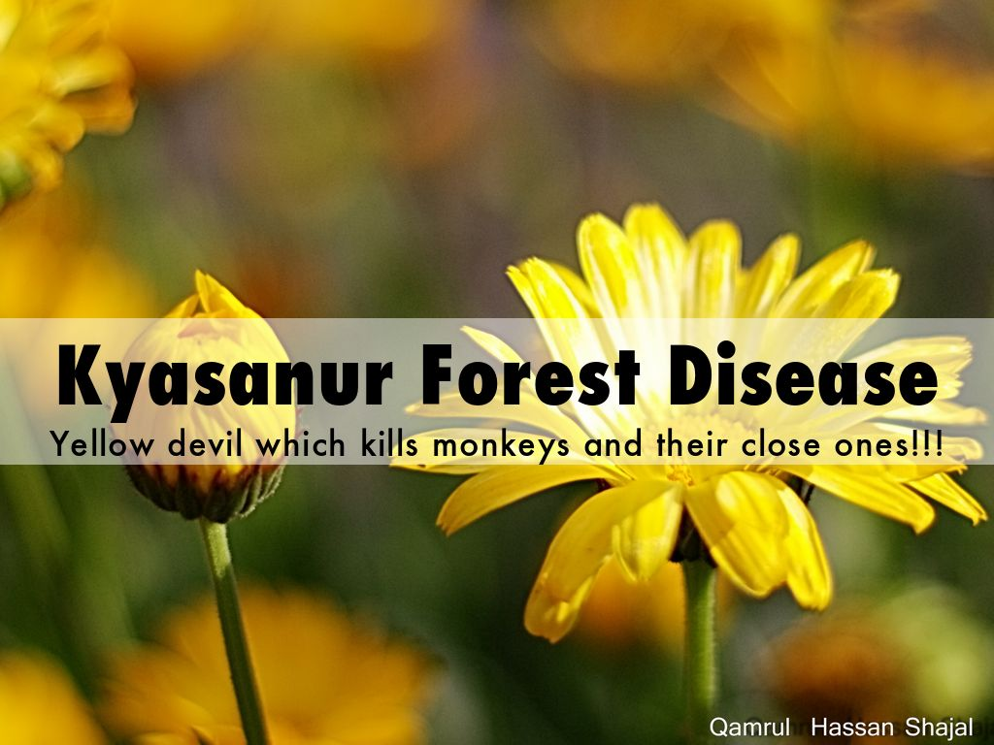
Kyasanur Forest disease (KFD) is a tick borne viral haemorrhagic fever caused by Flavivirus (flaviviridae)

Slide 3
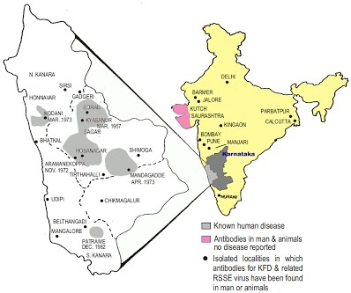
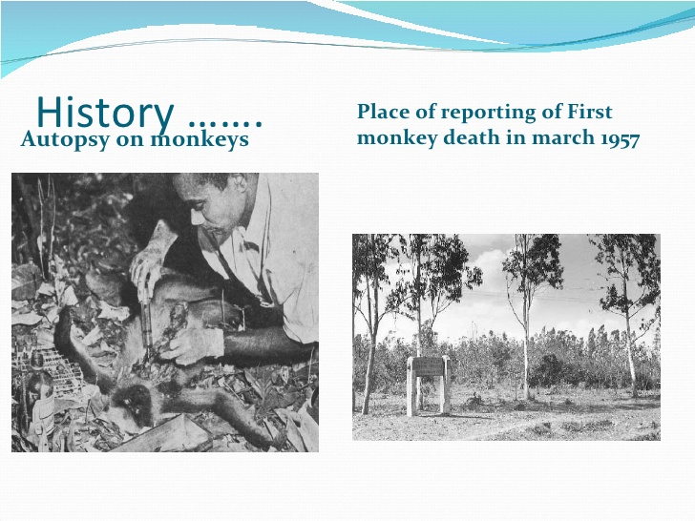
Introduction
First identified in 1957 in Kyasanur forest, Sorab taluka, Shimoga district of Karnataka
Also k/as haemorrhagic fever
In Kysanur forest area- Monkey fever
Endemic areas: Six districts of Karnataka (Chamarajanagar, Chikkamagalore, Dakshina Kannada, Shimoga, Udupi and Uttara Kannada) and malappuram of Kerala where each year during January–May, 100–500 persons are affected by the disease

Slide 4
Etiology
Caused by- Flavivirus (RNA genome)
It shares the antigenic relationship with
1. Russian Spring Summer encephalitis
2. European Spring Summer encephalitis
3. Louping ill
4. Omsk haemorrhagic fever

Slide 5
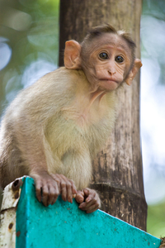
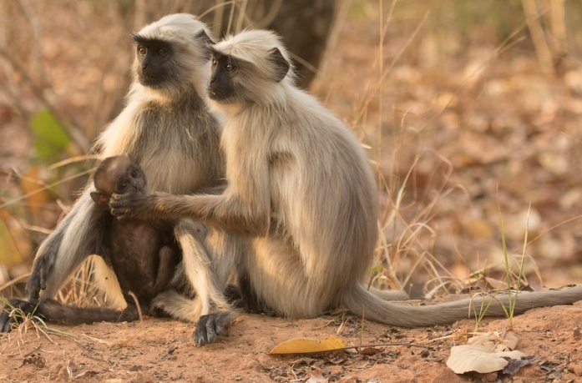
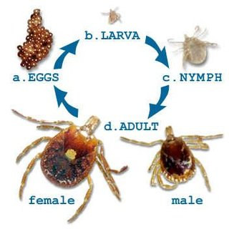
Host Range and Vector
Major wild life amplifier
In endemic area- Birds and Rodents play imp role
Vector -Haemaphysalis spinigera (most prominent), Ixodes
Macaca radiata
Presbytis entellus
Ticks carry the virus in the nymphal and adult instars for up to 14 months
Man and domestic animals act as a dead end host

Slide 6
Epidemiology
Season
  In Monkeys-maximum mortality observed during the period of December to may
  In human- maximum cases were reported between the period of January to June
  Prevalence of disease is low in the rainy season
Age
  Young and adult males are more commonly affected
Sex
  Males are more susceptible than female

Slide 7
NATURAL CYCLE
In enzootic states the infection is maintained in small animals and also in ticks
When monkeys comes in contact with infected ticks, they get infected, amplify and disseminate the infection in “hot spots” of infection
Humans in these hot spots are infected by bite of infected anthrophilic ticks like H. spinigera

Slide 8
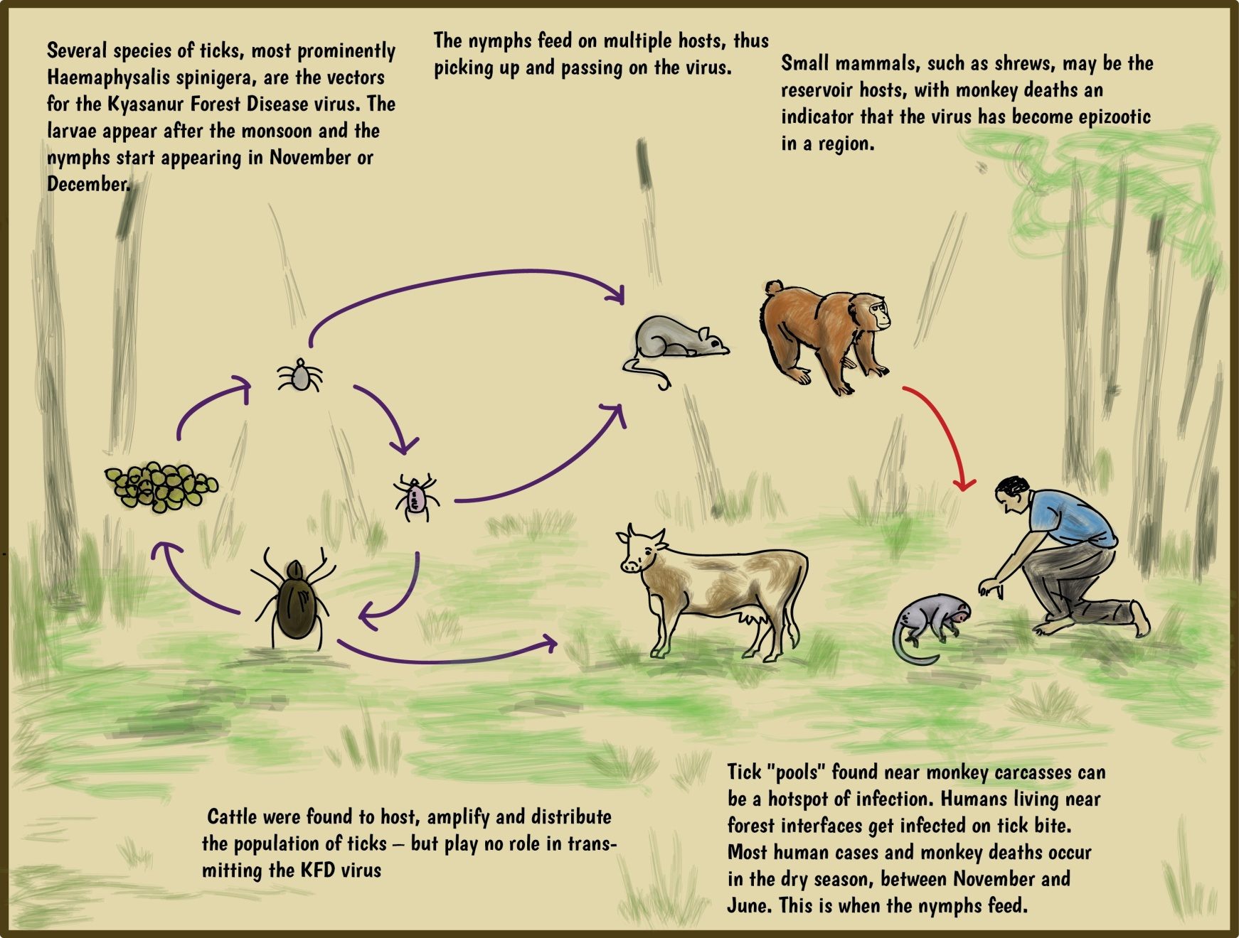
Transmission cycle
Viraemic birds play an important role in distant spread of virus and may also carry tick infected with virus

Slide 9

Disease in Man
Incubation period: 3-8 days
  Sudden onset of fever, cephalagia, myalgia, anorexia, & insomnia
  On 3-4 days patient tend to experience diarrhoea & vomiting
  Papulovesicular lesions on the palate are a consistence findings
  Hamorrhages: in poor & mal nourished individuals
  Neurological Signs- neck rigidity, prostration, mental confusion,
  Gastrointestinal & bronchial problems are common
  Case fatality rate- 5-10%

Slide 10
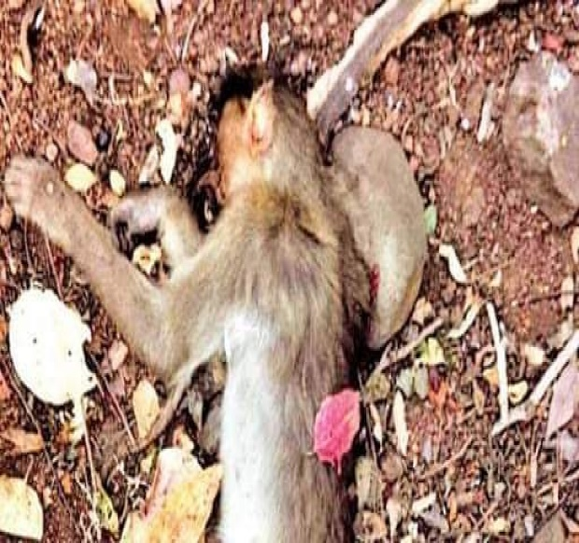
Disease in Animals
In monkey-
  Diarrhoea, bradycardia & hypotension
  In diseased monkeys virus is present-
    Blood,
    Liver, spleen, kidney, lung, heart,
    Skeletal muscles
    The brain
  Mortality: during the high viremic stage
  In experimental cases-100% fatality were noticed

Slide 11
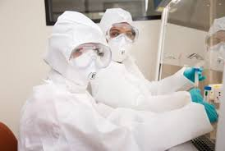
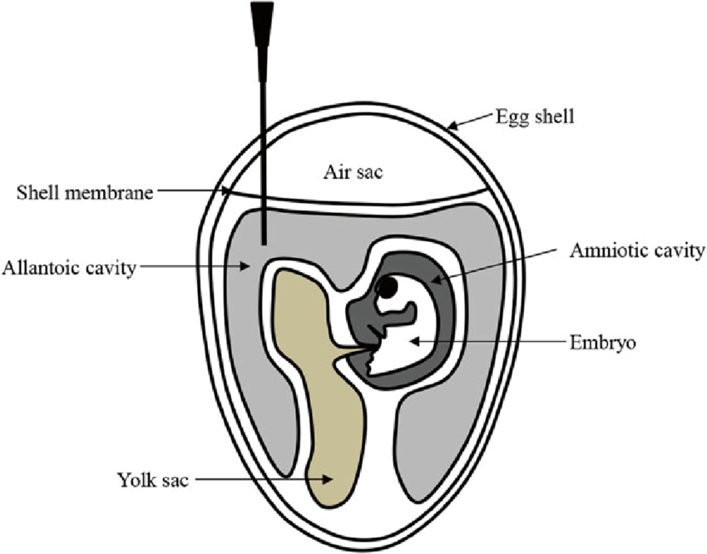
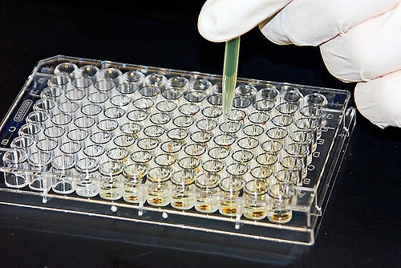
DIAGNOSIS
BSL–3 facility is required for handling and working
Samples: Blood and serum, CSF
  Isolation: from blood during febrile period or
  Organ samples collected during autopsy
Virus isolation
  Cell lines: BHK–21, Vero E6 cell lines
  Animal inoculation: Embryonated chick cell,
  In mice
Serological Methods:
  ELISA
  CF,
  HI test
  Neutralization test

Slide 12
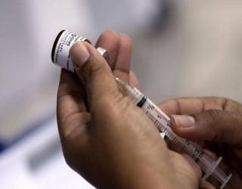
TREATMENT
No specific antiviral treatment
Early hospitalization & supportive treatment
Supportive therapy- maintenance of normal blood cell counts, blood pressure
Symptomatic treatment:
  Pain reliefs,
  Antipyretics,
  Blood transfusion,
  Antimicrobial therapy for secondary infections,
  Nervous disorder: Corticosteroids & anticonvulsants

Slide 13
LABORATORY HAZARDS
Inhalation of aerosol: most frequent way of acquiring infection
Other means of transmission includes:
  Conducting post mortem examination,
  Accidental parentral inoculation,
  Spilling out of contents from broken glass wares or
  Accidental ingestion
Follow the WHO guideline while shipping of samples for diagnosis

Slide 14
PREVENTION AND CONTROL
Prevention strategies such as:
  Quarantine,
  Vaccination,
  Early diagnosis,
  Tick control will restrict the entry of virus to new areas
  Spray insecticides has been recommended in a 50-m radius around a dead monkey
Other control strategy- wearing protective clothing while handling infectious materials and tick control
Strictly prohibit the visit to affected forest areas during outbreak time
If visit is inevitable, use protective clothing’s and gum boots to cover the whole body and apply some insect repellent to exposed body part

Slide 15
VACCINATION
Vaccines against KFDV were initially produced in Shimoga district of Karnataka.
Later, the unit was moved to Bangalore (Institute of Animal Husbandry and Veterinary Biologicals)
The first vaccine: formalin-inactivated, mouse-brain preparation of Russian Spring Summer Encephalitis Virus (RSSEV) by ICMR due to the close antigenic resemblance of KFDV with RSSEV
3- dose schedule at 0, 7 and 42 days , SC
In 1990s, Formalin-inactivated chick embryo vaccine: Haffkine Institute in Bombay licensed and used in India
  2 doses - one month apart
  Age group: 7 to 65 years of age.
  Vaccine-induced immunity is short-lived
  Booster dose within 6 to 9 months after primary vaccination
  Annual booster doses for 5 years
  Vaccine efficacy of 79.3% with 1 dose and 93.5% with 2 doses .

Slide 16
Government of Karnataka:
The Directorate of Health and Family Welfare, Karnataka, vaccination campaigns:
Formalin inactivated tissue culture vaccine in endemic districts
  Villages reporting KFD activity (laboratory-confirmed cases in monkeys and/or humans, or infected ticks), and all villages within 5 km of the affected location are targeted for vaccination
  If cases of KFD are reported in the area in spite of vaccination during the pre-transmission season, additional vaccination campaigns are conducted

