Slide 1
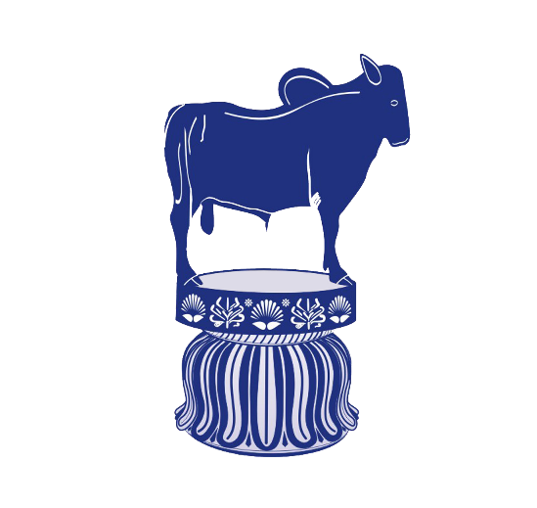
BREEDS OF EQUINES
DR. S. P. SAHU
Assistant Professor
Livestock Production Management
Bihar Veterinary College, Patna - 14

Slide 2
Terminology in Equine Production
Mare: A mature female horse of four years of age and given birth of a foal.
Stallion: A mature uncastrated male horse of four years of age.
Gelding: A castrated male horse of all ages.
Colt: A young uncastrated male horse.
Filly: A young female horse under 3-4 years of age. After foaling………. mare.

Slide 3
Foal: A young horse of either sex under the age of one year such as Colt foal and Filly foal.
Foaling: The act of giving birth by mare.
Foal at foot: A suckling foal running with its dam/mare.
Covering: Mating in horses.
Broodmare: A mare that is used for horse breeding.

Slide 4
Stud: An establishment where pedigreed stallion being kept for breeding.
Stud Book: A list of horses of a particular breed whose parents are known.
Hand: A measurement of the height of a horse. One hand is equal to 4 inches. The measurement is usually taken from the ground to the withers.
Pony: A horse breed that typically measures shorter than 14.2 hands (58 inches, 147 cm). it is used in sport of polo.
Horses: Individual animals of breeds that typically measure over 14.2 hands (148 cm, 58.27 in) of height without shoes and over 14.2½ h (149 cm, 58.66 in) (just) with shoes. Cut off height: 14 hands

Slide 5
Jack: An uncastrated male donkey or ass.
Jennet/Jenny: A female donkey.
Jockey: The rider of a horse in horse racing.
Mule: Hybrid offspring of a male donkey and a horse mare. Almost always sterile. Mules are noted for their sure-footedness.
Hinny: The sterile hybrid offsprings of horse stallion and female donkey.
Zebroid: Hybrid offspring of a zebra crossed on another equine.

Slide 6
Neigh: A sound made by a horse.
Stable: A building in which horses are kept.
Grooming: Cleaning horses for hygienic, practical or esthetic reasons.
Doping: Illegal use of medicines to improve a horse's performance in racing/showing or to harm an animal to perform poorly by an opponent.
Farrier: A professional hoof care specialist who does hoof trimming and horse shoeing.

Slide 7
Horses
Family: Equidae Scientific name: Equus caballus
Odd-toed ungulate mammal.
Important role in transportation, agriculture, sports and warfare.
Light riding horses: 14.0-16.0 hands weighing 386-540 kg. Ex. Arabians, Morgans, Quarter Horses.
Larger riding horses: 15.2-17 hands weighing 540-680 kg. Ex. Thoroughbreds, American Saddlebreds, Warmbloods.
Heavy/draft horses: 16.0-18.0 hands weighing 680-900 kg. Ex. Clydesdale, Belgian, Percheron and Shire.

Slide 8
Pony
Shorter than 14.2 hands (58 inches, 147 cm).
Ponies often exhibit thicker manes, tails and overall coat.
Proportionally shorter legs, wider barrels, heavier bone, shorter and thicker necks and short heads with broad foreheads.
Calmer temperaments than horses and high level of equine intelligence.

Slide 9
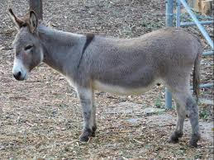
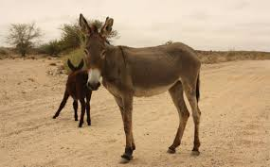
Donkey
Donkeys' ears are much longer in proportion to their size.
Straighter necks and back due to lack of true wither.
Coarse mane and tail.
Smaller and rounder hooves with more upright pasterns.
Characteristic brassy bray sound.
Colors from gray shades of gray-dun to brown, black, light-faced roan.
Sizes: 36" and under (Miniature Mediterranean), 36.01-48" (Standard), 48.01" to 56" (Large Standard).

Slide 10
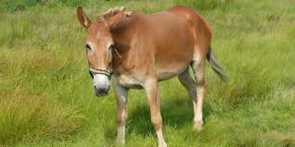
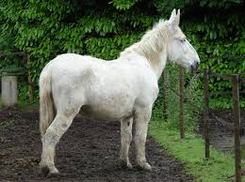
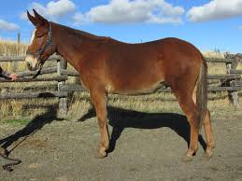
Mule
Body of a horse with the extremities of a donkey.
Grow taller than both parents due to hybrid vigour.
Stronger than horses.
Long ears, short thin mane, tail with shorter hairs.
Legs like the donkey with small and upright hooves.
Stubbornness and bad-tempered but highly intelligent.

Slide 11
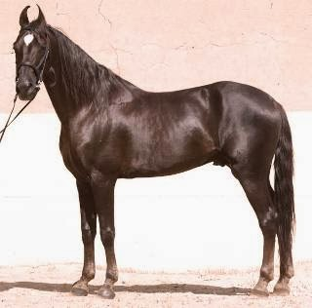
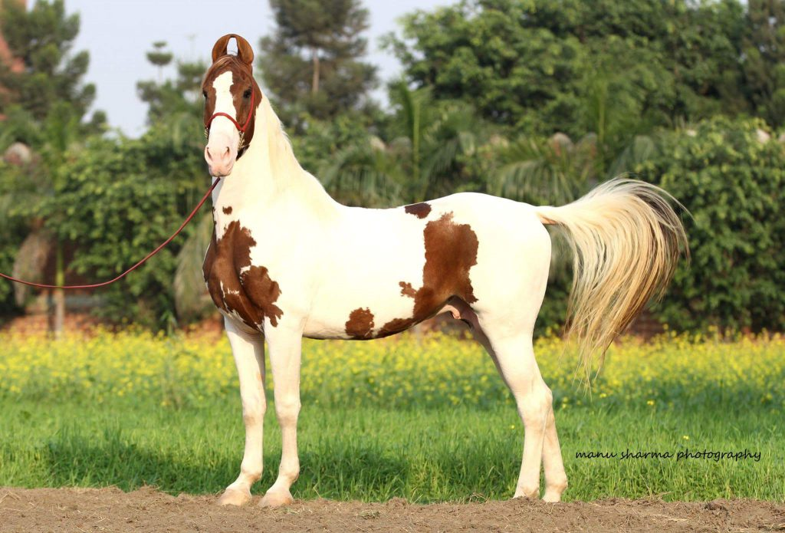
INDIAN BREEDS OF HORSES
1. Kathiawari
Kathiawar region of Gujarat.
World-class stamina with minimum food/water.
Closely related to Marwari horses.
Renowned for their loyalty and bravery.
14.2 and 15.0 hands
Very distinctive ears curve in toward each other.
Short neck and body, and high carried tail.

Slide 12
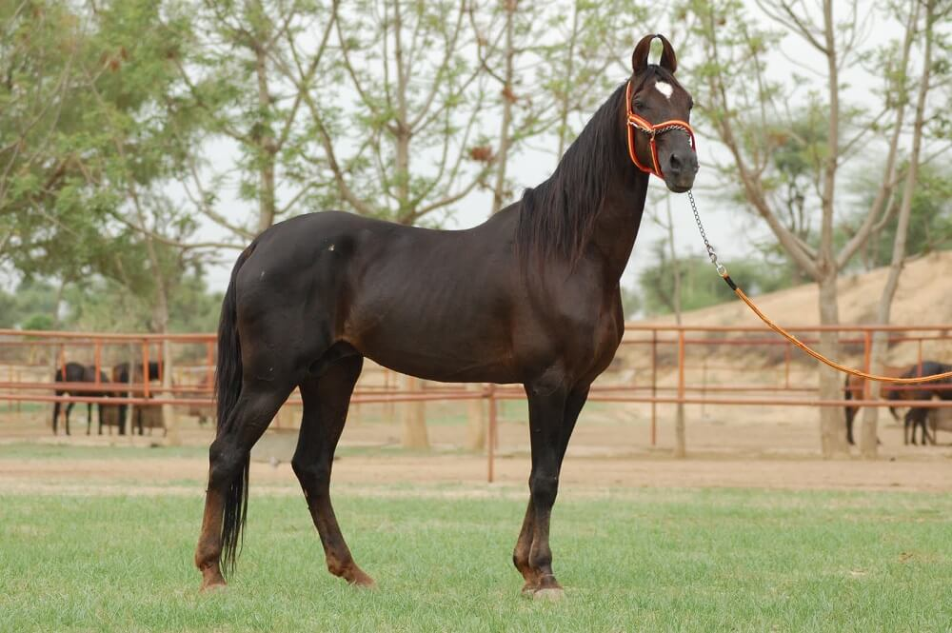
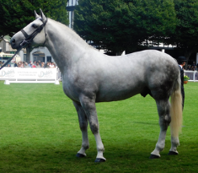
2. Marwari
Marwar region of Rajasthan.
Ambling gait and a superior level of hardiness.
14.2-15.2 hands.
Gray horses tend to be the most prized in this breed.
High arched neck and pronounced withers.
Deep chest and slender legs.
Ears like the Kathiawari and ears can rotate a full 180 degrees.

Slide 13
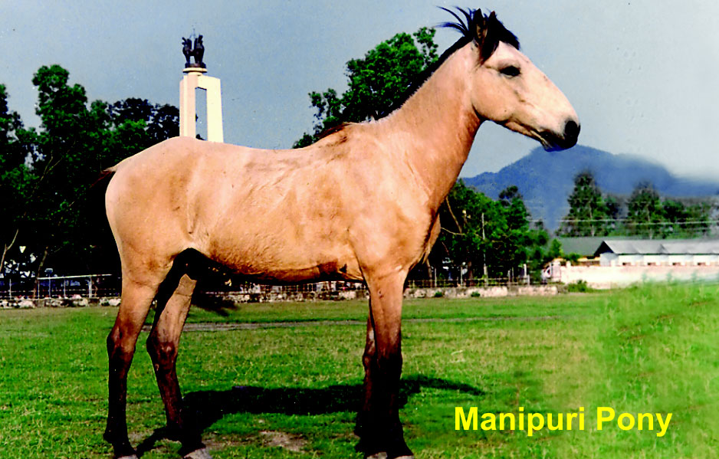
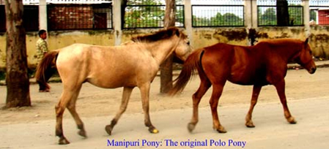
3. Manipuri
Manipur and Assam.
High in-demand horse.
Sloping shoulders, pronounced withers and deeper chest.
Colour: Bay, chestnut, gray and even pinto coats.
Shorter height (11-13 hands).
Used by polo players.

Slide 14
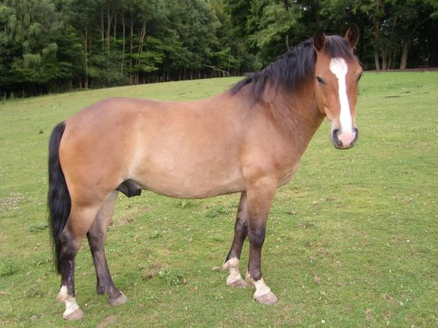
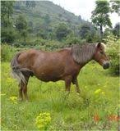
4. Bhutia:
Sikkim and Darjeeling.
Smaller in size (12-13.2 hands).
Grey/bay coat color.
Toughness.
Adapt to changing environ. conditions and sure-footed.
Classic equine look.

Slide 15
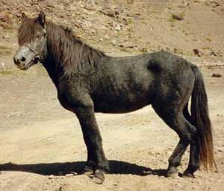
5. Spiti
From Himachal Pradesh.
Mountain-based breed.
Endangered breed due to traditional breeding.
9-12 hands.
Solid and compact body.
Convex face, deep chest, sloping shoulders, a short back and thick legs.
Colors: White with black spots.
used as pack animals and general riding ponies.
Very comfortable fifth gait using the laterals instead of the diagonals (Ideal for long distances).

Slide 16
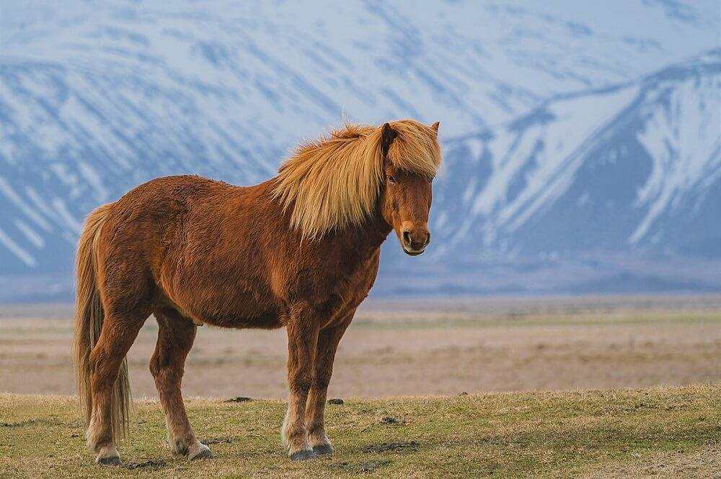
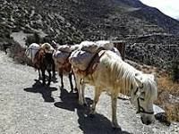
6. Zanaskari
Zanaskar Valley in Kargil (J & K).
Adapt better to higher altitudes.
Strong and compact body.
11-13.3 hands high.
Body length up to 45 inches only.
Grey coat colour.
Sure-footed breed and handle temp. as low as -4^{O}C.

Slide 17
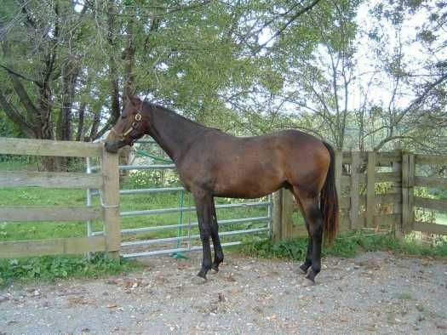
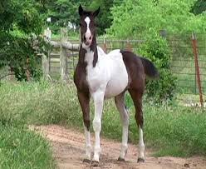
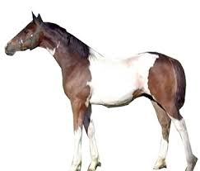
8. Deccani
Located in the Deccan plateau of Maharashtra.
Prized possession of Dhangar women.
General work horses.
9. Sikang
Tibet and Himachal Pradesh.
Attractive attributes: strength, stamina and taller standing.
Crossbred with local horses.

Slide 18
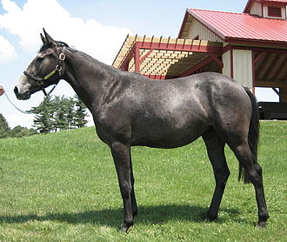
Important Exotic Breeds of Equines
1. Thoroughbreds:
A horse breed best known for its use in horse racing.
Warm blooded.
Any breed of purebred horses known for their agility, speed, and spirit.
Developed in England. Ex. Quarter Horse, Standardbred.

Slide 19
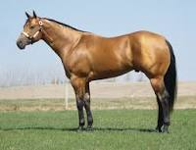
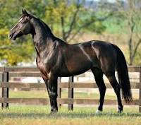
American quarter horse
American breed.
Excels at sprinting short distances.
Used as race horse and working ranch horse.
Standardbred horse
American breed.
Ability in harness racing.
Solid, well-built horses with good dispositions.

Slide 20
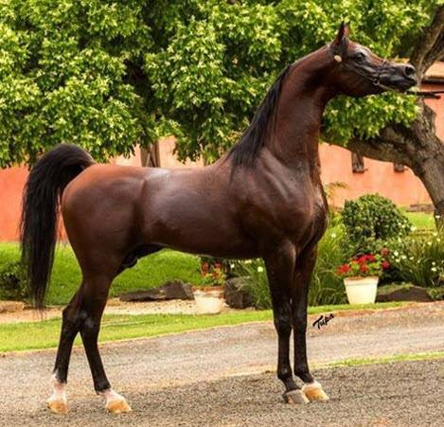
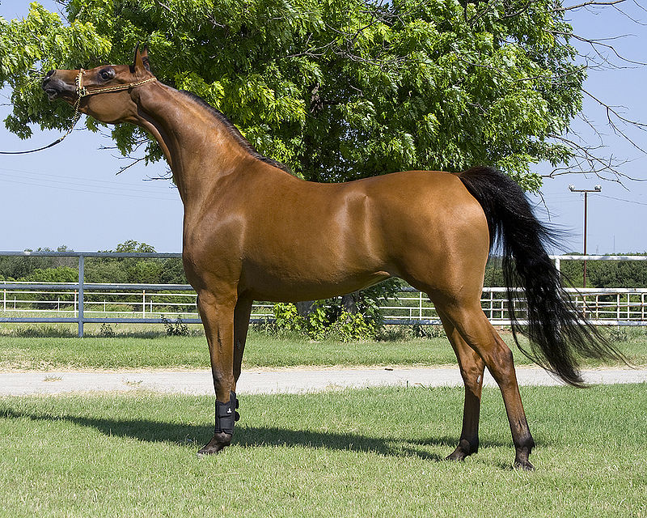
2. Arabian horse
Originated on the Arabian Peninsula.
Distinctive head shape and high tail carriage.
Most easily recognizable horse breeds in the world.
14.1 to 15.1 hands.
Hot-blooded.
Sensitivity and intelligence.
Quick learning and greater communication.

Slide 21
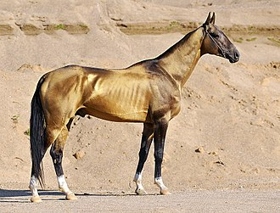
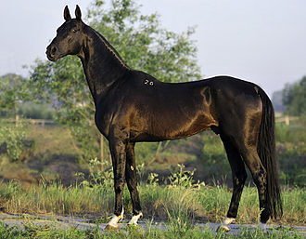
2. Akhal-Teke horse
Originated in Turkey.
Reputation for speed and endurance.
Intelligence and distinctive metallic sheen.
Shiny coat: Nickname "Golden Horses".
Adapted to severe climatic conditions.
One of the oldest existing horse breeds.

Slide 22
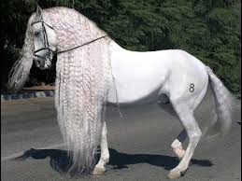
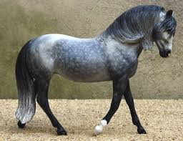
3. Andalusian horse
Pure Spanish Horse
Strong compact built and elegant.
Long, thick manes and tails.
Most common coat color is gray.
Very intelligent, sensitive and docile.
15.1 ¹⁄₂ hands.

Slide 23
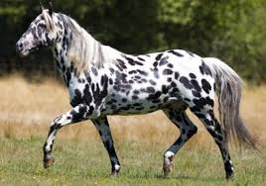
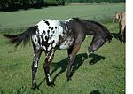
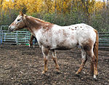
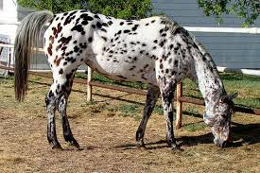
4. Appaloosa horse
American horse breed.
Best known for its colorful spotted coat pattern.
Stock horse used in western riding.

Slide 24
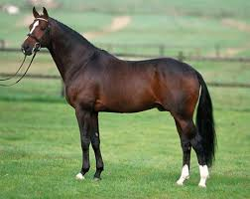
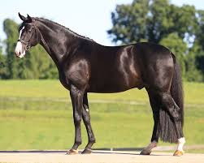
5. Hanoverian horse
Originated in Germany.
Warmblood horse breed
Used in the Olympic Games & English riding.
Good temperament, athleticism, beauty and grace.

Slide 25
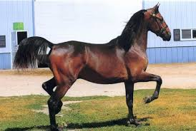
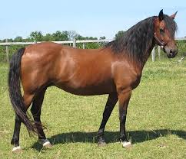
6. Morgan horse
Developed in the United States.
Compact and refined breed.
Generally bay, black or chestnut in color.
Large and prominent eyes.
Well-defined withers with well arched neck.
Strongly muscled hindquarters.
High attached tail carried gracefully and straight.
14.1 to 16.2 hands.

Slide 26
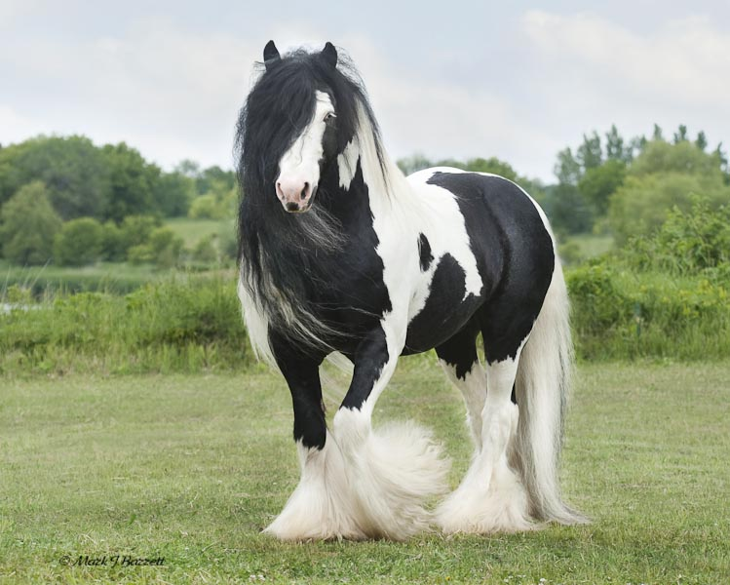
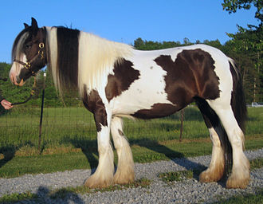
7. Gypsy horse
From Great Britain and Ireland.
Small and solidly-built horse.
13 to 16 hands.
14.3- to 16.2-hand range.
Feathering: long hair on the legs.
Strong hindquarters.
Distinct gaits.

Slide 27
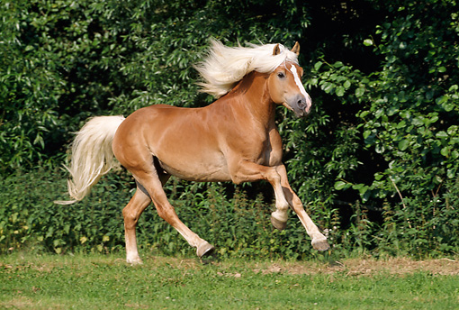
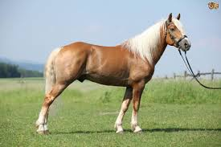
8. Haflinger horse
Developed in Austria and Italy.
Compact body and chestnut in color.
Distinctive gait both energetic and smooth.
Well-muscled elegant horses.
Adopted for mountain terrain due to hardiness.

Slide 28
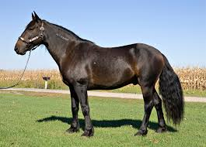
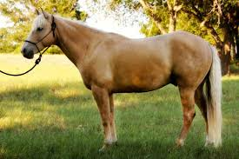
9. Mustang horse
Developed in Western United States.
Free-roaming or wild horse.
Surefooted.
Good endurance.

Slide 29
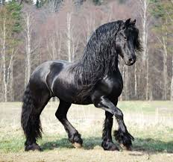
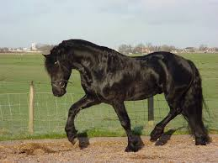
10. Friesian horse
Originated in Friesland of Netherlands.
Black coat colour.
14.2 to 17 hands.
Long thick wavy mane and tail.
Feather: Long silky hair on the lower legs.
Powerful overall conformation.
Surprisingly nimble and graceful.

Slide 30
THANKS

